Slide 1
HOTEL REVIEW CLASSIFIER
A project on sentiment analysis trained on Hotel Review Dataset

Slide 2
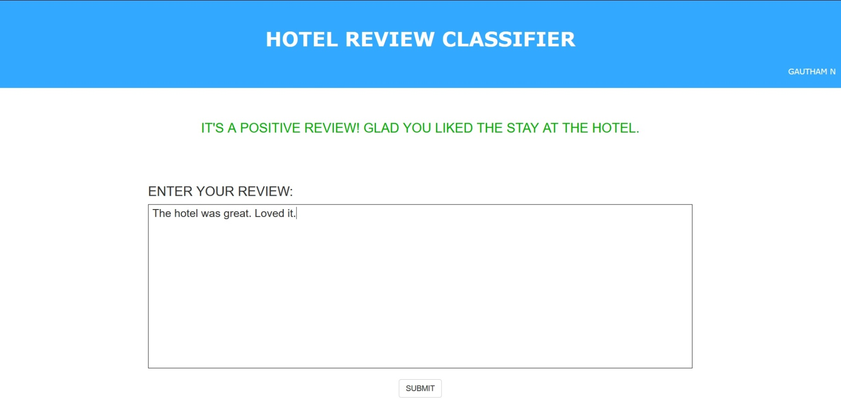
PROTOTYPE 1
Trained the MultinomialNB classifier on the dataset. It worked fine on the positive reviews.

Slide 3
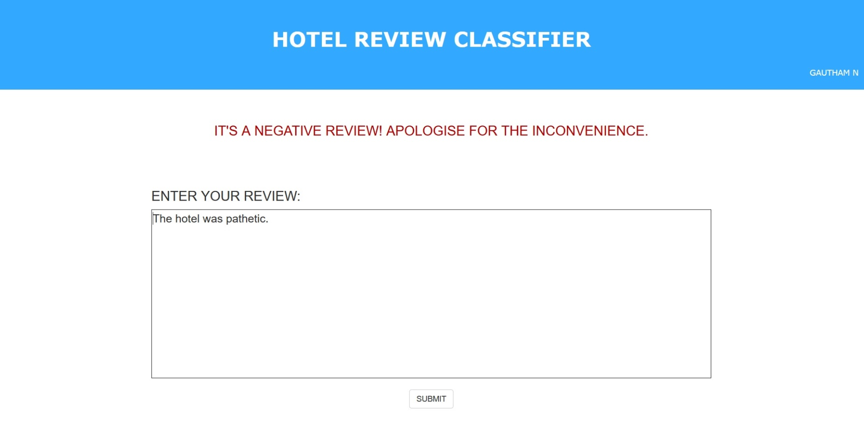
PROTOTYPE 1
The classifier also worked well on the simple negative reviews

Slide 4
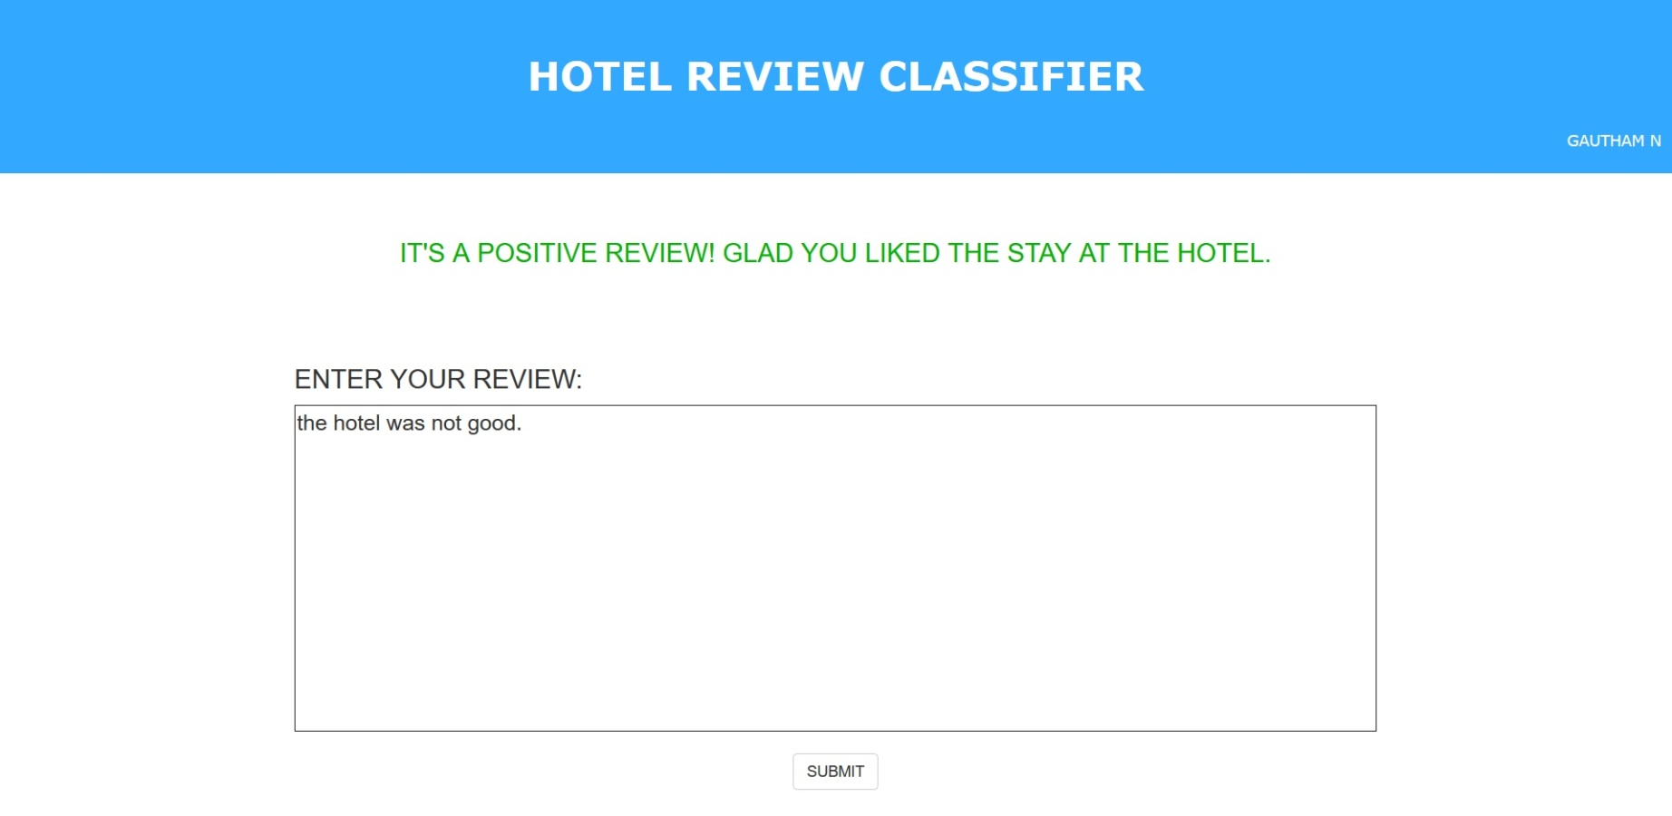
PROTOTYPE 1
However, the model suffered when negating words like “not” were used.

Slide 5

PROTOTYPE 1
A model also suffered when contractions were used.

Slide 6
PROTOTYPE 2
New rules were constructed to handle both negations and the contractions.
In case of a contraction, the word would be looked up the dictionary of contractions and the word is reduced to its simple form.
In case of negations, the next adjective in the sentence will be replaced with it’s antonym and the negating word is removed

Slide 7
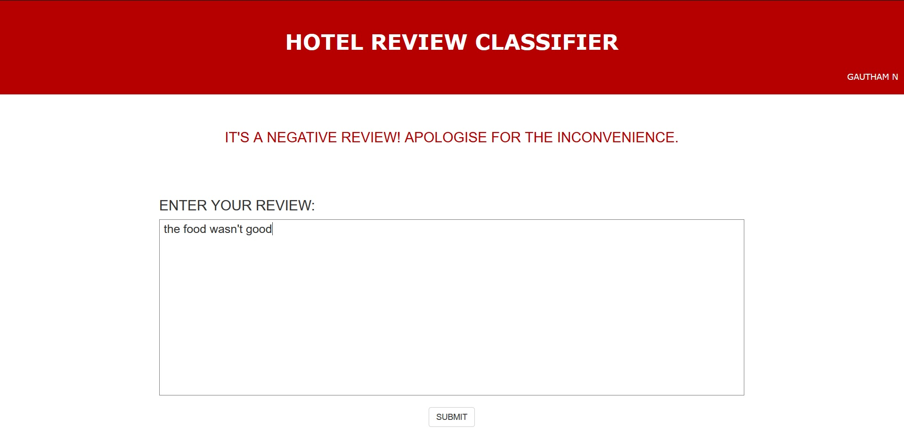
PROTOTYPE 2
HANDLING CONTRACTIONS

Slide 8

PROTOTYPE 2
HANDLING NEGATIONS

