Slide 1
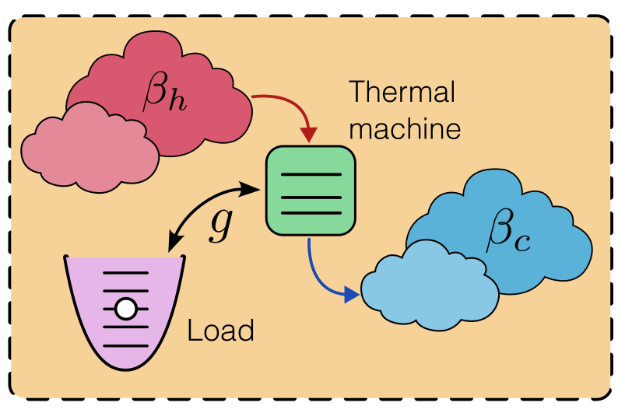




Quantum Thermal Machines And The Emergence Of Different Thermodynamic Functioning Regimes From Finite Coupling To A Load
Gauthameshwar S. , Noufal Jaseem, Dario Poletti

Slide 2
Table Of Contents
Concept and motivation
Overview: Quantum thermal machines.
Why autonomous machines?
Three-level engine: The semi-classical and autonomous picture.
Core results
The four thermal operation modes.
Finite coupling → new operation regimes.
Bosonic load back-action.
Experimental platforms to construct the device
Three-level engine and implementation.
Two-qubit engine and implementation.
Summary and outlook

Slide 3
What Are Quantum Thermal Machines
Work

Slide 4
What Are Quantum Thermal Machines
Thermal
Machines
Work

Slide 5
What Are Quantum Thermal Machines
Quantum
Thermal
Machines
Work
Heat currents: Bath’s Lindbladian term.
Work: Two-point measurements, ergotropy.
Temperature: Set by Gibbs thermal state.

Slide 6
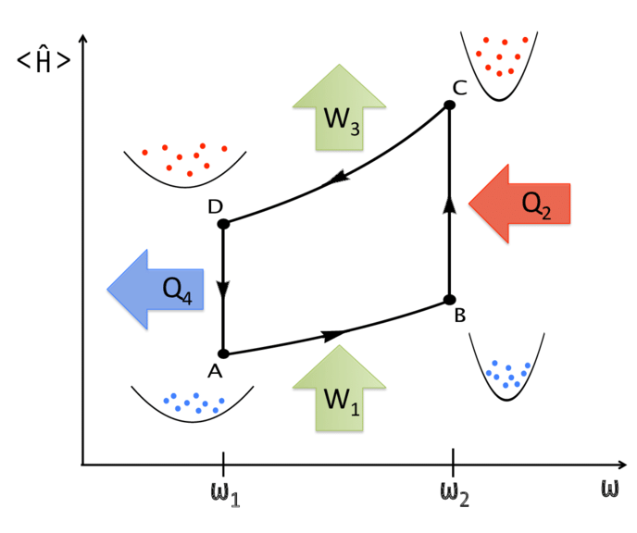

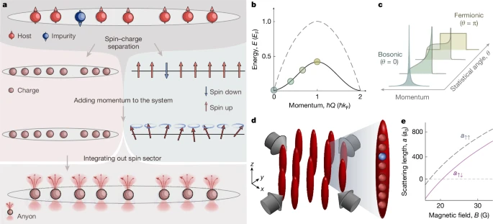

Types Of Quantum Thermal Machines
Periodically Driven Quantum Thermal Machines
Single/multiple qubits
Pros:
Intuitive link to classical thermodynamics.
Analytic tractability.
Programmable protocols.
Cons:
Tedious to engineer the strokes in an experimental setup.
Limited scalability.
Not robust to noise.
1D bosonic/spin chains
Single/multiple
harmonic oscillators
An Otto cycle implemented in a
many-particle quantum heat engine
Beau, M., Jaramillo, J. D., & del Campo, A. (2016). Scaling-up quantum heat engines efficiently via shortcuts to adiabaticity. Entropy, 18(5), 168.
Image source: https://doi.org/10.1038/s41586-025-09016-9

Slide 7
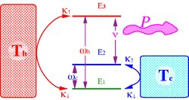
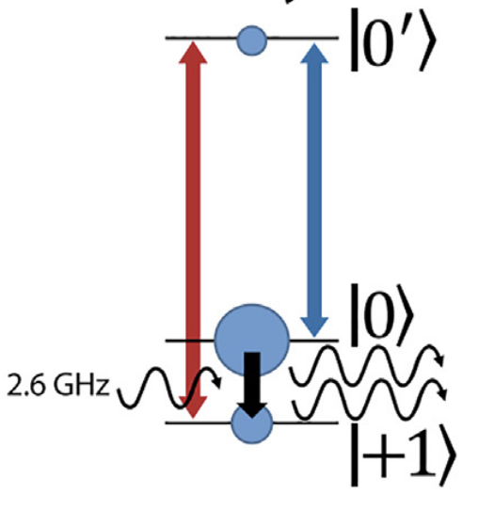
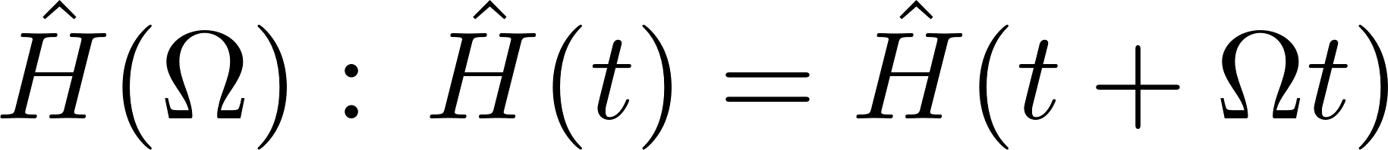
Types Of Quantum Thermal Machines
Continuously Driven Quantum Thermal Machines
Two/multiple qubits
Pros:
Closer to real physical processes
No need to engineer strokes.
Analytic solutions possible in simplified models.
Cons:
Semi-classical approximation of the work.
NV-centers
A three-level quantum heat engine with periodic driving that enhances output power P.
Multiple harmonic
oscillators
Kosloff, R., & Levy, A. (2014). Quantum Heat Engines and Refrigerators: Continuous Devices. Annual Review of Physical Chemistry, 65, 365–393.
Klatzow, J. et al. (2019). Experimental demonstration of quantum effects in the operation of microscopic heat engines. Physical Review Letters, 122, 110601.

Slide 8
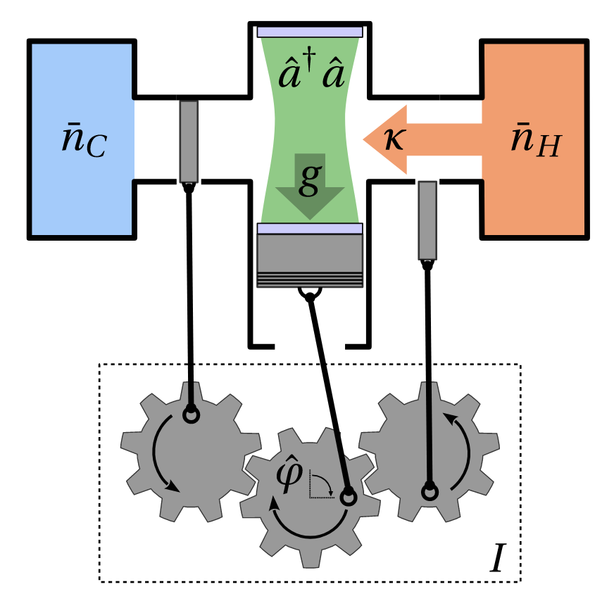
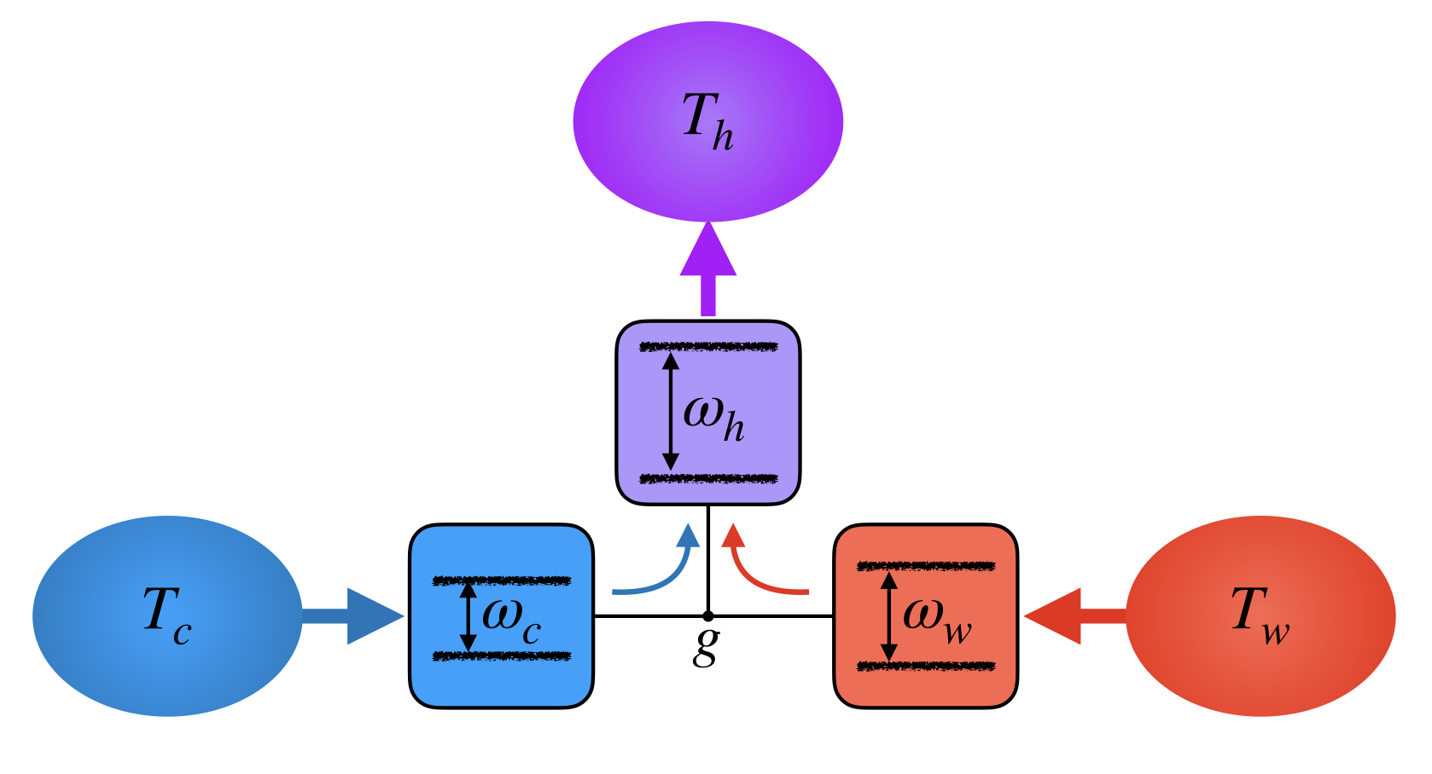
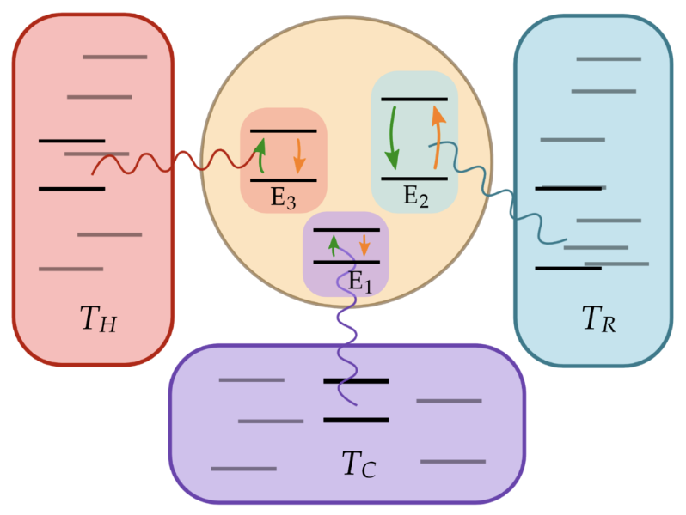
Types Of Quantum Thermal Machines
Autonomous Quantum Thermal Machines
Pros:
No external driving required.
Cons:
Usually difficult to get analytical solutions.
Rely on numerical methods to study.

Slide 9
Why Autonomous Machines?
Continuous, self-contained,
and time-independent.
The engine is not decoupled
from the load in quantum devices.
Backaction of the load onto the
Machine in-built in this framework.

Slide 10
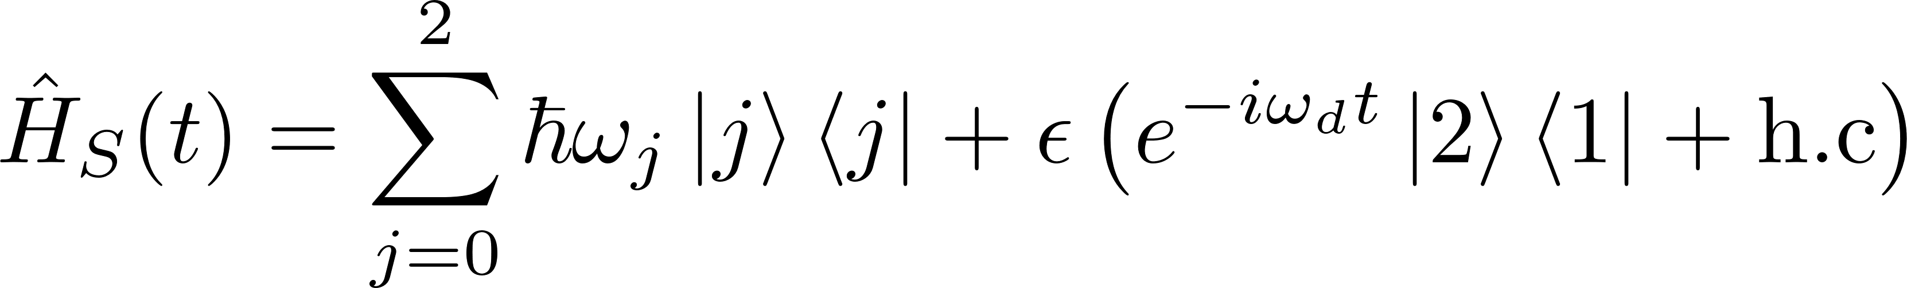
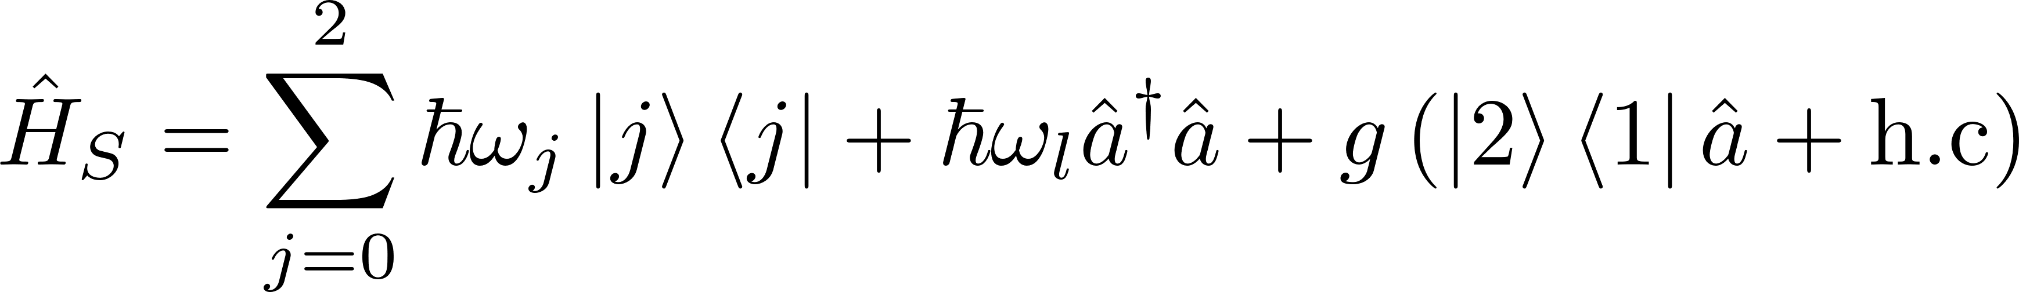
Three-level System: Semi-classical Vs Autonomous
Geva, E., & Kosloff, R. (1994). Three-level quantum amplifier as a heat engine: A study in finite-time thermodynamics. Phys. Rev. E, 49(5), 3903.

Slide 11
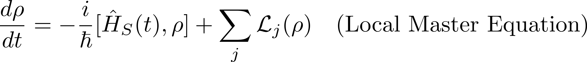
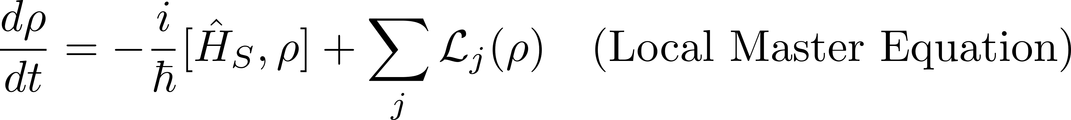
Three-level System: Semi-classical Vs Autonomous

Slide 12
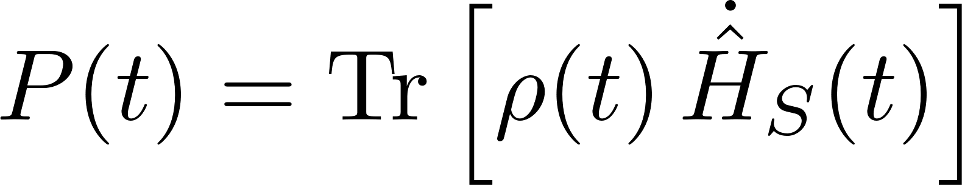
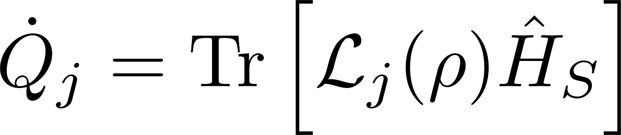
Three-level System: Semi-classical Vs Autonomous

Slide 13
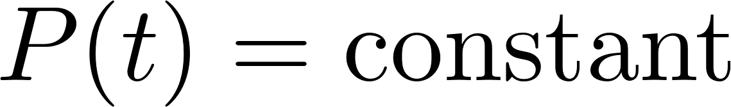
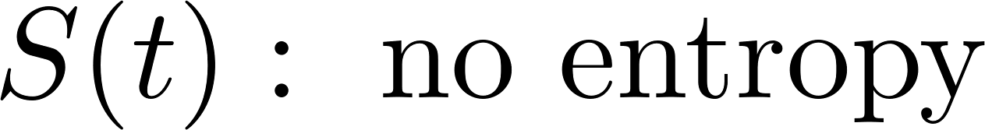
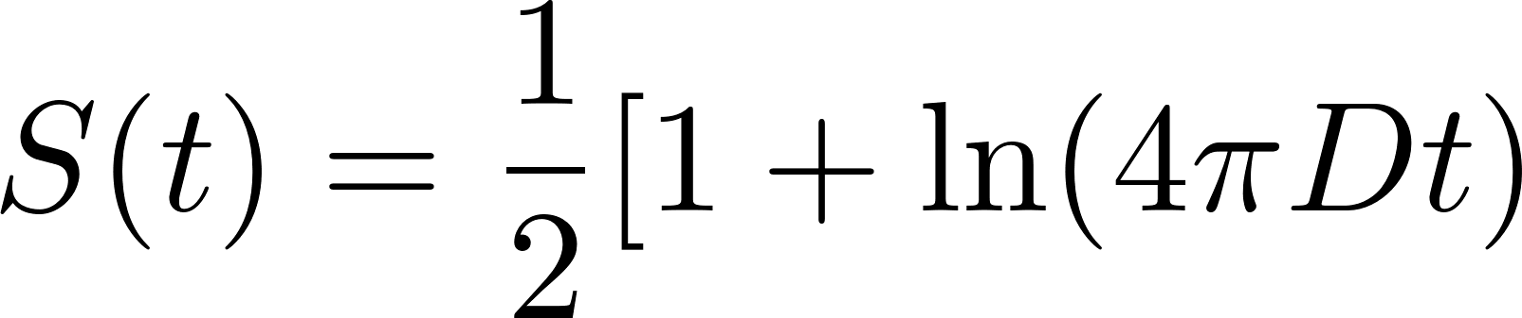
Three-level System: Semi-classical Vs Autonomous
Biased diffusion in the load: v, D

Slide 14
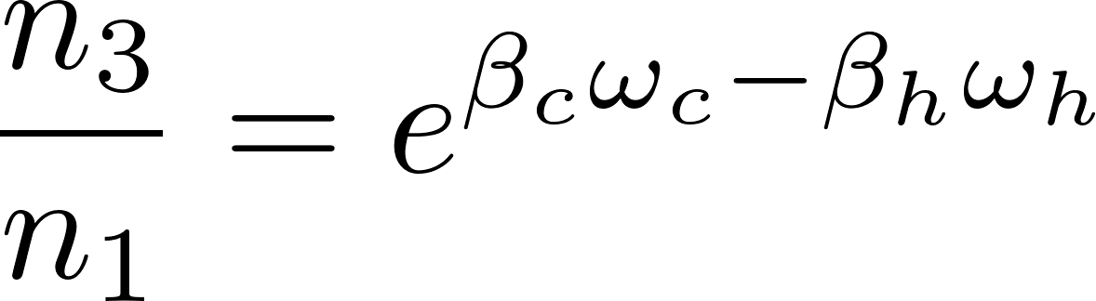
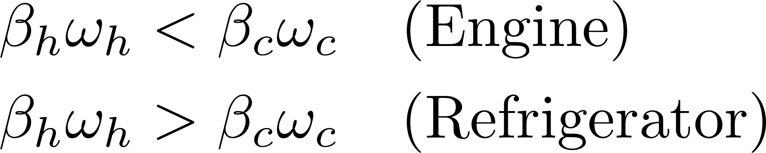
Three-level System: Semi-classical Vs Autonomous
Scovil, H. E. D., & Schulz-DuBois, E. O. (1959). Three-level masers as heat engines. Phys. Rev. Lett., 2(6), 262.

Slide 15
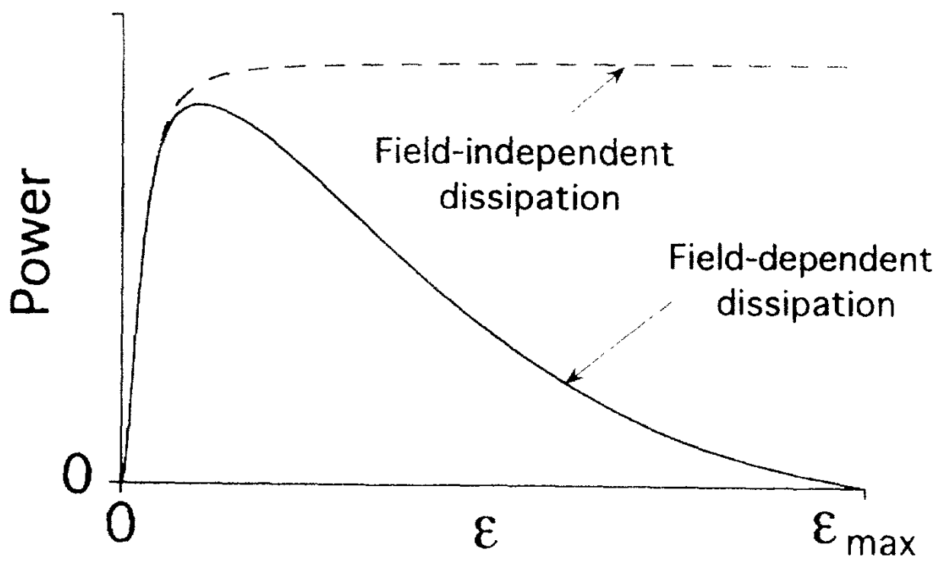
Three-level System: Semi-classical Vs Autonomous
Geva, E., & Kosloff, R. (1994). Three-level quantum amplifier as a heat engine: A study in finite-time thermodynamics. Phys. Rev. E, 49(5), 3903.

Slide 16
Finite coupling physics:
Four regimes
Load back-action physics:
Bosonic enhancement effectively
increases the coupling.

Slide 17
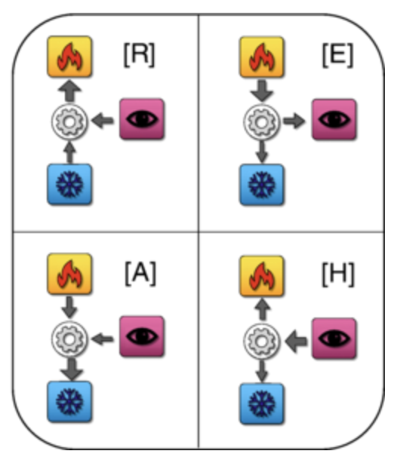
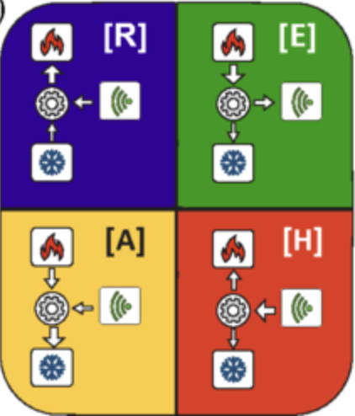
The Four Thermal Operation Modes
First observed in quantum
measurement cooling
The only four operation of quantum thermal machines coupled to two baths
Lorenzo Buffoni, Andrea Solfanelli, Paola Verrucchi, Alessandro Cuccoli, and Michele Campisi Quantum Measurement Cooling Phys. Rev. Lett. 122, 070603 (2019)
Andrea Solfanelli, Marco Falsetti, and Michele Campisi Nonadiabatic single-qubit quantum Otto engine Phys. Rev. B 101, 054513 (2020)

Slide 18
The Four Thermal Operation Modes
First observed in quantum
measurement cooling
The only four operation of quantum thermal machines coupled to two baths
Lorenzo Buffoni, Andrea Solfanelli, Paola Verrucchi, Alessandro Cuccoli, and Michele Campisi Quantum Measurement Cooling Phys. Rev. Lett. 122, 070603 (2019)
Andrea Solfanelli, Marco Falsetti, and Michele Campisi Nonadiabatic single-qubit quantum Otto engine Phys. Rev. B 101, 054513 (2020)

Slide 19
The Four Thermal Operation Modes

Slide 20
The Four Thermal Operation Modes

Slide 21
The Four Thermal Operation Modes

Slide 22
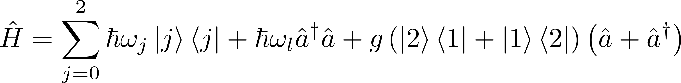
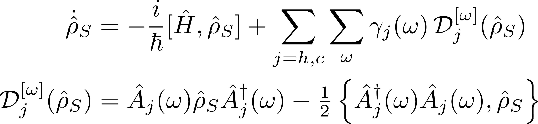
Global Master Equations For Finite Coupling

Slide 23
Finite Coupling → New Operation Regimes
First the local Lindblad phase space diagram.
Animate the four regimes coming out of coupling strength.
Emphasise they exist even at small values of g, and we missed it the whole time.
Show the power and heat currents showing how they engine -> ref contains accelerators and heaters.

Slide 24
Finite Coupling → New Operation Regimes
Accelerators and heaters also present
Engine suppressed, refrigerator disappears
Heater and accelerator dominated at large g

Slide 25
Finite Coupling → New Operation Regimes
Emphasise they exist even at small values of g, and we missed it the whole time.

Slide 26
Finite Coupling → New Operation Regimes
First the local Lindblad phase space diagram.
Animate the four regimes coming out of coupling strength.
Emphasise they exist even at small values of g, and we missed it the whole time.
Show the power and heat currents showing how they engine -> ref contains accelerators and heaters.

Slide 27
Bosonic Load Back-action
Initialising the load to a higher level effectively increases the coupling strength between them.
Offsetting the load causes crossover to the other regimes of operation in the thermal machine.
These arise from the bosonic properties of the load, not present in the ladder despite the four modes.

Slide 28
Experimental platforms:
Three-level thermal machine
Initialising the load to a higher level effectively increases the coupling strength between them.
Offsetting the load causes crossover to the other regimes of operation in the thermal machine.
These arise from the bosonic properties of the load, not present in the ladder despite the four modes.

Slide 29
Experimental platforms:
Two-qubit thermal machine
Initialising the load to a higher level effectively increases the coupling strength between them.
Offsetting the load causes crossover to the other regimes of operation in the thermal machine.
These arise from the bosonic properties of the load, not present in the ladder despite the four modes.

Slide 30
Summary and outlook
Beyond local master equation: Finite coupling gives rise to richer thermodynamic operations.
Four modes of operation exist even at weak coupling.
A fundamental effect that arises from coupling to a quantum load.
Demonstration of a purely quantum property:
Bosonic enhancement factor of the load changes the coupling strength.
What is the boundary between small, finite, and strong coupling?
When does the typical behavior deviate from bias diff?
The same effect observed on other loads?
Classical nanoscopic systems also have this four regimes appearing from finite coupling?

Slide 31
Acknowledgement

