Slide 1
Employee Data Analysis using Excel
STUDENT NAME: V.GAUTHAM KUMAR
REGISTER NO: 312219326
DEPARTMENT: B.Com (ACCOUNTING & FINANCE)
COLLEGE: S.A College of Arts and Science

Slide 2
PROJECT TITLE
Employee Performance Analysis using Excel

Slide 3



AGENDA
Problem Statement
Project Overview
End Users
Our Solution and Proposition
Dataset Description
Modelling Approach
Results and Discussion
Conclusion
3/21/2024 Annual Review

Slide 4

PROBLEM STATEMENT
The Employee Performance Analysis is Analysed to Track the performance of each employee
From this Analysis the management know the performance of each employees and they Make necessary Decision about their Increment.
The analysis also helps for employee for their growth and the Organisation can make better decisions and motivate them to improve more.

Slide 5


PROJECT OVERVIEW
Analy.sing the performance of the employees by considering the various factors like Gender, performance level , performance rating etc.
Identifying the Trends and patterns of different categories of employees like High , Medium and Low .

Slide 6




WHO ARE THE END USERS?
Employee Employers Organization Manager

Slide 7






OUR SOLUTION AND ITS VALUE PROPOSITION
Conditional Formatting - Conditional formatting is used to Highlight missing value
Filter - Filter is used to Remove the missing value highlights Formula - Formula is used to find the Performance Level of employees
Pivot table - Summary Graph - Data visualization

Slide 8
Dataset Description
Employee Dataset : The employee dataset is my own data which I have created in excel
Features : It has 10 different features like
Employee Name Employee Id
Gender - Male , Female
Department - Sales , Production , Research & Development Support , Service Employee Salary
Start Date
Employee Type - Permanent, Fixedterm Current employee rating
Performance Level

Slide 9
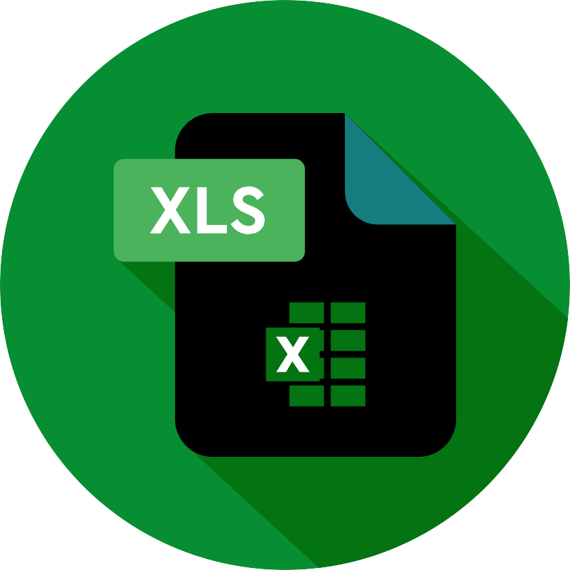

THE "WOW" IN OUR SOLUTION
Formula used to find the Performance Level of the employees
This Formula Shows the level of employees
The levels are Middle , High and low
3/21/2024 Annual Review
9

Slide 10
RESULTS
11

Slide 11

conclusion
From This we conclude that the performance analysis using Excel showed the performance level and other datasets which is useful the management and employees and employers to Find the trends and levels and achievements of an emplyee

