Slide 1
Master’s thesis
Leveraging web-scale data for robot planning

Slide 2
History of robotic control

Slide 3
Deep learning for generalization

Slide 4
VLA need data

Slide 5
Defining the problem
Planning VS Control two distinct problems
Planning -> Predicting future states
Control -> Predicting motors current to reach a state

Slide 6
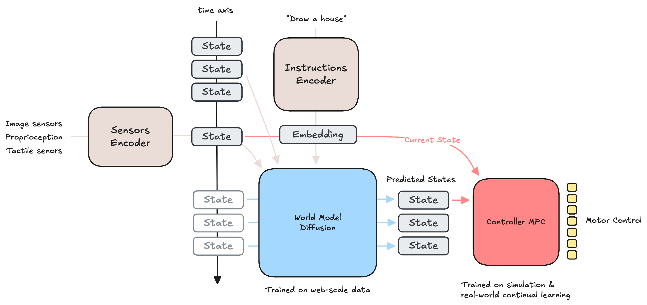
Core idea

Slide 7
World Models

Slide 8
Low-level Controller
Simple NN: Direct Supervised Learning –> need data
MPC: Cross-Entropy Method
Simple NN: Direct Supervised Learning + RL fine-tuning in simulation + Continual Learning

Slide 9
Thesis obejctives
Planning future states, conditioned on text
Visualization of results as a video generation model
Mapping future states to robotic control
Using simple NN
Using MPC
Showing that planning can be improved by scaling up data to non robot data, world dynamics -> Scaling laws

