Slide 1
Q1 | BEFORE ATTENTION
A 32-frame sample becomes B x 32 x 262 x 1024, then attention is factorized.
32 RGB frames
Frozen DINOv2
Per-frame corruption
Build frame tokens
Pre-attention tensor
5 Hz
224 x 224
32 x 256 x 768
CLS + DINO regs removed
x_t = s_t z_t + (1-s_t)e
one s_t per frame
6 prefix + 256 patches
all width 1024
B x 32 x 262 x 1024
8,384 tokens / sample
Per-frame token accounting
1
1
4
256
= 262 tokens / frame
signal
action
registers
DINO patches
Factorized attention reshapes
Noise and masks
Spatial layers
(B x 32, 262, 1024)
- Gaussian latent noise; no patch masking
- causal + 24-frame temporal window
- 30% independent-frame temporal block
- action mask; padding excluded from loss
Temporal layers
(B x 262, 32, 1024)
Sources: thesis Fig. 3.2; backbone.py; world_trainer.py; lerobot_dataset.py
01 / 03

Slide 2
Q2 | MISSING ACTIONS
The base token separates 'action unavailable' from a valid zero control.
One shared action-token position; availability changes only the added projected component.
Action unavailable
Action available
Why not a sentinel?
token = b_action
token = b_action + W a + c
0 is a valid / mean control
100 is out of distribution
Both depend on arbitrary scaling
Passive video, first frame,
independent frame, or action dropout
Normalized 7D UR5 transition
from frame t-1 to frame t
What passive video teaches
It does not teach 'ignore motion'. It teaches visual dynamics conditioned on history with no observed robot command.
A zero-filled action plus an explicit availability bit would also be valid; this thesis did not ablate that alternative.
Sources: thesis Sec. 3.4 and 3.8; backbone.py action-token construction
02 / 03

Slide 3
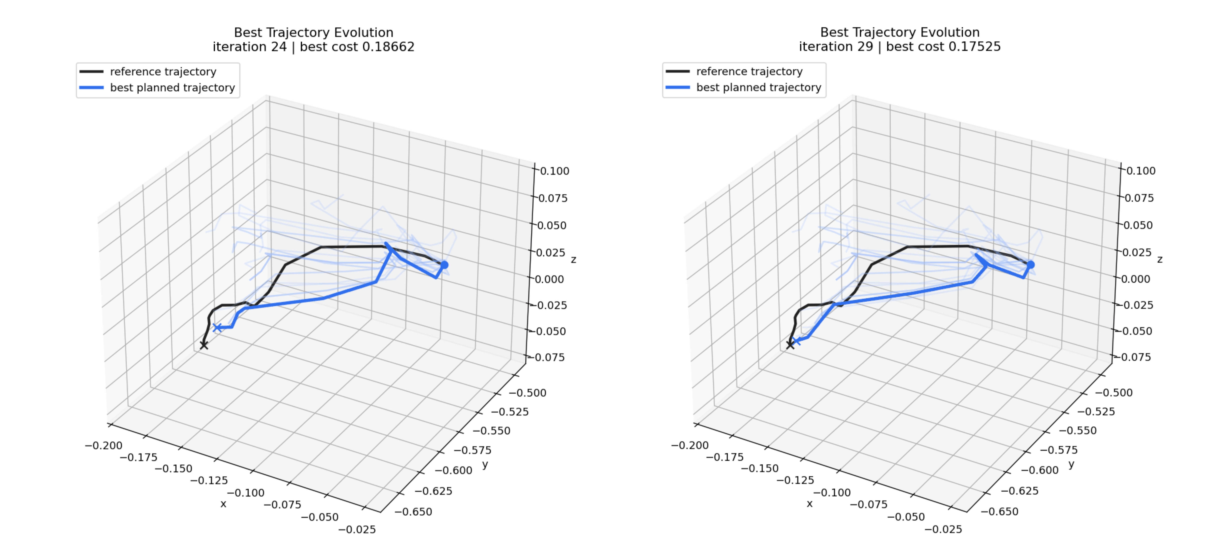
Q3 | CEM TRAJECTORY
The hook is allowed by the cost: CEM is endpoint-seeking, not path-following.
Implemented objective
J = terminal DINO MSE
+ 0.2 mean ||a_t||^2
Optimized
final visual state; small action magnitude
Not optimized
reference path; action differences; curvature; acceleration;
jerk; IK; joint limits; collisions; model uncertainty
Goal: 4 s later | Plan: 10 steps at 5 Hz = 2 s
Match the horizon
Add path smoothness
Enforce feasibility
Close the loop
Use 20 actions for a 4 s reference at 5 Hz.
Intermediate cost plus delta-action, acceleration, and jerk penalties.
Joint-space / IK planning, limits, workspace, and collision checks.
Receding-horizon MPC and uncertainty / OOD penalties.
Sources: thesis Fig. 4.6; planning objective; horizon and 5 Hz configuration
03 / 03

