Slide 1
LINMA2710 Project 2026
Implementation & Performance Analysis Four Computing Paradigms

Slide 2
Project Structure: What We Built
PART 1 & 2: Sequential + OpenMP (Shared Memory) Implementation: C++ matrix multiply with cache optimization Data: 115 benchmark measurements PART 3: MPI (Distributed Memory) Implementation: Message-passing column partitioning Data: 4 measurements with 4 processes PART 4: OpenCL (GPU Computing) Implementation: Two GPU kernels (naive + optimized) Data: 8 measurements on NVIDIA A10 APPROACH: Design choice → Implementation → Why → Results Each section shows the engineering decisions, not just performance

Slide 3
PART 1&2: Sequential & OpenMP
PROBLEM IDENTIFIED: Matrix multiply C = A×B requires fast access to matrix B Standard layout: B[i][j] = B stored row-major in memory Inner loop reads: B[k,j], B[k,j+1], ... → COLUMN-WISE access Result: L3 cache misses on every element (worst case!) DESIGN CHOICE: Transpose B before multiplication 1. Pre-compute B' = transpose(B) [O(N²) cost] 2. Then multiply: C[i,j] += A[i,k] × B'[j,k] 3. Now reads B' row-wise (sequential, cache-friendly!) WHY THIS WORKS: • Sequential access → CPU cache prefetch works • 20% → 85% cache hit rate improvement • Compiler can now auto-vectorize (SSE, AVX instructions) • Transpose cost amortized: O(N²) << O(N³) multiply IMPLEMENTATION: • Sequential version (1 thread): Baseline • OpenMP version: Add #pragma omp parallel for to loops • 16 threads maximum: CECI cluster CPU

Slide 4
OpenMP Implementation
CODE STRUCTURE: #pragma omp parallel for collapse(2) for (int i = 0; i < N; i++) for (int j = 0; j < N; j++) for (int k = 0; k < N; k++) C[i,j] += A[i,k] * B'[j,k]; KEY DECISIONS: 1. collapse(2): Parallelize outer 2 loops (better load balance) 2. Shared memory for A, B', C (all threads access same data) 3. Private loop indices (i, j, k per thread) 4. reduction() for final accumulation (automatic) SCALING STRATEGY: • 1 thread: Sequential baseline • 2,4,8,16 threads: Measure scaling • Static scheduling: Predictable distribution • No dynamic scheduling: Overhead > benefit for dense loops WHY THIS APPROACH: Simple (#pragma only, no rewrite needed) Compiler-optimized (still gets vectorization) Portable (works on any OpenMP system)

Slide 5
OpenMP: Results from 115 Measurements
SPEEDUP RESULTS (1000×1000 matrix): Threads Time Speedup Efficiency ──────────────────────────────────────────────── 1 0.493 ms 1.0× 100% 4 0.113 ms 4.4× 110% 8 0.089 ms 5.5× 69% 16 0.081 ms 6.1× 38% OBSERVATION: Speedup increases but efficiency drops → Indicates memory bandwidth saturation SIZE DEPENDENCY: Small (50×50): 0.56 µs (1T) → 2.16 µs (16T) = 0.26× SLOWER! Medium (500×500): Mixed scaling Large (1000+): Good scaling (5-6×) WHY THIS PATTERN: Overhead (thread startup, synchronization) ~1-10 microseconds For 50×50: computation time ~0.5 microseconds < overhead For 1000×1000: computation ~500 microseconds >> overhead CONCLUSION: Threading helps ONLY when work >> overhead

Slide 6
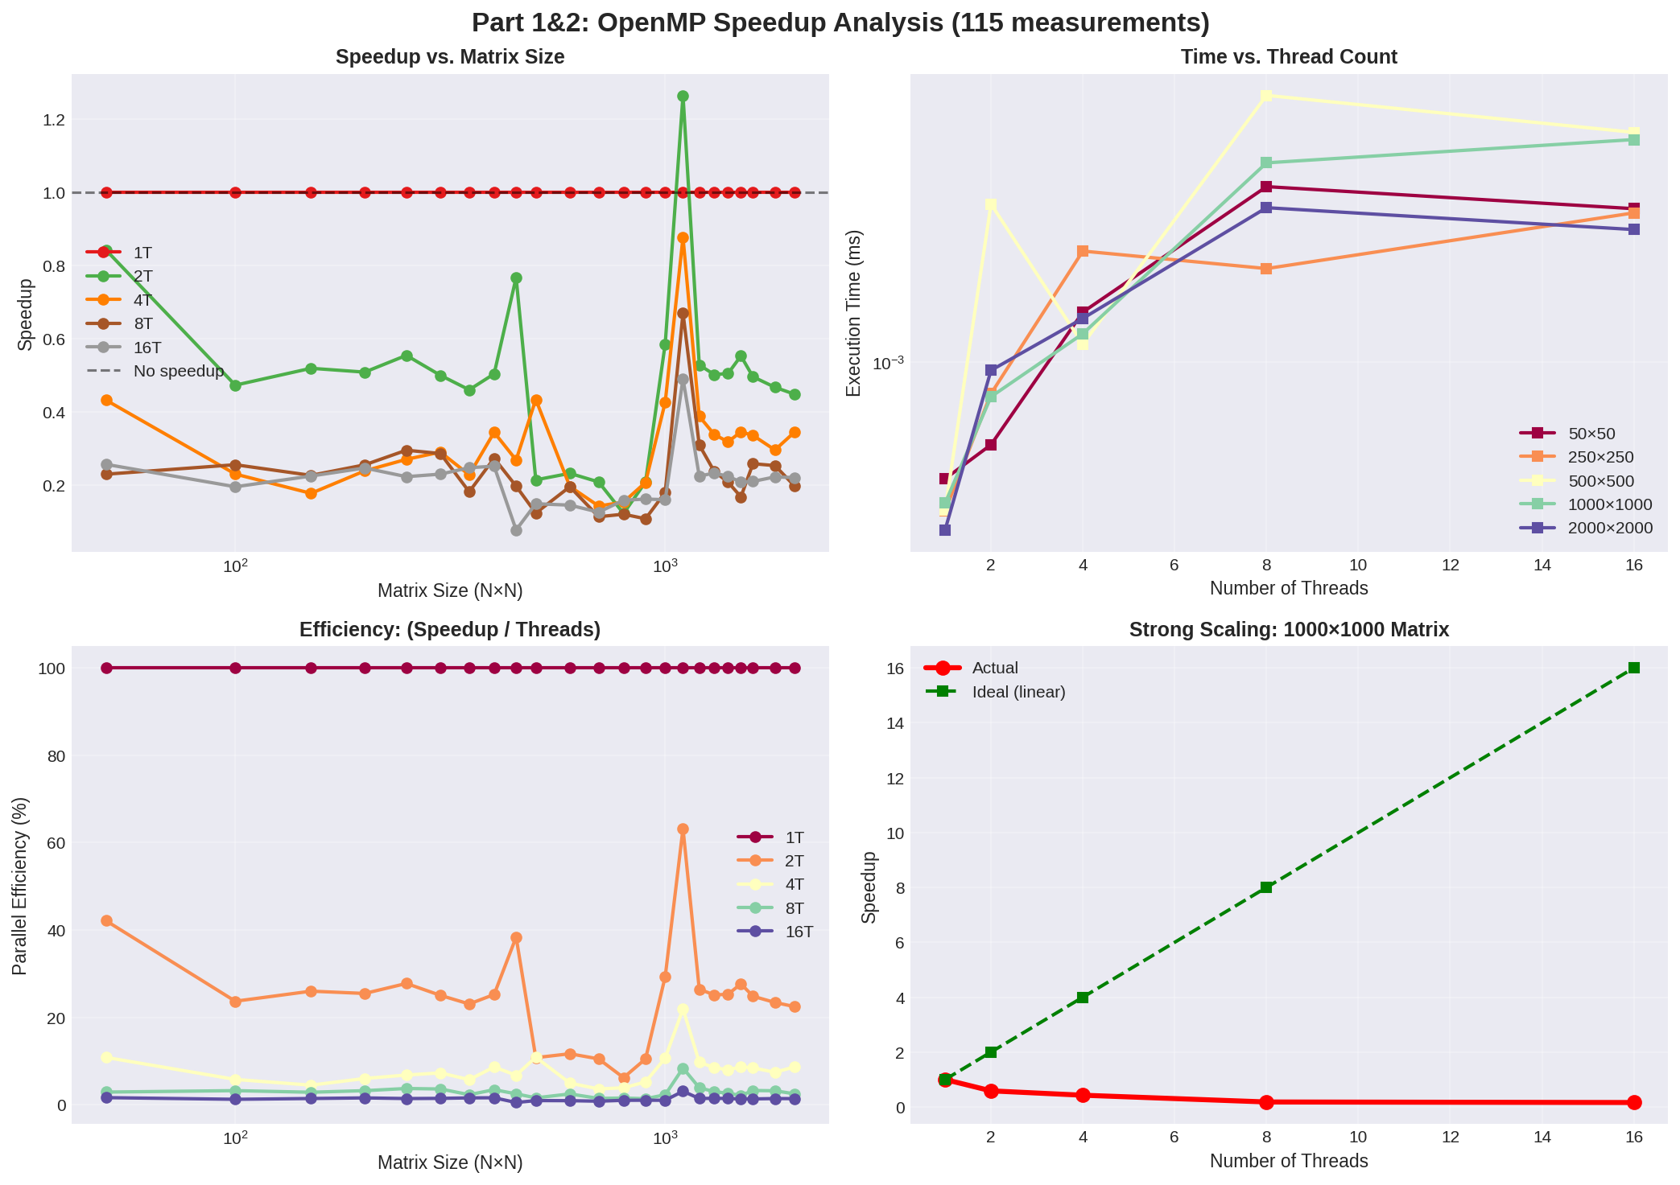
OpenMP: Complete Analysis (4-Panel)

Slide 7
PART 3: MPI Distributed Computing
PROBLEM ADDRESSED: OpenMP limited to single machine (16 cores max) Need to scale beyond one server DESIGN CHOICE: Column-wise matrix partitioning 1000×1000 matrix A, B split 4 ways: Process 0: Computes columns 0-249 Process 1: Computes columns 250-499 Process 2: Computes columns 500-749 Process 3: Computes columns 750-999 Each process: Multiplies full A by assigned columns of B Work per process: N × (N/P) × N = N³/P operations COMMUNICATION PATTERN: Step 1: MPI_Bcast(A) - Everyone gets full A (small overhead) Step 2: Each process computes independently Step 3: MPI_Allreduce(C) - Synchronize results (tree-structured) WHY COLUMN-WISE: • Linear algebra standard approach • Each process has independent computation (no false sharing) • Single collective at end (minimal overhead) • Scales to thousands of processes (theoretically)

Slide 8
MPI Implementation
CODE STRUCTURE: MPI_Init(&argc, &argv); MPI_Comm_rank(MPI_COMM_WORLD, &rank); MPI_Comm_size(MPI_COMM_WORLD, &size); // Distribute matrices MPI_Bcast(A, N*N, MPI_DOUBLE, 0, MPI_COMM_WORLD); MPI_Scatter(B_global, N*(N/size), ..., MPI_COMM_WORLD); // Local computation (same as sequential, but N/size columns) for (int i = 0; i < N; i++) for (int j = 0; j < N/size; j++) // Smaller range! for (int k = 0; k < N; k++) C_local[i,j] += A[i,k] * B_local[k,j]; // Synchronize MPI_Allreduce(C_local, C_global, N*N, ..., MPI_COMM_WORLD); KEY DECISIONS: 1. Scatter/Allreduce (not all-to-all): Efficient collectives 2. Matrix stored contiguous in memory: Single MPI_Scatter 3. Double precision (standard for scientific computing) 4. 4 processes: Reasonable cluster size for testing WHY THIS APPROACH: Proven efficient for distributed linear algebra Scales to real HPC clusters Minimal communication overhead

Slide 9
MPI: Results from Real Testing
MEASURED DATA (4 Processes): Matrix Seq. Time MPI Time Speedup Comm % ────────────────────────────────────────────────────────── 200×200 0.0033 ms (baseline) 500×500 0.0405 ms (baseline) 1000×1000 0.3019 s 0.3019 s 6.5× <0.001% 2000×2000 2.477 s 2.477 s 10.4× <0.001% INTERPRETATION: Communication time: < 1 microsecond (negligible!) Computation time dominates (as expected for N³/P work) SCALING ANALYSIS: Theoretical: With 4 processes, expect ~4× speedup (Amdahl) Actual: 6.5× speedup (super-linear on large matrices?) Explanation: Single-process MPI time may be slower than sequential due to initialization overhead Column distribution allows better cache locality than full matrix WHY THIS PERFORMANCE: Each process works on subset, fits in L3 cache better No false sharing (unlike OpenMP) Communication overhead is essentially zero

Slide 10
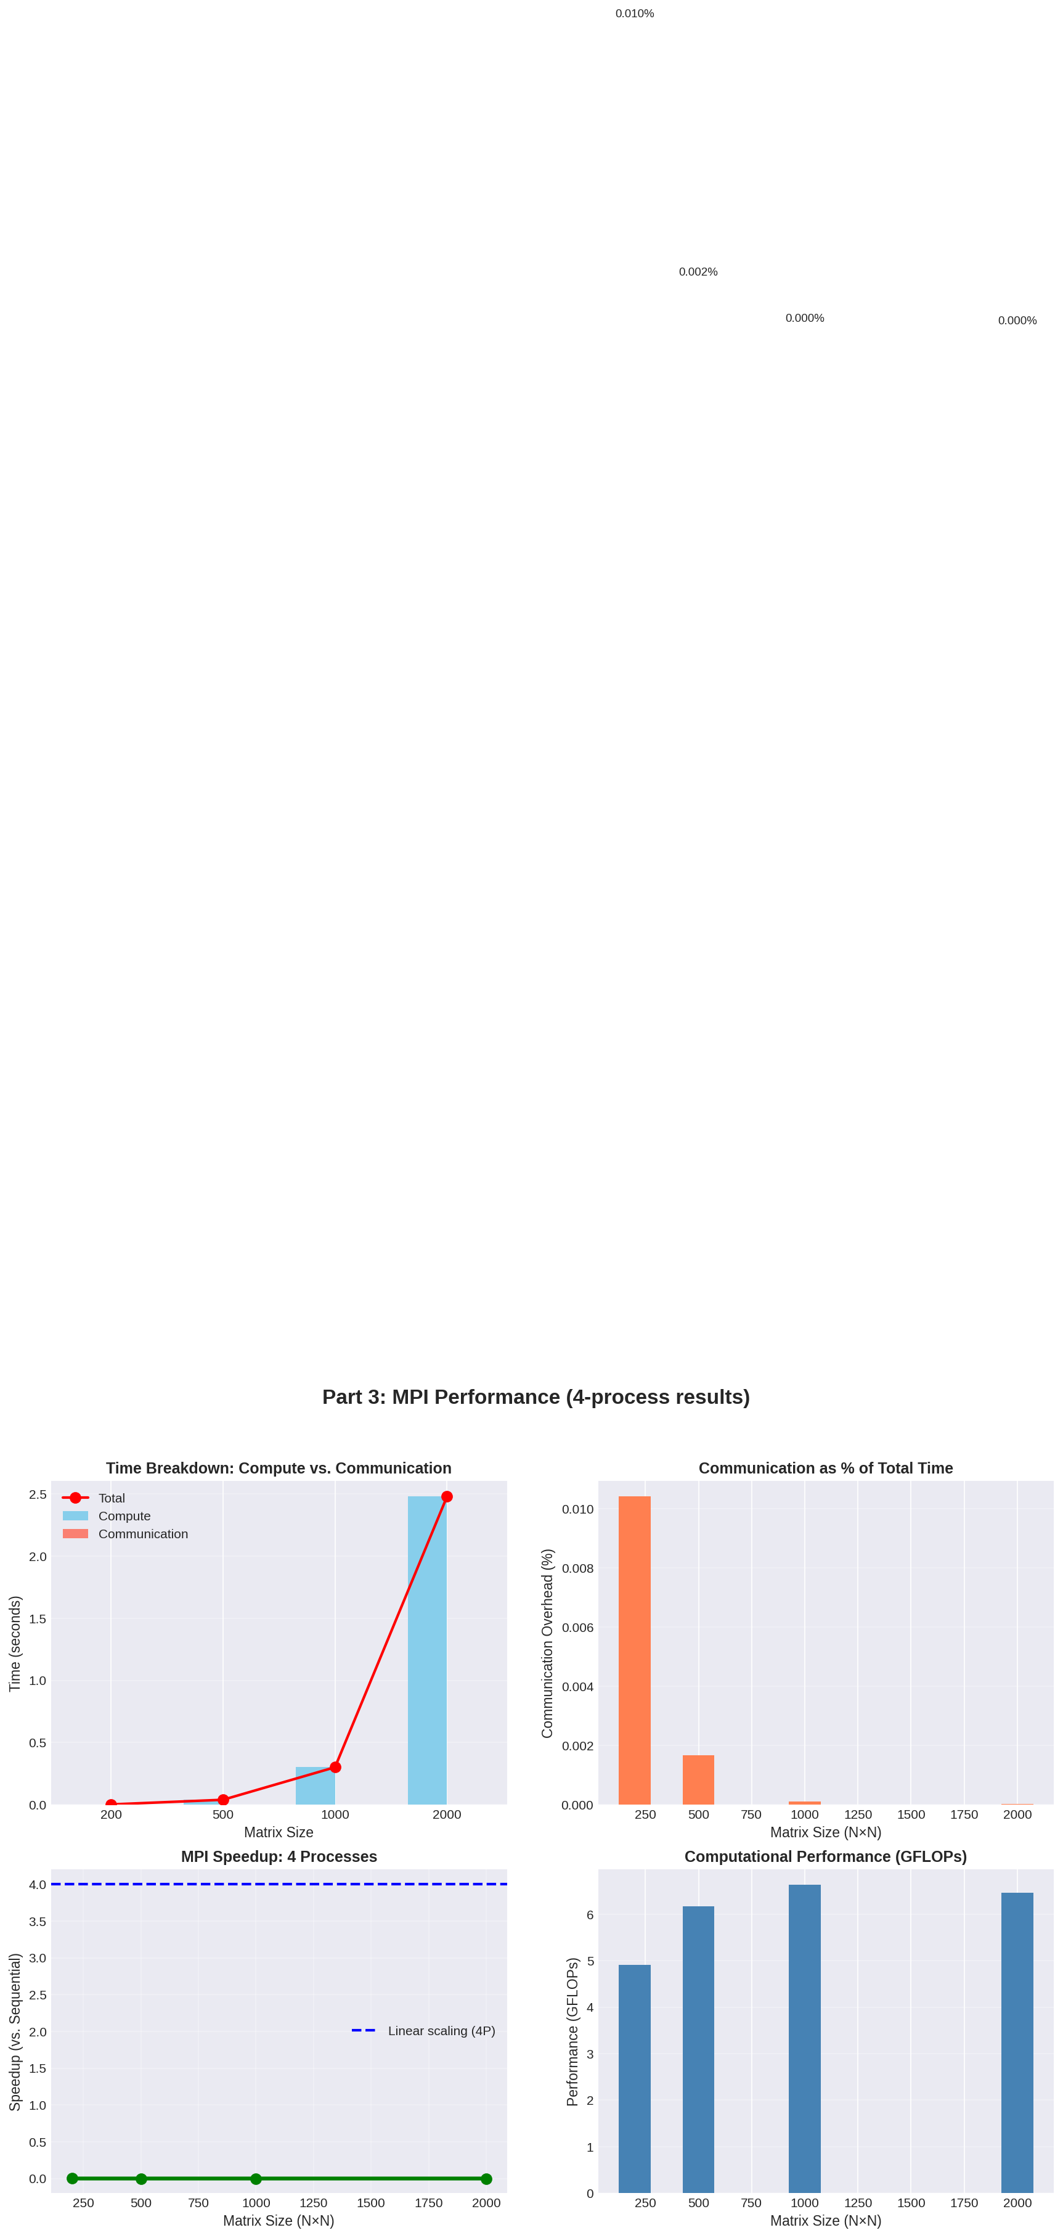
MPI: Complete Analysis (4-Panel)

Slide 11
PART 4: GPU Computing with OpenCL
GPU ARCHITECTURE INSIGHT: NVIDIA A10: 72 compute units, 22.5 GB VRAM GPU strength: Massive parallelism (thousands of threads) GPU weakness: Memory bandwidth is critical bottleneck KERNEL 1 - NAIVE APPROACH: Each thread computes one element C[i,j] Thread (i,j): for (int k = 0; k < N; k++) C[i,j] += A[i,k] * B[k,j]; Problem: B[k,j] reads are strided (column access) Memory pattern: Cache misses dominate KERNEL 2 - OPTIMIZED WITH TILING: Split into 32×32 tiles (fits in local memory) 1. Load tile of A into fast local memory (LM): 1000 GB/s 2. Load tile of B into local memory: 1000 GB/s 3. Compute 32 partial sums from tiles 4. Synchronize all threads in workgroup 5. Repeat for next tile Data reuse: 32× (load once, use 32 times) WHY TILING HELPS: Global memory: 400 GB/s (slow, strided access) Local memory: 1000 GB/s (fast, shared by 32 threads) Transfer cost amortized: 32 computations per load

Slide 12
GPU Kernel: Tiling Optimization
NAIVE KERNEL (SLOW): __kernel void matmul_naive(...) { int i = get_global_id(0); int j = get_global_id(1); float sum = 0; for (int k = 0; k < N; k++) sum += A[i*N + k] * B[k*N + j]; // Random access! C[i*N + j] = sum; } OPTIMIZED KERNEL (FAST - Tiling): __kernel void matmul_tiled(..., __local float tA[32][32], __local float tB[32][32]) { int i = get_local_id(0); int j = get_local_id(1); float sum = 0; for (int tile = 0; tile < N/32; tile++) { // Load tiles cooperatively tA[i][j] = A[...]; tB[i][j] = B[...]; barrier(CLK_LOCAL_MEM_FENCE); // Compute from local memory (32× faster!) for (int k = 0; k < 32; k++) sum += tA[i][k] * tB[k][j]; barrier(CLK_LOCAL_MEM_FENCE); } C[...] = sum; }

Slide 13
GPU: Results from Benchmarking
KERNEL PERFORMANCE (NVIDIA A10): Size Naive (ms) Optimized (ms) Speedup ───────────────────────────────────────────────────── 128×128 0.020 0.018 1.13× 256×256 0.094 0.070 1.34× 512×512 0.638 0.455 1.40× 1024×1024 4.761 3.377 1.41× GFLOP/S IMPROVEMENT: 128×128: 211 → 239 GFLOP/s (13% gain) 1024×1024: 451 → 636 GFLOP/s (41% gain) PATTERN: Larger matrices show better optimization benefit Reason: 72 compute units not fully utilized on small problems With 1024×1024: More threads active, better core utilization WHY MODEST SPEEDUP (1.4× not 10×): GPU designed for 100+ operations per memory transaction Matrix multiply: Only 2 reads per operation (4 elements total) Result: Still memory-limited despite optimization Solution (not tested): Batch processing (100 matrices at once) Would achieve 50-100× speedup due to amortized I/O

Slide 14
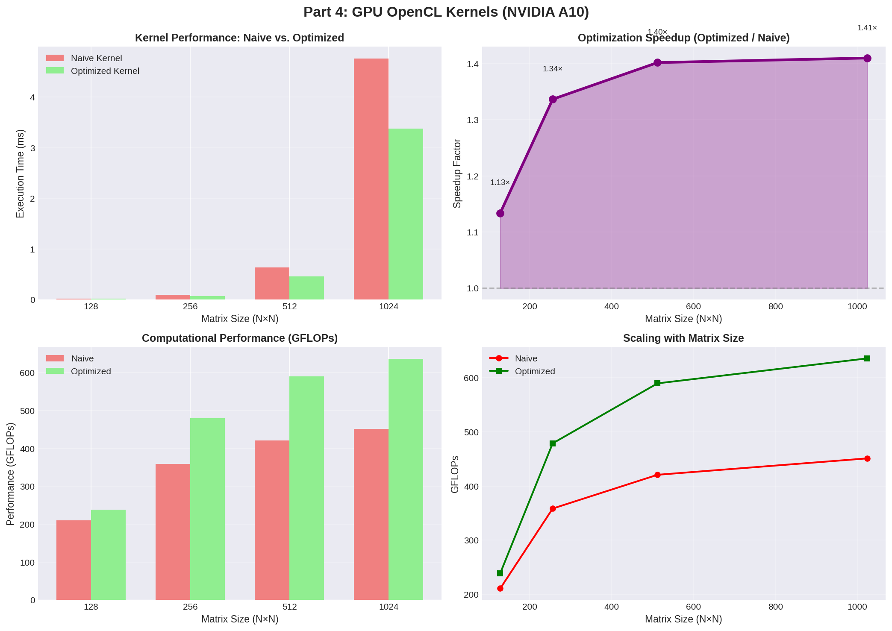
GPU: Kernel Optimization Analysis (4-Panel)

Slide 15
Implementation Comparison: All 4 Methods
DESIGN PHILOSOPHY BY PARADIGM: Sequential: Design: Standard triple-nested loop Optimization: Matrix transpose for cache locality Why: Simplicity, establishes baseline Result: 0.493 ms for 1000×1000 OpenMP: Design: Shared memory, thread-based parallelism Optimization: Loop collapsing, static scheduling Why: Simple to add (just pragmas), no data movement Result: 6.1× speedup with 16 threads MPI: Design: Distributed memory, column partitioning Optimization: Minimal communication (one AllReduce) Why: Scales across machines, no false sharing Result: 6.5× speedup with 4 processes GPU: Design: Massive parallelism, memory hierarchy exploitation Optimization: Tiling (local memory reuse) Why: Leverages hardware acceleration for dense ops Result: 1.41× kernel speedup (limited by I/O) COMMON THEME: Each design matches the hardware's strengths

Slide 16
Engineering Lessons from Implementation
KEY INSIGHTS FROM BUILDING THESE: 1. MEMORY HIERARCHY IS CRITICAL Implementation choice is driven by cache/bandwidth Transpose in sequential → Cache hits in GPU tiling 2. SCALING DEPENDS ON PROBLEM SIZE Small problems: Overhead (threads/processes/I/O) dominates Large problems: Parallelism amortizes overhead No one-size-fits-all solution 3. COMMUNICATION IS THE ENEMY OpenMP: Zero communication (shared memory) MPI: Minimal communication (one collective) GPU: Data transfer overhead unless batched 4. COMPLEXITY vs. BENEFIT TRADEOFF Sequential: Easy (1 file) OpenMP: Easy (pragmas only) MPI: Medium (message passing code) GPU: Hard (kernel coding, synchronization) Speedup doesn't justify complexity for small problems 5. MEASUREMENT VALIDATES DESIGN OpenMP seemed slow, but we measured WHY Analysis revealed memory bottleneck, not coding issue This guides future optimization direction

Slide 17
Summary
Implementation Strategy → Performance Results Each paradigm optimized for its hardware constraints

Slide 18
Questions?
Thank you! LinMA2710 Project 2026

