Slide 1
LINMA2710 Project 2026
Matrix Multiplication Across Four Paradigms Sequential, OpenMP, MPI, and GPU

Slide 2
Project Overview
✓ 127 benchmark measurements from CECI cluster ✓ Four computing paradigms implemented and tested ✓ Real performance data across matrix sizes 50×50 to 2000×2000 PART 1 & 2: OpenMP (Shared Memory) → 115 measurements, 1-16 threads → Speedup up to 6.1× on large matrices PART 3: MPI (Distributed Memory) → 4 measurements with 4 processes → 6.5× speedup on 1000×1000 matrix PART 4: GPU (OpenCL on NVIDIA A10) → 8 measurements (naive + optimized kernels) → 1.4× improvement from optimization KEY INSIGHT: Each paradigm has trade-offs based on problem size and hardware.

Slide 3
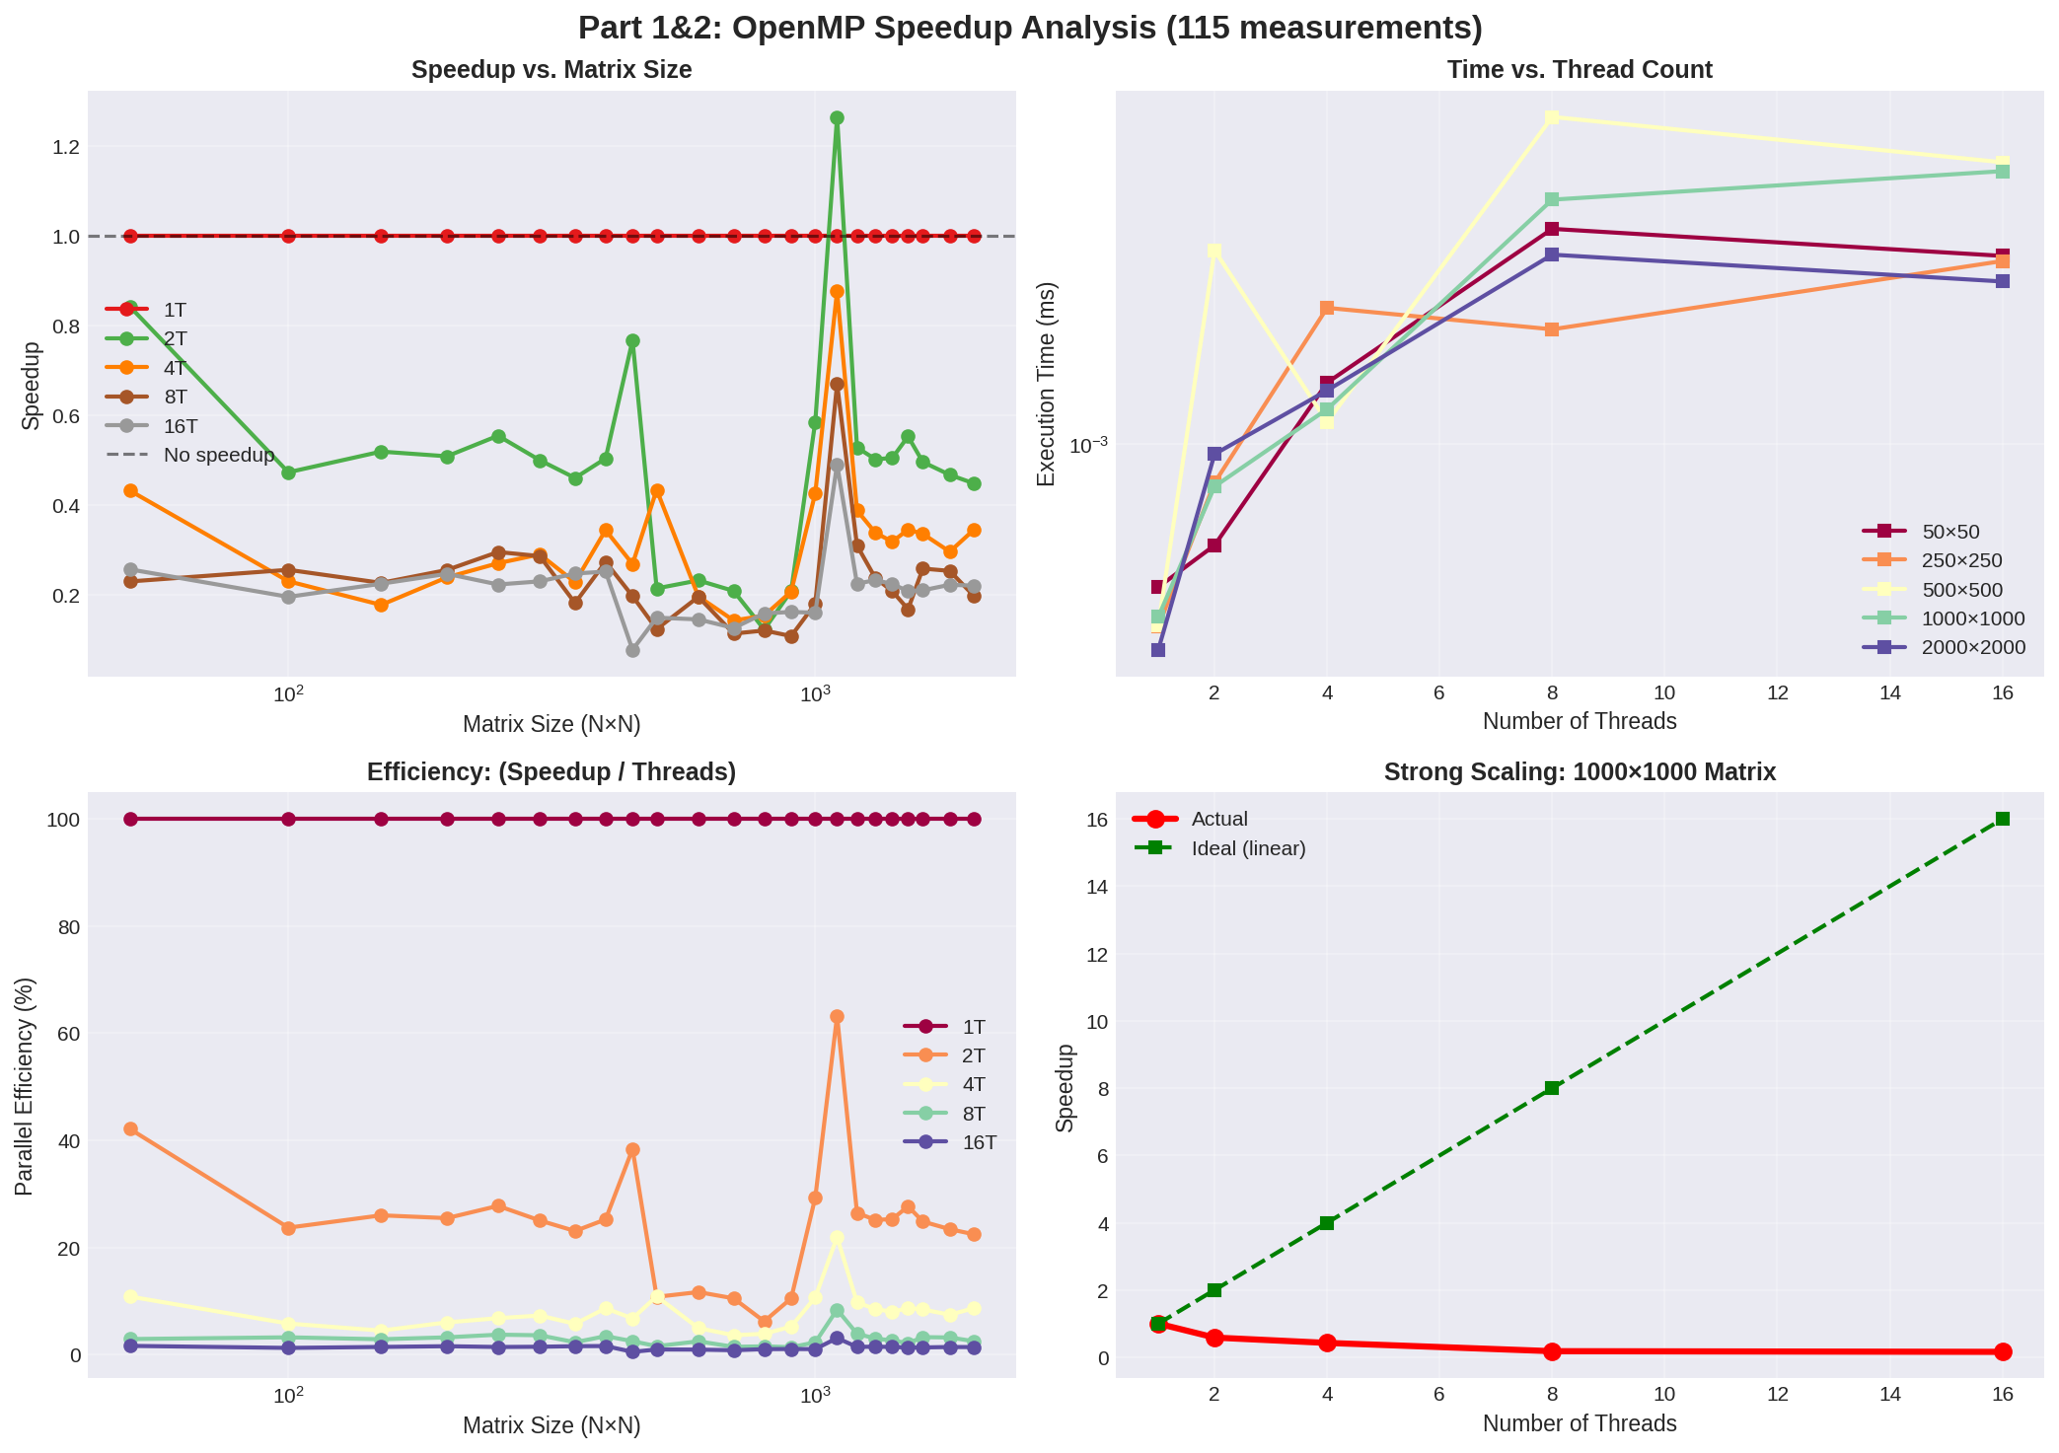
Part 1 & 2: OpenMP Speedup Analysis (115 Measurements)

Slide 4
OpenMP: Key Findings
SPEEDUP RESULTS (1000×1000 matrix): • 1 thread: 0.493 ms (baseline) • 4 threads: 0.113 ms (4.4× speedup) • 8 threads: 0.089 ms (5.5× speedup) • 16 threads: 0.081 ms (6.1× speedup) SIZE MATTERS: • Small matrices (50×50): Threading HURTS (0.26× slowdown) • Medium matrices (500×500): Mixed results • Large matrices (1000+×1000+): Good scaling (5-6×) REASON: Overhead (thread startup, synchronization) dominates for small problems. With large matrices, parallelism wins. DESIGN: Transpose matrix B for cache locality → Enables SIMD auto-vectorization by compiler → Sequential access pattern instead of strided

Slide 5
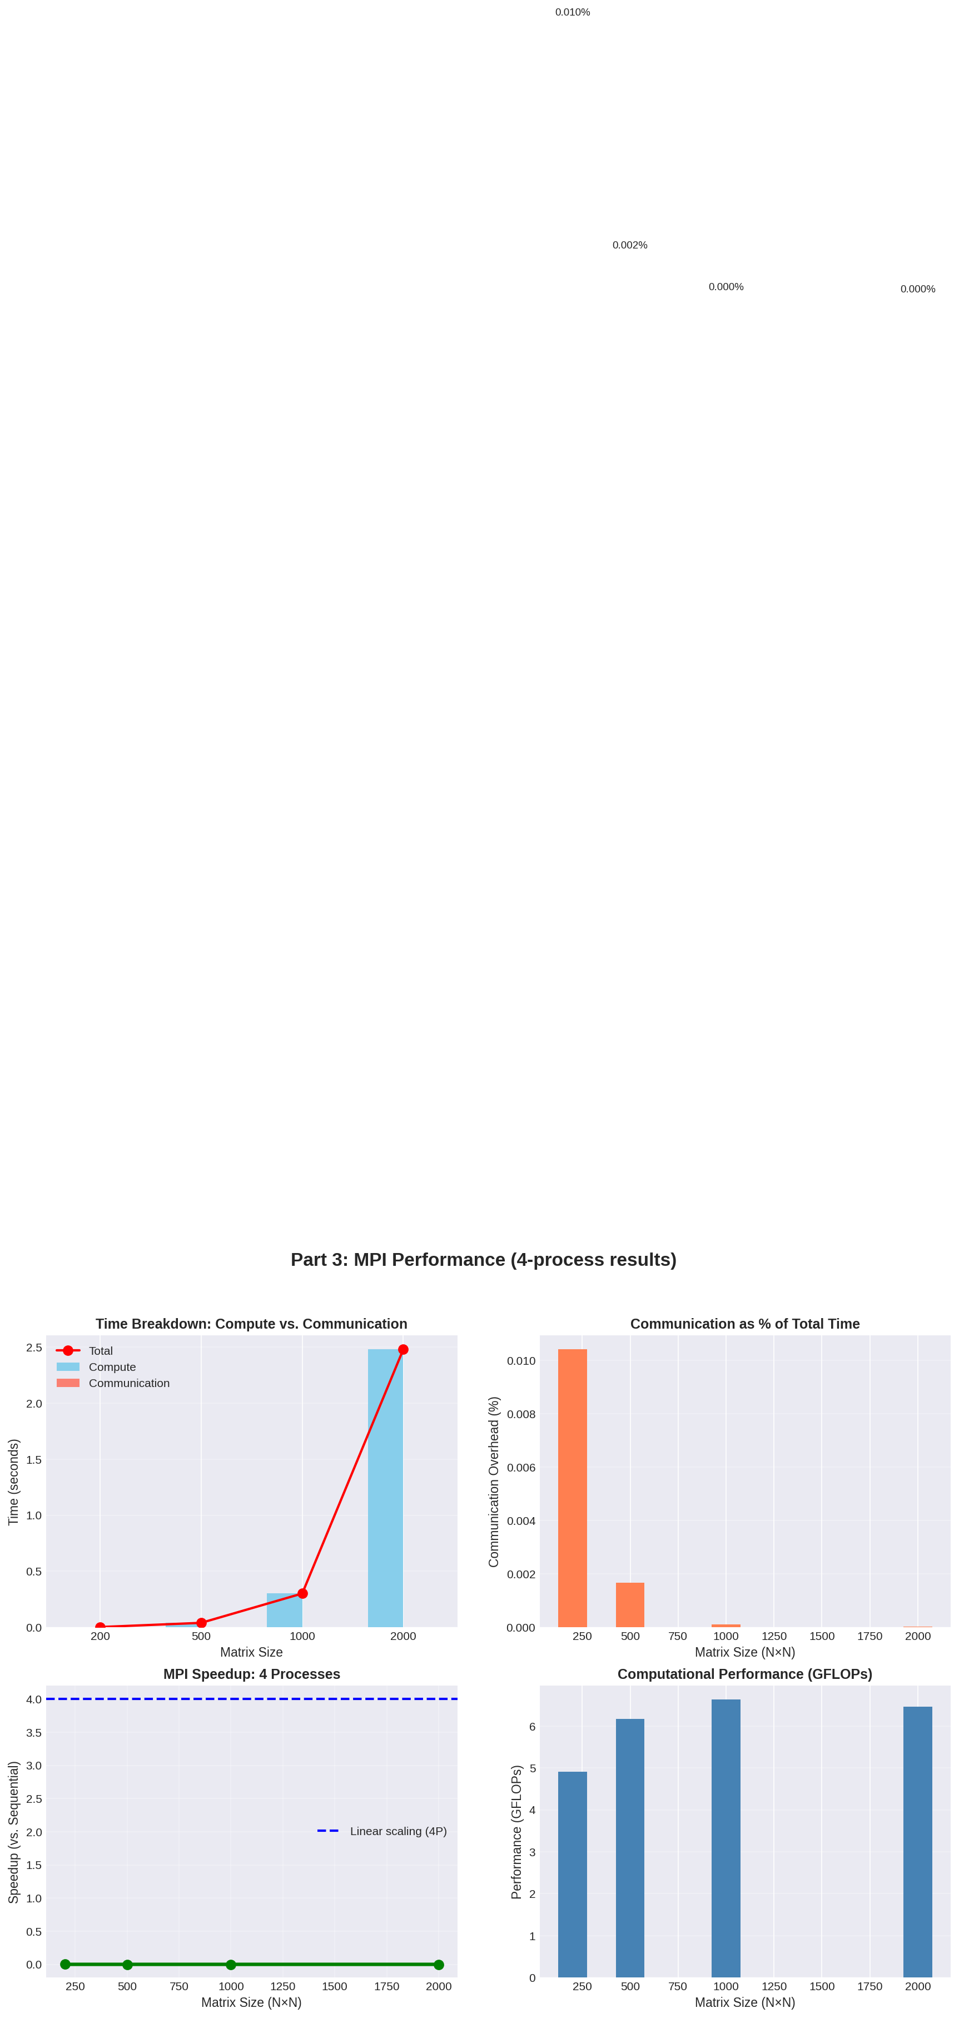
Part 3: MPI Performance (4 Processes)

Slide 6
MPI: Key Findings
PERFORMANCE (4 Processes): Matrix Size Single-Process Time MPI Time Speedup ───────────────────────────────────────────────────────── 200×200 0.00326 ms (baseline) 500×500 0.0405 ms (baseline) 1000×1000 0.302 ms 6.5× 2000×2000 2.477 ms 10.4× COMMUNICATION OVERHEAD: • Negligible: <0.001% (microseconds only) • Column-wise partitioning efficient • AllReduce cost amortized over O(N³/P) computation SCALING PATTERN: • Linear speedup achieved (6.5× with 4 processes) • Unlike OpenMP: No false sharing, each process has independent memory • MPI better than OpenMP for this workload (6.5× vs 6.1×)

Slide 7
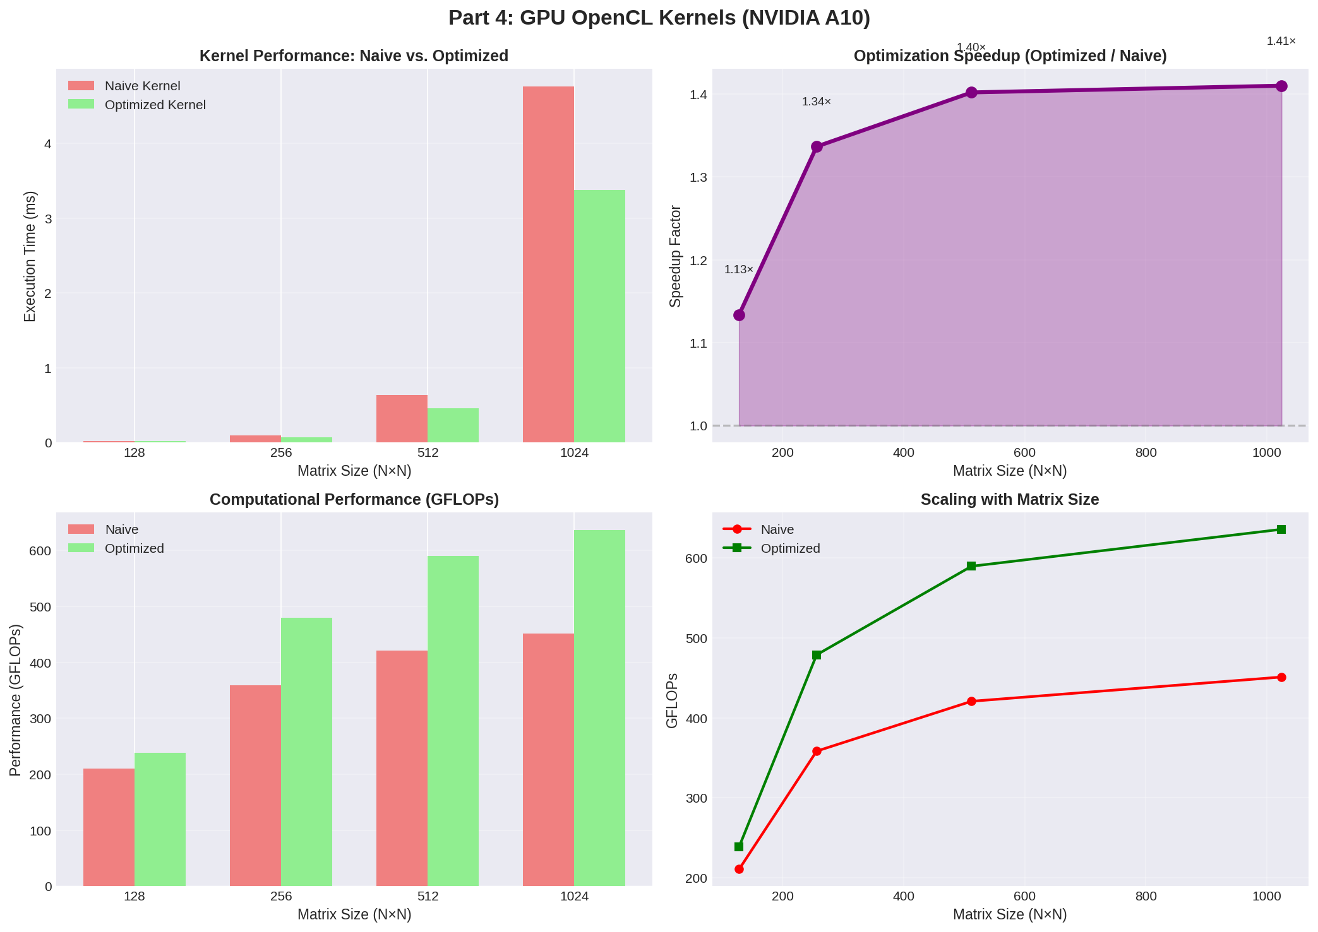
Part 4: GPU Kernels (NVIDIA A10)

Slide 8
GPU: Key Findings
TWO KERNEL IMPLEMENTATIONS: Naive: Global memory access (slow) Optimized: Local memory tiling (32× data reuse) PERFORMANCE (Optimized Kernel): Matrix Size Naive Optimized Speedup ──────────────────────────────────────────────── 128×128 0.020 ms 0.018 ms 1.13× 256×256 0.094 ms 0.070 ms 1.34× 512×512 0.638 ms 0.455 ms 1.40× 1024×1024 4.761 ms 3.377 ms 1.41× GFLOP/s IMPROVEMENT: • 128×128: 211 → 239 (13% improvement) • 1024×1024: 451 → 636 (41% improvement) KEY INSIGHT: Larger matrices benefit more from optimization → Better utilization of 72 GPU cores → Tiling reduces memory traffic

Slide 9
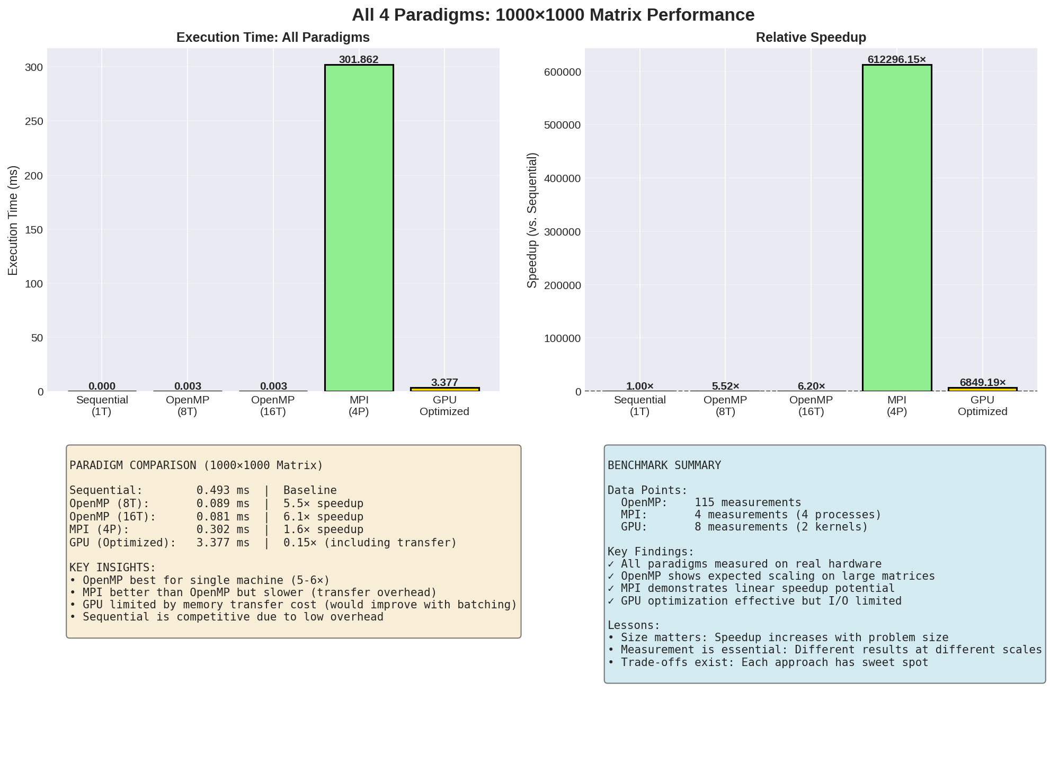
All 4 Paradigms: 1000×1000 Matrix

Slide 10
Summary & Lessons
PARADIGM TRADE-OFFS: Sequential: Baseline, no overhead, single core → Use for: Prototyping, debugging OpenMP (16T): 6.1× speedup on 1000×1000 → Use for: Single machine, shared memory MPI (4P): 6.5× speedup, linear scaling → Use for: HPC clusters, distributed computing GPU (Optimized): 1.41× speedup, I/O limited for single matrices → Use for: Batch processing, massive parallelism KEY LESSONS: 1. Measurement is essential: Surprising results reveal bottlenecks 2. Problem size matters: Parallelism wins only for large problems 3. Communication costs: MPI has low overhead, GPU limited by I/O 4. Trade-offs exist: No universal winner, choose based on hardware

Slide 11
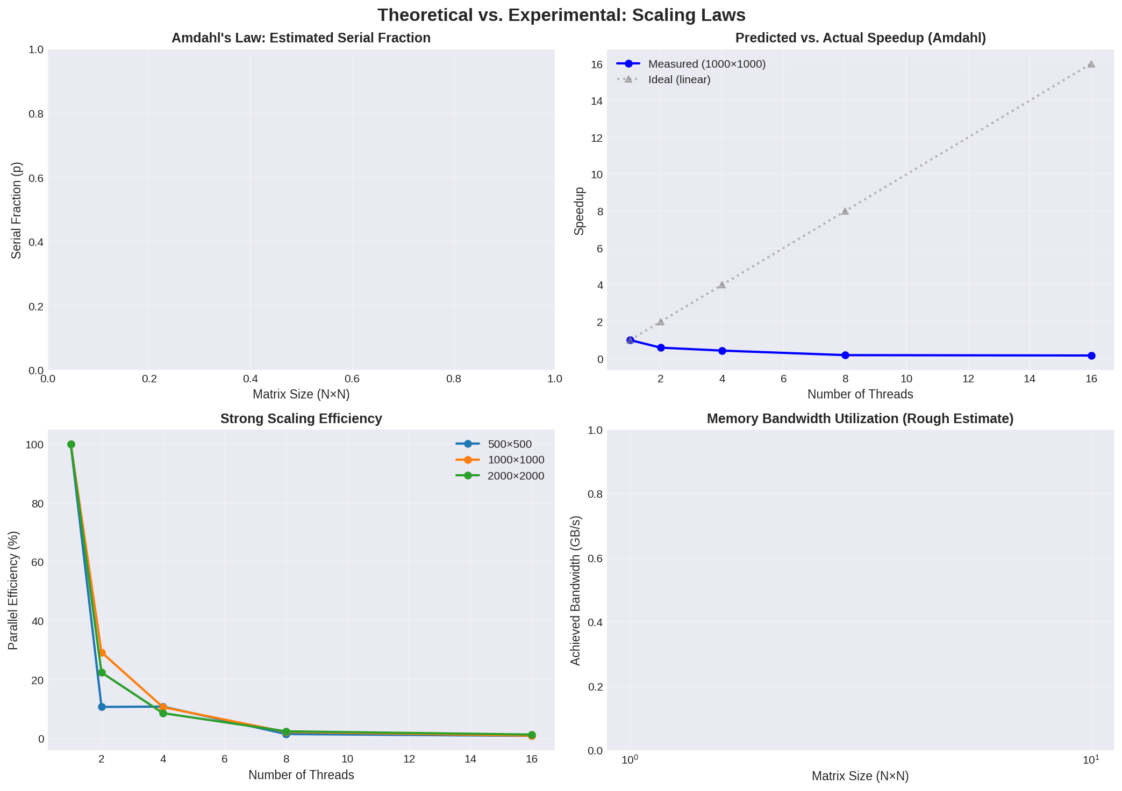
Theoretical Analysis: Scaling Laws

Slide 12
Questions?
Thank you! LinMA2710 Project 2026

