Slide 1

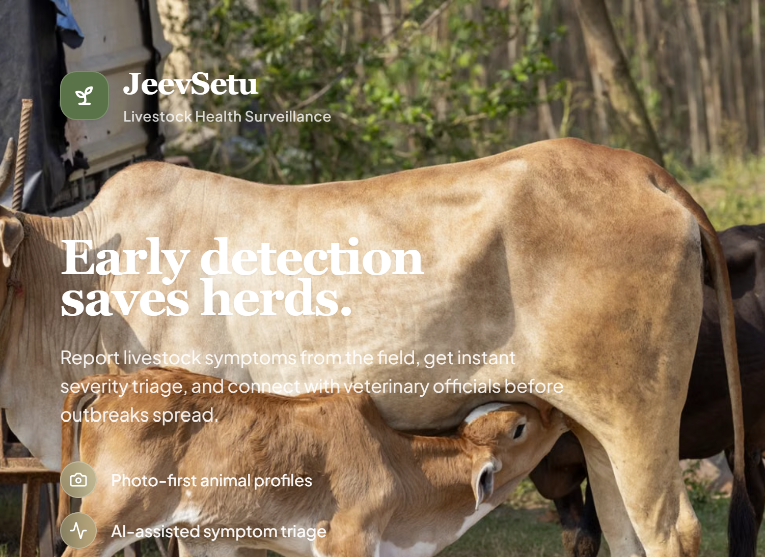
SMART INDIA HACKATHON 2026
JeevSetu
Multilingual, Offline-First Livestock Health Surveillance & Outbreak Early-Warning Platform
Problem Statement ID – SIH26128
Problem Statement Title- Efficient systems for early detection, prevention, and management of livestock diseases and animal health issues
Theme- MedTech / BioTech / HealthTech
PS Category- Software
Team ID- AUS_SIH26_130
Team Name (Registered on portal) – ChaoTics
Government of Maharashtra — Maharashtra State Innovation Society,
Dept. of Skills, Employment, Entrepreneurship & Innovation

Slide 2








IDEA TITLE
ChaoTics
PROBLEM: Sick/dying livestock go unreported for days — language barriers, low literacy, patchy connectivity ► OUTCOME: faster escalation & district-level disease visibility
JEEVSETU
FARMER / OWNER
VETERINARY (VAS)
AUTHORITY (DVO)
Reports symptoms
Reviews & triages case
Tracks district clusters
STRUCTURED SURVEILLANCE — timestamped, geotagged case records
EARLY ACTION — mortality auto-escalates to “Outbreak Risk”
CAPABILITIES DOCUMENTED IN THE JEEVSETU PROTOTYPE
Multilingual Voice Reporting
Rule-Based Triage Engine
Offline Report Queue*
Speak symptoms in English, Hindi or Telugu via browser-native speech recognition.
Deterministic severity scoring; mortality auto-escalates a case to “Outbreak Risk”.
Reports made without connectivity are queued (IndexedDB) and synced later.
Role-Based Workflows
Geospatial Case Map
Indian Livestock Breed Data
Distinct flows for Farmers, Veterinary Assistant Surgeons and District Officers.
District-level case visualisation built with Leaflet / React-Leaflet.
Localised breed coverage: Cattle, Buffalo, Goat, Sheep, Pig, Poultry.
*Documented in project README; not independently verified from application source code.

Slide 3










TECHNICAL APPROACH
ChaoTics
USER WORKFLOW
SYSTEM ARCHITECTURE
TECHNOLOGY STACK
Farmer / Field Worker
FRONTEND
01
Frontend
React 18 SPA — TypeScript, Vite, Tailwind
React 18 · TypeScript 5 · Vite 5
notices symptoms
02
Styling
Tailwind CSS
Voice / Text Report
APPLICATION LOGIC
03
Data & Auth
in EN, HI or TE
Client-side routing, state & rule-based triage logic
Supabase · PostgreSQL · RLS
04
Mapping
Rule-Based Triage
AUTH
Leaflet · React-Leaflet
severity is scored
Supabase Authentication
05
Speech Input
Web Speech API (en-IN/hi-IN/te-IN)
VAS / DVO Review
DATABASE
06
UI Icons
case queue & records
Supabase PostgreSQL + Row-Level Security
lucide-react
07
Hosting
Advisory / Action
MAPPING / EXTERNAL
Netlify Edge CDN
guidance to farmer
Leaflet map layer · offline queue (documented)
08
Offline Queue*
IndexedDB (documented)
FUTURE SCOPE: Supabase Edge Functions as an extensible automation/AI layer (not implemented in current build).
ACCURACY NOTE: Triage is a deterministic RULE-BASED ENGINE — no trained/hosted ML model is confirmed in the codebase; not presented as AI diagnosis.

Slide 4
FEASIBILITY AND VIABILITY
ChaoTics
CHALLENGE
JEEVSETU RESPONSE
WHY IT'S FEASIBLE
Rural connectivity is patchy or absent
Offline-First Reporting
Reports queue safely in IndexedDB and auto-sync once back online.
No dependency on continuous connectivity for core reporting.
Language & literacy barriers among field-level farmers
Multilingual Voice Input
Native dictation in English, Hindi or Telugu via the browser — zero cost.
No paid STT service and no app-store literacy hurdle.
Delayed, informal disease reporting
Structured Reporting + Rule-Based Triage
Every report gets an instant, deterministic severity score.
Auditable rules a vet can verify — not a opaque model.
Fragmented, paper-based surveillance across villages
Centralised Records + Outbreak Map
PostgreSQL records plus a geospatial heatmap with automatic 3-case village triggers.
One source of truth per district; scales on managed Postgres.
Overloaded veterinary workforce
Prioritised Case Queue
VAS case queue (Open → In Progress → Closed) with one-click lab sample requests.
Existing VAS / DVO roles map directly onto the app.
TECHNICAL
React 18 + TypeScript 5 builds and type-checks today (npm run build / typecheck).
DEPLOYMENT
Already live on Netlify Edge CDN; Supabase manages Auth & Postgres — no server ops.
SCALABILITY
Stateless SPA + managed Postgres with RLS scales without re-architecture.
USABILITY
Voice-first in 3 Indian languages + offline queue removes literacy/connectivity hurdles.
OPERATIONAL
Farmer → VAS → DVO workflow mirrors the existing veterinary chain of command.

Slide 5
IMPACT AND BENEFITS
ChaoTics
Why this matters: Foot-and-Mouth Disease alone costs India an estimated ₹20,000+ crore every year¹ — and losses compound the longer an outbreak goes unreported.
JEEVSETU
FARMERS
• Report symptoms without typing, in their own language
• Instant triage advice + emergency guidance
• Photo-based medical history per animal, not paperwork
VETERINARY ASST. SURGEONS
• Prioritised case queue instead of ad hoc visits
• One-click lab sample requests
• Prescription log kept with the case
DISTRICT VET. OFFICERS
• Real-time cluster heatmap, not after-the-fact paper reports
• Automatic 3-case village trigger flags outbreaks early
• Push geo-targeted advisories directly to farmers
REPORT
TRIAGE
PRIORITISE
ACT
TRACK
SURVEIL
EARLIER RESPONSE
CURRENT PROTOTYPE CAPABILITIES
POTENTIAL SCALE IMPACT
✓ Voice symptom reporting in English, Hindi & Telugu
✓ Rule-based triage with automatic mortality escalation
✓ Offline reporting queue with background auto-sync
✓ Role-based dashboards for Farmer / VAS / DVO
✓ Geospatial district outbreak heatmap
✓ Native Indian breed database (6 species)
→ Faster farm-to-district reporting chain
→ Earlier visibility into emerging clusters for authorities
→ A paperless record per animal that persists across vet visits
→ Zero-license-cost stack a state department can deploy without new procurement
→ Complements top-down systems (e.g. ICAR-NIVEDI's NADRES) with bottom-up, farm-level data

Slide 6
RESEARCH AND REFERENCES
ChaoTics
01 GOVERNMENT / POLICY
02 DISEASE SURVEILLANCE
03 SCIENTIFIC / INSTITUTIONAL
National Animal Disease Control Programme (NADCP) — Dept. of Animal Husbandry & Dairying, GoI — dahd.gov.in/schemes/programmes/nadcp
20th Livestock Census 2019, All-India Report — Dept. of Animal Husbandry & Dairying, GoI — 535.78 million livestock nationwide
Problem Statement 26128 — Govt. of Maharashtra, Maharashtra State Innovation Society (MSInS)
NADRES (v2/v3) — ICAR-NIVEDI — AI-driven district-level forewarning for 15 diseases — nivedi.res.in
Govindaraj et al. (2021) — Economic impact of FMD in cattle & buffaloes in India — Prev. Vet. Med. 190
Naidu et al. (2025) — Economic burden of Lumpy Skin Disease in India — Scientific Reports
Singh et al. (2022) — FMD status in India, 2011–2020 — PMC / Indian J. Microbiol.
Rout et al. — Animal disease surveillance: importance & present status in India — Indian J. Med. Res.
04 TECHNOLOGY DOCUMENTATION
05 MAPPING / WEB / INFRASTRUCTURE
React 18 — react.dev
TypeScript 5 — typescriptlang.org
Vite 5 & Tailwind CSS — vitejs.dev · tailwindcss.com
Supabase (Auth, Postgres, RLS, Edge Functions) — supabase.com/docs
Web Speech API & IndexedDB — MDN Web Docs — developer.mozilla.org
Leaflet & React-Leaflet — leafletjs.com · react-leaflet.js.org
Netlify Edge CDN — netlify.com
Project repository — github.com/GavaraNeha/JeevSetu_SIH
Live prototype — deployed build on Netlify (https://6a95aa3455b4ec489d920721--remarkable-palmier-2eaa81.netlify.app/)

