Slide 1

PRESENTED BY : GAVASKAR S

Slide 2
PROJECT OVERVIEW
Real-time Power BI Dashboard Creation
Raw data to insights
Business Decision Supports

Slide 3
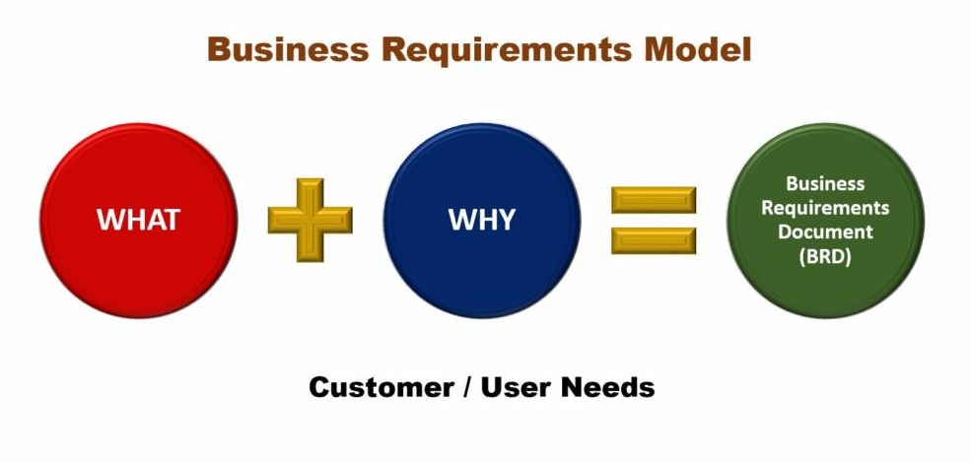
BUSINESS REQUIREMENTS
To conduct a comprehensive analysis of Blinkit’s
Sales Performance,
Customer Satisfaction,
Inventory Distribution
To identify key insights and opportunities for optimization using various KPIs and visualizations in Power BI.

Slide 4


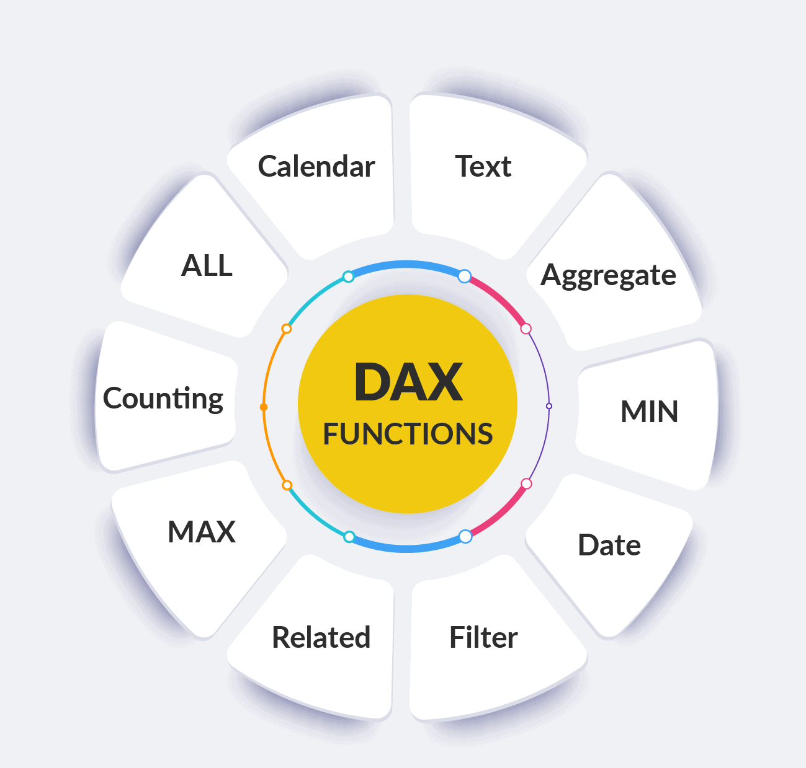
TOOLS USED
Power BI Desktop
Data Set Source (excel/.csv)
DAX (Data Analysis Expressions)

Slide 5
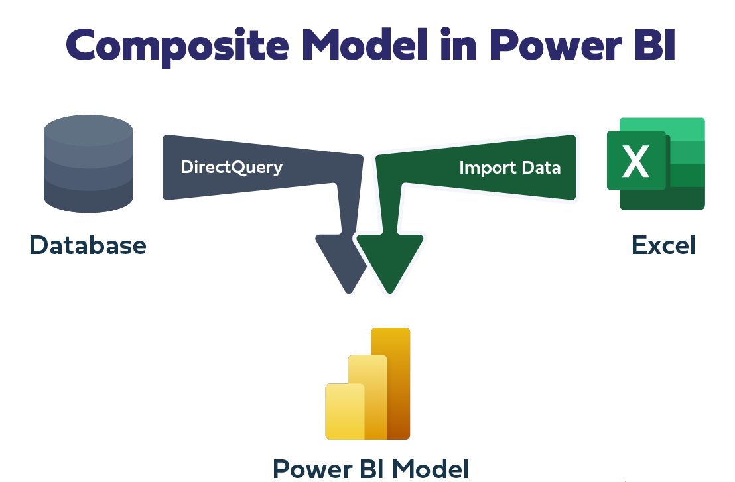
DATA COLLECTIONS
Raw Business Data in GitHub in the form of .excel
Import in to the Power BI

Slide 6
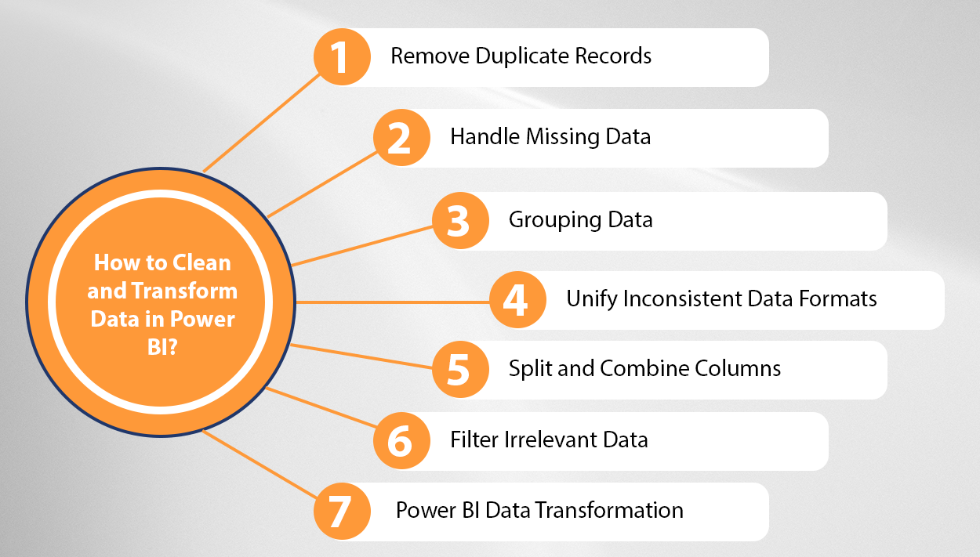
DATA CLEANING
Removes Duplicates
Handle Missing Values
Changing the Correct Data Type

Slide 7
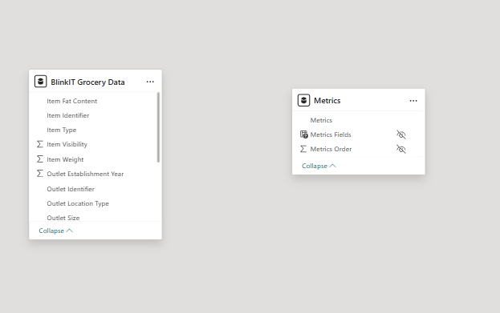
DATA MODELLING
Fact & Dimension Table
To create One – to – Many relationships

Slide 8
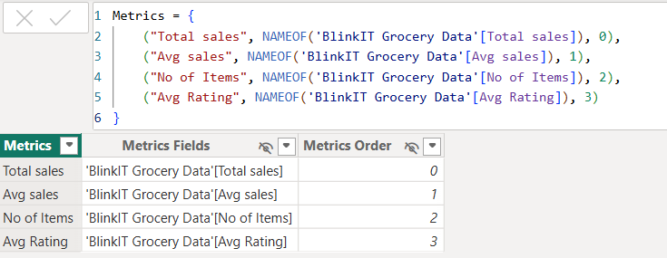
MEASURES & CALCULATIONS
Total Sales
Total Profit
KPIs Using DAX

Slide 9
CALCULATIONS
Average Rating:
Avg Rating = AVERAGE (‘BlinkIT Grocery Data’[Rating])
Average Sales:
Avg Sales = AVERAGE (‘BlinkIT Grocery Data’[Sales])
No of Items:
No of Items = COUNTROWS('BlinkIT Grocery Data’)
Total Sales:
Total sales = SUM('BlinkIT Grocery Data'[Sales])

Slide 10
METRICS
Metrics = {
("Total sales", NAMEOF('BlinkIT Grocery Data'[Total sales]), 0),
("Avg sales", NAMEOF('BlinkIT Grocery Data'[Avg sales]), 1),
("No of Items", NAMEOF('BlinkIT Grocery Data'[No of Items]), 2),
("Avg Rating", NAMEOF('BlinkIT Grocery Data'[Avg Rating]), 3)
}
USES:
NAMEOF is a DAX function used to safely reference column or measure names as text.
It helps in dynamic metric selection and avoids errors when column names change.

Slide 11
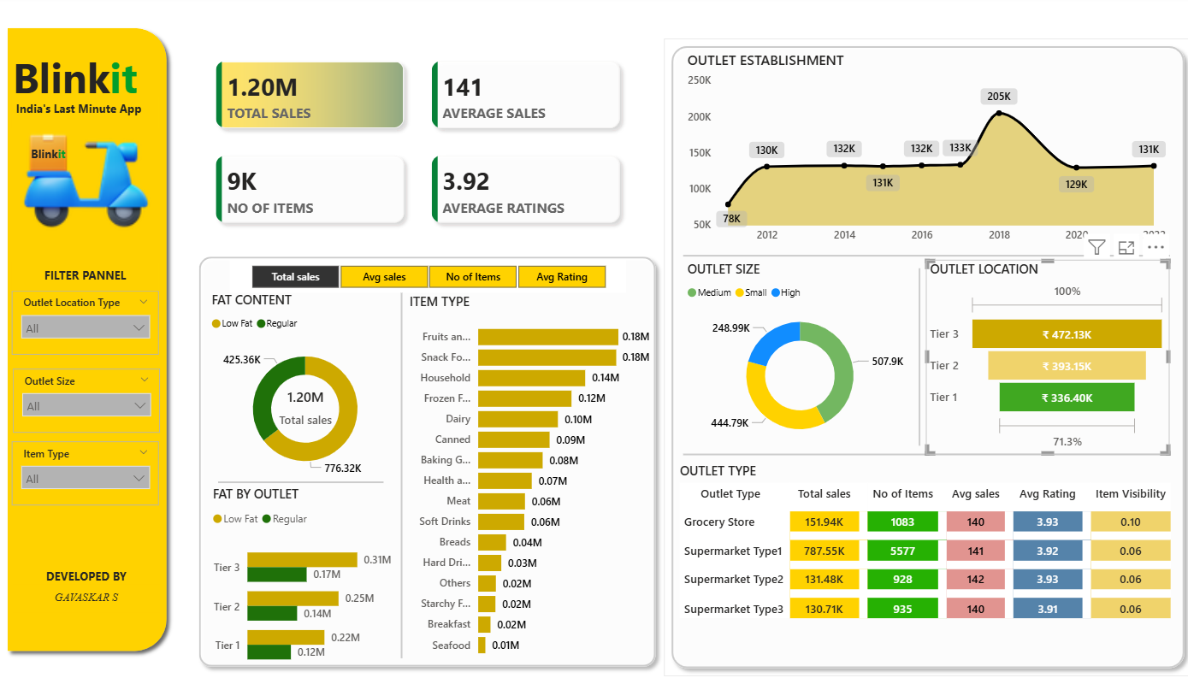
DASHBOARD DESING
Bar Chart
Clustered Bar Chart
Stacked Bar Chart
Line Chart
Matrix Table
Donut Chart
Funnel Chart
KPI Cards

Slide 12
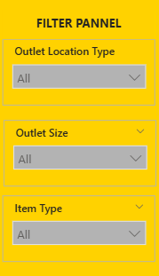
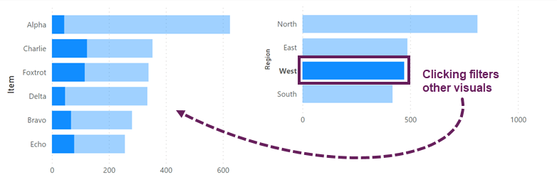
INTERACTIVE
Slicers
Cross Filtering
Drill – Down

Slide 13
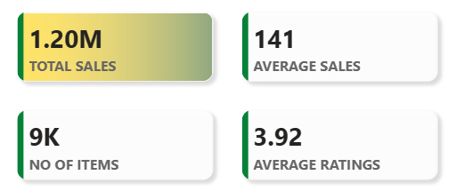
KPI’S REQUIREMENTS
Total Sales: The overall revenue generated from all items sold.
Average Sales: The average revenue per sale.
Number of Items: The total count of different items sold.
Average Rating: The average customer rating for items sold.

Slide 14
CHART’S REQUIREMENTS
Total Sales by Fat Content:
Objective: Analyze the impact of fat content on total sales.
Additional KPI Metrics: Assess how other KPIs (Average Sales, Number of Items, Average Rating) vary with fat content.
Chart Type: Donut Chart
Total Sales by Item Type:
Objective: Identify the performance of different item types in terms of total sales.
Additional KPI Metrics: Assess how other KPIs (Average Sales, Number of Items, Average Rating) vary with fat content.
Chart Type: Bar Chart
Fat Content by Outlet for Total Sales:
Objective: Compare total sales across different outlets segmented by fat content.
Additional KPI Metrics: Assess how other KPIs (Average Sales, Number of Items, Average Rating) vary with fat content.
Chart Type: Stacked Bar Chart

Slide 15
CHART’S REQUIREMENTS
Total Sales by Outlet Establishment:
Objective: Evaluate how the age or type of outlet establishment influences total sales.
Chart Type: Line Chart
Sales by Outlet Size:
Objective: Analyze the correlation between outlet size and total sales.
Chart Type: Donut/Pie Chart
Sales by Outlet Location:
Objective: Assess the geographic distribution of sales across different locations.
Chart Type: Funnel Chart
All Metrics by Outlet Type:
Objective: Provide a comprehensive view of all key metrics (Total Sales, Average Sales, Number of Items, Average Rating) broken down by different outlet types.
Chart Type: Matrix Card

Slide 16
BUSINESS INSIGHTS
Performance Analysis
Trend Identification

Slide 17


