Slide 1
Introduction to Three Js
Google Developers Student Club, DBIT, Kurla

Slide 2

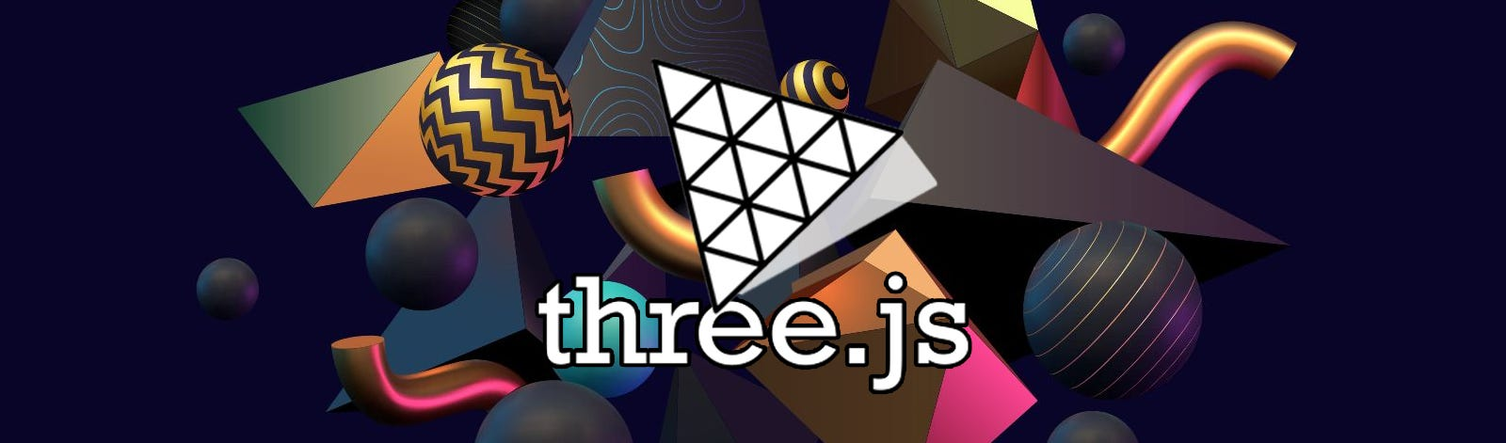
2D Web development is like creating a shareable document
3D Web development is like creating a shareable movie scene

Slide 3

The Scene
In Three.js, a Scene is a container that holds all the 3D objects, lights, and cameras that make up your virtual environment. It serves as the space where your 3D world exists.
// Create a scene
const scene = new THREE.Scene();

Slide 4

A Scene consists of 3 main things
The Light Source
The Camera
The Renderer

Slide 5
Types of Light
Ambient Light
Applies a light globally to every object in the scene
Point Light
Shines light in all directions and lights up anything that is in range
Directional Light
Works like a spotlight, in a position and shines in a direction
Spot Light
Emits light in a specific cone-shaped direction
Hemisphere Light
.Useful for creating realistic outdoor lighting

Slide 6
Ambient Light
const ambientLight = new THREE.AmbientLight(0x404040);
scene.add(ambientLight);
Point Light
const pointLight = new THREE.PointLight(0xffffff, 1, 100);
pointLight.position.set(5, 5, 5);
scene.add(pointLight);
Directional Light
const directionalLight = new THREE.DirectionalLight(0xffffff, 0.5);
directionalLight.position.set(0, 1, 0);
scene.add(directionalLight);

Slide 7
Spot Light
const spotlight = new THREE.SpotLight(0xffffff); // white
spotlight.position.set(0, 100, 0); // position
scene.add(spotlight);
Hemispheric Light
const hemiLight = new THREE.HemisphereLight(0xffffff, 0x00ff00, 1);
// Sky color, ground color, intensity
scene.add(hemiLight);

Slide 8
Most used Types of Camera
Orthographic Camera:
Unlike the PerspectiveCamera, the OrthographicCamera does not take perspective into account.
Objects maintain their size regardless of their depth in the scene.
const camera = new THREE.OrthographicCamera(left, right, top, bottom, near, far);
Perspective Camera:
This is the most common camera type used for 3D scenes.
It mimics the way human eyes perceive the world, with depth and perspective.
Objects closer to the camera appear larger, and those farther away appear smaller.
const camera = new THREE.PerspectiveCamera(fov, aspect, near, far);

Slide 9
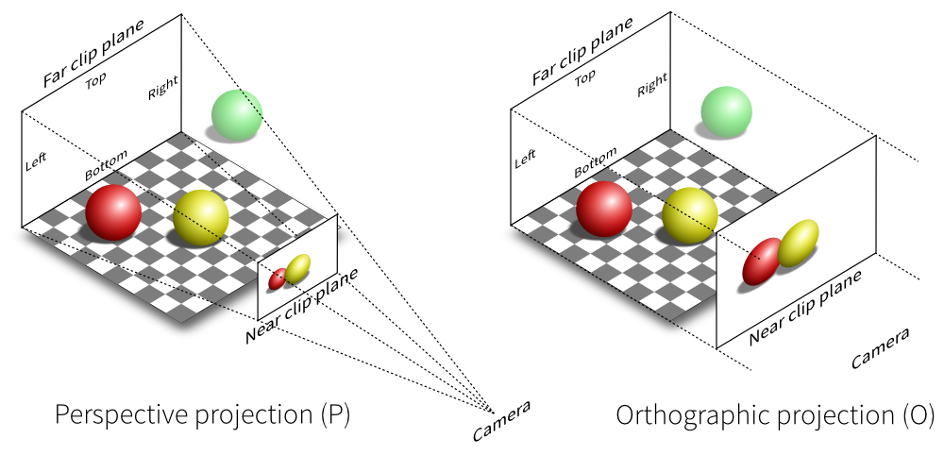

Slide 10
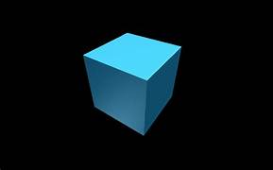
The Renderer
In Three.js, the renderer is responsible for taking the 3D scene and rendering it onto a 2D canvas or the HTML page. The renderer interacts with the WebGL API to achieve hardware-accelerated 3D graphics in the browser

Slide 11
Creating a renderer
const renderer = new THREE.WebGLRenderer();
This creates a WebGLRenderer instance, which is the most common renderer in Three.js. It utilizes WebGL for efficient hardware-accelerated rendering.
Setting the Size
renderer.setSize(window.innerWidth, window.innerHeight);
Set the size of the renderer to match the size of the window or the container where you want to display the 3D scene.
Adding the renderer to the DOM
document.body.appendChild(renderer.domElement);
Append the renderer's DOM element to the document body or another HTML element.

Slide 12
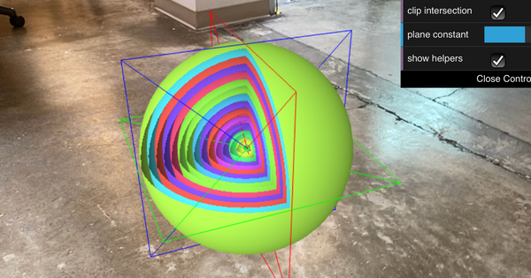
Rendering the Scenes
function animate(){
// Code for all the required Animations
renderer.render(scene,camera)
}
// Running the Animations in a Loop
renderer.setAnimationLoop(animate)
// Making the Scene Responsive on all Devices
window.addEventListener('resize',function(){
camera.aspect = window.innerWidth / this.window.innerHeight
camera.updateProjectionMatrix()
renderer.setSize(window.innerWidth, window.innerHeight)
})

Slide 13
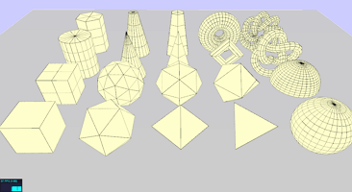
Creating an Object
Define the Geometry
- Use a predifined three.js object
- Define your own vertices
- Use a Modelling tool
Define the Material
- Basic
- Lambert
- Phong
- Custom
Create the Mesh
Add it to the Scene

Slide 14
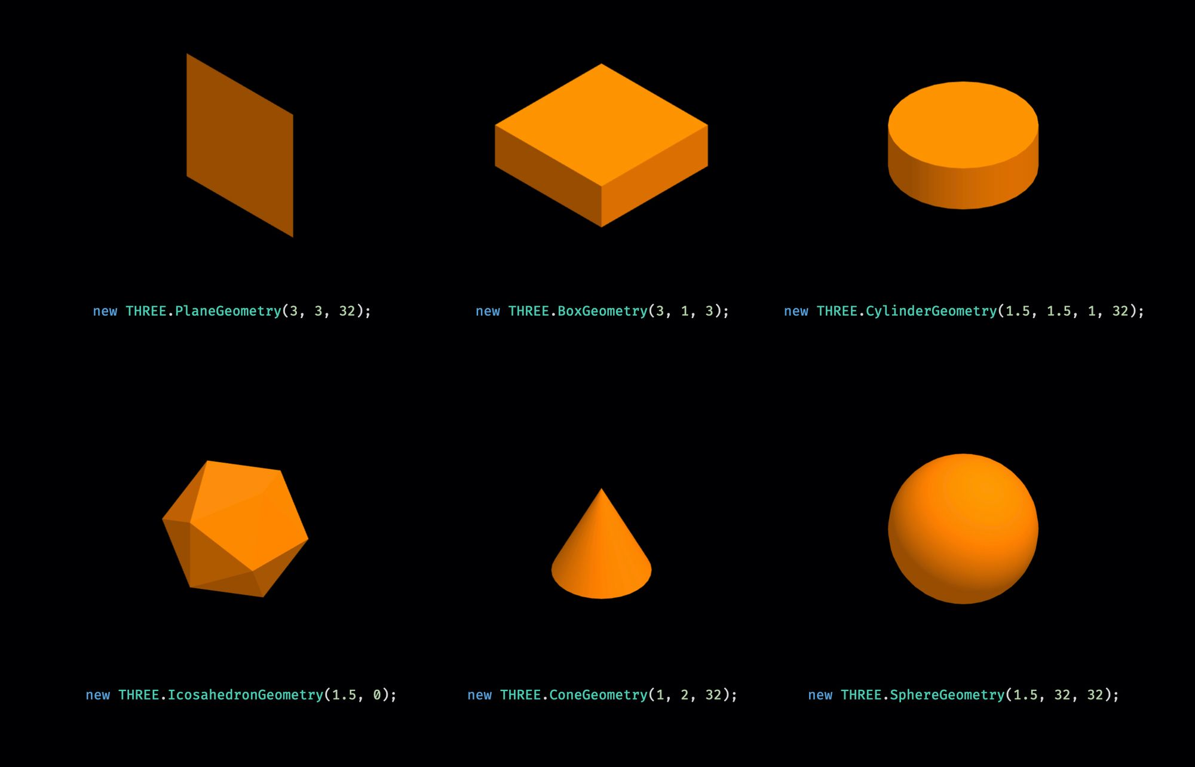

Slide 15
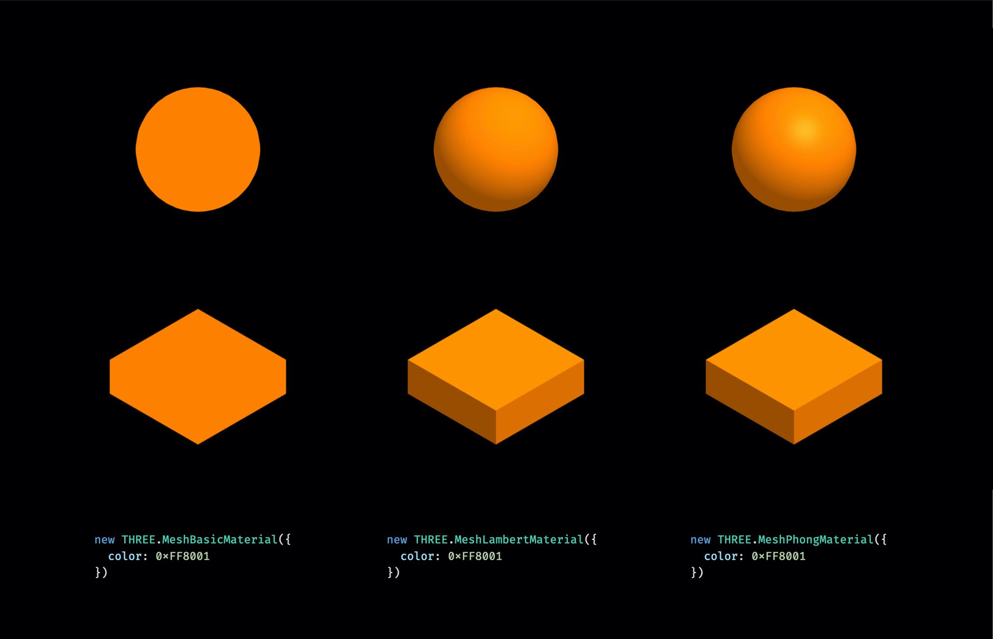
Basic Material
Lambert Material
Phong Material

Slide 16
A basic code for overview
import * as THREE from 'three'
// Create a scene
const scene = new THREE.Scene();
// Create a camera
const camera = new THREE.PerspectiveCamera(75, window.innerWidth / window.innerHeight, 0.1, 1000);
camera.position.z = 5;
// Create a renderer
const renderer = new THREE.WebGLRenderer();
renderer.setSize(window.innerWidth, window.innerHeight);
document.body.appendChild(renderer.domElement);

Slide 17
// Create a cube geometry
const geometry = new THREE.BoxGeometry();
// Create a material
const material = new THREE.MeshBasicMaterial({ color: 0x00ff00 });
// Create a mesh by combining the geometry and material
const cube = new THREE.Mesh(geometry, material);
// Add the mesh to the scene
scene.add(cube);

Slide 18
// Render the scene
const animate = function () {
requestAnimationFrame(animate);
// Rotate the cube for animation
cube.rotation.x += 0.01;
cube.rotation.y += 0.01;
renderer.render(scene, camera);
};
animate();

Slide 19
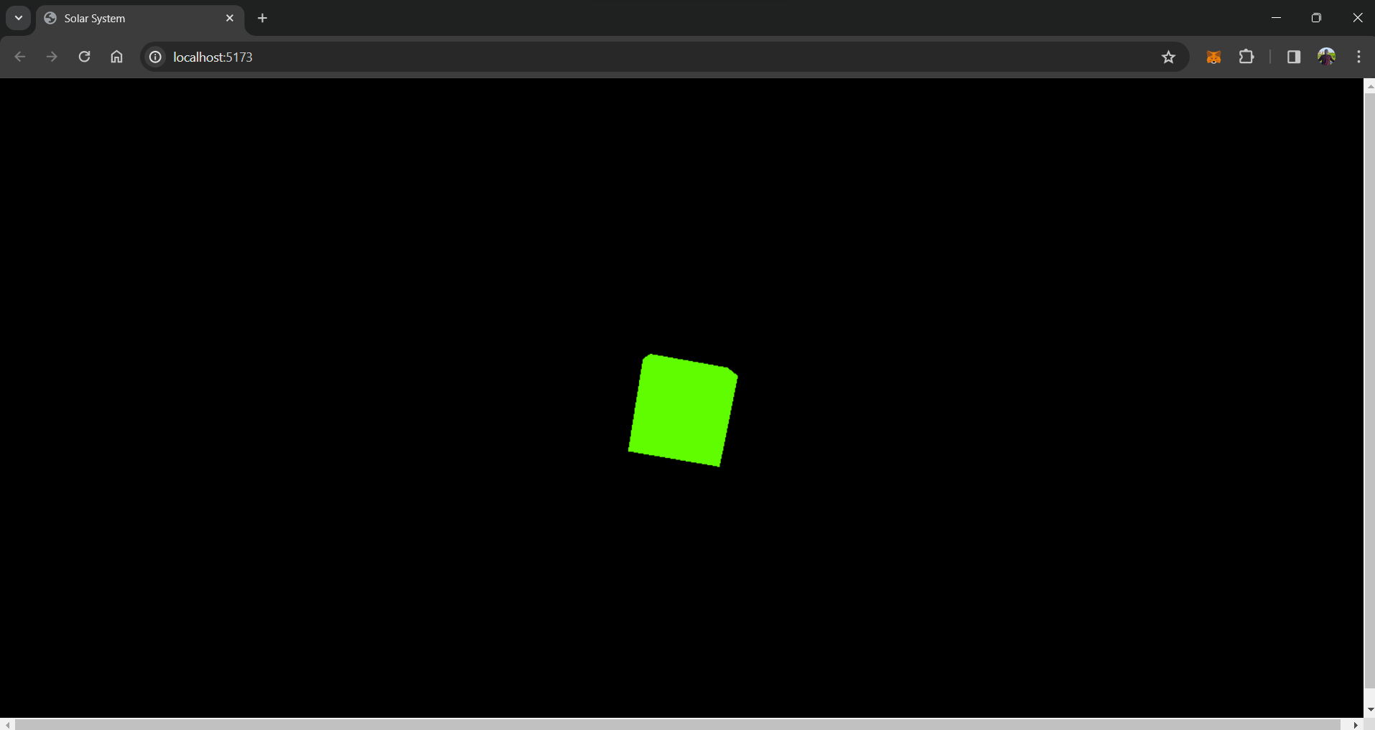

Slide 20



