Slide 1
ThermalScout-Net
Custom thermal detection research prototype
Gavin Anderson • AIAA • November 11, 2026
Notes:
Open with the research question. This is a custom CNN research prototype, not a validated flight safety system. The architecture remains unchanged at 88,503 parameters.

Slide 2
ThermalScout-Net
Research question
Can a compact custom CNN locate animals and people in aerial thermal images?
Custom model
88,503 trainable parameters
Single grayscale input
Two detection classes
Current status
GPU training works
Some animal matches
Human generalization remains unresolved
Measured development results from a 60-frame BAMBI pilot
Notes:
Explain object detection as predicting a location and a class. Thermal brightness alone does not identify humans. BIRDSAI was an earlier development dataset; the measured experiments in this talk use BAMBI only.

Slide 3
BAMBI pilot and split audit
Split | Flights | Frames | Animal / human
Training | 47 | 30 | 145 / 16
Validation | 6 and 22 | 30 | 70 / 16
247 labels checked against source annotations
No shared flights or exact duplicate images
Training animals: wild boar and dogs. Validation animals: red deer.
All three flights are in BAMBI’s published training partition. This is custom development validation.
Notes:
Source: https://github.com/bambi-eco/Dataset/blob/main/docs/annotation-format.md and local flight_metadata for 47, 6 and 22. Source MOT labels use thermal coordinates in the left 1024-pixel half. Each selected label matches the original annotation within rounding tolerance. Source video checks were sampled once per flight. Training has 141 wild boar, 4 dogs and 16 human boxes. Validation has 70 red deer and 16 human boxes. All frames contain annotations, so background-only flight performance is not established. Data have no shared flight IDs; distinct flight IDs alone do not establish full location independence.

Slide 4
Custom CNN architecture
Thermal input
512 × 512 grayscale
Pixels scaled to 0–1
Shallow features
1 → 16 → 24 channels
Stride 4 spatial detail
Deep features
24 → 40 → 56 channels
Stride 8 context
Feature fusion
Upsample deep features
80 → 48 → 48 channels
Detection head
128 × 128 grid
Seven values per cell
Scored boxes
Objectness × class score
Per-class box suppression
Notes:
The architecture has convolution, BatchNorm and ReLU blocks, shallow/deep fusion and a 1×1 head. Seven outputs: objectness, x/y offsets, log width/height, animal and human logits. Each center cell can represent one object. No cell collisions occurred in these pilot runs. All changes were to training options and diagnostics, not model structure.

Slide 5
What the diagnosis established
The original failure reproduced exactly
0.00% mAP@50, 229 animal false positives, zero human matches
40 boxes per image came from the output limit.
The CNN responds to different images
Training-only normalization calibration recovered 17 animal matches.
Target encoding and box decoding pass a round-trip test.
Training learns humans, but held-out flights still have zero human recall.
Notes:
Source: records/experiments/20261110_bambi_repair/diagnosis.json. Different-image mean absolute raw-output differences were 0.0191–0.0201. Repeated rounded maxima do not prove constant outputs. Train-only BatchNorm calibration changed animal TP from 0 to 17 but FP rose to 1,183. This isolates sensitivity to normalization statistics, not a complete fix. The synthetic encoder/decoder test reaches perfect AP at IoU 0.95 for both classes.

Slide 6
Controlled GPU experiments
Experiment | Best epoch | mAP@50 | Human recall
Original 2 epochs | 2 | 0.00% | 0 / 16
40-epoch control | 12 | 1.54% | 0 / 16
Hard negatives, 0.25 | 17 | 4.12% | 0 / 16
Hard negatives, 1.0 | 17 | 4.31% | 0 / 16
Same CNN, seed 42, 512-pixel inputs, batch 2, learning rate 0.001
Best epoch uses validation loss within each run. Single-seed development results.
At confidence 0.25, the 4.31% model still has 1,182 false positives.
Notes:
Source: control_evaluation.json, hardneg_evaluation.json and hardneg_bg1_evaluation.json in records/experiments/20261110_bambi_repair. AP uses 101-point interpolation and IoU 0.50; scores are on a 0–1 scale in JSON and multiplied by 100 here. Precision/recall counts use score 0.25 and IoU 0.50. All runs use 30 train / 30 val frames, seed 42, AdamW, learning rate 0.001, weight decay 0.0001, horizontal flips and RTX 4070. Hard negative mining takes top max(32,3×positive cells) negative losses. Hardneg-bg1 animal TP=18, FP=987; human TP=0, FP=195. Total FP=1,182. The training set human AP is 76.53% for this checkpoint but validation human AP is zero. No statistical significance or final test claim. Optional spatial peaks yield 4.51% mAP@50, excluded from the main comparison to preserve inference settings.

Slide 7
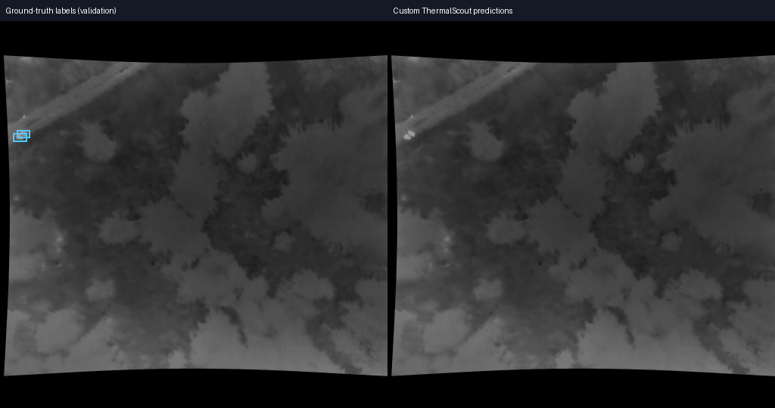
False alarms and missed humans remain
Flight 22, frame 2135: labeled humans, no predictions at confidence 0.50.
Notes:
Source image: BAMBI flight 22 frame 2135, labels from released annotations. This example deliberately shows a failure, not a successful detection. Left is ground truth, right is model output. At confidence 0.50 across the entire validation sample the hardneg-bg1 model has 5 animal TP, 17 animal FP and 16 human FP, with zero human TP. Raising confidence reduces alarms but also misses more animals. Do not present confidence as a calibrated probability. Source: comparison.json.

Slide 8
A reproducible research prototype
Next: more human examples across flights
Validate generalization before field use
Notes:
Close with the engineering outcome: verified data conversion, reproducible GPU experiments, preserved custom CNN, regression tests and documented limits. Next collect more diverse human and background frames using only training flights, reserve untouched flights for final testing, and compare a reference detector under the same split. The current model is unsuitable for autonomous safety decisions. Repository: https://github.com/Gavin-Anderson214/ThermalScout-Net

