Slide 1
Work report and program introduction
Li Jingyu 2021.4.30

Slide 2
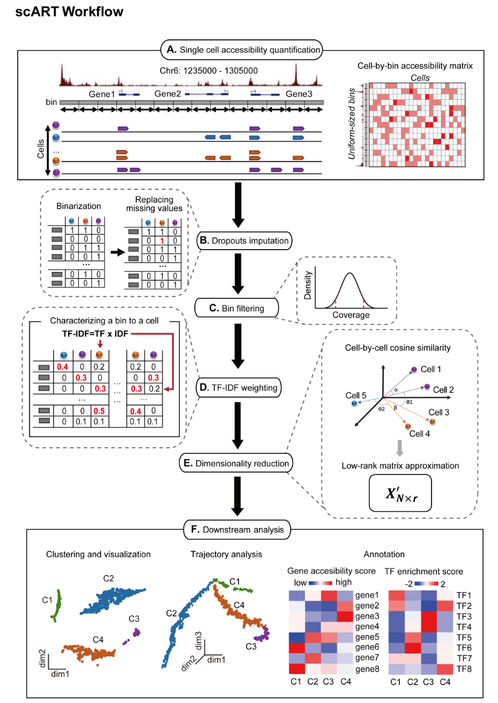
My past work
1. Wrote the imputation function
2. Took part in the building of scART Rpackage。
A pipeline for single-cell ATAC-seq

Slide 3
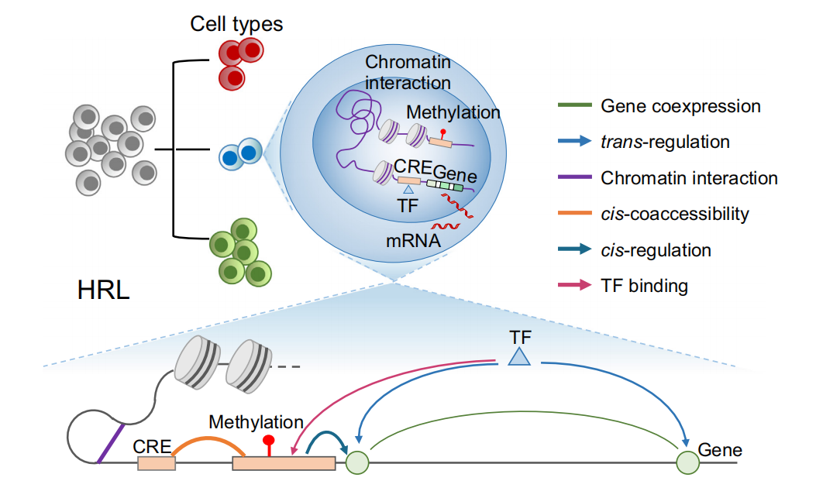
Background of project
Gene regulatory network
Yang Li et al 2020

Slide 4
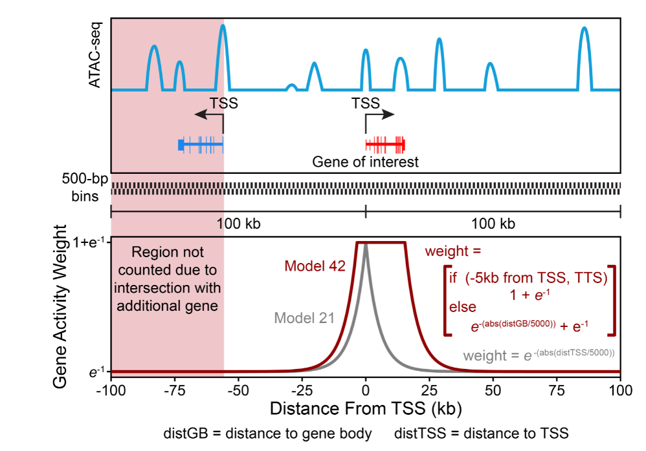
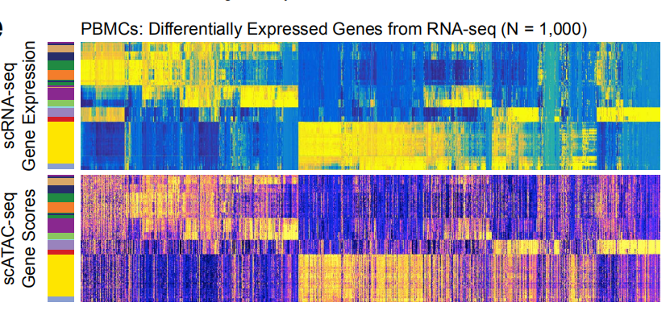
1. Build the gene regulatory network
Compute gene activity score
Jeffrey M. Granja et al 2020

Slide 5
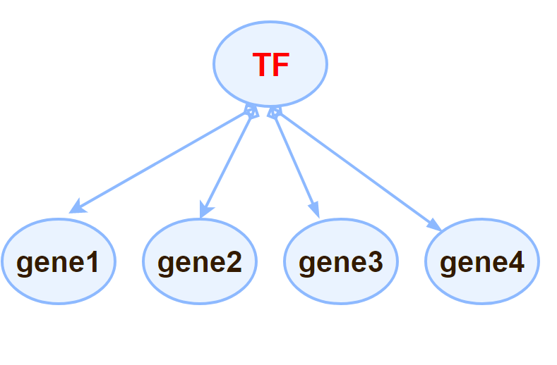
1. Build the gene regulatory network
Find the co-accessible genes of TF

Slide 6
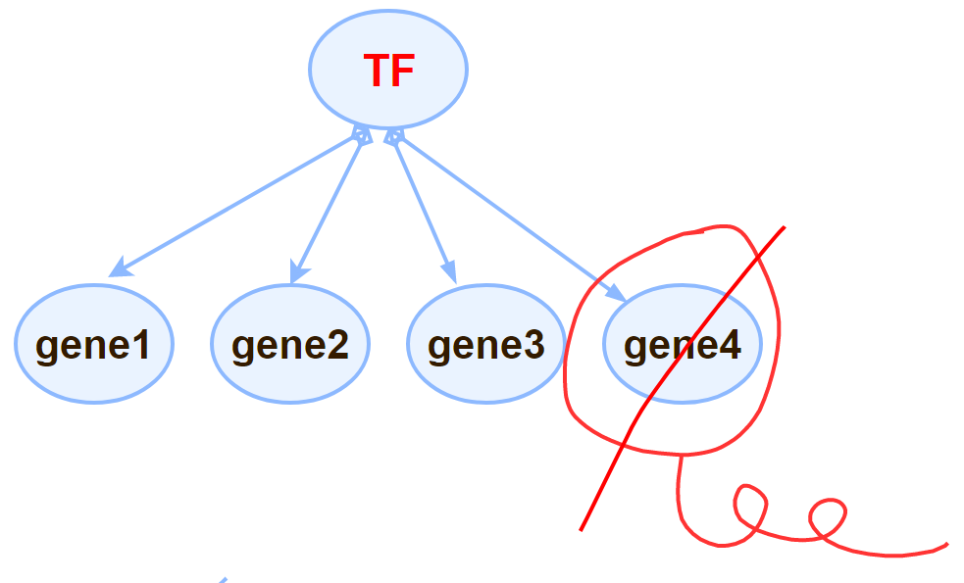
1. Build the gene regulatory network
Prune by motif enrichment

Slide 7
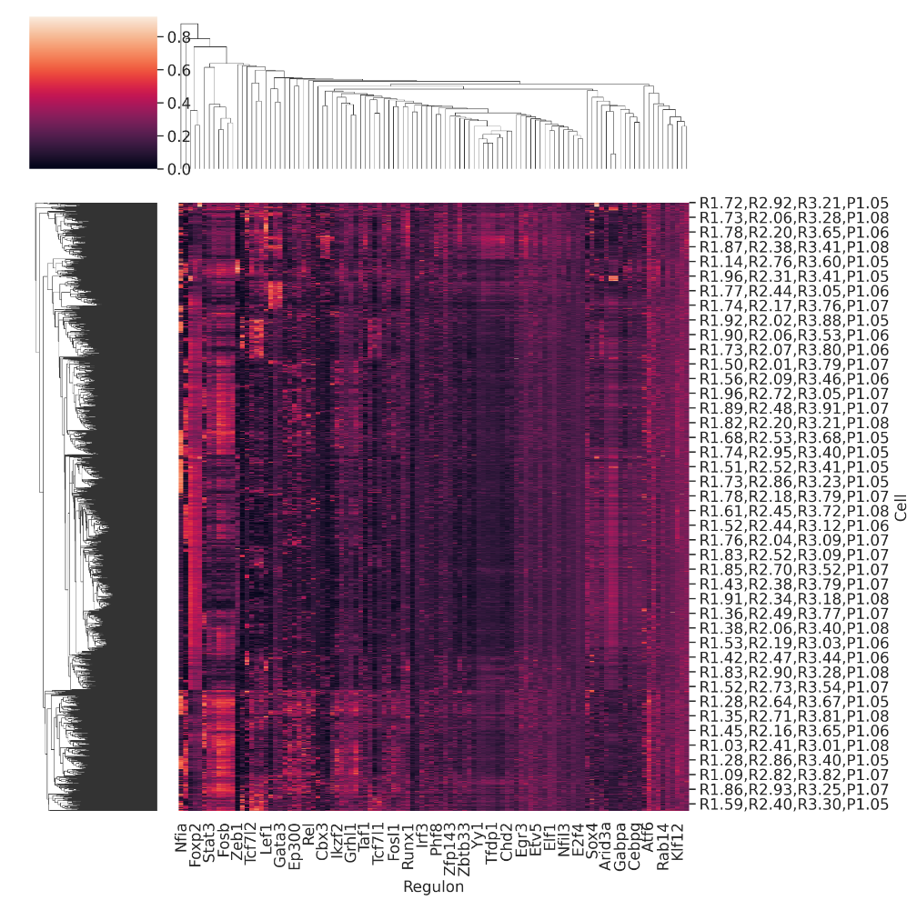
2. Compute the activity of these regulons
Build regulon activity matrix respectively

Slide 8
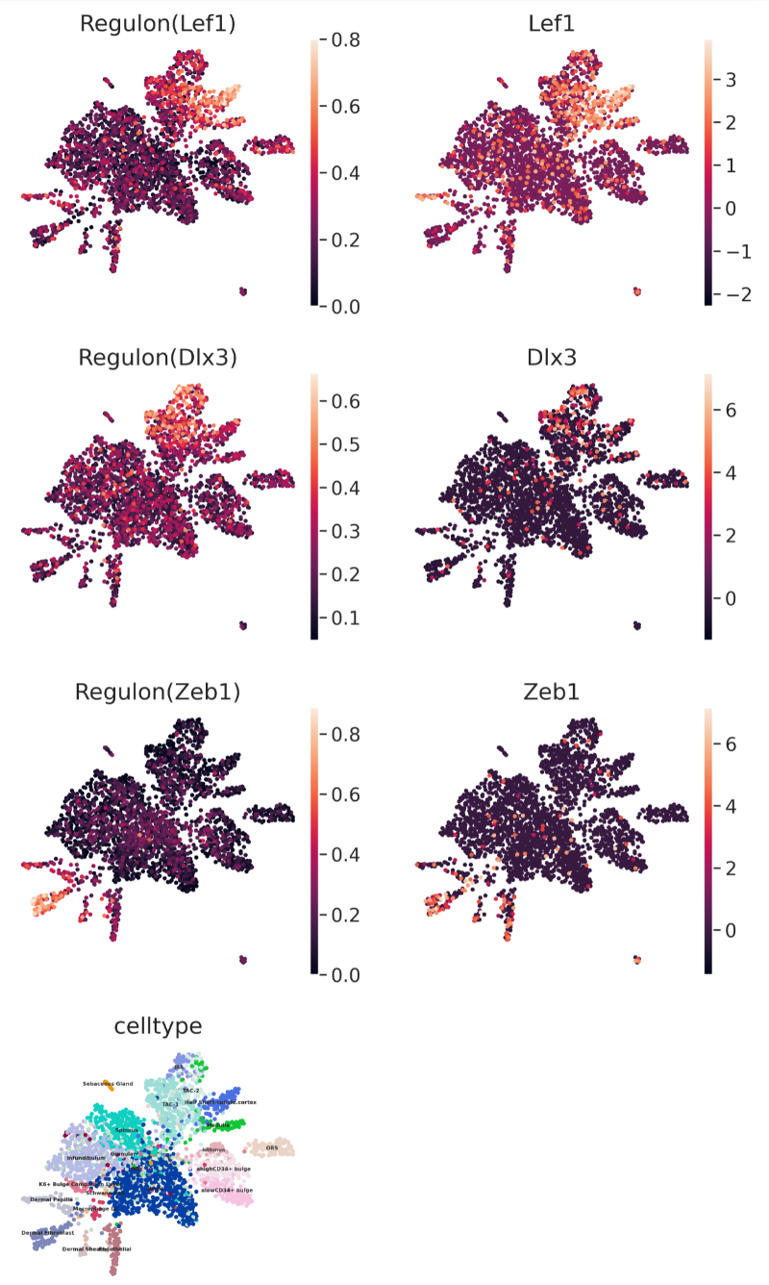
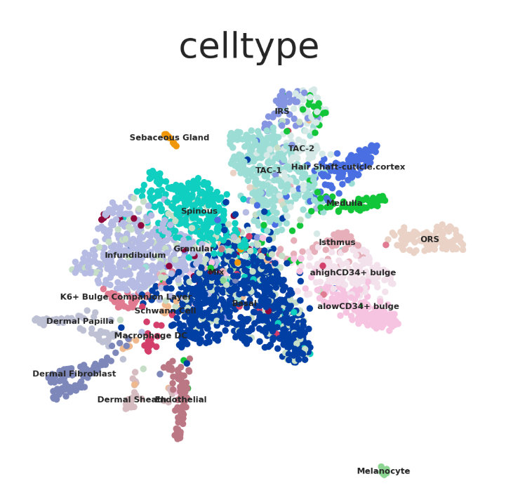
2. Compute the activity of these regulons
Downstream analysis

Slide 9
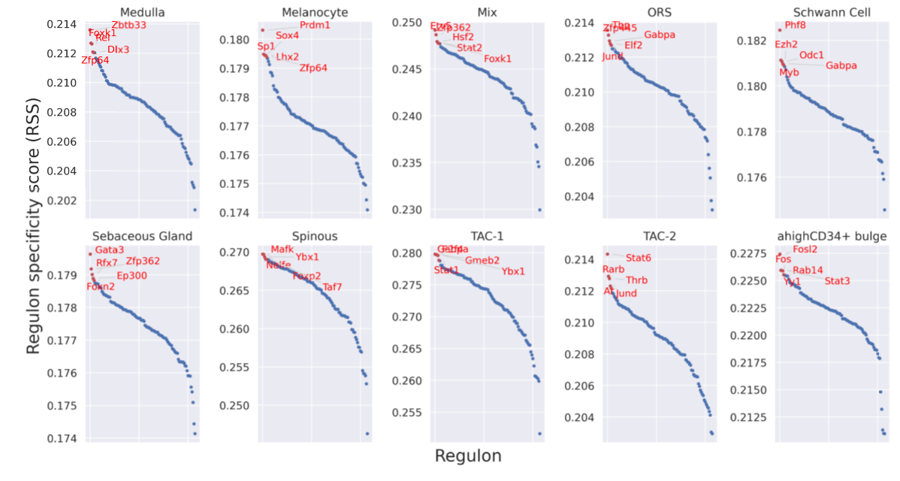
2. Compute the activity of these regulons
Downstream analysis

Slide 10
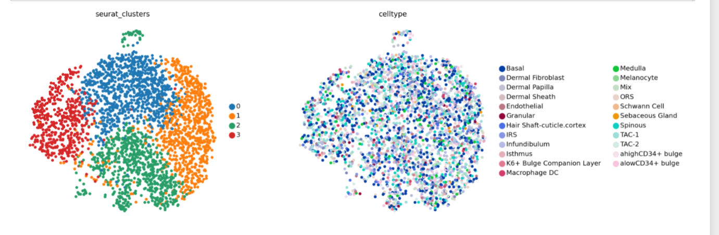
2. Compute the activity of these regulons
Downstream analysis

Slide 11
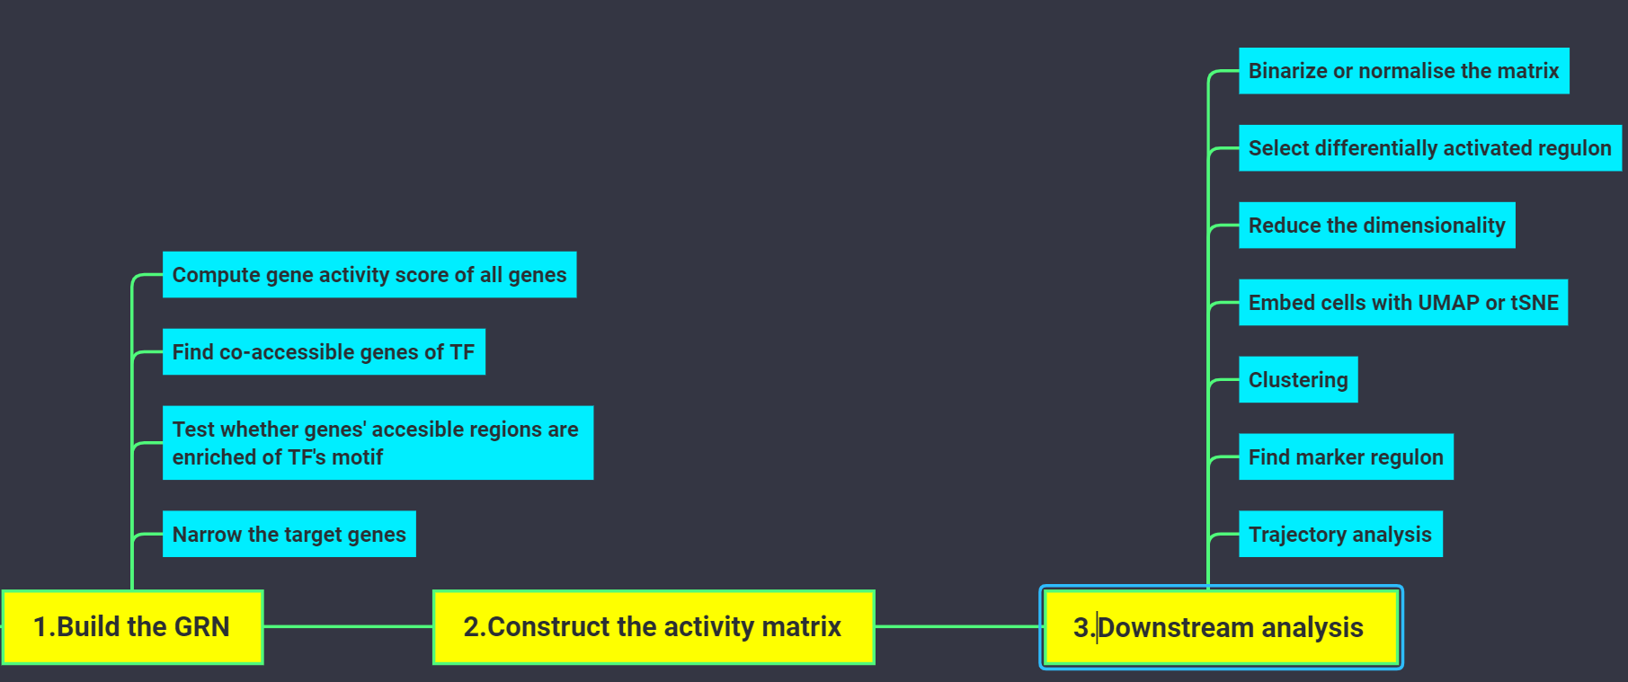
Workflow of my project

Slide 12
Plan of project
1. Chang datasets to test the performance.
2. Check the motif enrichment of TF on accessible peaks
3. Construct a package and write a tutorial

Slide 13
THANK YOU !
Li Jingyu 2021.4.30

