Slide 1


Slide 2
TIME IS THE NEW GREEN

Slide 3
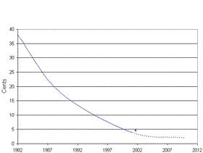
Cost is yesterday’s news.
Wind power costs, 1982-2012

Slide 4
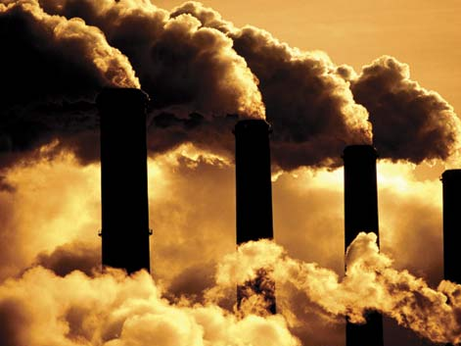
Question: Why do we even have climate change?

