Slide 1
INTDSCI Final Project · De La Salle Lipa · Section C2B
Will Seoul bikes be in High or Low demand this hour?
Classifying hourly bike-sharing demand from weather and calendar data
The Good The Bad The Lodor
Artvincent Abesamis · Ian Lodor · Kurt Tengonciang

Slide 2
The problem: High or Low demand?
Supervised binary classification: predict High (505+ rentals) or Low (under 505) for each hour
Inputs: weather, hour of day, season, holiday and service status
Why it matters: operators can send rebalancing vans before a rush leaves stations empty or full
8,760
hourly records, Dec 2017 to Nov 2018
505
rentals per hour: the median, our cutoff
50 / 50
4,380 Low and 4,380 High hours

Slide 3
The dataset: 8,760 hours, 14 columns
Time
Weather (8)
Calendar (3)
Date · Hour
Temperature · Humidity · Wind speed · Visibility · Dew point · Solar radiation · Rainfall · Snowfall
Seasons · Holiday · Functioning Day
Target source: Rented Bike Count (0 to 3,556 per hour) becomes the High/Low label.
Source: Sathishkumar & Cho (2020), Seoul Bike Sharing Demand, UCI Machine Learning Repository

Slide 4
Cleaning: before and after
Check | Before | After
Column names | Spaces, brackets and ° symbols | Clean snake_case names
Date column | Text (str) | datetime64
Missing values | 0 | 0 (nothing to fix)
Duplicate rows | 0 | 0 (nothing to drop)
Closed hours | 295 hours, all 0 rentals | Kept: closed means Low
Rows | 8,760 | 8,760 (none removed)

Slide 5
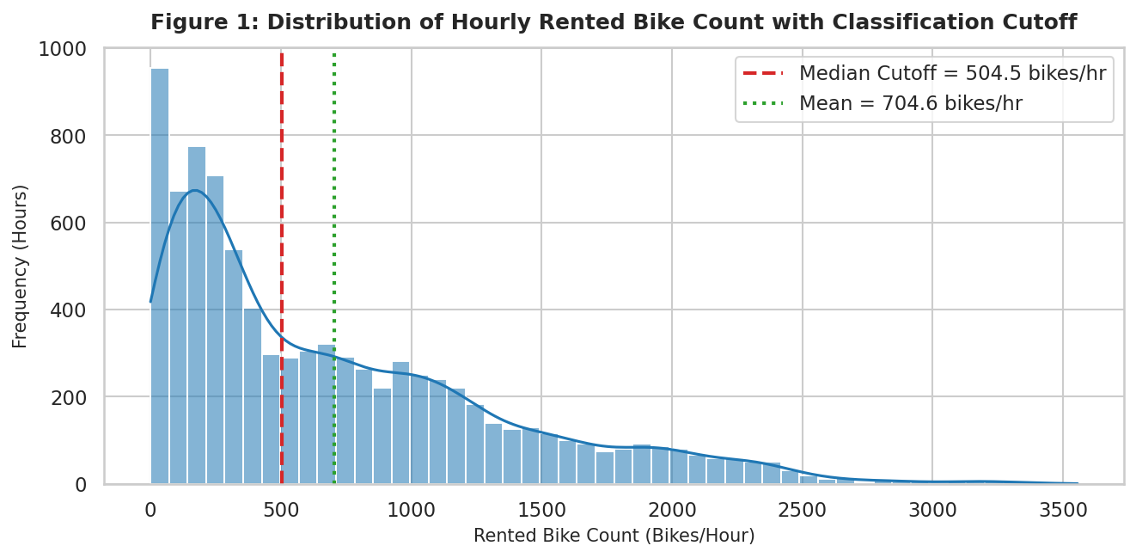
Finding 1: demand is skewed
505
rentals per hour: High vs. Low cutoff
Mean 704.6, median 504.5
Skewness 1.15, max 3,556
Median cutoff gives a perfect 50/50 split

Slide 6
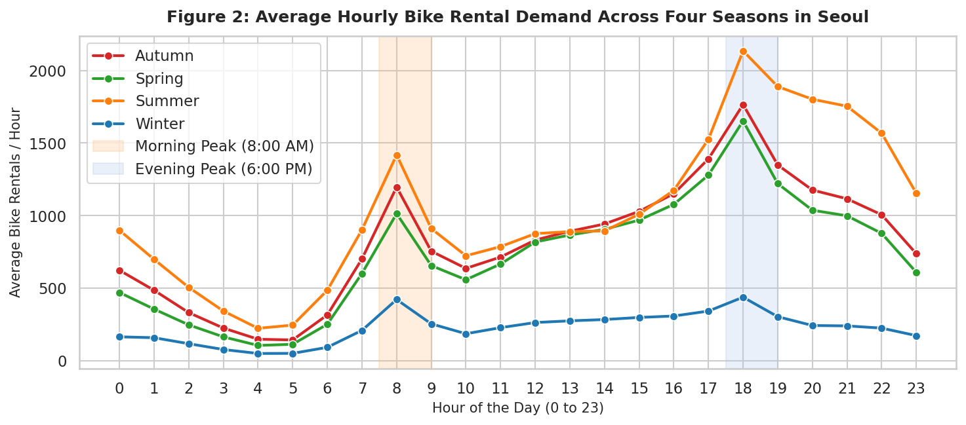
Finding 2: two commute peaks
2,135
average rentals at 6 PM in summer
8 AM: about 1,016 bikes on average
6 PM: about 1,503 on average
Winter never averages above 438 in any hour

Slide 7
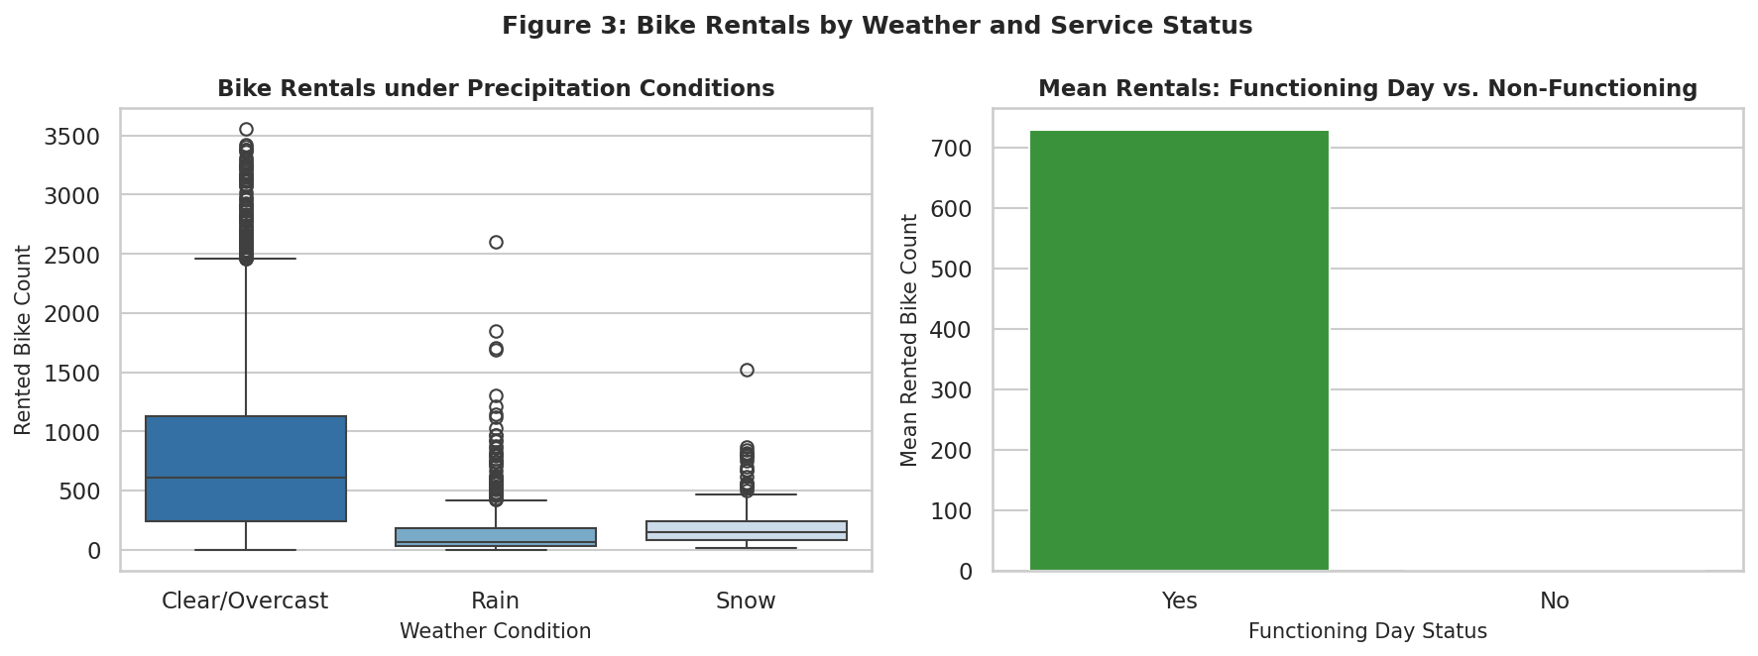
Finding 3: rain and closures
Median 606 clear, 151 snow, 67 rain · All 295 closed hours: 0 rentals
606 → 67 median, clear vs. rain

Slide 8
Features: what the model sees
1
Label
Demand_Class = 1 if rentals ≥ 505, else 0
14 → 16
2
Calendar
input features become numeric predictors
Month and DayOfWeek extracted from Date
No leakage
0
3
Rented Bike Count and Date dropped from X
leaks: scaler and encoder fit on train only
4
Scale and encode
StandardScaler on 11 numeric, one-hot on 3 categorical

Slide 9
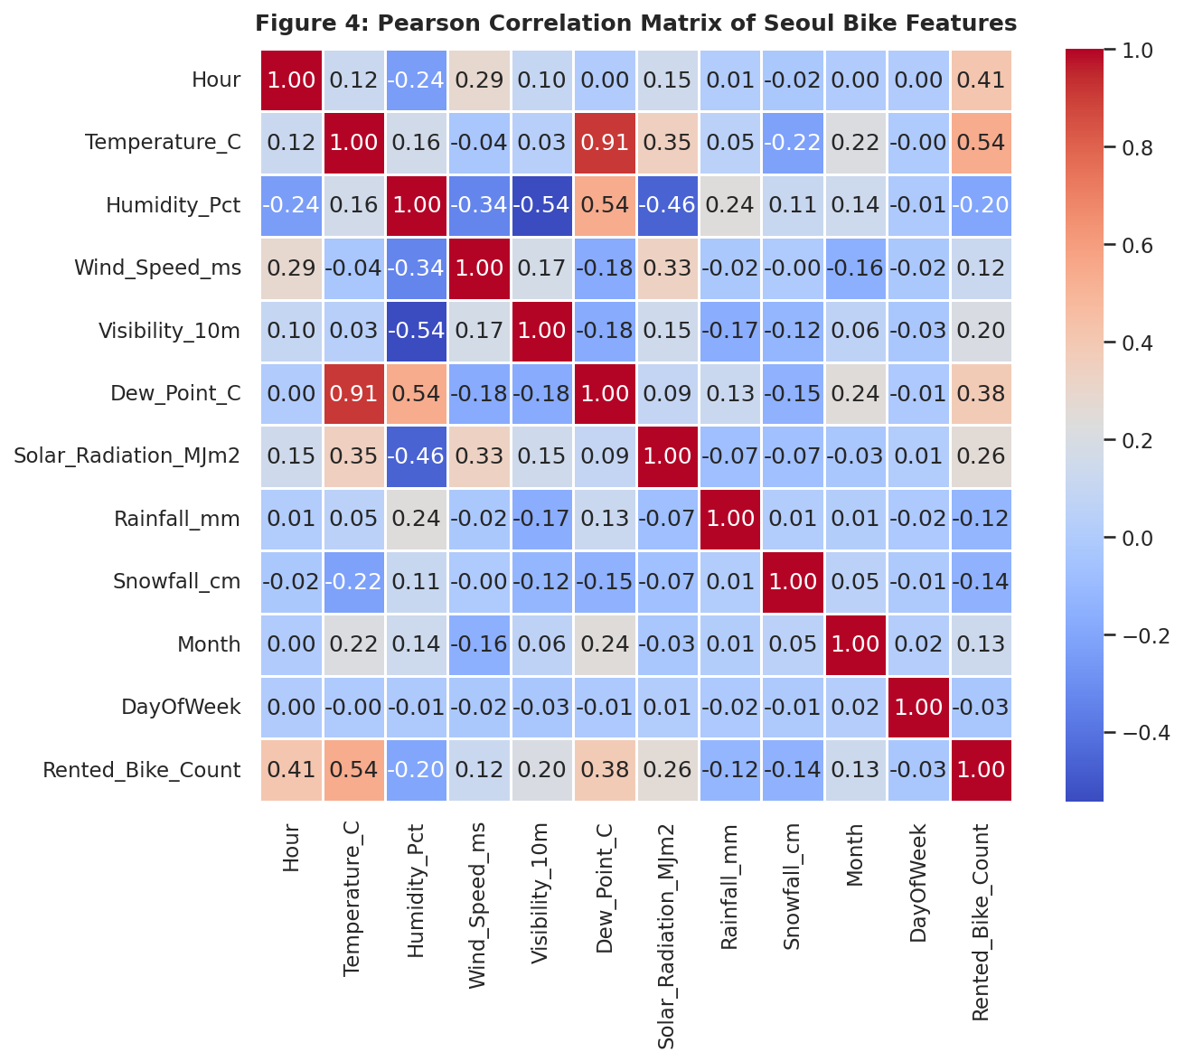
Correlation: temperature and hour lead
Temperature +0.54 and Hour +0.41 are the strongest
Humidity −0.20, snowfall −0.14 and rainfall −0.12 push demand down
Temperature and dew point: r = 0.913 (near duplicates)
Drop-dew-point check: 86.93% vs. 86.99%, one test hour apart

Slide 10
Split and models
7,008 / 1,752
Baseline
Always guesses the most common class
train / test hours (80/20, random_state=42)
Logistic Regression
Preprocessing is learned from the training hours only, then applied to the test hours.
Linear, interpretable benchmark
Random Forest
100 trees, max depth 16; handles non-linear effects

Slide 11
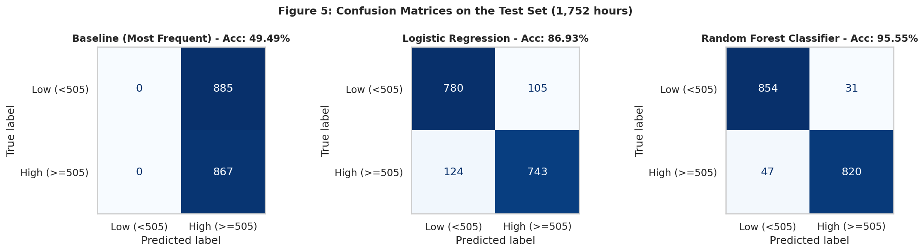
Random Forest wins: 95.6%
49.5%
86.9%
95.6%
Baseline · 885 errors
Logistic Regression · 229 errors
Random Forest · 78 errors

Slide 12
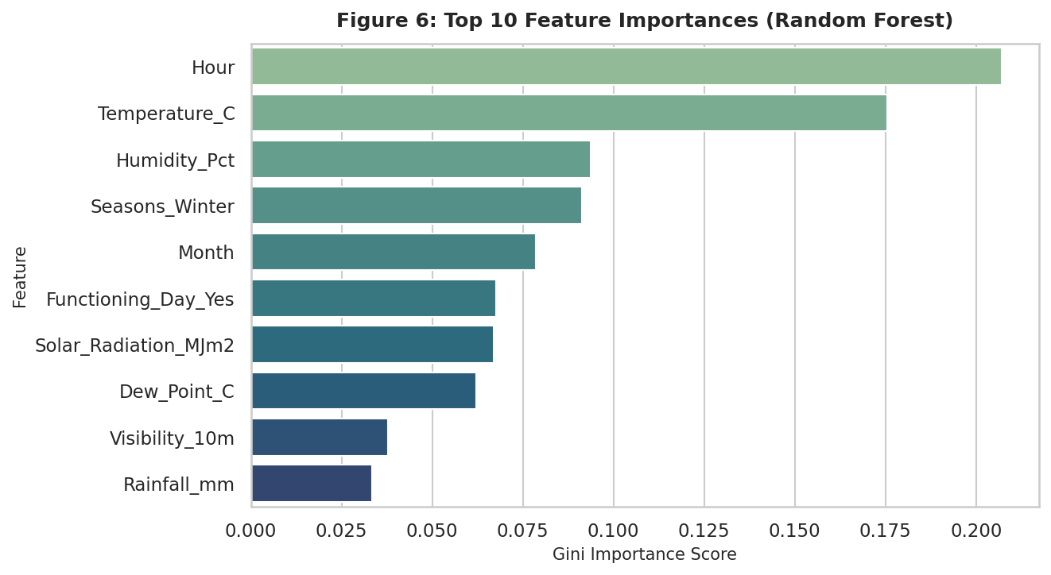
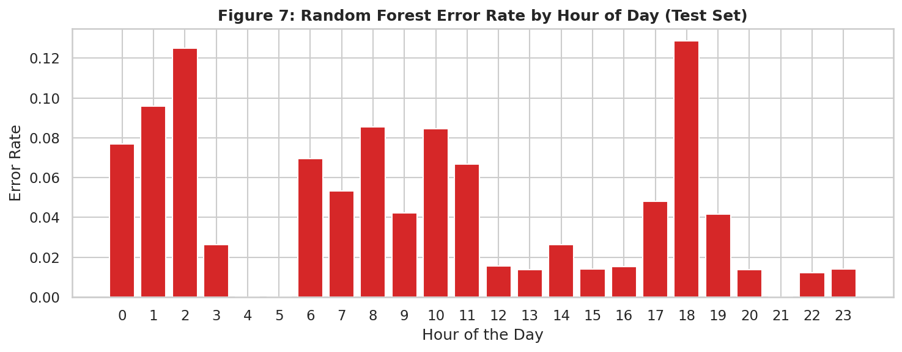
Where the Random Forest goes wrong
Top drivers: Hour (20.7%), Temperature (17.6%), Humidity (9.4%)
54 of 78 errors are within 150 rentals of the cutoff
Error rate is 3.5% to 5.1% in every season

Slide 13
Limits and takeaways
Limits
Takeaways
Past-to-future split: Random Forest drops to 85.1% (Logistic 86.1%)
System-wide totals only, no station detail
2017 to 2018 data, one city
Hour, temperature and weather predict demand well
Random Forest beats Logistic Regression by 8.6 points
Remaining errors sit near the 505 cutoff

