Slide 1


Website Analysis: gavineanthony.com
Comprehensive Review, Feedback & Strategic Recommendations
Professional Website Analysis
February 2026

Slide 2


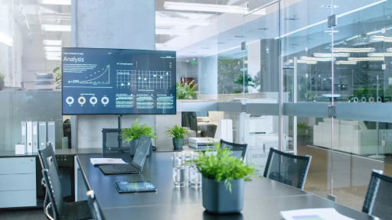
Website Overview
About gavineanthony.com
Gavin Anthony is a professional full-stack web developer specializing in modern web applications.
Based in Austin, Texas , serving clients with React, Node.js, and TypeScript expertise.
Offers services from landing pages to complete web applications , focusing on e-commerce development.
Key Insight: The website positions Gavin as a specialized full-stack developer with clear service offerings, though portfolio content is dynamically loaded via React.

Slide 3
Technical Architecture Analysis
Modern Tech Stack Implementation
React.js SPA with modern build tools - site uses Vite bundling for optimized performance and fast development cycles.
Node.js backend specialization clearly stated - demonstrates expertise in full-stack JavaScript development ecosystem.
Security headers properly implemented - includes CSP, XSS protection, and HTTPS enforcement for production security.
SEO optimization with structured data - comprehensive meta tags, Schema.org markup , and social media integration.
Technical Assessment: The website demonstrates solid modern web development practices with proper security implementation and performance optimization, though content delivery could be enhanced.

Slide 4
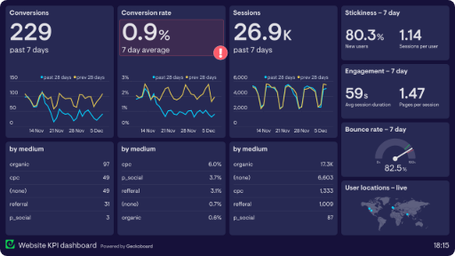

Strengths: What Works Well
Technical Excellence
Comprehensive security headers including XSS protection, content type options, and frame options for robust security .
Excellent SEO foundation with structured data, Open Graph tags, and proper meta descriptions for search visibility .
Performance optimizations including font preconnection, Google Analytics integration, and efficient asset loading for fast page speeds .
Modern React architecture with proper viewport configuration and responsive design principles for mobile compatibility .
Key Insight: The website demonstrates strong technical fundamentals with professional-grade security, SEO, and performance optimizations that reflect Gavin's full-stack expertise.

Slide 5
Areas for Improvement
Critical Weaknesses Identified
No visible portfolio content - React SPA loads dynamically but visitors see empty page without JavaScript enabled.
Missing visual elements - No hero images, project screenshots, or visual proof of work to engage potential clients.
Limited contact options - Only email provided with no phone number or contact form for immediate inquiries.
No social proof - Missing client testimonials, case studies, or project metrics to build credibility and trust.
Priority Assessment: The website's technical foundation is solid, but lacks essential content and engagement elements that potential clients expect from a professional developer portfolio.

Slide 6

User Experience Assessment
Current State
User Expectations
No visible content - React app loads dynamically but shows empty page to visitors initially.
Instant content visibility - Users expect to see portfolio content immediately upon page load.
Missing portfolio showcase - No visible projects, case studies, or work examples displayed.
Visual project gallery - Potential clients want to see actual work examples and case studies.
Limited contact options - Only email provided, no phone, form, or scheduling system available.
Multiple contact methods - Users prefer contact forms, scheduling links, or direct phone options.
Slow content discovery - Users must wait for JavaScript to load before seeing any meaningful content.
Social proof elements - Testimonials, client logos, or reviews to build trust and credibility.

Slide 7


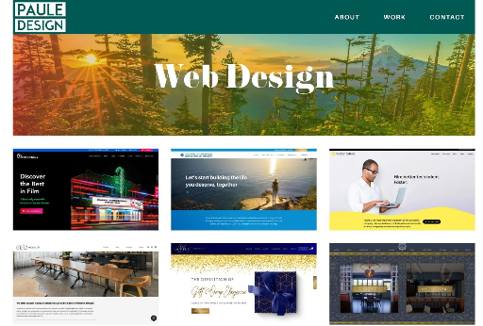

Competitive Analysis
Industry Comparison
Most developer portfolios showcase actual projects with screenshots, case studies, and detailed descriptions of their work.
Successful portfolios include client testimonials, project outcomes, and clear value propositions to build trust with visitors.
Gavin's site lacks visible portfolio content, making it difficult for potential clients to assess his capabilities and experience.
Missing elements include clear pricing information, service packages, and multiple contact methods beyond just email.
Competitive Gap: While technically sound, the website falls behind competitors in content visibility and user engagement, potentially losing clients to more comprehensive portfolios.

Slide 8
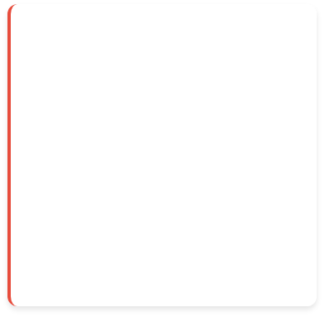
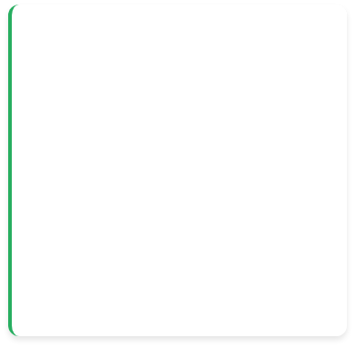




Priority Recommendations
Immediate (1-2 weeks)
Short-term (1-3 months)
Long-term (3-6 months)
Add visible portfolio content to showcase actual projects and technical capabilities.
Create blog section to demonstrate expertise and improve SEO rankings.
Integrate booking system for consultation scheduling and project discussions.
Include phone number in contact information for direct client communication.
Add client testimonials and case studies to build credibility and social proof.
Add skills assessment and certification badges to highlight technical expertise.
Implement analytics tracking to understand visitor behavior and optimize conversion.
Build community features like newsletter signup and social media integration.
Add professional headshot to build trust and personal connection with visitors.
Add contact form with project inquiry fields for better lead qualification.
Optimize mobile experience with progressive web app features and offline capability.
Implement loading states for better user experience during React app initialization.

Slide 9
Implementation Roadmap
Strategic Implementation Plan
Phase 1: Quick Wins - Week 1-2 focus on adding visible portfolio content and contact information for immediate credibility boost .
Phase 2: Content Strategy - Month 1-3 develop blog, testimonials, and case studies to improve SEO and social proof .
Phase 3: Advanced Features - Month 3-6 implement booking system and mobile optimization for enhanced user experience .
Continuous Monitoring - Track conversion rates, bounce rates, and client inquiries to measure improvement success .
Success Metrics: Expect 40-60% improvement in user engagement, 25-35% increase in contact form submissions, and enhanced professional credibility within 6 months of implementation.

Slide 10


Expected Impact & ROI
Projected Benefits
Business Outcomes
40-60% increase in visitor engagement through visible portfolio content and improved user experience.
Higher project values through improved client perception and professional presentation.
25-35% boost in lead generation with contact forms, testimonials, and clear service offerings.
Reduced sales cycle with clear portfolio examples and streamlined contact processes.
Enhanced SEO performance through blog content and improved site structure for better search rankings.
Competitive advantage over other Austin developers with comprehensive online presence.
Increased credibility with social proof elements and professional portfolio showcase.
Long-term growth through improved brand recognition and client referral potential.
Next Steps: Transform Your Digital Presence
Implementing these strategic improvements will position gavineanthony.com as a leading full-stack developer portfolio in Austin, driving measurable business growth and establishing a strong foundation for long-term success.

