Slide 1
Generative Models with an Application for Professional Tennis Data
Dr Gavin Dowdell

Slide 2
Why Machine Learning is great area
Always new things to learn
Always new areas of application
I was asked to talk about a technical area of interest so I thought this area may interest the group.
Outline
Quickly describe the Language Modelling problem via Generative Models
Show an application from a personal project of mine. Personal projects are great opportunities to learn and good fun
Maybe it will generate some ideas for your own projects!!

Slide 3
What are generative models
Generative Models are models that generate synthetic probable realisations
The models to do so are still essentially Machine Learning models except the target variable is interpreted as a parameter of a probability distribution and can therefore be sampled for realisations.
For discrete distributions such as language commonly p(t;θ) = Cat(θ)
E[θ]= f(x;ω) via a particular ML model and then sample from p()
Good to remember we are sampling from probability distributions even though the applications are incredibly good and look like magic!
The challenging part isn’t really to generate the realisation, as much fun as it is, but to find a good use case for doing so.

Slide 4
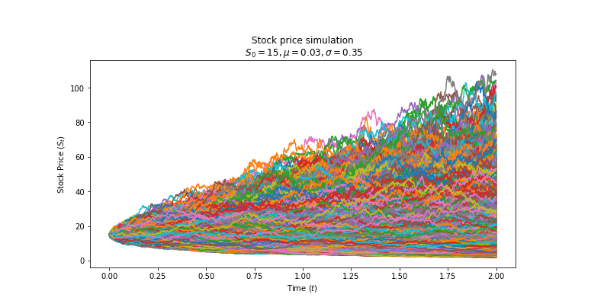
Generative Models are not new!!
Many years ago I was employed to price Energy options which involved generating many synthetic price distributions – over a continuous distribution.
Pricing Options. Price approx = the discounted expected payoff for strike K.
Asymmetric Payoff
Max(S_{t} – K,0)
Need to generate a large number of possible price paths
Strike = 14

Slide 5
Generative Models are not new but things are more difficult with discrete sequential data
For large discrete distributions such as Natural Text, where the distribution is now categorical over the size of the token Vocab (1000’s), then this becomes more difficult.
As if things weren’t hard enough, if the data is sequential such that values are dependent upon the previous values, hence non IID or autoregressive, then this becomes much, much more difficult unless you make assumptions such as
p(y_{n}|y_{n-1}) = p(y_{n}|y_{n-1},y_{n-2} … y₁) = p(y_{n}|y_{n-1},y_{n-2} ) - trigrams -> limited context
Language is not IID – a word distribution is based upon the previous words
“Someone making others do Maths on a Friday afternoon is ????”
The sampling distribution for ???? Is dependent on the whole sentence/prompt

Slide 6
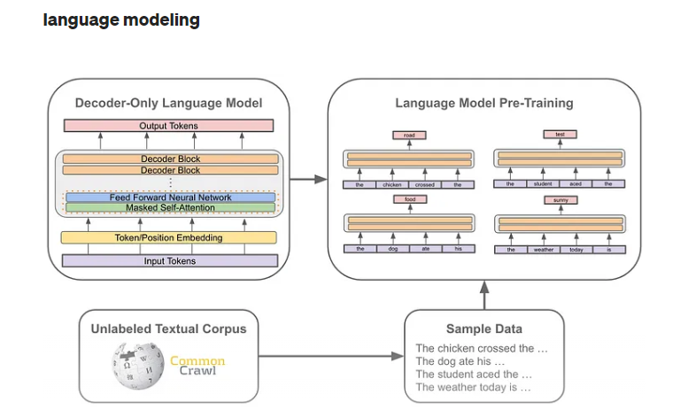
Everyone is familiar now with the success around language models
Language tends to have long-term dependencies as words really only have their meaning derived from a longer context
A few pretraining options but a self- supervised Language Model (aka predict the next word model) is a popular pretraining architecture. Don’t have to worry about collecting targets for a self-supervised model – game changer.
Generative Pretrained Models (including the GPT family), which implement Language Models, have been particularly successful because of their architecture and the vast quantity of data they were trained on.
Emergent ->Works better than expected!!

Slide 7
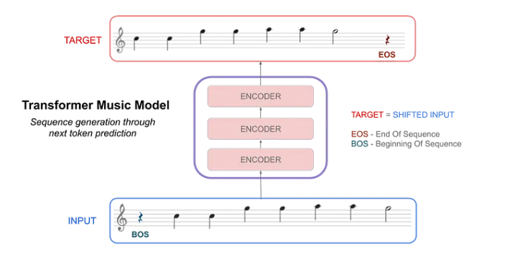
However what about autoregressive sequential data that has some similarities with language?
Music notation is an example that is structured like language
The current note is not independent of the previous notes
I am not musical but I like sports so I was interested in understanding it’s sequential structure
Hence many NLP techniques and architectures can be applied, although not usually pretrained models which are specific to language

Slide 8
Shots within a tennis point as like words in a sentence
Professional Tennis players are like chess players – setting up strategies many shots ahead.
Unlike us their play is not random – Rafa Nadal a great example.
Play Video
It ties into a core concept in Machine Learning – observable vs latent. What we see during a sporting event looks quite unstructured however it is more likely to be a noisy representation of some much simpler latent behaviour.
Can we discover that latent behaviour with a language model?

Slide 9
What are we actually trying to achieve here?
Generate new points data with and without prompts. This is the impressive part – think of ChatGPT. Prompting is the upside of this sequential sturcture
To extract point embeddings – like document embeddings so we can cluster and extract similar points by semantic search. It may ultimately help us uncover latent strategies
The Generation part is what is getting all of the attention now, particularly with the emergent capabilities of these Super Large Language Models – simply doing things no one really expected.
However long term the ability of these models to uncover latent structure via the embeddings may prove just as useful.

Slide 10
Going to need Data and lots of it!!
Unfortunately the Hawkeye Data is not publicly available - yet
However an amazing project at github.com/JeffSackman runs a match charting project
Each point is coded as a sequence of shots
- shot type,direction,<depth>,<outcome>
- 1 f/h side, 2 middle, 3 b/h side
- f1 -> forehand hit to forehand side
- b3* -> backhand cross court winner
A point is a series of shots, with a beginning (serves a?? and an ending ??*/@/#
a214,b28,f1*
a116,b29,f1,f1,b2,b2n@
The important point is that there is some sequential structure over a series of shots

Slide 11
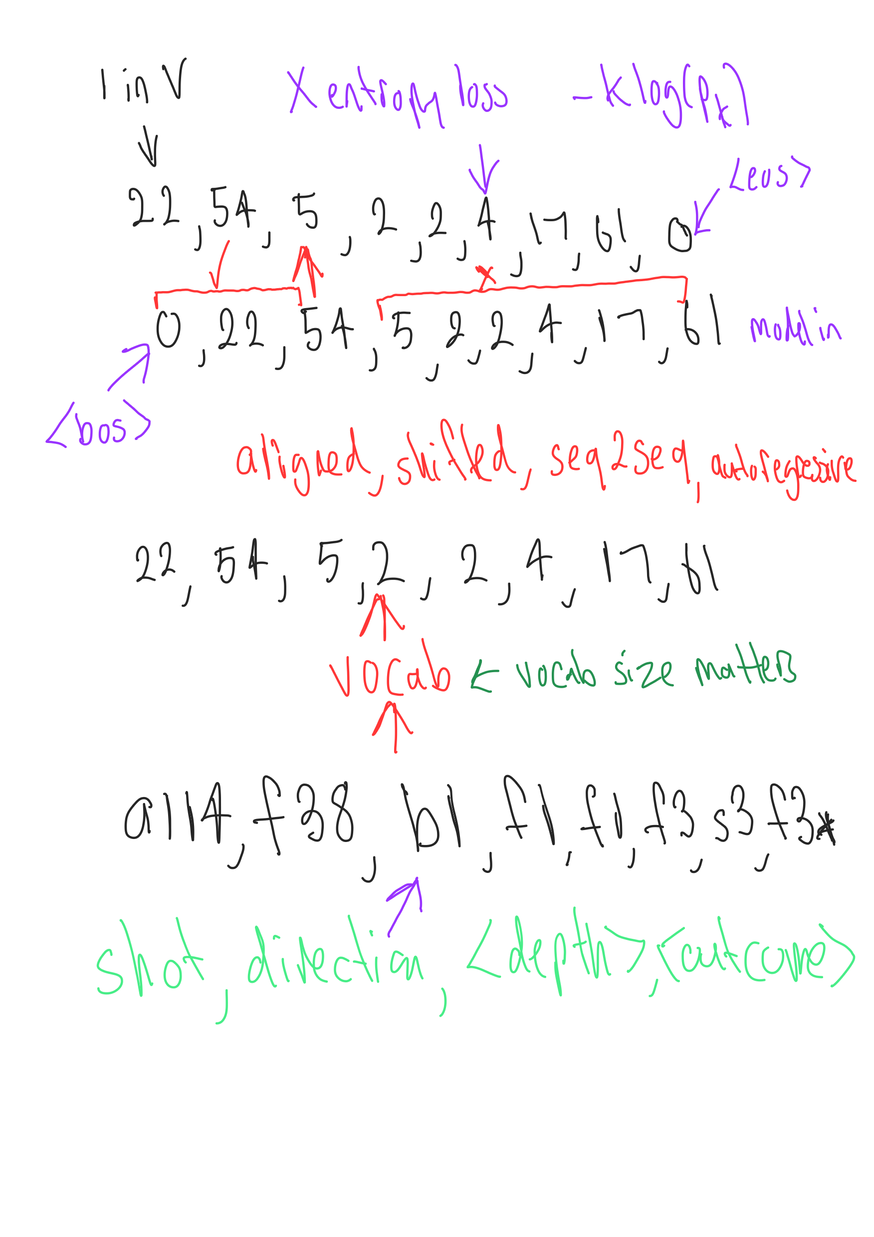
How is the data prepared??
1. Assume the data vocab has been extracted from the dataset. In this case 257 discrete values in the Vocab
2. Use the Vocab to numericalise the data and add <bos> and <eos> tokens to understand start and finish
3. The key is how to prepare the training dataset
Could build the training dataset this way
0 🡪 22
0,22 🡪 54
0,22,54 🡪 5
4. But seq2seq model is more efficient. During training use autoregressive teacher forcing which means that the correct answer is fed back in even if it is not the predicted value. During inference feed the predicted value in as the next value.
Target seq
Input seq

Slide 12
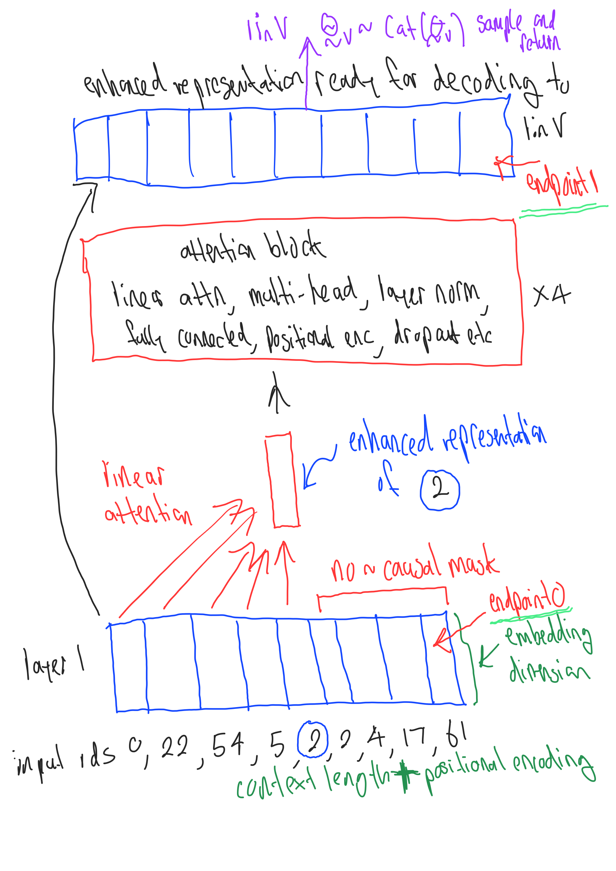
The transformer architecture - briefly
Transformers within the recent language models so quite famous now.
“Attention is all you need” – Vaswani et. al. adapted to language models
A single block does a few things but well known for self attention which produces layers of contextualised representations by attending to different parts of the input with the target in mind.
Parallel computation and long-range dependencies subject to context length
The goal is simple to produce better representations to predict the target.
1. Better prediction = better generative model or
2. maybe we just want the representation?

Slide 13
Lets see how it works
All code is in Python/Pytorch but there are many ways to do it – Keras, Tensorflow, Hugginface, FASTAI, OPENAI etc depending upon whether you want to work with low level code or a higher level API. The code is adapted from nanoGPT https://github.com/karpathy/nanoGPT
What can go wrong with a real time demo ha?
Run demo

Slide 14
In Conclusion
Hopefully this example demonstrates how to apply the learning from Generative Language Models to other areas that have sequential discrete data. Of course it is still mostly used for NLP.
Other examples include
Medical Codes. Medical patients/injured workers tend to receive a time indexed set of medical treatments identified by discrete treatment codes which form a language like sequence – embeddings and semantic search could be useful to identify effective treatment patterns?
Biology – a lot of biological structures are discrete and sequential. Some people think it will revolutionise the area.
Anything you can think of, if you have a good idea give it a try!!

