Slide 1
Led 1 2 3 | reset
Battery
方案一：如下图(IC或者模块)
方案二：使用充放电一体现成模块
方案三：ZS6300/IP5108(充放电一体IC)
方案四： ZS6300/IP5108+同步整流升压
方案五：IP5306+DC同步升压[或只有IP5306]
方案六：IP5306(用来充电和检测电量) +DC同步升压
实验5V时电流分别多少，总量多少
SIM
DC 5-16
IPX
Gateway
192.168.8.1
WAN/LAN
LAN
TTL
led
Battery
2000mha
DC 5
SW
Eth
micro usb
DC-DC升压
Linux ip
192.168.8.8
WAN/LAN
ch340e
Charge
LED指示
低电量
LED
Uart 0

Slide 2
12.65mm
2mm
M3标准
内：3mm
外：5.5mm
3mm M3: 6mm
M2标准
4.35mm
H
内：2mm
外：4mm
3.1mm
M3: 4.7mm
铜柱M2-H *4
M2螺帽 *4 内2mm 外3.91mm 高1.48
M3螺帽 *4 内3mm 外5.41mm 高2.3
M2螺丝 *4 d=2 L=6 头部K=1.5 DK=3.7
M3螺丝 *4 d=3 L=6 头部K=1.6 DK=5.1
PCB板厚 1.6mm
Mm mil 在线转换 http://www.ab126.com/abc/4029.html
电池小于 30*38mm 50*58mm

Slide 3
Battery
≈2
7
11
28
8

Slide 4
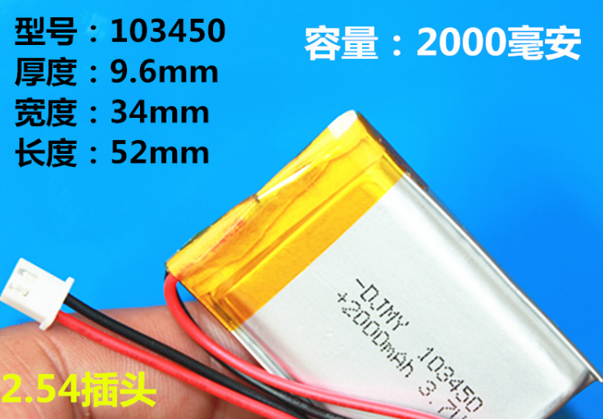

Slide 5
Ethernet
58.1
Led 1 2 3 | reset | SIM
40
USB | LED | SW
42
40

Slide 6
6mm battery
4mm
7mm
17.6
13
1.6mm
7.4mm
1mm
1.6mm
2
42
50
17
NET LED
Micro SIM
Switch
LED
USB
ETH
60.5

Slide 7
RJ 45
MEM
ARM
Core 4
4G 信号灯-H
4G 信号灯-L
-+
Micro USB
WIFI STATUS
MTK
WIFI
SYSTEM LED
Switch
WIFI 天线2
WIFI 天线1

Slide 8
RJ 45
Reset KEY
Micro SIM
4G ANT 1
4G ANT 2

Slide 9
109
单位：mm
13.6
RJ 45
32.8
40
60
椭圆孔和圆孔为板子固定孔：均使用直径为2mm的螺丝

Slide 10
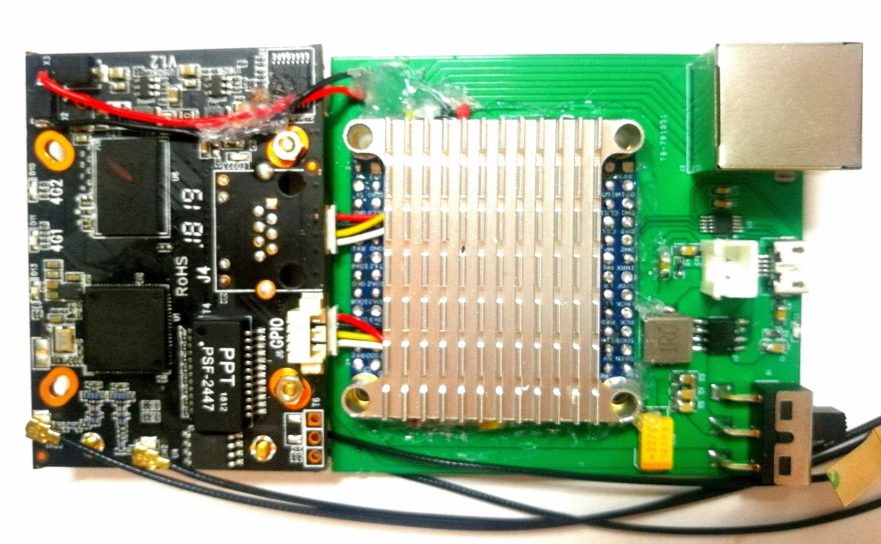

Slide 11
Version 4 – S1
SIM
card
rest
4G Model
Battery
MT7688 Model
1Gb/64Mb
key
RJ45
led
USB

Slide 12
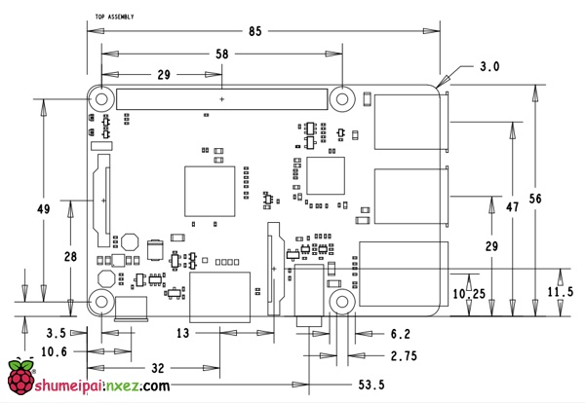
Version 4 – S2
56*33.3
4G Model
Battery
49.4*60.5
bit3
33*17.78
bit5
35*22

Slide 13
Version 4 – S3
基于 WIDORA_bit3
SD
Card
4G PCI-E Model
MT7688/7628 Model
1Gb/64Mb
SIM Card
rest
key
RJ45
BAT WiFi Sign NET
RJ45
USB

