Slide 1
VibeScent
VibeScent
Multimodal Fragrance Recommender via Zero-Shot Vision
and Semantic Context Retrieval
Project Manager: Gavin Gong | Team: Darren Nguyen, Harsh Agarwal, Karan Singh, Neil Bhattacharyya
BAC – MACHINE LEARNING - SPRING 2026

Slide 2
VibeScent
System Architecture
01
02
03
04
05
06
DATA PREP
INPUT LAYER
IMAGE + TEXT PROCESSESING
VIBE VECTOR EXTRACTION
RECOMMEND
WEB SCRAPE
Collecting + Processing Data
Image + Text Input
Vision + Sentence Transformers
5-Dimensonal Classification
Partition + Compare
SerpAPI + Google Shop
TECH STACK
llama-3.1-8b-instant
all-MiniLM-L6-v2
clip-vit-large-patch14
KMeans Clustering
Cosine Similarity
SerpAPI · requests

Slide 3
VibeScent
Stage 01 — Data Prep
LLM VIBE EXTRACTION
llama-3.1-8b-instant
SOURCE DATASETS
01
02
03
Parfumo
Text Embedding
KMeans Cluster
LLM Vibe Tag
TidyTuesday
all-MiniLM-L6-v2
scikit-learn KMeans
Groq · llama-3.1-8b-instant
Fragrantica Clean
Kaggle / olgagmiufana1
Rawanalqarni
› Combines fragrance notes + accords
› Reduces 36,000 rows → 500 clusters
› Vibe extracted from centroid
Kaggle
› Embeds each fragrance scent profile
› Cluster assigned to every fragrance
› Attach vibe to fragrances in cluster
rdemarqui
Kaggle
› Same model as inference pipeline
› 5 new vibe columns appended
› Centroid is the most representative
Ayush
Kaggle
~36,000
384-d
500
36K
FRAGRANCES
EMBEDDING DIM
CLUSTERS
ROWS LABELLED
OUTPUT SCHEMA — vibescent_enriched.csv
Formality
Season
Gender
Time_of_Day
Frequency
0.3 · 0.5 · 0.8
Spring · Summer · Autumn · Winter
Male · Female · Unisex
Day · Night
Often · Occasionally · Rarely

Slide 4
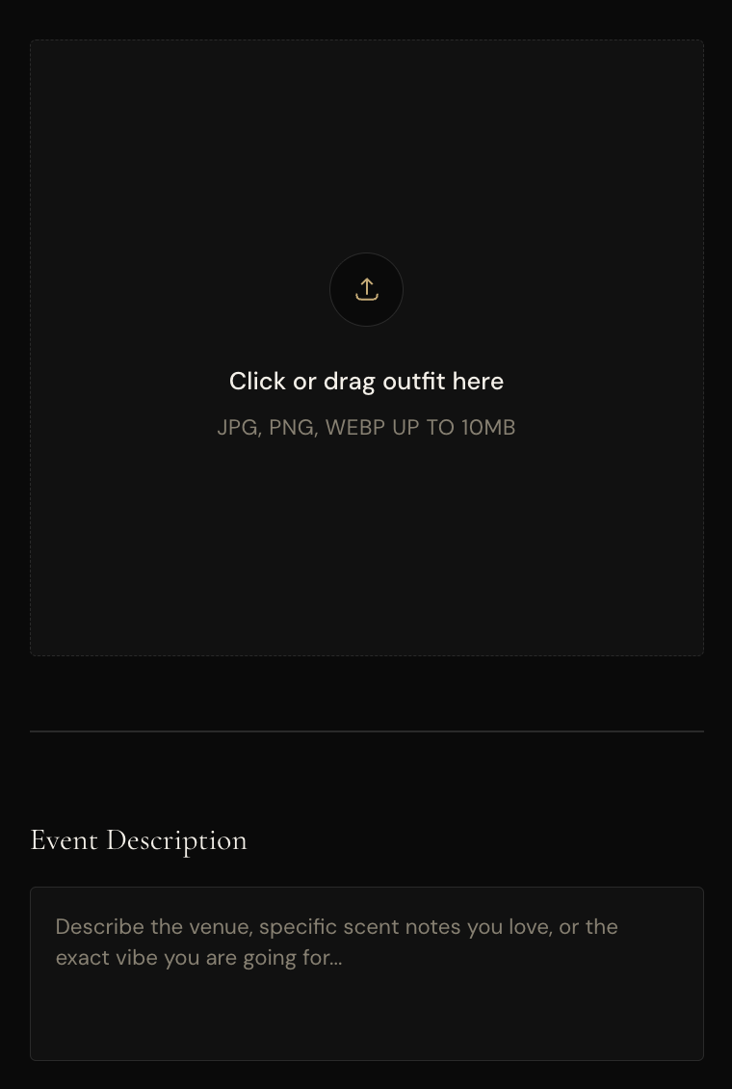
VibeScent
Stage 02 — Input Layer
MULTI-MODAL
MODALITY 01
Outfit Image
› Input: The user uploads an outfit they plan to wear
› Goal: Identify the outfit and fragrances that match
› Pipeline: Feeds into a vision transformer as raw pixel tensor
MODALITY 02
Occasion Description
› Input: The user describes the occasion they are dressing for
› Goal: Understand the occasion and choose fragrances that are appropriate
› Pipeline: Feeds into a sentence transformer as a string

Slide 5
VibeScent
Stage 03 — Image + Text Processing
CONTEXT
openai/clip-vit-large-patch14
all-MiniLM-L6-v2
VISION TRANSFORMER
SENTENCE TRANSFORMER
CLIP ViT-L / 14
all-MiniLM-L6-v2
Vision Backbone:
Vision Transformer (ViT-L/14)
Model:
all-MiniLM-L6-v2
Patch Size:
14 × 14 pixels
Architecture:
BERT-based (6-layer MiniLM)
Image Resolution:
224 × 224 (CLIPProcessor)
Output Dim:
384-d dense vector
Embedding Dim:
768-d L2-normalized vector
Max Tokens:
256 (WordPiece tokenizer)
Text Encoder:
Transformer (77 token context)
Pooling:
Mean pooling over embeddings
Contrastive Loss:
Softmax cross-entropy (ITAL)
Training Obj.:
Multiple Negatives Ranking Loss
Inference Mode:
@torch.no_grad() · .eval()
Warm Boot:
Loaded once at server startup
Device Target:
MPS → CUDA → CPU (auto)
Encoding Scope:
User description
Models loaded once at FastAPI startup to eliminate cold-start latency on user query

Slide 6
VibeScent
Stage 04 — Vibe Vector Extraction
5-DIM VIBE VECTOR
FORMALITY
SEASON
GENDER
Formality
Season
Gender
Classes:
casual · smart casual · formal
Classes:
spring · summer · fall · winter
Classes:
male · female · neutral
Output:
0.8 (float)
Output:
"Winter"
Output:
"Male"
TIME OF DAY
FREQUENCY
OUTPUT DICT
Time of Day
Frequency
'Formality': 0.8
'Season': 'Winter'
Classes:
day · night
Classes:
occasional · everyday
'Gender': 'Male'
Output:
"Day"
Output:
"Often"
'Time_of_Day': 'Day'
'Frequency': 'Often'
'Description': <user_text>

Slide 7
VibeScent
Stage 05 — Recommend
HYBRID RETRIEVAL
FILTER
COMPARE
Partitioning
Query vs. Dataset
› Non-Description keys extracted from vibe dict as categorical filters
Query Embedding
Embed the user’s context input → shape (1, 384)
› Each column compared with regex word-boundary pattern: \b{value}\b
Dataset Embedding
› Formality treated as float with ±0.15 tolerance window
Embed the notes for each fragrance → shape (N, 384)
› pandas boolean mask applied iteratively to reduce df
Similarity Matrix
› Empty result-set triggers graceful 'No fragrances found' error
cosine_similarity(user_emb, db_embs) → shape (1, N)
› Reduces search space from O(N) to O(k) before expensive embedding
Flatten + Rank
.flatten() → argsort desc → head(3)
Score Assignment
Return the top three fragrances and their similarity scores

Slide 8
VibeScent
Stage 06 — Web Scrape
SERPAPI SCRAPER
01
02
03
Google Shopping Query
Priority Store Ranking
Result Sanitization
› Engine: google_shopping via SerpAPI
› Sephora → Nordstrom → Macy's
› None guard → fallback dict injected
› Query: '{name} perfume fragrance'
› Bloomingdale's → Neiman Marcus
› Price regex: r'[\d,]+\.?\d*'
› Num results: 20 per fragrance
› Ulta → Generic stores (fallback)
› Float casting with ValueError guard
› Budget cap applied post-fetch
› _store_priority() rank function
› Thumbnail URL passed to frontend
› timeout=15s · raise_for_status()
› sort() on (priority, price) tuple
› purchaseUrl field for deep-link CTA

Slide 9
VibeScent
Output — Descriptive Recommendations
TOP-3 RESULTS
SELECTION NO. 01
Pineapple
Bergamot
Birch
Musk
94%
Aventus
"A daytime winter aesthetic — birch smoke projects success."
Creed
$320.00
Sephora · WITHIN BUDGET
SELECTION NO. 02
Oud
Sandalwood
Rosewood
Amber
87%
Oud Wood
"Formal evening silhouette — resinous warmth for smart casual."
Tom Ford
$195.00
Nordstrom · WITHIN BUDGET
SELECTION NO. 03
Jasmine
Saffron
Amberwood
Fir
81%
Baccarat Rouge 540
"Luminous crystalline amber — commands every room."
Maison F. Kurkdjian
$340.00
Bloomingdale's · WITHIN BUDGET

Slide 10
VibeScent
Summary & Future Directions
WHAT WE BUILT
FUTURE DIRECTIONS
Pipeline Summary
Model Evolution
✓ LLM enriched dataset of 36,000 fragrances across 500 clusters
Dataset
Filter fragrance database for popular fragrances
✓ Zero-shot CLIP classifier with prompt-engineered vibe embeddings
Enrichment
Use a smarter model or enrich fragrance data individually
✓ Sentence Transformer for semantic description matching
CLIP
Fine-tune CLIP on outfit data and associated vibes
✓ 5-dimensional structured vibe vector constructed from user input
MiniLM
Fine-tune sentence transformer on fragrance language
✓ Efficient rank and recommendation system using cosine similarity
Vibe
Increase vibe dimensions to represent fragrances better
✓ Real-time price discovery via SerpAPI Google Shopping engine
Recommend
Upgrade other pieces to increase model accuracy
✓ Top 3 matching fragrances to match the user’s outfit and occasion
Webscrape
Only recommend and search for popular fragrances
Dress for the occasion. Scent it perfectly.

