Slide 1
Predicting Sports Injury Occurrence Using Machine Learning Methods and Feature Analysis
Tyler Caplinger, Daniel Hanson, Gavin Jones
Capstone in Business Analytics
April 21, 2025

Slide 2
Problem Statement and Motivation
Problem Statement :
Use Machine Learning to predict athlete injuries based on physiological, biomechanical, and training data
Motivation :
Help to keep athletes on the field at all levels so players, coaches, and fans can all continue to thrive

Slide 3
Data Overview
15,420 Athlete Observations
Target = Injury Occurred (0=No; 1=Yes)
No Injury ~ 85%; Injury ~15%
Training Load -
  Training Load, Duration, Intensity, Fatigue Index, Step Count
Physiological -
  Heart Rate, Body Temp, Hydration, BMI, Muscle Activity
Performance -
  Gait Speed, Cadence, Ground Reaction Force, Joint Angles, Jump Height, Range of Motion
Environment -
  Ambient Temp, Humidity, Altitude, Playing Surface, Sport Type
Recovery and Wellness -
  Sleep Quality, Stress Levels, Age

Slide 4
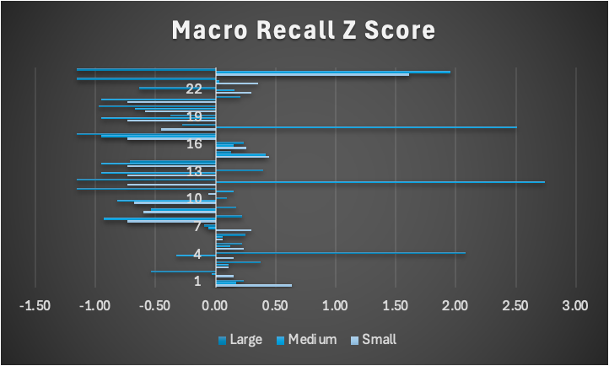
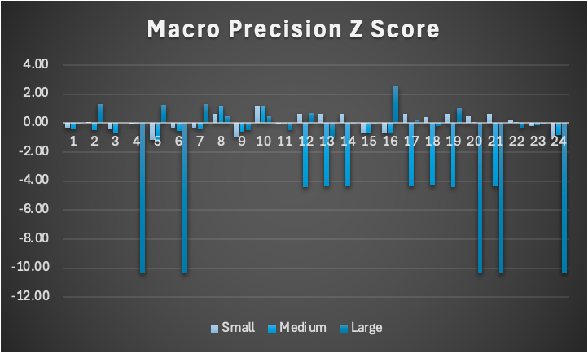
Feature Selection
Small (10)
Fatigue Index
Training Load
Training Intensity
Heart Rate
Sleep Quality
Ground Reaction Force
Joint Angles
Ambient Temperature
Humidity
Age
Medium (18)
All of Small +
Hydration Level
Stress Level
BMI
Gait Speed
Cadence
Range of Motion
Training Duration
Playing Surface
Large (25)
All of Medium +
Body Temperature
Step Count
Jump Height
Altitude
Gender
Sport Type
Best Performance : Medium Feature Set

Slide 5
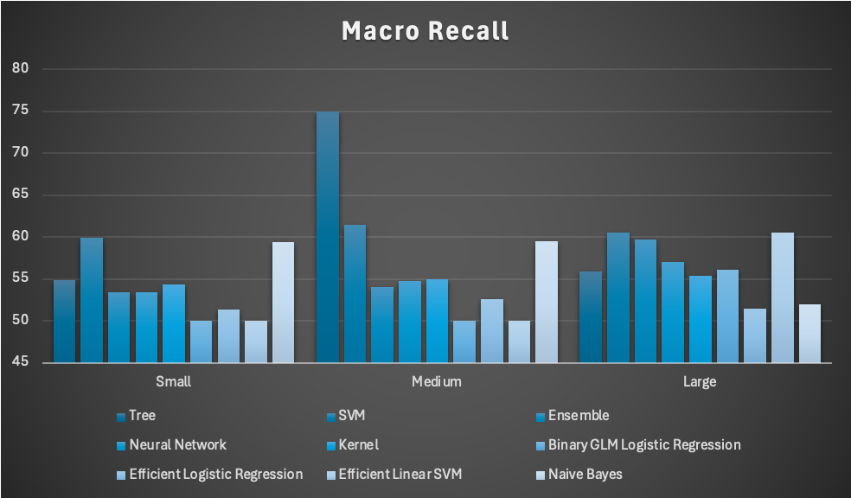
Methodology
Ranking Criteria for ML Methods
Macro Recall
Error Rate
Accuracy
Macro Precision
Macro Recall and Macro Precision Z-Score
Higher Z Score shows better than average
SVM :
Low Accuracy Range (69-86%)
High Error Rate (14-28%)
High Recall (50-72%)
Long training Times
Avg Z score - 13.6
Decision Trees :
Accuracy range (76-85)
Error Rate (15%)
Recall (50-62%)
Varying Time
Naive Bayes :
High Accuracy (85-86%)
Error Rates (14%)
Recall (50-59%)
Medium Training Time
Neural Networks :
Accuracy (85%)
Error Rate (15%)
Recall (51-63%)
Fast Training Time

Slide 6
Model Rankings
Naive Bayes : best with Small and Medium, adding features increased noise
Neural Networks : large data decreased accuracy and macro while increasing error
Tree : all similar, just large training time variance
SVM : large features increased error
Overall :
More features did not always improve performance
Medium feature set was most consistent and had growth from small
Medium to large decreased accuracy for all feature sets

Slide 7
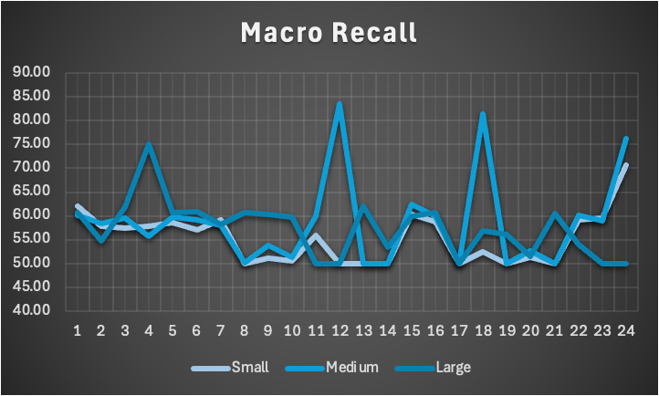
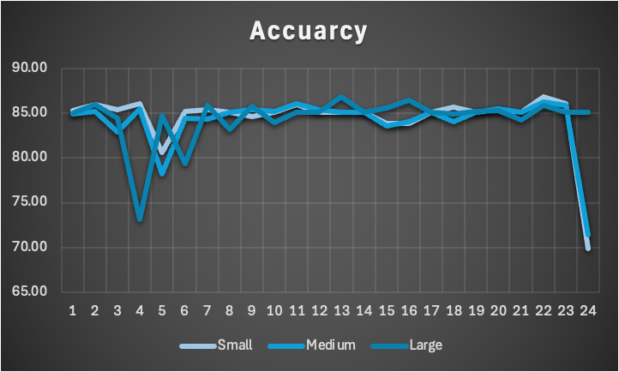
Insights
More features does not automatically increase performance or accuracy
Recall is essential in injury prediction
Machine Learning identifies patterns in athlete data that are not visible in traditional analysis

Slide 8
Challenges
• Choosing the right criteria for our study was challenging due to the large number of possible predictors
• We had to determine which variables were actually relevant to injury prediction
• Our dataset was complex, including physiological, biomechanical, environmental, and training factors
• Some variables added little value and could reduce model performance by adding noise
• We tested different feature sets (25, 18, 10 predictors) to balance accuracy and simplicity
• Data cleaning was completed using Ohio Supercomputer MATLAB processing
• Our focus was ensuring the data was properly structured and ready for modeling
• This process showed how important feature selection and clean data are for strong model performance

Slide 9
Skills Gained / Lessons Learned
Learned how feature selection impacts model performance
Developed a stronger understanding of recall, precision, and accuracy
Gained experience in data cleaning and data preparation
Improved ability to interpret model results and apply them to real-world insights
Learned to evaluate tradeoffs between model complexity and performance

Slide 10
Conclusion
• Feature selection plays a major role in model success - choosing relevant variables reduces noise and improves pattern detection
• Recall becomes one of the most important metrics in this type of project. It is calculated as:
Recall = true positives / (true positives + false negatives)
and measures how well the model identifies actual positive cases
• A higher recall means fewer missed injuries, making it the most important takeaway
• There are real tradeoffs between model complexity and performance - too many features adds noise and too few reduced predictive power
Overall, these results show that effective feature selection and a focus on recall are critical for accurate sports injury prediction

