Slide 1
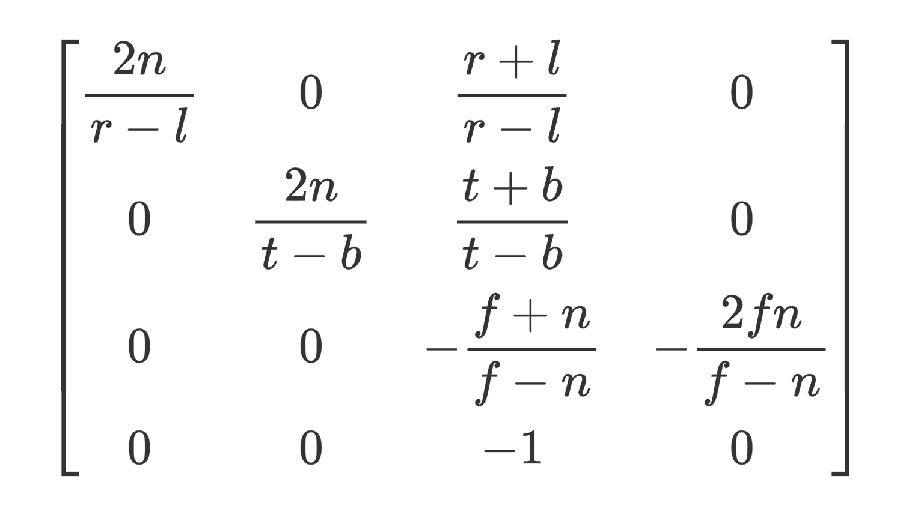

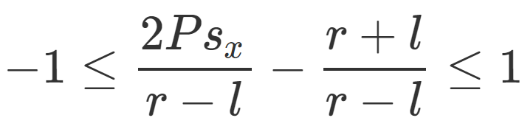

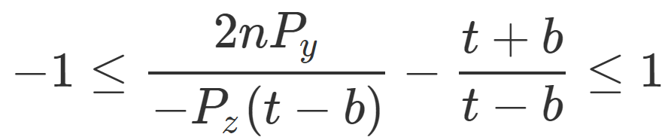
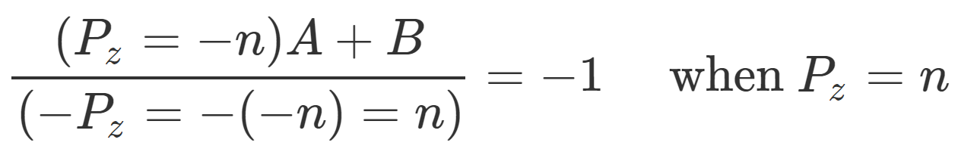
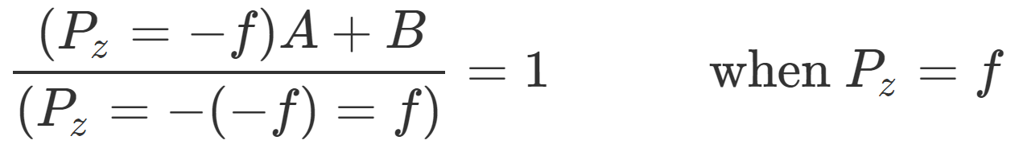
,
OpenGL Perspective Projection Matrix
(Column-major)
Params: l, r, t, b, n, f
https://gavinkg.github.io/ILearnVulkanFromScratch-CN/mdroot/概念汇总/不同图形%20API%20之间的区别.html
https://www.scratchapixel.com/lessons/3d-basic-rendering/perspective-and-orthographic-projection-matrix/opengl-perspective-projection-matrix

Slide 2
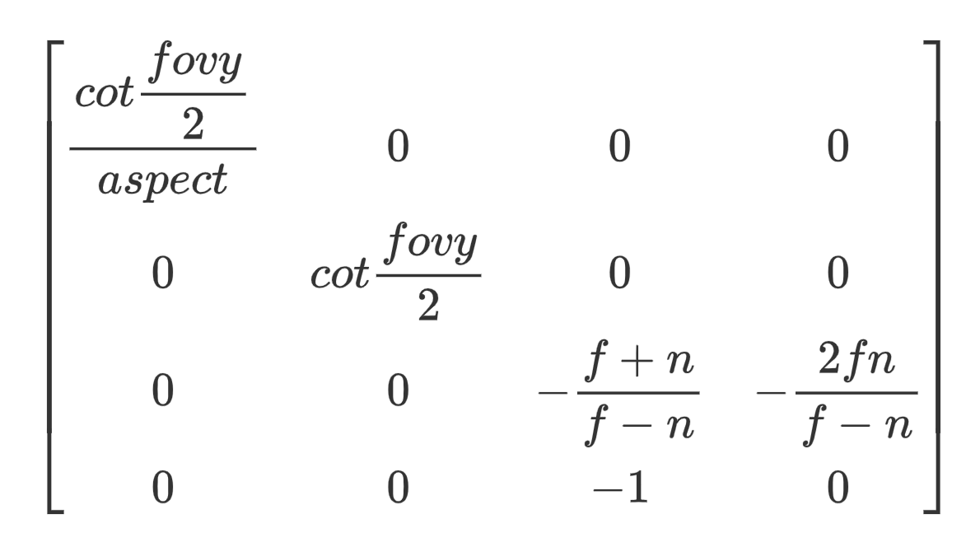
OpenGL Perspective Projection Matrix
(Column-major)
Params: fov(y), aspect, n, f

Slide 3
当 r≠-l, t≠-b 时
x, y与 z 相关的斜切
OpenGL Perspective Projection Matrix
(Column-major)
Params: l, r, t, b, n, f

