Slide 1
Evaluating the Performance of the naïve bayes Record Linkage Algorithm
Gavin Maxwell
Advisor: H. Dennis Tolley

Slide 2
Introduction to Record Linkage
Decide whether to merge pieces of information that may or may not refer to the same entity
Applications include genealogy, economics, and public health
First Name | Last Name | Sex | Birth Date | Birthplace
John | Smith | M | 08/03/1850 | NA
Record A
First Name | Last Name | Sex | Baptism Date | Parish
John | Smyth | M | 08/13/1850 | Leeds
Record B

Slide 3

Probabilistic linkage algorithm
Our research uses David White’s 1997 article, “A Review of the Statistics of Record Linkage for Genealogical Research”
Let M be the event that the two records in a pair are a true match (i.e., they refer to the same person). Let E_{i} be the event that for the i^{th} field (e.g., First Name or Birth Year) of Q fields shared by both records, a) the records agree, b) the records disagree, or c) the field is missing in one or both records.
$P(M|E1, E2, …, EQ)$ $=$ $\frac{P(E1, E2, …, EQ|M) ⋅ P(M)}{P(E1, E2, …, EQ)}$
$=$ P(M)$⋅\frac{P(E1|M) ⋅ P(E2|M) ⋯ P(EQ|M)}{P(E1) ⋅ P(E2) ⋯ P(EQ)}$
$∝$ $\prod_{i=1}^{Q}{\frac{P(Ei|M)}{P(Ei)}}$
(Bayes Rule)
(Independence assumptions)
“Odds in favor of a match”
Take the log to obtain “log odds”

Slide 4

Symbolic
AI
Because of the vast size of genealogical datasets, we prefer to let AI make the majority of decisions
To ensure quality linkage decisions, we provide a clear set of rules to Symbolic AI
Symbolic AI relies on explicitly defined logic to perform a task rather than learning from large amounts of data and creating its own rules for the task

Slide 5
Setting up a simulation
We simulated methodology in White’s paper to understand how well it performs under various conditions
The simulation involved these steps:
  Generate a population
  Subset the population into two “files”
  Randomly introduce missingness and recording errors into each file according to set parameters
  Assess utility of algorithm under varying parameters

Slide 6

Setting up a simulation: Generate a population
We generated a synthetic population of 1,000 individuals and importantly, we recorded the identity of each as an integer from 1 to 1000
500 individuals were assigned to each gender, and a gender-appropriate first and last name were assigned to each individual from uniform distributions
18 total variables were created for each individual, some of which derived their value from others (e.g., “Birth Year” comes from “Birth Date”)

Slide 7
Setting up a simulation: Subset the population into two Files
We select 500 rows of the 1,000 rows at random and select the variables of greatest interest in government to yield a “State” file
A “Church” file with 200 rows is created similarly
These files have seven fields in common out of the 18 variables in the original population
The Cartesian product implies 500 x 200 = 100,000 record pairs

Slide 8
Setting up a simulation: Perturb the files
We write a function to introduce real-world missingness and recording errors into the two files according to set parameters
A missingness parameter controls how often a field is left blank
A correctness parameter controls how often a non-blank field is correctly recorded (if not, it is replaced by a different value from the pool for the corresponding field)

Slide 9
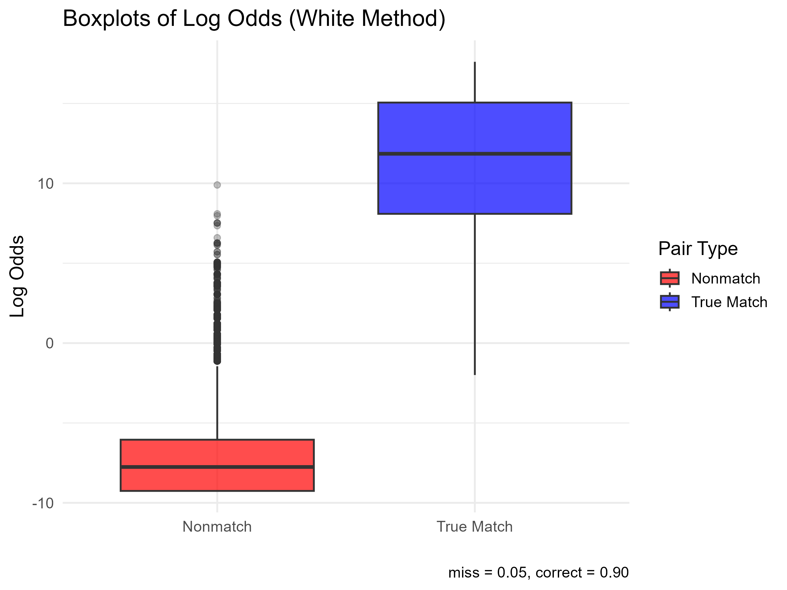
Setting up a simulation: Assess utility of algorithm under varying parameters
Compute the log odds for each record pair and compare the distributions for true matches and non-matches
If the probability of missingness is 0.05 and the probability of correctness is 0.90, we obtain the boxplots to the right
To use the log odds distributions for deciding whether to link a record pair, we can choose a threshold or slice an appropriate number of the highest log odds and compute the percentage representing true matches

Slide 10
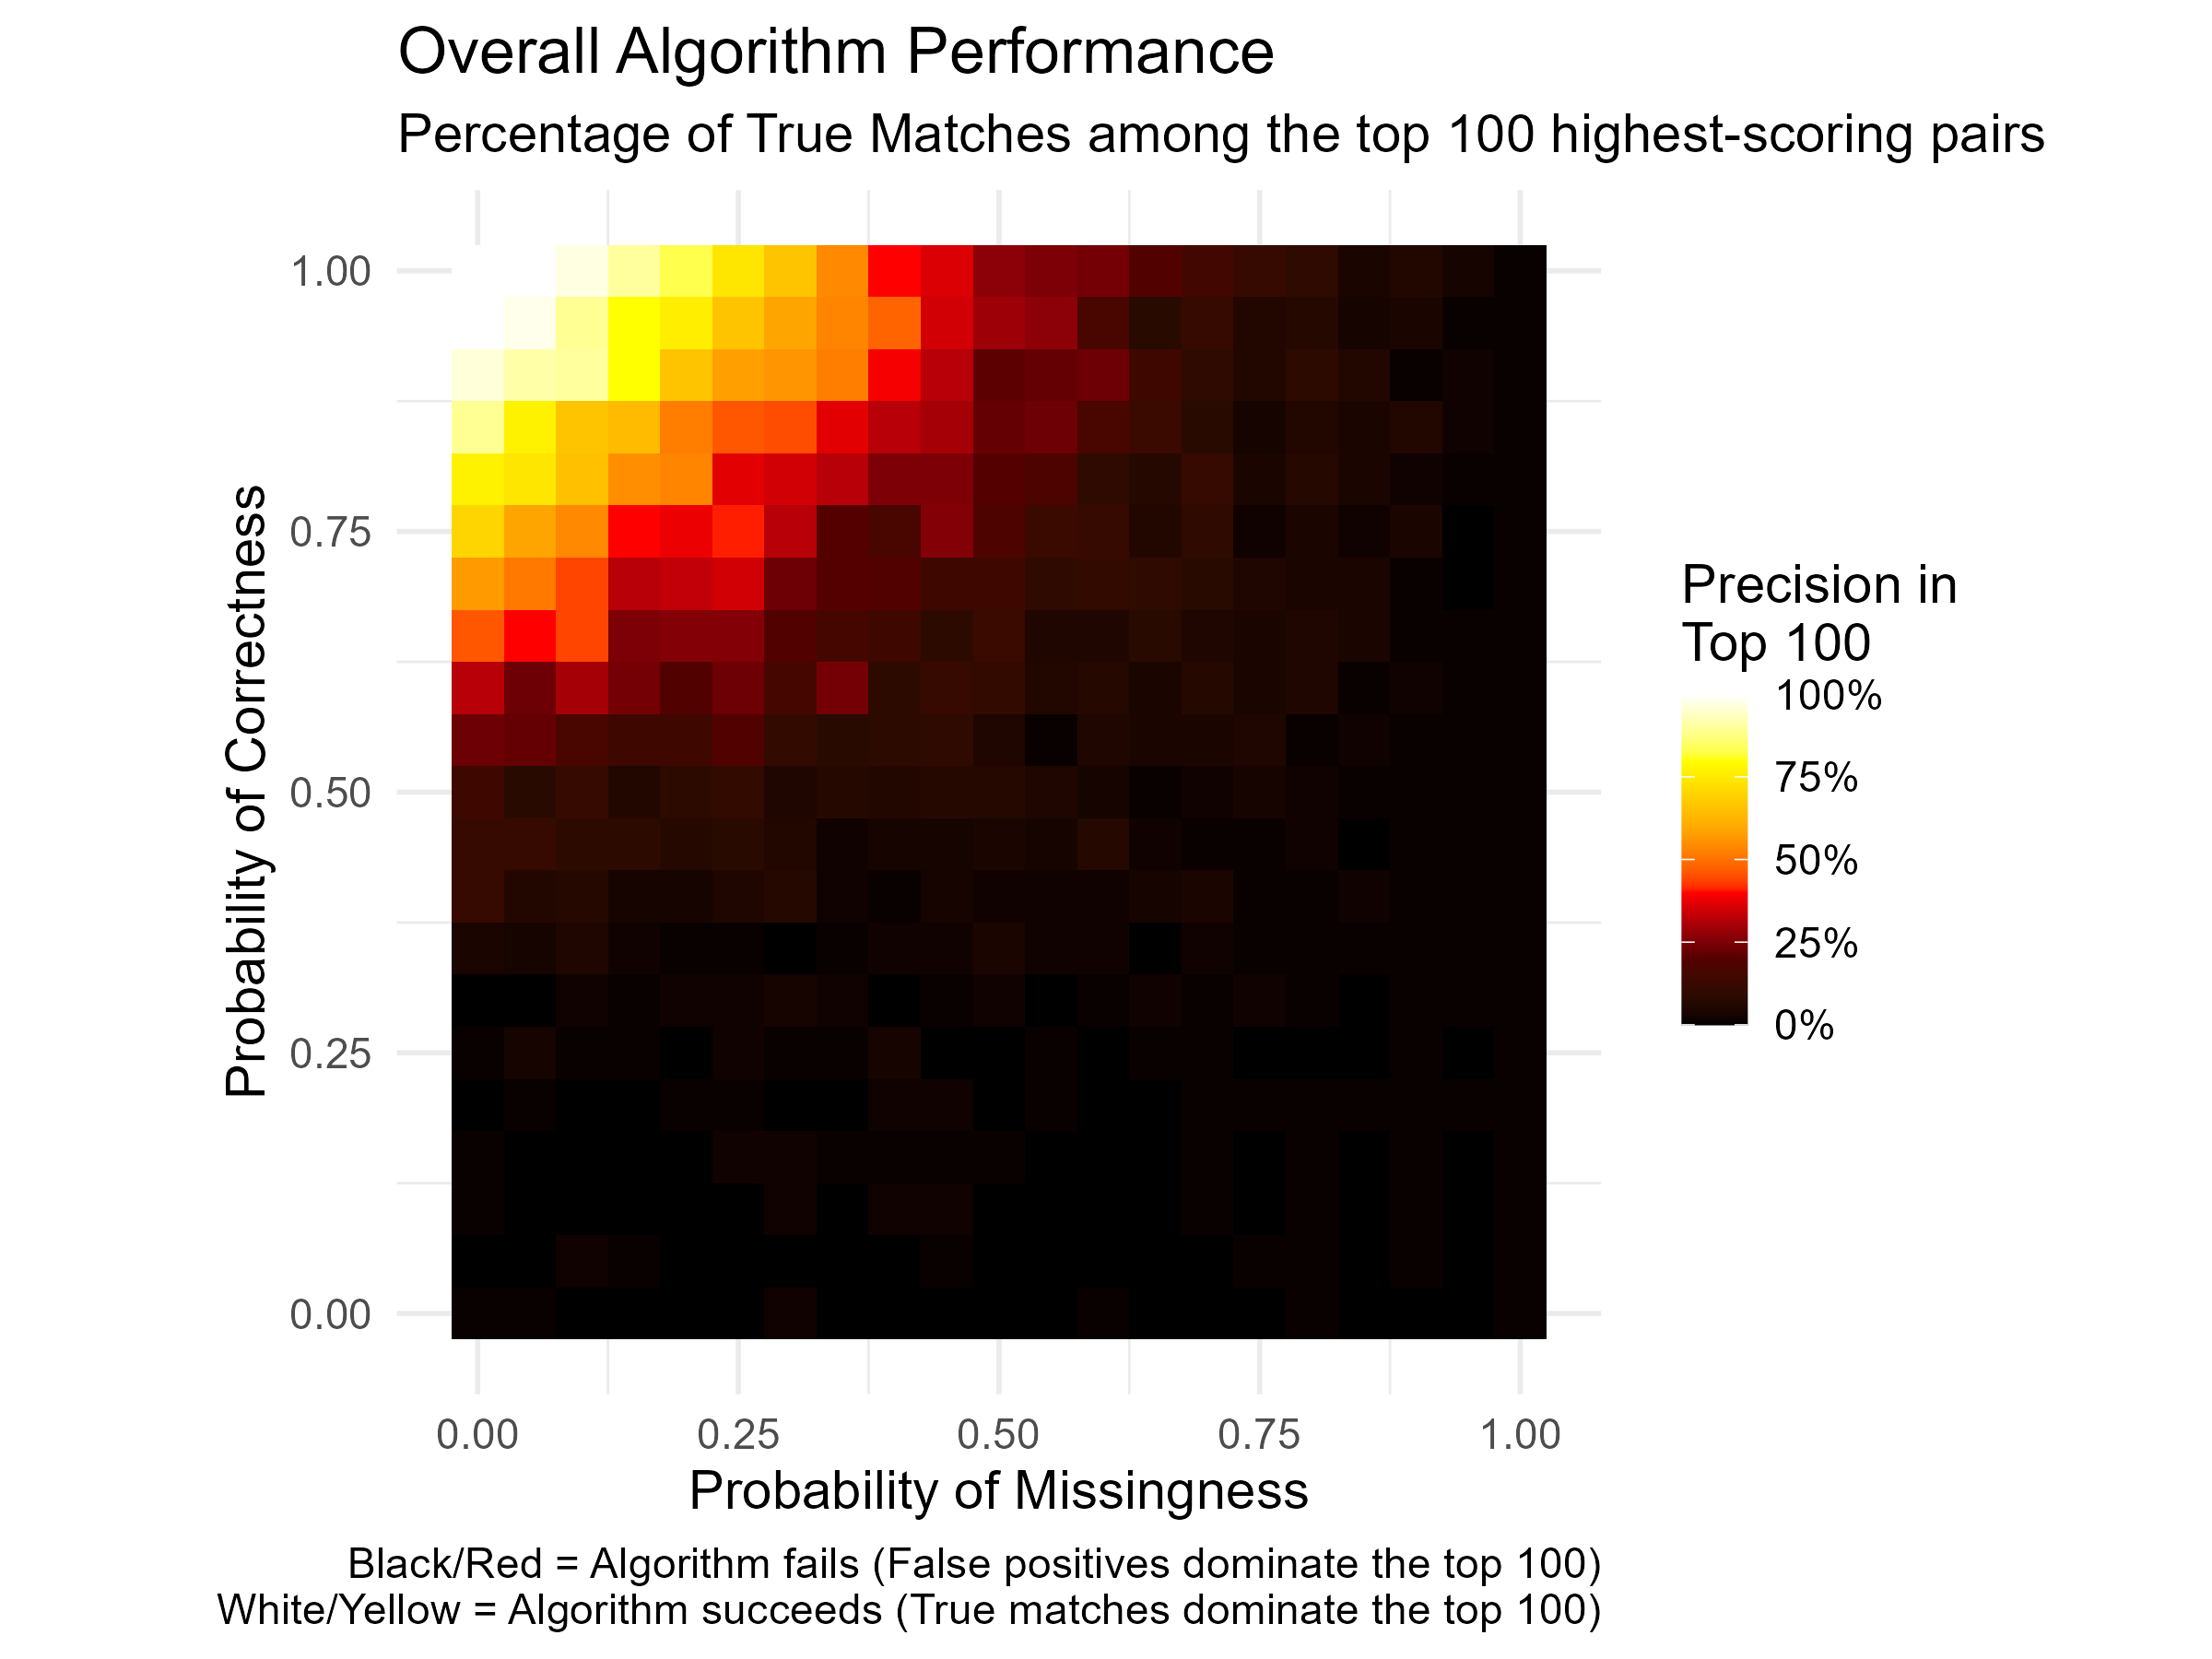
Setting up a simulation: Assess utility of algorithm under varying parameters
Run the algorithm at various pairs of parameter values, select the highest 100 log odds (we expect about 100 true matches)
Visualize the percentage of those 100 log odds that are from true matches

Slide 11
Conclusion
The algorithm in White’s paper worked well for record linkage purposes on our synthetic dataset for favorable parameter values
Next steps for research include understanding how to identify more true matches while avoiding false positives when there are many record pairs to deal with
Integrating a well-refined record linkage algorithm with Symbolic AI would be a powerful tool for revealing insights on a variety of problems

