Slide 1
Ranking Expedia Hotel Bookings Using Apache Hive
Presented By:
Group 8
Malhar Deshpande
Gavin McCullion

Slide 2


Our Dataset
Search Criteria
Date and time of search
Destination ID
Length of Stay
Booking Window
# Adults
# Children
# rooms
If includes Saturday Night
Static Hotel Characteristics
Hotel ID
Hotel Country
Star Rating
User Review Score
Independent/Chain
Location Desirability Score (1)
Location Desirability Score (2)
Historical Price
Dynamic Hotel Characteristics
Rank Position
Price
Promotion Flag
Probability of Click
If Clicked
If Booked
Total Value of Transaction
Visitor Information/History
Visitor Country
Distance From Hotel
Mean Star Rating
Mean Price per Night
Competitor Information
Price vs Expedia
Room availability
Price Difference
Notes:
9 million + rows, 54 columns

Slide 3
Feature Selection

Slide 4
Selected Features
Search Criteria
Date and time of search
Destination ID
Length of Stay
Booking Window
# Adults
# Children
# rooms
If includes Saturday Night
Static Hotel Characteristics
Hotel ID
Hotel Country
Star Rating
User Review Score
Independent/Chain
Location Desirability Score (1)
Location Desirability Score (2)
Historical Price
Dynamic Hotel Characteristics
Rank Position
Price
Promotion Flag
Probability of Click
If Clicked
If Booked
Total Value of Transaction
Visitor Information/History
Visitor Country
Distance From Hotel
Mean Star Rating
Mean Price per Night
Competitor Information
Price vs Expedia
Room availability
Price Difference

Slide 5
Approach
Create logistic regression model to predict bookings and assess variable importance. Use this information to create custom user recommendations
Employ Hivemall machine learning library:
- Developed in 2013 by National Institute of Advanced Industrial Science
and Technology in Japan
Available to public since 2014
Requires less programming knowledge than approaches such as Mahout
Due to young age, very little documentation available

Slide 6
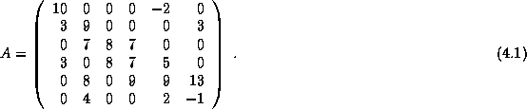
Logistic Regression
- Uses Compressed Row Storage for input (sparse matrix format)
Stores each nonzero element in a vector
Stores column index in a vector
Stores location of the value vector
Images courtesy of http://netlib.org/linalg/html_templates/node91.html

Slide 7
Logistic Regression
- Process:
Extract features into new table and export as CSV
Convert to compressed row storage format using python script; further preparation using regular expressions
Re-upload into HDFS and create training and test sets (80%/20%)
Train algorithm on 80% set
Create predictions on 20% testing data, and evaluate results

Slide 8
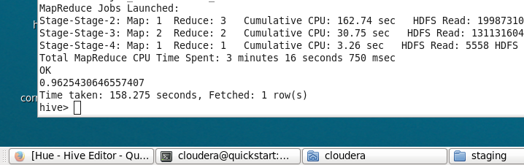
Logistic Regression
- Results:
Seems a little too good?
After running through R, realized that logistic regression predicts every response as false; penalized regression does the same.
Decreasing threshold for true predictions raises overall error, but
reduces false negatives.
Notes:
Hivemall does not give output the way SAS or R would – do not know p values or variable importance

Slide 9
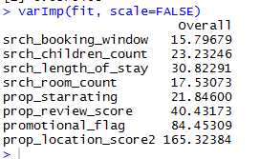
Ranking Model
Logistic regression does reveal some variable importance ranking:
We will use the four variables related to the actual hotel properties available to create custom user recommendations.
Variables will be weighted by relative importance:
4 * prop_location_score2 + 2 * promotional_flag +
prop_review_score + 0.5 * prop_starrating

Slide 10
Ranking Model
Process:
Impute mean for missing values in prop_location_score2 and prop_review_score
Take Z-score for each of our 4 ratings variables to normalize
Weight and add variables; gives an overall rating between -11.7 and 31.3 (average: 0.07)
Create training and test data sets (80%/20%)
Train model using matrix factorization
Predict on test set
Calculate mean absolute error and root mean squared error
Generate recommendations

Slide 11
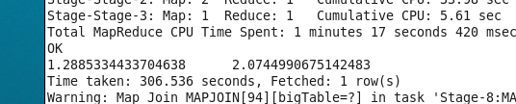
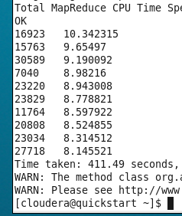
Ranking Model
Results:
MAE and RMSE:
User Recommendations (prop_id, rating)

Slide 12
Future Considerations
Research other methods of feature selection for large data sets
Use more sophisticated means of imputing data to deal with missing values and improve performance
Use algorithms such as random forest to predict bookings
Dig further in to variables to create better overall rating to describe properties
Implement evaluation methods such as normalized discounted cumulative gain.

Slide 13
Questions?

