Slide 1

Data Mining Application in Telecommunication Churn Management
Gavin Mccullion Chuxin Xue Omkar Kulkarni

Slide 2

Project Methodology – CRISP-DM

Slide 3
Business Understanding
Retaining current customers is five to six times cheaper than attracting new ones.
Increasing retention by 1% can boost company’s share price by 5%
Reasons for Customer Churn:
Poor quality
Poor pricing
Inadequate phones/features
Prior data mining studies
SVM and NN have high accuracy
Decision trees most common method

Slide 4
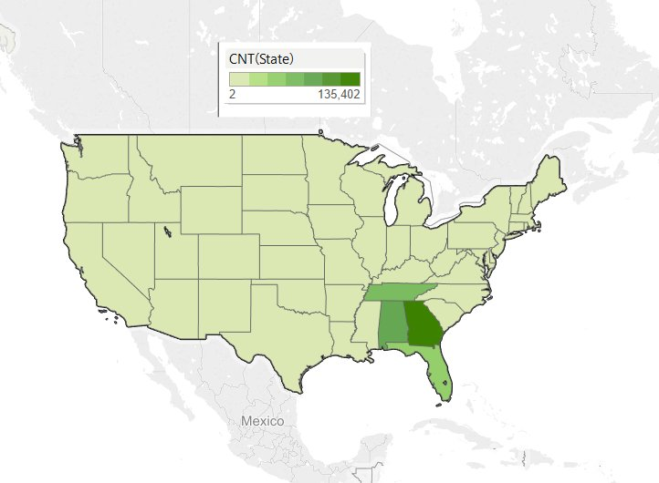
Data Understanding
Regionally based company

Slide 5
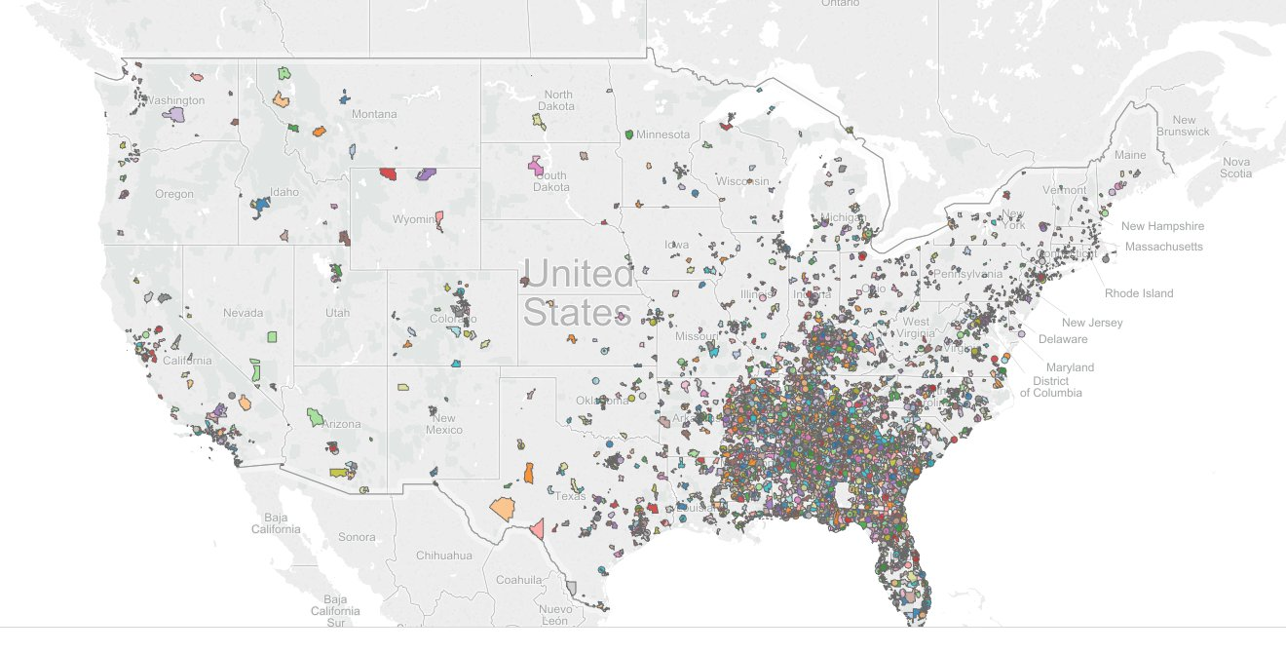
Data Understanding
Regionally based company

Slide 6
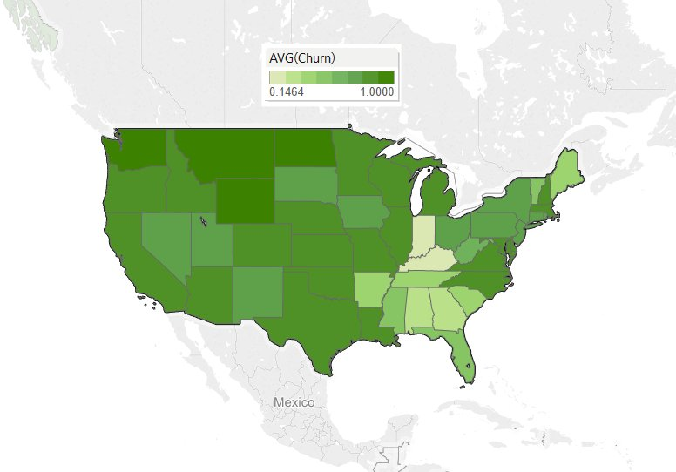
Data Understanding
Churn rates much higher outside of core region

Slide 7
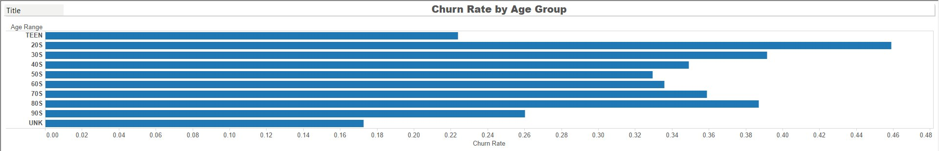
Data Understanding
Customer Age lacks clear pattern for churn rates

Slide 8
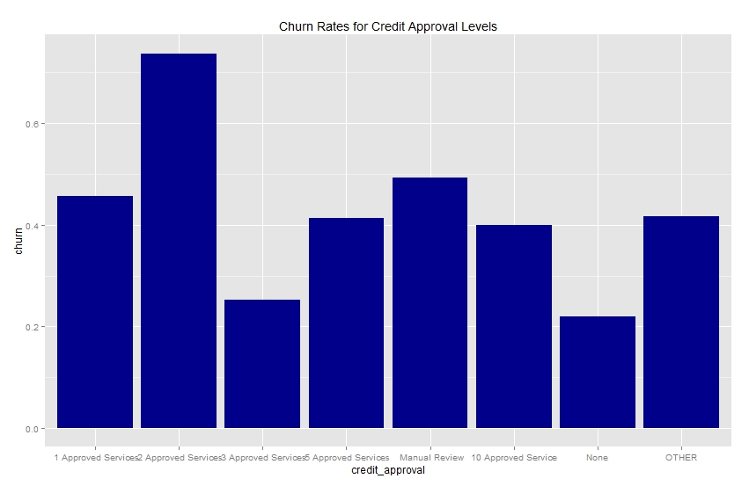
Data Understanding
Certain Credit approval levels have very different churn rates

Slide 9
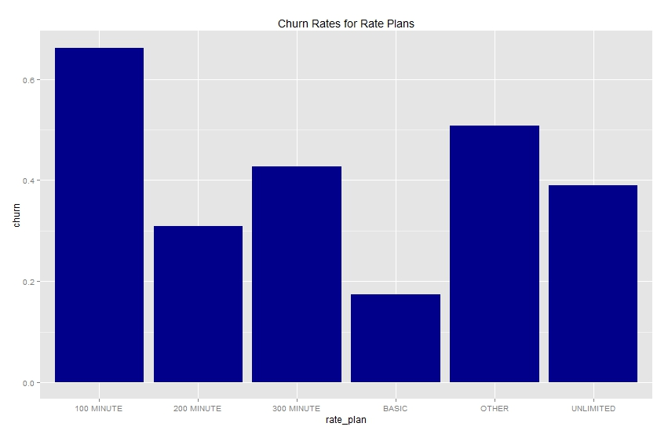
Data Understanding
Rate Plans – 100 minute has highest, churn, Basic plan has lowest

Slide 10
Data Preparation
Removed city, state, and zip code
Removed customerID number
Checked for outliers in continuous variables
Analyzed potential interaction terms
Added calculated variables to describe continuous data:
Notes:
Interaction terms age and rate plan had 3 pairs interacting

Slide 11
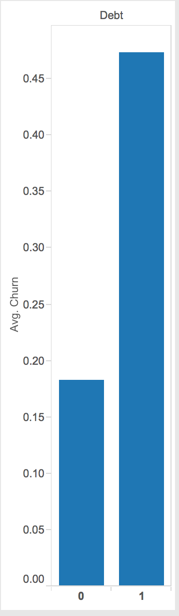
Data Preparation
Customers with outstanding billing amounts coded with debt variable

Slide 12
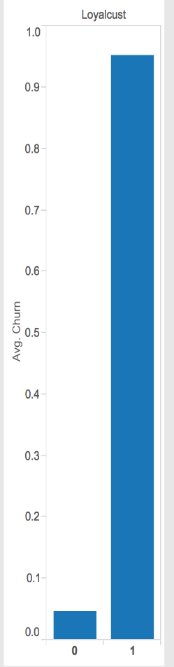
Data Preparation
Those with renewal dates differing from activation dates coded as “loyal customers.” Difference (in weeks) coded as “customer lifetime”

Slide 13
Data Preparation
Possible leakage issue
Date related variables dominated the model
Ran with two datasets:
First dataset included “loyal customer”, “customer lifetime”, “renewal data” and “activated date” variables
Second dataset removed these variables altogether

Slide 14
Modeling
Techniques Used:
Decision Trees
Support Vector Machines
Boosting
Neural Network
Logistic Regression
Random Forests

Slide 15
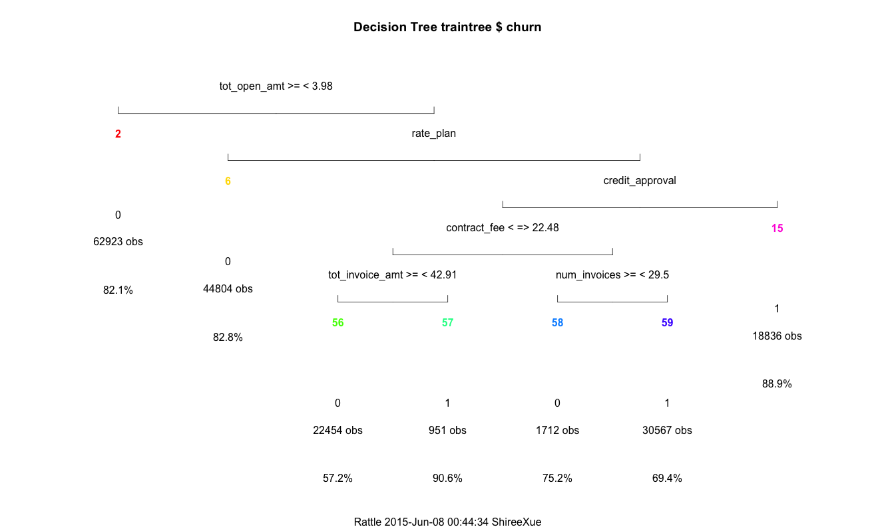
Modeling – Notable events
Decision Tree
Rate_plan,
Contract_fee
Credit_approval
Tot_open_amt
Number of invoice
Notes:
Find the best cp level=0.01 , tested multiple minsplit and minbucket
As to the our new dataset (without dates), the tree plot revealed that five variables were selected in the order of importance – rate_plan, contract_fee, credit_approval, tot_open_amt, and number of invoice. Based on the tree, we may be able to conclude that customers who have unpaid balance, fewer credit approval services, and stay with the company for a long time (more than 29 invoices) are more likely to be churners.

Slide 16
Modeling – Notable events
Support Vector Machines
Low efficiency –
Unable to run on full dataset
Solution
Train on 1% of Traindata
Predict on four 1% of Testdata
Estimated accuracy range
Find Best Parameters with LOOPs
Linear Method yields the best result.
Notes:
Important variables
tot_open_amt, credit_approva, l rate_plan, tot_invoice_amt, tot_invoice_amt

Slide 17
Modeling – Notable events
Neural Networks
Recoded categorical variables
Combined categories to reduce variables
No noticeable difference compared to using dummy variables
Attempted cross validation, but could not complete
New Variables | Level | Churn
credit_approval
cahigh | 2 approved services | 0.73
camid | 1 approved services | 0.45
 | 5 approved services | 0.41
 | Manual review | 0.49
 | other | 0.41
calow | 3 approved services | 0.25
 | none | 0.22
contact_method
contact_low | PHONE SALE | 0.19
contact_mid | FAMILY SALE | 0.38
 | OTHER | 0.34
 | RETAIL SALE | 0.35
contact_high | INTERNET SALE | 0.56
 | MALL SALE | 0.53
rate_plan
rate_low | BASIC | 0.17
rate_mid | 200 MINUTE | 0.31
 | 300 MINUTE | 0.43
 | UNLIMITED | 0.39
rate_high | 100 MINUTE | 0.66
 | OTHER | 0.51

Slide 18
Modeling – Notable events
Logistic Regression
Unable to run glm on data set with extra variables
Solution? penalized regression
GLMnet package uses LASSO to run regression
Cross validate to determine penalty coefficient
Able to use base glm on new data set
Ran VIF test – rate_plan and contact_method were slightly high, but ultimately chose to keep in the model
Very similar error rates to GLMnet on new data set (21.6% to 21.1%)
Notes:
GLM net was unable to provide variance inflation factor analysis.

Slide 19
Modeling – Notable events
Random Forest
Mtree Try – 100 vs. 500 Trees
Out-of-Bag Errors
Very reliable close to error on test data
Best model of all! 82.9% accuracy (data with no dates).
Notes:
Mtry function helped us automate the parameter testing process.
500 trees works better . (large dataset requires more trees), if we had time, we should also test out 1000 trees.
Out of bag errors is the RF version’s cross validation.
Best model Reason
- Random forest works well with categorical data, and it ‘s an advanced decision tree, avoid overfitting.

Slide 20
Model Evaluation
Result Comparison (On data without dates)
Important Variables
Rate_plan,
Contract_fee
Credit_approval
Tot_open_amt
Number of invoice
 | Random Forest | Boosting | NN
Test | 17.0% | 19.6% | 20.0%
Validate | 16.9% | 19.2% | 18.9%
Notes:
Results across our top 3 models
Important variables are consistent across all models

Slide 21
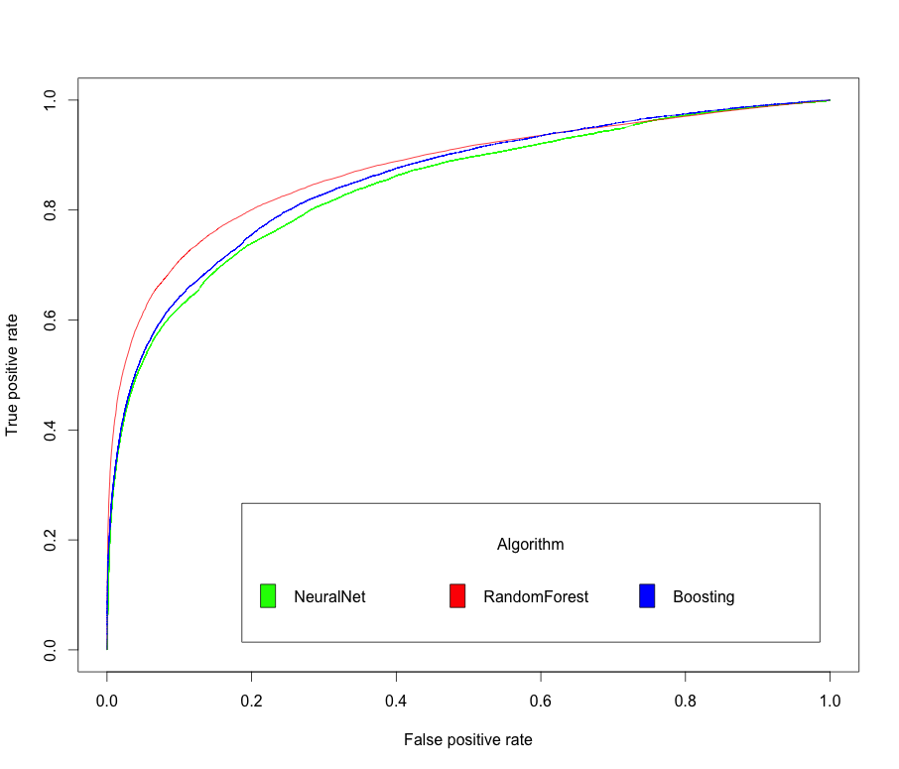
Model Evaluation
ROC Curve
F-measure
RF | Boosting | NN
0.749 | 0.709 | 0.693
Notes:
ROC curve measure how well the model predict true positives.
F-measure is a parameter to measure the balance between Precision and Recall in confusion matrix

Slide 22
Deployment
Determine future churners, give data to customer retention team
Continually monitor accuracy of model
Retrain model as time goes on

Slide 23
Recommendations
Poor customer retention in general
Possible retention strategies:
New Phones
Free service upgrades
Bonus features
Flexible plans
Further data collection to determine reasons for churn

Slide 24
Future Wishlist
Better understanding of dataset
Stay efficient with large-scale data (eg. sample dataset)
More use of cross validation
Better understanding of parameters for each model, and each package for our models
Read best practices for organizing code and documenting results
Notes:
Cross validation is extremely important
Though we haven’t got a chance to cross validate every model in our project, we relied on cross validation result to identify optimal parameters. It has significantly improved our efficiency in model testing and it’s proven to be very reliable as to accuracy rate.
Better understanding of R Packages
Since R packages are open-sourced and written by so many different people, it’s very important for us beginners to learn and understand the most common and reliable packages for each data mining technique. Being unfamiliar with all the functions and objects made our coding process very time-consuming. We wish we could have done more practices with these packages before start using them on large-scale data.
Stay efficient with large dataset
Last but not least, the number one issue we faced in our project is efficiency. With no experience in large-scale data, we found it extremely inefficient to try out models on the full dataset with traditional methodologies. Sampling data in support vector machine has helped us solve the efficiency issue and should be considered as a best practice in future data mining project.

Slide 25
Questions?

