Slide 1
Who Is the European Elite?
Gating, positions, and overproduction
Gavin Mendel-Gleason · Donagh Davis
Workshop on Crisis and Resilience in Historical and Modern Societies · October 2026
Evidence from Commissioner, DG/DDG, judicial and College of Europe data

Slide 2
The European Union
SDT analysis of supranational entity
Is this even possible?

Slide 3
Link to workshop theme and SDT agenda
Interest in elites and elite overproduction
Crisis
Methodology

Slide 4
Why choose EU as unit of analysis?
SDT has largely been applied to nation-states in modern context
However, crisis and crisis response can no longer be understood entirely at nation-state level
Formal and informal constraints on policies of EU member states

Slide 5
Approach and methodology
Inherent difficulties of carrying out SDT research on supranational entity
27 different economies with their own political and demographic dynamics
Focus on elites: conducive to research and germane to SDT

Slide 6
The problem of elites and elite overproduction
What do we mean by “elites” and ”elite overproduction”?
Deep roots of “elite research”:
Plato on “philosopher-kings”
Italian elite theorists (Pareto, Mosca, Michels et al)
C. Wright Mills The Power Elite
G. William Domhoff Who Rules America?
Bourdieu on elite reproduction
Etc.

Slide 7
Elite overproduction
Can mean at least three different things:
Elite over-extraction (“wealth pump”)
Downwardly mobile elites
Frustrated elite aspirants

Slide 8
How to “do” SDT-type elite research on EU elite?
Open-minded approach
EU institutions appear to recruit from higher education pool where elite overproduction/credentialisation could plausibly be occurring
However, not clear how these things join up

Slide 9
How to “do” SDT-type elite research on EU elite? (contd.)
Focus on European Commission and to a lesser extent European Court of Justice
Among the most supranational European institutions
In the case of the Commission, also a substantial permanent bureaucracy (c. 32,000 staff)

Slide 10
Contribution of paper
Theoretical/conceptual
Methodological
Empirical

Slide 11
Contribution of paper (contd.)
Theoretical/conceptual:
- Refinement of concepts of “elites” and “elite overproduction”

Slide 12
Contribution of paper (contd.)
Methodological:
AI-assisted methodology
Anti-hallucination measures

Slide 13
Contribution of paper (contd.)
Empirical:
Puzzle of where power really lies in Europe
(Or if it even lies in Europe)

Slide 14
THE QUESTION
Who is the European elite?
• There is no single, coherent “European elite.”
• Commissioners, DGs, corporate directors, judges and MEPs are different populations with different recruitment.
• We study a narrow, testable core: Commission + DG/DDG and EU jurists.
• This is a choice of elite positions
A narrower object
• Political-administrative: Commission + DGs/DDGs
• Legal: EU judges and Advocates General
• Excluded here: MEPs and corporate elites
European Elites · Gating, positions, and overproduction
2

Slide 15
THE CONFLICT
National versus supranational elites
• European integration creates competing recruitment orders: national administrations and parties versus EU institutions and law.
• The question is whether these are separate pipelines or one shared gate.
• Education coverage is strong for the chosen core: Commissioners 79%, DGs/DDGs 92%, jurists 100%.
• Corporate education coverage is only 6%, so the corporate track is not used for this comparison.
79%
92%
100%
Commissioners
DGs/DDGs
Jurists
High coverage makes the comparison possible; it does not make it representative of all elites.
European Elites · Gating, positions, and overproduction
3

Slide 16
OPERATIONAL CHOICE
Why Commission + DG/DDG and jurists?
• They are EU-level positions, not national offices.
• They sit on opposite sides of the institutional divide: political-administrative versus legal.
• Their biographies are unusually well documented.
• If a European gating structure exists, it should be visible here first.
• This is an operational test, not a complete theory of European power.
European Elites · Gating, positions, and overproduction
4

Slide 17
COVERAGE
Gating institutions? A 23-institution panel
• Narrow definition: institutions repeatedly present among educated elite people.
• Presence is measurable; necessity and causation are not.
• Panel: every institution with at least five educated elite people — N ≥ 5.
• 23 institutions; largest are College of Europe (18), Harvard (14), Cambridge (10), ENA (10).
• Coverage: 29.9% of Commission + DG/DDG; 59.2% of jurists.
• Bocconi University
• Charles University
• College of Europe
• Georgetown University
• HEC Paris
• Harvard University
• INSEAD
• London School of Economics
• National and Kapodistrian University of Athens
• Sapienza University of Rome
• Stockholm University
• UCLouvain
• University of Cambridge
• University of Cologne
• University of Ljubljana
• University of Malta
• University of Oxford
• University of Tartu
• Université Paris II Panthéon-Assas
• Université libre de Bruxelles
• Vilnius University
• École Polytechnique
• École nationale d’administration
European Elites · Gating, positions, and overproduction
5

Slide 18
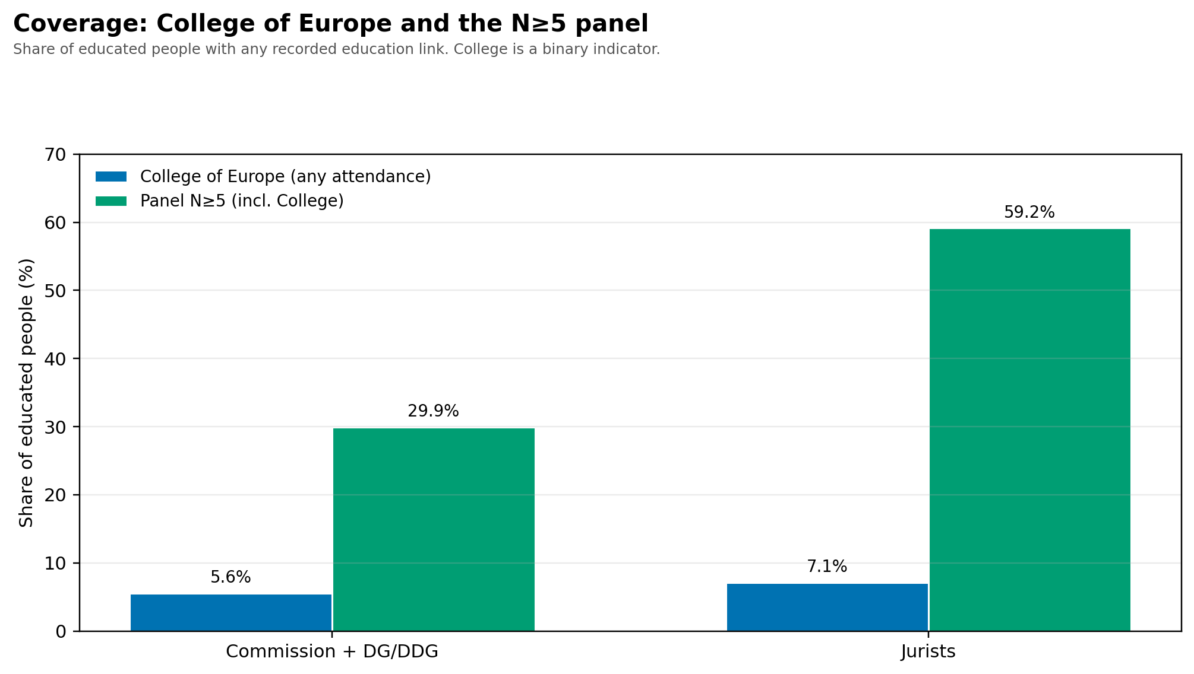
THE COLLEGE
College of Europe: a real but minority gate
• Largest single institution in the elite-education table: 18 people.
• 3 commissioners, 8 DGs/DDGs, 7 jurists; no observed corporate track.
• Covers 5.6% of Commission + DG/DDG and 7.1% of jurists.
• A genuine European pipeline, but not a standalone gateway.
• Alumni surveys: about 25% in EU institutions; 10–13% in national/regional public administration.
European Elites · Gating, positions, and overproduction
6

Slide 19
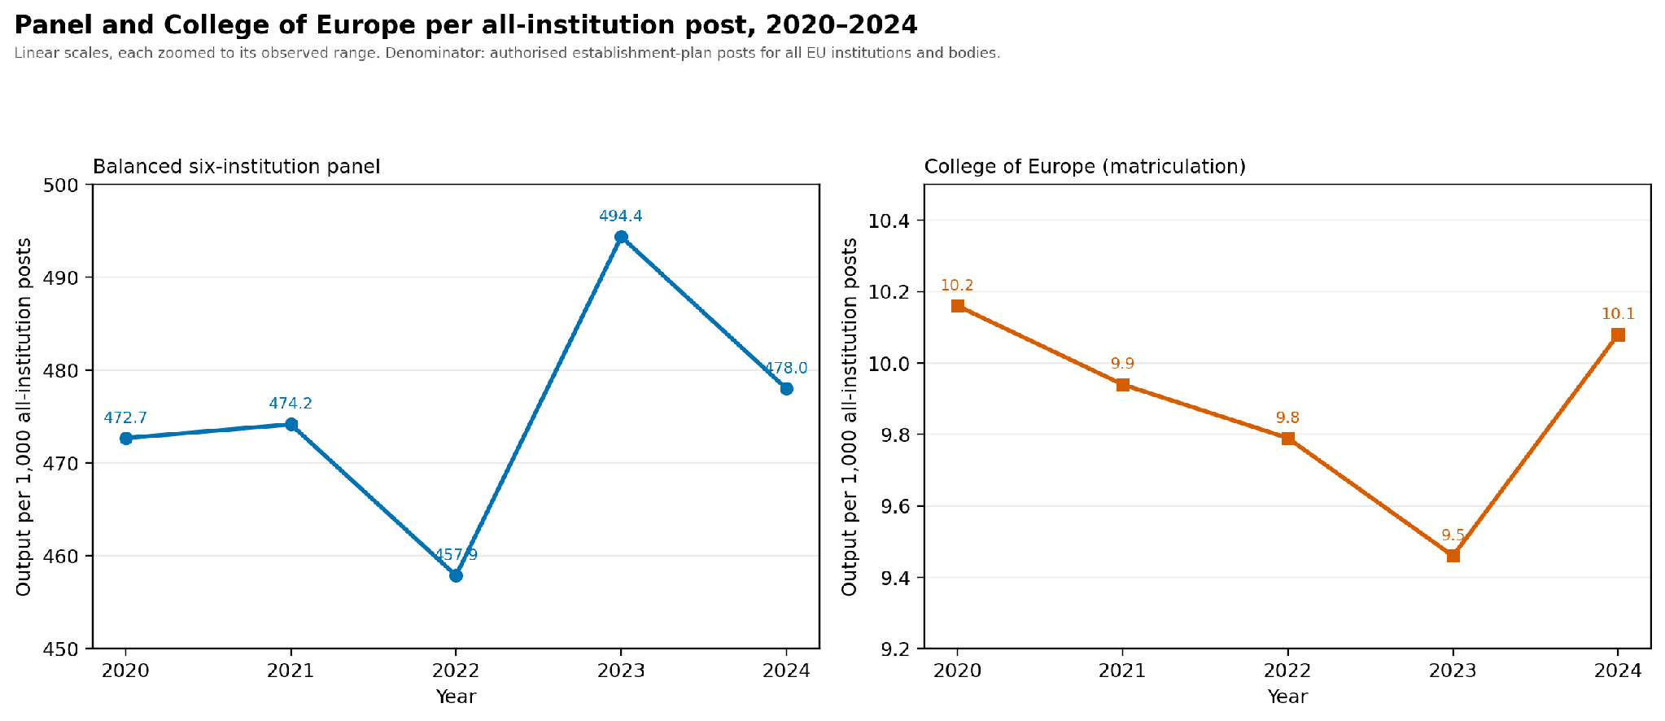
THE DENOMINATOR
Stability relative to bureaucracy size
• All-institution establishment posts: 47,151 → 49,028 (2020–2024), +4.0%.
• Panel output per 1,000 posts: 473 → 478.
• College output per 1,000 posts: 10.2 → 10.1.
• The bureaucracy grew; gating output did not expand relative to it.
European Elites · Gating, positions, and overproduction
7

Slide 20
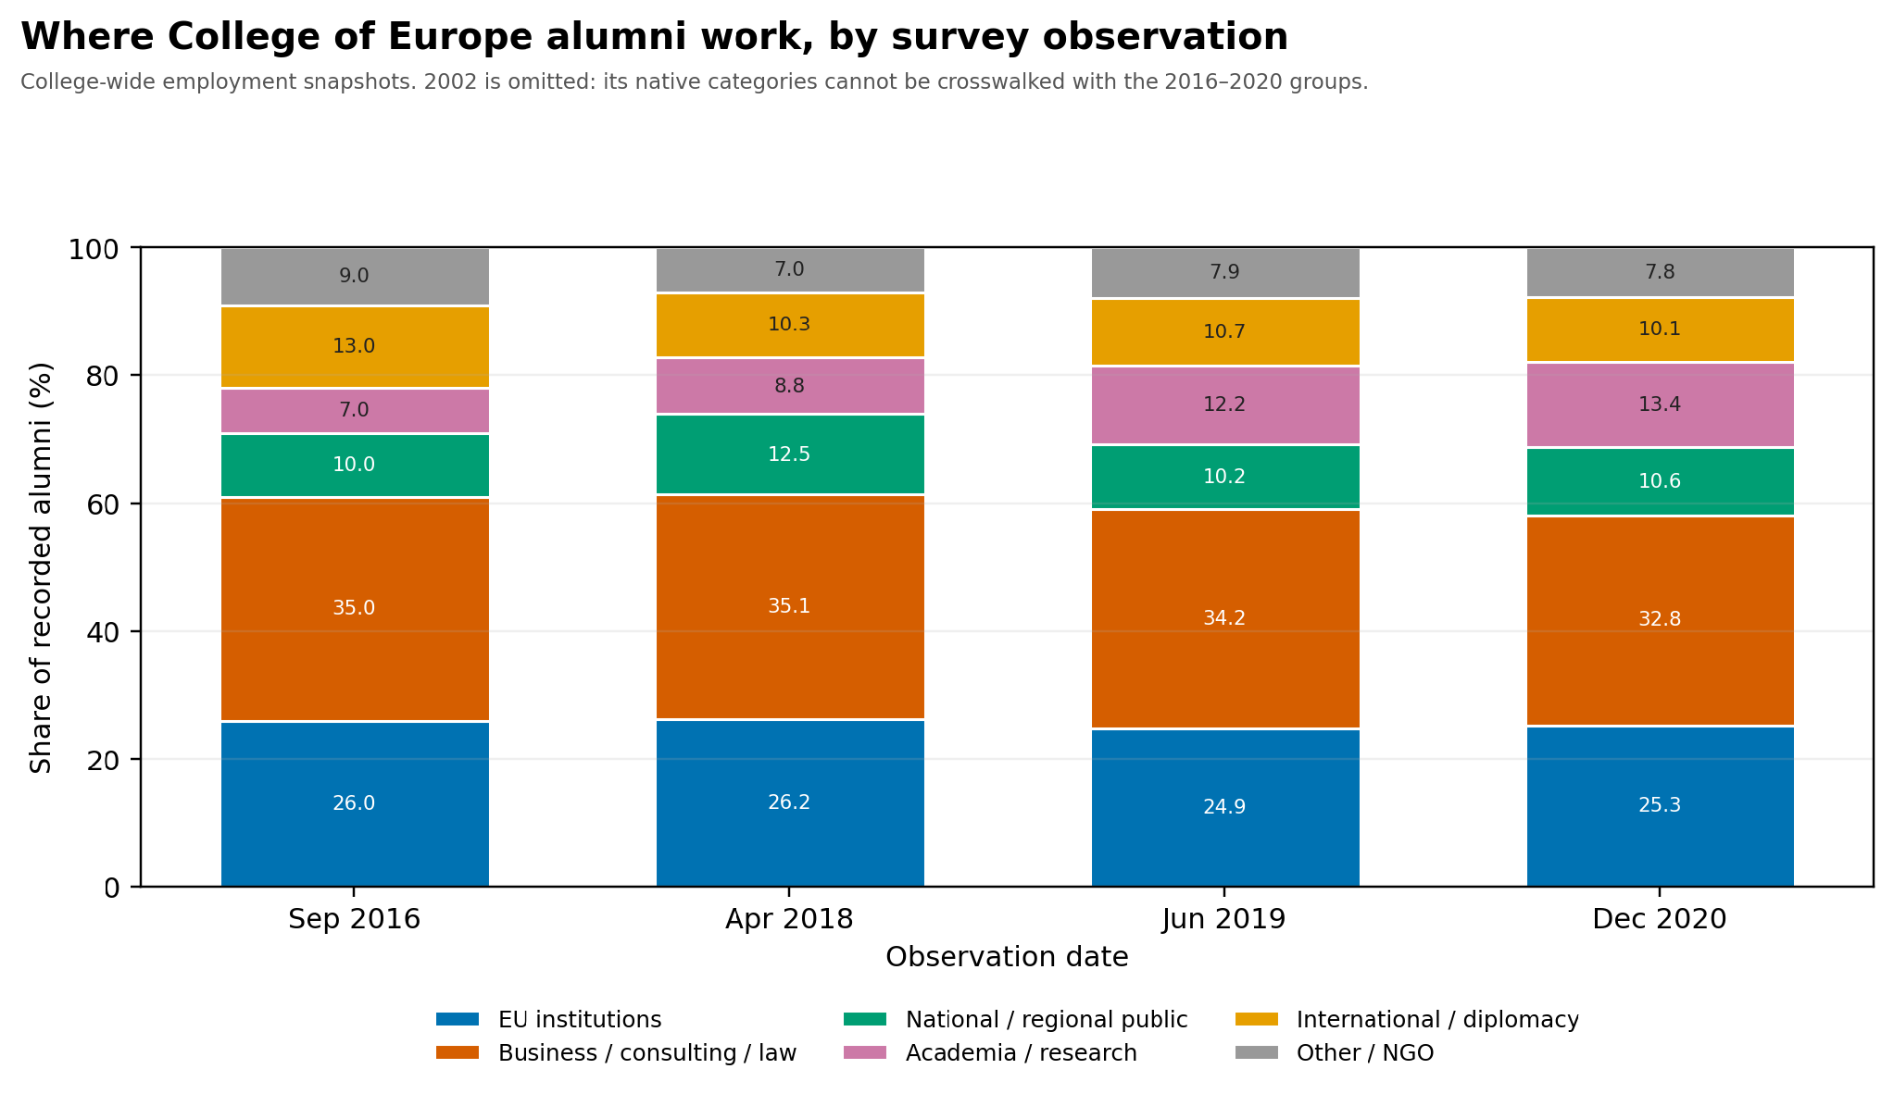
DESTINATIONS
Where College of Europe alumni work
• EU institutions stable at roughly 25–26%.
• National/regional public: 10–12.5%.
• Business, consulting and law: 33–35%.
• Academia/research rose from 7% to 13%.
• 2002 omitted: categories cannot be crosswalked.
European Elites · Gating, positions, and overproduction
8

Slide 21
CONCLUSION
Not a lot of elite overproduction at the European level
• The long output series do not show a uniform expansion.
• Relative to the total EU institutional bureaucracy, panel and College output are relatively flat.
• Gating is real but plural: 23 institutions, not one school.
• The College of Europe is a meaningful but minority pipeline.
• This is descriptive: no unemployment, rejection or cohort-placement data.
• The evidence supports stability, not a demonstrated overproduction crisis.
What would change this conclusion: matched applicant, appointment and rejection series, and cohort-level placement after graduation.
European Elites · Gating, positions, and overproduction
9

Slide 22
PANEL LIST
Appendix: the N ≥ 5 panel
• Bocconi University
• Charles University
• College of Europe
• Georgetown University
• HEC Paris
• Harvard University
• INSEAD
• London School of Economics
• National and Kapodistrian University of Athens
• Sapienza University of Rome
• Stockholm University
• UCLouvain
• University of Cambridge
• University of Cologne
• University of Ljubljana
• University of Malta
• University of Oxford
• University of Tartu
• Université Paris II Panthéon-Assas
• Université libre de Bruxelles
• Vilnius University
• École Polytechnique
• École nationale d’administration
European Elites · Gating, positions, and overproduction
10

Slide 23
Preliminary conclusions
Elite overproduction in EU?
If we take professional cadres of institutions such as European Commission and its gating institutions such as College of Europe as proxy, it is not obvious that this is occurring
However, this brings us back to question of what we mean by “elites” and “elite overproduction”

Slide 24
Preliminary conclusions (contd.)
However, this does not mean that “elite overproduction” in other senses of term is not happening
Qualitative (including elite-interview-based) evidence that gating institutions such as College of Europe may be exerting strong “Bourdieusian” effect, i.e. selecting for the “right” people among already highly-qualified pool of applicants

Slide 25
Preliminary conclusions (contd.)
Thus, elite pipeline to European institutions may be operating in stable manner while overproduction of elite aspirants continues around this pipeline

Slide 26
Next steps
Supranational elite forming outside EU institutions?
Elite overproduction in sense of wealth pump operating at this level?
EU elite pipeline may be relatively stable, but is this really a “power elite”?
Broader SDT analysis of EU looking beyond elites and elite pverproduction

