Slide 1
Who Is the European Elite?
Gating, positions, and overproduction
Gavin Mendel-Gleason · Donagh Davis
Workshop on Crisis and Resilience in Historical and Modern Societies · October 2026
Evidence from Commissioner, DG/DDG, judicial and College of Europe data

Slide 2
THE QUESTION
The European Union
SDT analysis of supranational entity
Is this even possible?
European Elites · Gating, positions, and overproduction
2

Slide 3
FRAMING
Link to workshop theme and SDT agenda
• Interest in elites and elite overproduction
• Crisis
• Methodology
European Elites · Gating, positions, and overproduction
3

Slide 4
UNIT OF ANALYSIS
Why choose EU as unit of analysis?
• SDT has largely been applied to nation-states in modern context
• However, crisis and crisis response can no longer be understood entirely at nation-state level
• Formal and informal constraints on policies of EU member states
European Elites · Gating, positions, and overproduction
4

Slide 5
METHODOLOGY
Approach and methodology
• Inherent difficulties of carrying out SDT research on supranational entity
• 27 different economies with their own political and demographic dynamics
• Focus on elites: conducive to research and germane to SDT
European Elites · Gating, positions, and overproduction
5

Slide 6
CONCEPTS
The problem of elites and elite overproduction
• What do we mean by “elites” and ”elite overproduction”?
• Deep roots of “elite research”:
  Plato on “philosopher-kings”
  Italian elite theorists (Pareto, Mosca, Michels et al)
  C. Wright Mills The Power Elite
  G. William Domhoff Who Rules America?
  Bourdieu on elite reproduction
  Etc.
European Elites · Gating, positions, and overproduction
6

Slide 7
CONCEPTS
Elite overproduction
• Can mean at least three different things:
  Elite over-extraction (“wealth pump”)
  Downwardly mobile elites
  Frustrated elite aspirants
European Elites · Gating, positions, and overproduction
7

Slide 8
METHOD
How to “do” SDT-type elite research on EU elite?
• Open-minded approach
• EU institutions appear to recruit from higher education pool where elite overproduction/credentialisation could plausibly be occurring
• However, not clear how these things join up
European Elites · Gating, positions, and overproduction
8

Slide 9
METHOD
How to “do” SDT-type elite research on EU elite? (contd.)
• Focus on European Commission and to a lesser extent European Court of Justice
• Among the most supranational European institutions
• In the case of the Commission, also a substantial permanent bureaucracy (c. 32,000 staff)
European Elites · Gating, positions, and overproduction
9

Slide 10
CONTRIBUTION
Contribution of paper
• Theoretical/conceptual
• Methodological
• Empirical
European Elites · Gating, positions, and overproduction
10

Slide 11
CONTRIBUTION
Contribution of paper (contd.)
• Theoretical/conceptual:
- Refinement of concepts of “elites” and “elite overproduction”
European Elites · Gating, positions, and overproduction
11

Slide 12
CONTRIBUTION
Contribution of paper (contd.)
• Methodological:
• AI-assisted methodology
• Anti-hallucination measures
European Elites · Gating, positions, and overproduction
12

Slide 13
CONTRIBUTION
Contribution of paper (contd.)
• Empirical:
• Puzzle of where power really lies in Europe
• (Or if it even lies in Europe)
European Elites · Gating, positions, and overproduction
13

Slide 14
THE QUESTION
Who is the European elite?
• There is no single, coherent “European elite.”
• Commissioners, DGs, corporate directors, judges and MEPs are different populations with different recruitment.
• We study a narrow, testable core: Commission + DG/DDG and EU jurists.
• This is a choice of elite positions
A narrower object
• Political-administrative: Commission + DGs/DDGs
• Legal: EU judges and Advocates General
• Excluded here: MEPs and corporate elites
European Elites · Gating, positions, and overproduction
14

Slide 15
THE CONFLICT
National versus supranational elites
• European integration creates competing recruitment orders: national administrations and parties versus EU institutions and law.
• The question is whether these are separate pipelines or one shared gate.
• Education coverage is strong for the chosen core: Commissioners 79%, DGs/DDGs 92%, jurists 100%.
• Corporate education coverage is only 6%, so the corporate track is not used for this comparison.
79%
92%
100%
Commissioners
DGs/DDGs
Jurists
High coverage makes the comparison possible; it does not make it representative of all elites.
European Elites · Gating, positions, and overproduction
15

Slide 16
OPERATIONAL CHOICE
Why Commission + DG/DDG and jurists?
• They are EU-level positions, not national offices.
• They sit on opposite sides of the institutional divide: political-administrative versus legal.
• Their biographies are unusually well documented.
• If a European gating structure exists, it should be visible here first.
• This is an operational test, not a complete theory of European power.
European Elites · Gating, positions, and overproduction
16

Slide 17
COVERAGE
Gating institutions? A 23-institution panel
• Narrow definition: institutions repeatedly present among educated elite people.
• Presence is measurable; necessity and causation are not.
• Panel: every institution with at least five educated elite people — N ≥ 5.
• 23 institutions; largest are College of Europe (18), Harvard (14), Cambridge (10), ENA (10).
• Coverage: 29.9% of Commission + DG/DDG; 59.2% of jurists.
• Bocconi University
• Charles University
• College of Europe
• Georgetown University
• HEC Paris
• Harvard University
• INSEAD
• London School of Economics
• National and Kapodistrian University of Athens
• Sapienza University of Rome
• Stockholm University
• UCLouvain
• University of Cambridge
• University of Cologne
• University of Ljubljana
• University of Malta
• University of Oxford
• University of Tartu
• Université Paris II Panthéon-Assas
• Université libre de Bruxelles
• Vilnius University
• École Polytechnique
• École nationale d’administration
European Elites · Gating, positions, and overproduction
17

Slide 18
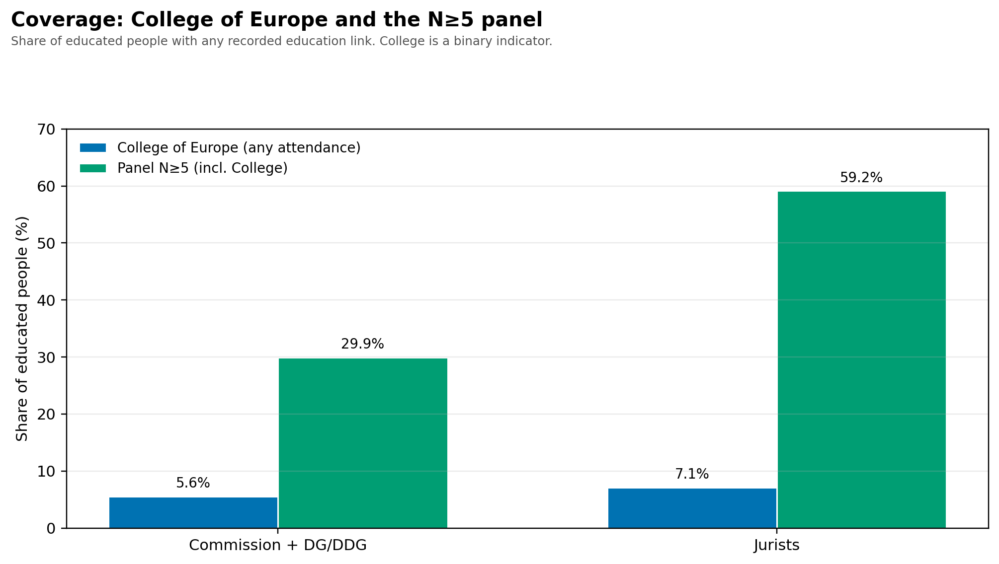
THE COLLEGE
College of Europe: a real but minority gate
• Largest single institution in the elite-education table: 18 people.
• 3 commissioners, 8 DGs/DDGs, 7 jurists; no observed corporate track.
• Covers 5.6% of Commission + DG/DDG and 7.1% of jurists.
• A genuine European pipeline, but not a standalone gateway.
• Alumni surveys: about 25% in EU institutions; 10–13% in national/regional public administration.
European Elites · Gating, positions, and overproduction
18

Slide 19
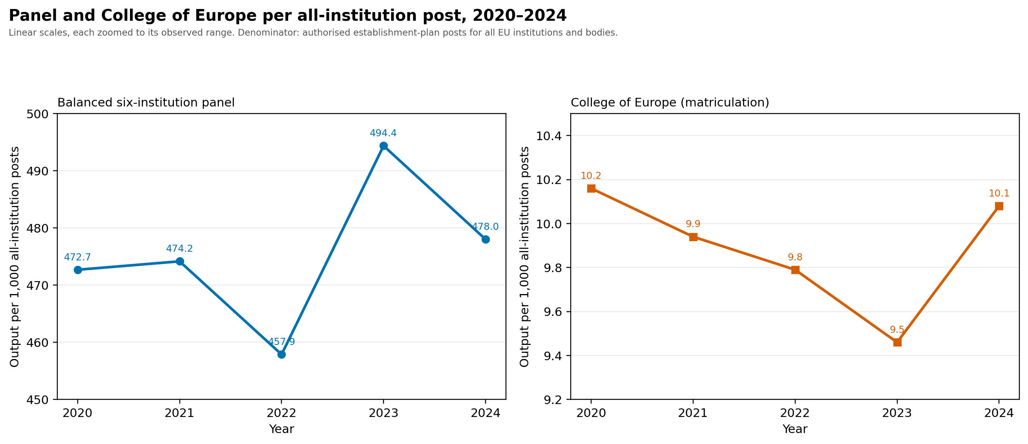
THE DENOMINATOR
Stability relative to bureaucracy size
• All-institution establishment posts: 47,151 → 49,028 (2020–2024), +4.0%.
• Panel output per 1,000 posts: 473 → 478.
• College output per 1,000 posts: 10.2 → 10.1.
• The bureaucracy grew; gating output did not expand relative to it.
European Elites · Gating, positions, and overproduction
19

Slide 20
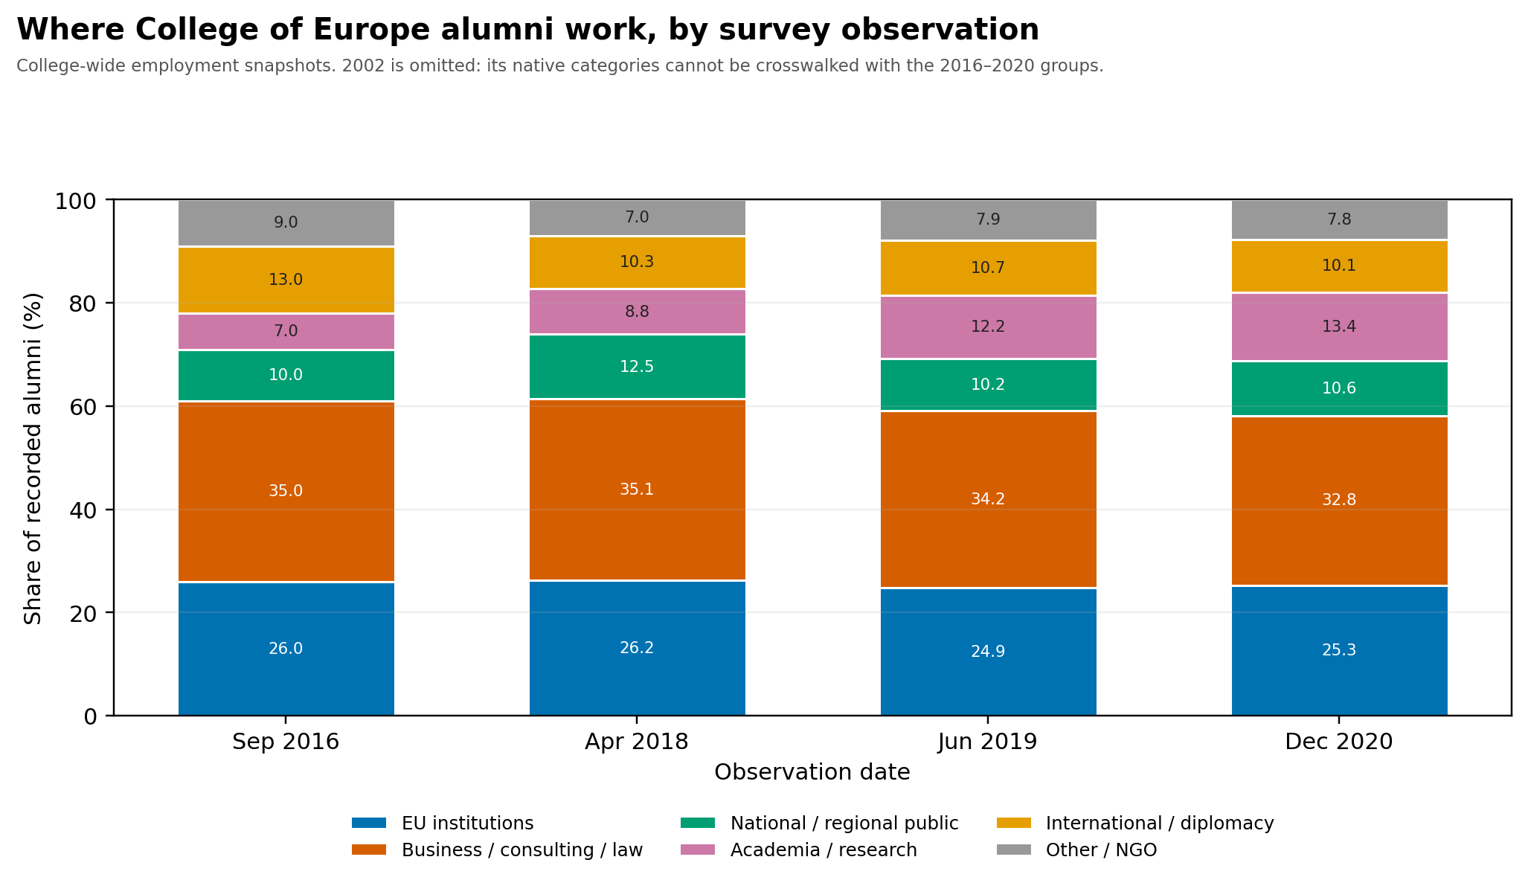
DESTINATIONS
Where College of Europe alumni work
• EU institutions stable at roughly 25–26%.
• National/regional public: 10–12.5%.
• Business, consulting and law: 33–35%.
• Academia/research rose from 7% to 13%.
• 2002 omitted: categories cannot be crosswalked.
European Elites · Gating, positions, and overproduction
20

Slide 21
CONCLUSION
Not a lot of elite overproduction at the European level
• The long output series do not show a uniform expansion.
• Relative to the total EU institutional bureaucracy, panel and College output are relatively flat.
• Gating is real but plural: 23 institutions, not one school.
• The College of Europe is a meaningful but minority pipeline.
• This is descriptive: no unemployment, rejection or cohort-placement data.
• The evidence supports stability, not a demonstrated overproduction crisis.
What would change this conclusion: matched applicant, appointment and rejection series, and cohort-level placement after graduation.
European Elites · Gating, positions, and overproduction
21

Slide 22
PANEL LIST
Appendix: the N ≥ 5 panel
• Bocconi University
• Charles University
• College of Europe
• Georgetown University
• HEC Paris
• Harvard University
• INSEAD
• London School of Economics
• National and Kapodistrian University of Athens
• Sapienza University of Rome
• Stockholm University
• UCLouvain
• University of Cambridge
• University of Cologne
• University of Ljubljana
• University of Malta
• University of Oxford
• University of Tartu
• Université Paris II Panthéon-Assas
• Université libre de Bruxelles
• Vilnius University
• École Polytechnique
• École nationale d’administration
European Elites · Gating, positions, and overproduction
22

Slide 23
CONCLUSION
Preliminary conclusions
• Elite overproduction in EU?
• If we take professional cadres of institutions such as European Commission and its gating institutions such as College of Europe as proxy, it is not obvious that this is occurring
• However, this brings us back to question of what we mean by “elites” and “elite overproduction”
European Elites · Gating, positions, and overproduction
23

Slide 24
CONCLUSION
Preliminary conclusions (contd.)
• However, this does not mean that “elite overproduction” in other senses of term is not happening
• Qualitative (including elite-interview-based) evidence that gating institutions such as College of Europe may be exerting strong “Bourdieusian” effect, i.e. selecting for the “right” people among already highly-qualified pool of applicants
European Elites · Gating, positions, and overproduction
24

Slide 25
CONCLUSION
Preliminary conclusions (contd.)
• Thus, elite pipeline to European institutions may be operating in stable manner while overproduction of elite aspirants continues around this pipeline
European Elites · Gating, positions, and overproduction
25

Slide 26
NEXT
Next steps
• Supranational elite forming outside EU institutions?
• Elite overproduction in sense of wealth pump operating at this level?
• EU elite pipeline may be relatively stable, but is this really a “power elite”?
• Broader SDT analysis of EU looking beyond elites and elite pverproduction
European Elites · Gating, positions, and overproduction
26

