Slide 1
Who Is the European Elite?
Gating, positions, and overproduction
Gavin Mendel-Gleason · Donagh Davis
Workshop on AI Methodology for Social Science · May 2026
Evidence from Commissioner, DG/DDG, judicial and College of Europe data

Slide 2
THE QUESTION
Who is the European elite?
• There is no single, coherent “European elite.”
• Commissioners, DGs, corporate directors, judges and MEPs are different populations with different recruitment.
• We study a narrow, testable core: Commission + DG/DDG and EU jurists.
• This is a choice of elite positions, not a claim that all power lies there.
A narrower object
• Political-administrative: Commission + DGs/DDGs
• Legal: EU judges and Advocates General
• Excluded here: MEPs and corporate elites
European Elites · Gating, positions, and overproduction
2

Slide 3
THE CONFLICT
National versus supranational elites
• European integration creates competing recruitment orders: national administrations and parties versus EU institutions and law.
• The question is whether these are separate pipelines or one shared gate.
• Education coverage is strong for the chosen core: Commissioners 79%, DGs/DDGs 92%, jurists 100%.
• Corporate education coverage is only 6%, so the corporate track is not used for this comparison.
79%
92%
100%
Commissioners
DGs/DDGs
Jurists
High coverage makes the comparison possible; it does not make it representative of all elites.
European Elites · Gating, positions, and overproduction
3

Slide 4
OPERATIONAL CHOICE
Why Commission + DG/DDG and jurists?
• They are EU-level positions, not national offices.
• They sit on opposite sides of the institutional divide: political-administrative versus legal.
• Their biographies are unusually well documented.
• If a European gating structure exists, it should be visible here first.
• This is an operational test, not a complete theory of European power.
European Elites · Gating, positions, and overproduction
4

Slide 5
METHODOLOGY I
How we obtain the network
• Fixed roster: 150 commissioners, 85 DGs/DDGs, 1,000 corporate elites and 98 jurists; MEPs are a separate corpus.
• 823 source snapshots: Wikipedia, Commission CVs, CJEU biographies, declarations of interests; each hashed with SHA-256.
• Each source is segmented into sentences with exact character offsets.
• A claim is a subject–predicate–object candidate; only verified claims with active endpoints become edges.
• Graph export: 3,226 nodes and 3,850 edges; 2,837 are network edges. The network is person–organisation, not person–person.
European Elites · Gating, positions, and overproduction
5

Slide 6
METHODOLOGY II
How we extract the data
• Long biographies are never truncated: chunks of at most 40 sentences or about 12,000 characters, with two-sentence overlap.
• The model receives numbered sentences and returns: organisation, role phrase, relation, exact evidence sentence, sentence number.
• A controlled relation vocabulary separates membership, board, advisory board, chair, employment, fellowship, party and attendance.
• Extraction runs at temperature zero with thinking disabled; prompt/response pairs are cached by a model-aware hash.
• The output is a candidate claim, not a fact; the model is never evidence for itself.
European Elites · Gating, positions, and overproduction
6

Slide 7
METHODOLOGY III
How we cross-check
• Deterministic locator: normalised prefix match from 240 down to 40 characters; exact character offsets.
• No match = reject; never assign a guessed phrase index.
• Grade A: subject, object and role keyword present. Grade B: role implicit. Grade C: missing element → adjudication.
• Second-model adjudication and human review; rejections and reviews are durable rows.
• Verified requires located evidence. Only verified assertions enter the graph.
Current build
5,707
claims
4,326
verified
229
under review
1,152
rejected
European Elites · Gating, positions, and overproduction
7

Slide 8
COVERAGE
Gating institutions? A 23-institution panel
• Narrow definition: institutions repeatedly present among educated elite people.
• Presence is measurable; necessity and causation are not.
• Panel: every institution with at least five educated elite people — N ≥ 5.
• 23 institutions; largest are College of Europe (18), Harvard (14), Cambridge (10), ENA (10).
• Coverage: 29.9% of Commission + DG/DDG; 59.2% of jurists.
• Bocconi University
• Charles University
• College of Europe
• Georgetown University
• HEC Paris
• Harvard University
• INSEAD
• London School of Economics
• National and Kapodistrian University of Athens
• Sapienza University of Rome
• Stockholm University
• UCLouvain
• University of Cambridge
• University of Cologne
• University of Ljubljana
• University of Malta
• University of Oxford
• University of Tartu
• Université Paris II Panthéon-Assas
• Université libre de Bruxelles
• Vilnius University
• École Polytechnique
• École nationale d’administration
European Elites · Gating, positions, and overproduction
8

Slide 9
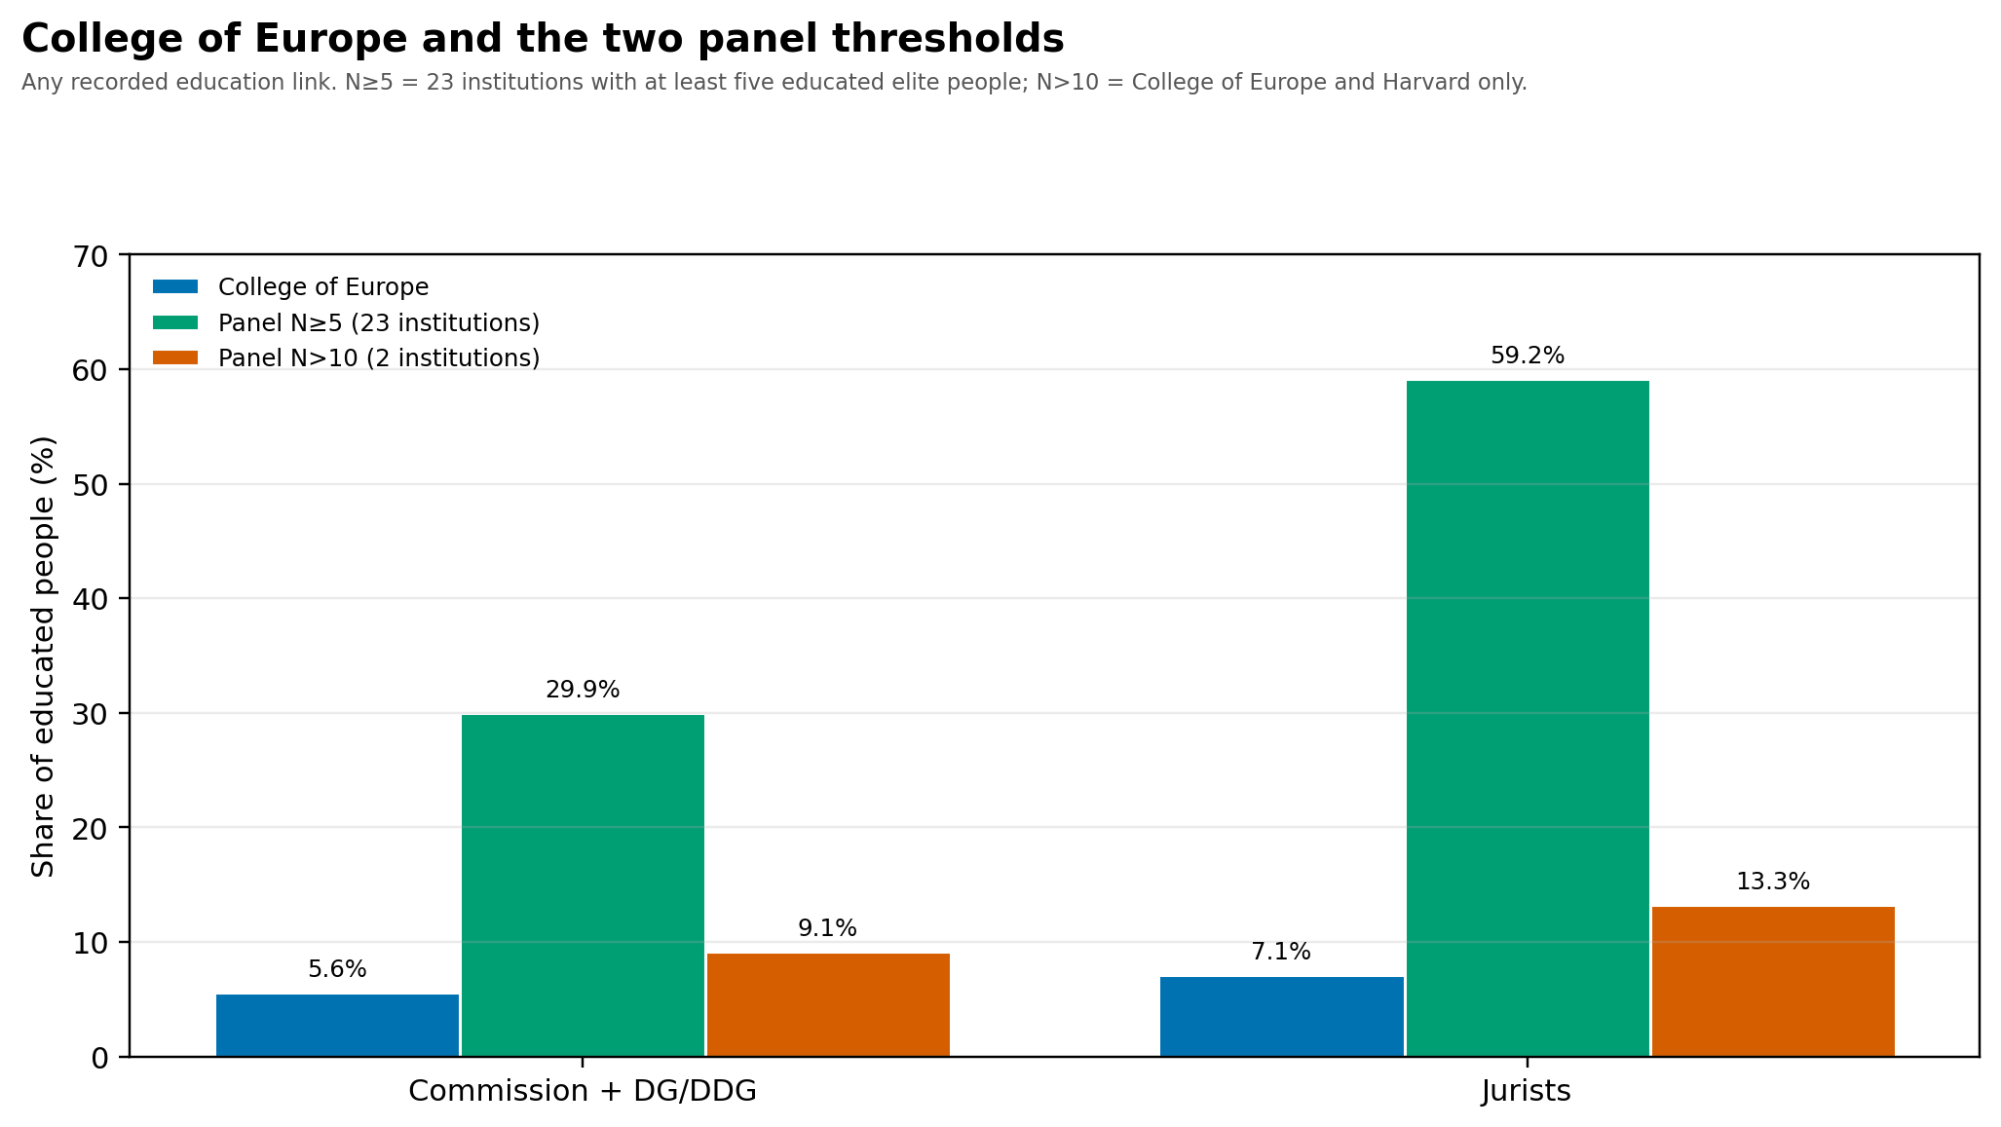
COVERAGE
College of Europe and the two panels
• College alone: 5.6% of Commission + DG/DDG; 7.1% of jurists.
• Panel N≥5 (23 institutions): 29.9% and 59.2%.
• Panel N>10 (College + Harvard): 9.1% and 13.3%.
• Raising the threshold collapses coverage toward the College.
• The College is a real pipeline, but not a standalone gateway.
European Elites · Gating, positions, and overproduction
9

Slide 10
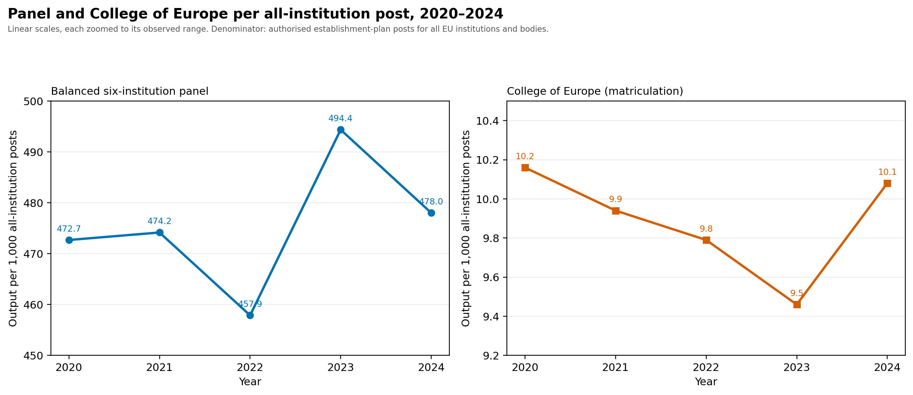
THE DENOMINATOR
Stability relative to bureaucracy size
• All-institution establishment posts: 47,151 → 49,028 (2020–2024), +4.0%.
• Panel output per 1,000 posts: 473 → 478.
• College output per 1,000 posts: 10.2 → 10.1.
• The bureaucracy grew; gating output did not expand relative to it.
European Elites · Gating, positions, and overproduction
10

Slide 11
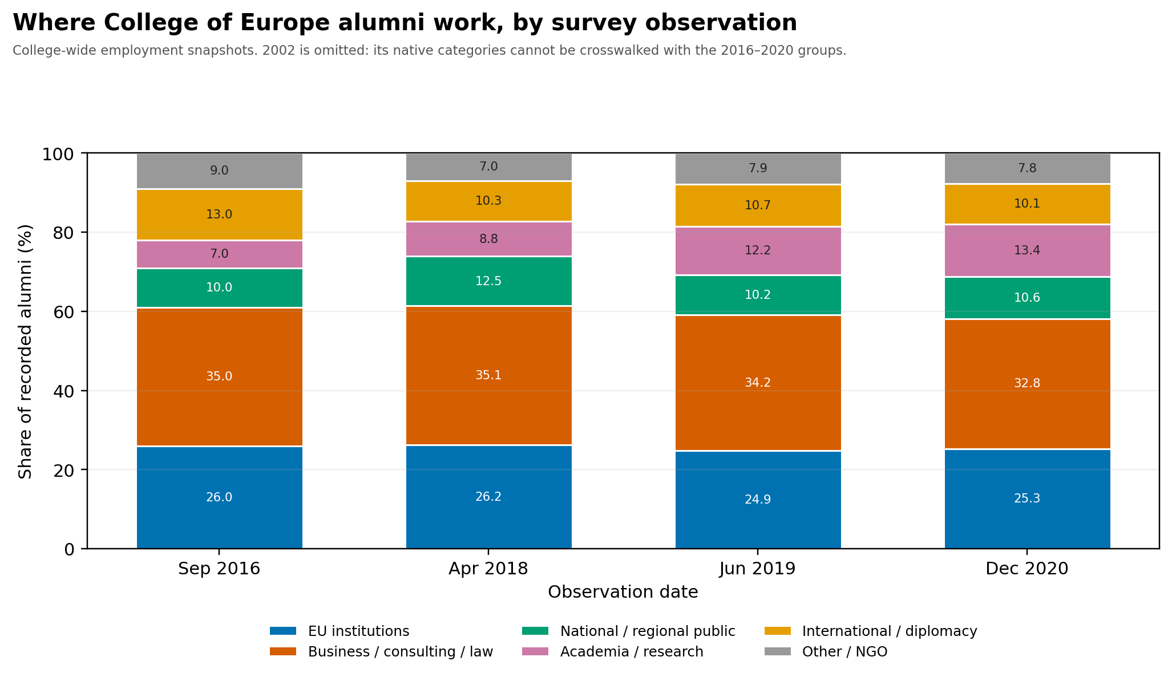
DESTINATIONS
Where College of Europe alumni work
• EU institutions stable at roughly 25–26%.
• National/regional public: 10–12.5%.
• Business, consulting and law: 33–35%.
• Academia/research rose from 7% to 13%.
• 2002 omitted: categories cannot be crosswalked.
European Elites · Gating, positions, and overproduction
11

Slide 12
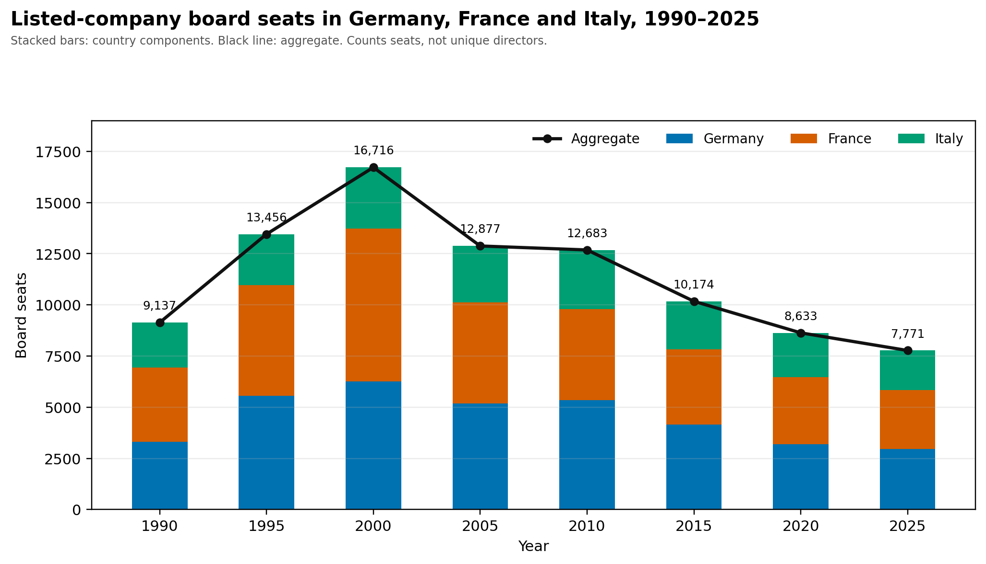
LIMITATIONS
A very incomplete picture
• Corporate frame: only 64 of 1,000 people have usable education records.
• No way to distinguish a European economic elite from a national economic elite.
• Board seats in Germany, France and Italy contract after 2000.
• If national positions shrink while aspirants continue, that is potential overproduction at the national level.
• A national elite rupture could destabilise the EU; the data cannot test that link.
European Elites · Gating, positions, and overproduction
12

Slide 13
CONCLUSION
Not a lot of elite overproduction at the European level
• The long output series do not show a uniform expansion.
• Relative to the total EU institutional bureaucracy, panel and College output are flat.
• Gating is real but plural: 23 institutions, not one school.
• The College of Europe is a meaningful but minority pipeline.
• This is descriptive: no unemployment, rejection or cohort-placement data.
• The evidence supports stability, not a demonstrated overproduction crisis.
What would change this conclusion: matched applicant, appointment and rejection series, and cohort-level placement after graduation.
European Elites · Gating, positions, and overproduction
13

Slide 14
PANEL LIST
Appendix: the N ≥ 5 panel
• Bocconi University
• Charles University
• College of Europe
• Georgetown University
• HEC Paris
• Harvard University
• INSEAD
• London School of Economics
• National and Kapodistrian University of Athens
• Sapienza University of Rome
• Stockholm University
• UCLouvain
• University of Cambridge
• University of Cologne
• University of Ljubljana
• University of Malta
• University of Oxford
• University of Tartu
• Université Paris II Panthéon-Assas
• Université libre de Bruxelles
• Vilnius University
• École Polytechnique
• École nationale d’administration
European Elites · Gating, positions, and overproduction
14

