Slide 1

Family Capital Gap Analysis + Blueprint
Mr. and Mrs. ______
Aligning Family & Capital With a 100-Year Vision
Presented | March 3rd, 2026
PARADIEM | FAMILY CAPITAL ARCHITECTURE
Paradiem, LLC is a Registered Investment Advisor.
CONFIDENTIAL — NOT FOR DISTRIBUTION

Slide 2
DISCLOSURES
Legal Disclosures & Important Information
Paradiem, LLC is a Registered Investment Advisor.
This presentation is provided for informational and educational purposes only and is intended solely for the recipient. It is not intended as, and should not be construed as, personalized investment advice, a recommendation, or an offer to buy or sell any security or to adopt any investment strategy.
Any references to investment strategies, portfolio construction, or planning concepts are general in nature and may not be suitable for all individuals. Investment decisions should be made based on an individual’s specific financial situation, objectives, risk tolerance, and time horizon, and in consultation with appropriate financial, tax, and legal advisors.
All investing involves risk, including the potential loss of principal. Past performance is not indicative of future results. Any forward-looking statements, projections, or scenario analyses are hypothetical in nature, subject to significant limitations, and do not reflect actual results. There is no guarantee that any investment objective or strategy will be achieved.
Where performance results are shown or discussed, additional information regarding calculation methodologies, time periods, benchmarks, and material assumptions is available upon request. Any comparisons to benchmarks or indices are provided for illustrative purposes only, and such indices may differ significantly from the strategy described.
Paradiem, LLC may utilize third-party data, research, or tools believed to be reliable; however, the accuracy and completeness of such information cannot be guaranteed. Any opinions expressed are as of the date of the presentation and are subject to change without notice.
Advisory services are only offered to clients or prospective clients where Paradiem and its representatives are properly licensed or exempt from registration.
Additional information about Paradiem, LLC including its Form ADV Part 2A (Firm Brochure), is available upon request or at www.adviserinfo.sec.gov.
PARADIEM | FAMILY CAPITAL ARCHITECTURE
Paradiem, LLC is a Registered Investment Advisor.
CONFIDENTIAL — NOT FOR DISTRIBUTION

Slide 3
INVESTMENT PHILOSOPHY
Two Kinds
of Return
You can have strong returns...
and still fail your family long-term.
RETURN ON INVESTMENT
Preparing the Money for the Family
Most advisors stop here.
RETURN ON INTENTION
Preparing the Family for the Money
Where we go further.
PARADIEM | FAMILY CAPITAL ARCHITECTURE
Paradiem, LLC is a Registered Investment Advisor.
CONFIDENTIAL — NOT FOR DISTRIBUTION

Slide 4
OUR PROCESS
Family Capital Architecture
01
02
03
Family Capital
Assessment
Family Capital
Gap Analysis + Blueprint
Family Capital
Blueprint
First session — mapping the current state of your family and capital.
Deep diagnostic identifying gaps between where you are and where you should be.
Today - Your comprehensive multi-generational wealth and legacy roadmap.
TODAY
PARADIEM | FAMILY CAPITAL ARCHITECTURE
Paradiem, LLC is a Registered Investment Advisor.
CONFIDENTIAL — NOT FOR DISTRIBUTION

Slide 5

SECTION ONE
Preparing the Money for the Family
PARADIEM | FAMILY CAPITAL ARCHITECTURE
Paradiem, LLC is a Registered Investment Advisor.
CONFIDENTIAL — NOT FOR DISTRIBUTION

Slide 6
YOUR CURRENT GOALS AND OBJECTIVES
Goals and Intentions
Maintain annual lifestyle spending at $96,000
Maintain our emergency reserve at $40,000
Minimize the impact of inflation on our regular income
Spend up to $10,000 per year on travel
Use retirement funds to open a small business for carpentry and real estate opportunities
Leave our estate to our children as their inheritance
Continue annual charitable giving at $8,000
PARADIEM | FAMILY CAPITAL ARCHITECTURE
Paradiem, LLC is a Registered Investment Advisor.
CONFIDENTIAL — NOT FOR DISTRIBUTION

Slide 7
FINANCIAL OVERVIEW
Our Financial Security and Fulfillment
PARADIEM | FAMILY CAPITAL ARCHITECTURE
Paradiem, LLC is a Registered Investment Advisor.
CONFIDENTIAL — NOT FOR DISTRIBUTION

Slide 8
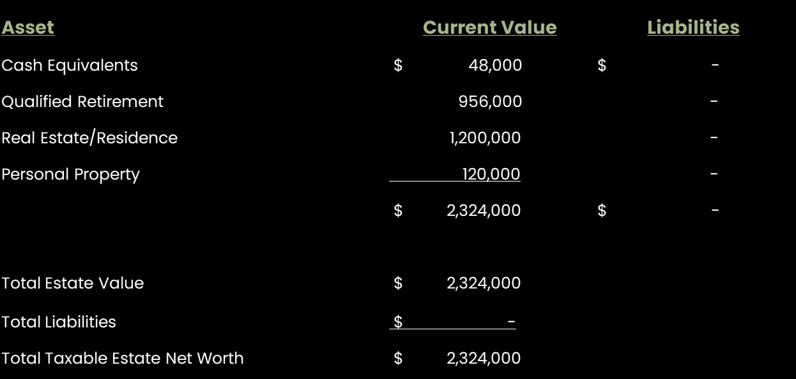
FINANCIAL OVERVIEW
Your Current Balance Sheet
PARADIEM | FAMILY CAPITAL ARCHITECTURE
Paradiem, LLC is a Registered Investment Advisor.
CONFIDENTIAL — NOT FOR DISTRIBUTION

Slide 9
GOALS AND INTENTIONS ANALYSIS
Basic Legal Documents
OBSERVATIONS
SOLUTIONS
You have a recently updated Will.
We did not receive any complete legal documents to review them.
Create or review the following Legal Documents for accuracy: Wills, Durable Power of Attorney, Medical Power of Attorney, Healthcare Directive.
Obtain signed HIPAA authorization forms from your adult children.
PARADIEM | FAMILY CAPITAL ARCHITECTURE
Paradiem, LLC is a Registered Investment Advisor.
CONFIDENTIAL — NOT FOR DISTRIBUTION

Slide 10
GOALS AND INTENTIONS ANALYSIS
Cash Flow
OBSERVATIONS
SOLUTIONS
You plan to spend $96,000/year on living expenses, including $10,000/year on travel.
You estimated you have about $48,000 in cash across all accounts, including your $40,000 in desired reserves.
After rolling the annuity into an IRA, your pension income, Social Security, and IRA distributions will fully fund your $96,000 annual lifestyle while maintaining the $40,000 cash reserve.
PARADIEM | FAMILY CAPITAL ARCHITECTURE
Paradiem, LLC is a Registered Investment Advisor.
CONFIDENTIAL — NOT FOR DISTRIBUTION

Slide 11
GOALS AND INTENTIONS ANALYSIS
Insurance
OBSERVATIONS
SOLUTIONS
Frank currently has $120,000 of Whole Life insurance coverage and Tina has $30,000 of coverage.
We have not received copies of the policies, so we have not been able to evaluate the policy structures and cash values.
Obtain and review existing Whole Life policies to evaluate cash value, structure, performance & necessity.
Assess whether current Life Insurance coverage remains appropriate.
Evaluate Long-Term Care planning options to help protect retirement assets from healthcare expenses.
PARADIEM | FAMILY CAPITAL ARCHITECTURE
Paradiem, LLC is a Registered Investment Advisor.
CONFIDENTIAL — NOT FOR DISTRIBUTION

Slide 12
GOALS AND INTENTIONS ANALYSIS
Medicare
OBSERVATIONS
SOLUTIONS
Both of you are not eligible to enroll in Medicare until age 65.
Create a reminder to enroll in Medicare at age 65 to avoid potential late enrollment penalties.
Add any estimated Medicare premiums and healthcare costs into your retirement cash flow projections. (Approx $24,000 annually)
PARADIEM | FAMILY CAPITAL ARCHITECTURE
Paradiem, LLC is a Registered Investment Advisor.
CONFIDENTIAL — NOT FOR DISTRIBUTION

Slide 13
GOALS AND INTENTIONS ANALYSIS
Social Security
OBSERVATIONS
SOLUTIONS
Both of you are not currently drawing your Social Security benefits.
Frank is unsure when to begin Social Security after he retires to best supplement retirement income.
Begin Social Security at age 63 in November, which would increase your benefit by approximately $150 per month compared to starting earlier.
Tina should plan to draw SS beginning at age 63, taking the spousal benefit (1/2 of Frank’s SS benefit).
PARADIEM | FAMILY CAPITAL ARCHITECTURE
Paradiem, LLC is a Registered Investment Advisor.
CONFIDENTIAL — NOT FOR DISTRIBUTION

Slide 14
GOALS AND INTENTIONS ANALYSIS
Inheritance
OBSERVATIONS
SOLUTIONS
You plan to leave whatever is left in your estate to your children after your passing.
We did not receive complete copies of your will or trust documents to analyze the distribution of assets.
Consider leaving some inheritance to your children during your lifetime.
Facilitate open family conversations about inheritance to align expectations, reduce conflict, and reinforce shared values.
PARADIEM | FAMILY CAPITAL ARCHITECTURE
Paradiem, LLC is a Registered Investment Advisor.
CONFIDENTIAL — NOT FOR DISTRIBUTION

Slide 15
CURRENT PLAN ANALYSIS
Planning Assumptions & Strategies
PARADIEM | FAMILY CAPITAL ARCHITECTURE
Paradiem, LLC is a Registered Investment Advisor.
CONFIDENTIAL — NOT FOR DISTRIBUTION

Slide 16
CURRENT PLAN ANALYSIS
Assumptions in Plan
CASH GROWTH
INVESTMENT GROWTH
0%
6.62%
PARADIEM | FAMILY CAPITAL ARCHITECTURE
Paradiem, LLC is a Registered Investment Advisor.
CONFIDENTIAL — NOT FOR DISTRIBUTION

Slide 17
CURRENT PLAN ANALYSIS
Pension and Social Security
Pension Benefits optimization: modeled 100% Participant Spouse on Pension 1 and 50% Participant Spouse on Pension 2.
Social Security optimization: Both of you begin at age 63.
PARADIEM | FAMILY CAPITAL ARCHITECTURE
Paradiem, LLC is a Registered Investment Advisor.
CONFIDENTIAL — NOT FOR DISTRIBUTION

Slide 18
CURRENT PLAN ANALYSIS
Potential Strategies Analyzed
Pension Benefits optimization: analysis of options.
Social Security optimization: early benefit vs. waiting until full retirement age vs. delaying to age 70.
Investing full $956,000 of IRA Rollover into Paradiem Dividend Strategy [Base Plan].
Applying $300,000 of your IRA Rollover towards a Long Term Care optimized annuity [LTC Annuity].
PARADIEM | FAMILY CAPITAL ARCHITECTURE
Paradiem, LLC is a Registered Investment Advisor.
CONFIDENTIAL — NOT FOR DISTRIBUTION

Slide 19
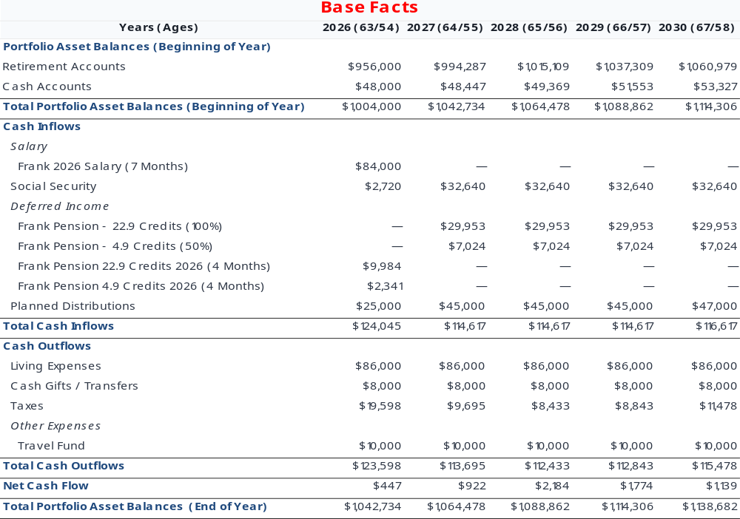
BASE PLAN
5-Year Cash Flow
PARADIEM | FAMILY CAPITAL ARCHITECTURE
Paradiem, LLC is a Registered Investment Advisor.
CONFIDENTIAL — NOT FOR DISTRIBUTION

Slide 20
BASE PLAN
5 Year Cash Needs
UPCOMING CASH NEED
YEAR 1 CASH ON HAND
$25K
$34K
YEAR 2
YEAR 3
YEAR 4
YEAR 5
2027
2028
2029
2030
$45K
$45K
$45K
$47K
PARADIEM | FAMILY CAPITAL ARCHITECTURE
Paradiem, LLC is a Registered Investment Advisor.
CONFIDENTIAL — NOT FOR DISTRIBUTION

Slide 21
BASE PLAN
5 Year Cash Needs
Retirement Cash Need: $25K
Year 1 Cash on Hand: $34K
$45K
$45K
$45K
$47K
Year 2
Year 3
Year 4
Year 5
2027
2028
2029
2030
PARADIEM | FAMILY CAPITAL ARCHITECTURE
Paradiem, LLC is a Registered Investment Advisor.
CONFIDENTIAL — NOT FOR DISTRIBUTION

Slide 22
RESEARCH REVEALS OPPORTUNITY
Buy Option Cash Strategy in Down Markets
Down Market Deployment Logic
25% Drop
1
Invest 70% of the last year bond
40% Drop
2
Invest the remaining 30% of last year bond
(Average duration: 40 months*)
*40 Months to recovery – “Bear markets may not be as ferocious as they appear”, Mark Hulbert, Wall Street Journal, March 8-9, 2014.
PARADIEM | FAMILY CAPITAL ARCHITECTURE
Paradiem, LLC is a Registered Investment Advisor.
CONFIDENTIAL — NOT FOR DISTRIBUTION

Slide 23
Teeves FAMILY OWNERSHIP
Teeves Family Proposed Ownership
PORTFOLIO COMPOSITION
PROPOSED OWNERSHIP BREAKDOWN
STRATEGY
MANAGER
ALLOC
AMOUNT
Dividends
Paradiem Dividend Strategy
64.4%
$611,800
Dividends
64.4%
$611,800
Growth
Paradiem Growth Strategy
27.6%
$262,200
Growth
27.6%
$262,200
Cash
Cash
8.0%
$76,000
Cash
TOTAL
100%
$950,000
8.0%
$76,000
TOTAL
$950,000
PARADIEM | FAMILY CAPITAL ARCHITECTURE
Paradiem, LLC is a Registered Investment Advisor.
CONFIDENTIAL — NOT FOR DISTRIBUTION

Slide 24
SIMPLICITY OVER COMPLEXITY
25 Stock Dividend Strategy Returns & Statistics
ANNUALISED RETURNS (AS OF 9/30/2026)
YTD
1-YR
3-YR
5-YR
10-YR
GROSS
13.55%
17.11%
20.98%
16.73%
14.54%
NET
12.28%
15.37%
19.18%
14.99%
12.84%
iShares Select Dividend ETF (DVY)
10.33%
10.83%
16.33%
9.66%
9.74%
State Street S & P 500 ETF Trust (SPY)
12.71%
15.71%
22.76%
13.70%
15.23%
STATISTICS vs. iShares Select Dividend ETF (DVY)
1-YR
3-YR
5-YR
10-YR
UP-MARKET CAPTURE
115.84%
102.17%
108.19%
109.09%
DOWN-MARKET CAPTURE
94.05%
84.67%
85.57%
97.10%
Paradiem, LLC is a Registered Investment Advisor. Performance is based on actual client accounts that are invested in Paradiem’s Dividend strategy.
Past performance is no guarantee of future results. Returns presented include the reinvestment of all income. Gross-of-fee performance includes trading expenses and custodial expenses. Net-of-fee performance includes actual account-level gross returns, less a model investment management fee. The model fee is deducted monthly from composite returns at the rate of 1/12 of Paradiem’s highest annual fee tier. The highest rate of our annual fixed fee is 1.5%.
The iShares Select Dividend ETF fund generally will invest at least 80% of its assets in the component securities of its underlying index and in investments that have economic characteristics that are substantially identical to the component securities of its underlying index. The underlying index measures the performance of the U.S.’s leading stocks by dividend yield.
The State Street SPDR S&P 500 ETF Trust is an exchange-traded fund (ETF) that tracks the Standard & Poor’s 500 (S&P 500) index. It does this by holding a portfolio of stocks in companies that are included in the S&P 500.
PARADIEM | FAMILY CAPITAL ARCHITECTURE
Paradiem, LLC is a Registered Investment Advisor.
CONFIDENTIAL — NOT FOR DISTRIBUTION

Slide 25
25 Stock Growth Strategy
RETURNS (AS OF 9/30/2026)
1-MO
3-MO
TR 8-MO
GROSS
-1.52%
-0.80%
22.81%
NET
-1.65%
-1.17%
21.58%
iShares Core S&P U.S.
Growth ETF (IUSG)
1.78%
3.14%
14.89%
State Street S&P 500
ETF Trust (SPY)
-0.33%
2.38%
11.07%
Paradiem, LLC is a Registered Investment Advisor. Performance is based on actual client accounts that are invested in Paradiem’s Growth strategy.
Past performance is no guarantee of future results. Returns presented include the reinvestment of all income. Gross-of-fee performance includes trading expenses and custodial expenses. Net-of-fee performance includes actual account-level gross returns, less a model investment management fee. The model fee is deducted monthly from composite returns at the rate of 1/12 of Paradiem’s highest annual fee tier. The highest rate of our annual fixed fee is 1.5%.
The iShares Core S&P U.S. Growth ETF seeks to track an index composed of U.S. large and mid-cap companies, selected using metrics such as above-average earnings and revenue growth. The fund provides low-cost, targeted exposure to U.S. large and mid-cap growth stocks.
The State Street SPDR S&P 500 ETF Trust is an exchange-traded fund (ETF) that tracks the Standard & Poor’s 500 (S&P 500) index. It does this by holding a portfolio of stocks in companies that are included in the S&P 500.

Slide 26
PERFORMANCE ANALYSIS
Performance Audit
Current Portfolio
Potential Portfolio
8.68%
10.23%
Potential Annual Return
Potential Annual Return
0.84%
1.64%
Annual Dividend Yield
Annual Dividend Yield
9.52%
11.87%
Total Potential Return
Total Potential Return
Projections are hypothetical and do not reflect actual results. Past performance is no guarantee of future results. Calculated using Riskalyze methodology.
PARADIEM | FAMILY CAPITAL ARCHITECTURE
Paradiem, LLC is a Registered Investment Advisor.
CONFIDENTIAL — NOT FOR DISTRIBUTION

Slide 27
RISK ASSESSMENT
Abrams Family — Lifeboat Drill
95% Probability Range — 6-Month Horizon
-17.25%
$950,000
+27.90%
-$163,000 Potential Loss
CURRENT PORTFOLIO
+$265,000 Potential Gain
Current
The 95% Probability Range was calculated using a long-term average of 10.4% for the S&P 500, 0bps change in the Ten-Year US Treasury Rate, and correlation and volatility data from 2008 to present. Riskalyze uses actual historical data to calculate the statistical probabilities
shown. For securities calculated using Average Annual Return, the Average Return will be calculated using actual price history from June 2004-present or inception. We calculate the annualized return number as ( final price / initial price ) ^ ( 1 / number of years ) - 1. Riskalyze
does not provide investment analysis on investments with less than 6 months of historical performance. In instances where an investment’s inception is more recent than January 1, 2008 and greater than 6 months Riskalyze will use correlation statistics from the investments
actual trading history to extrapolate missing volatility data. In most cases the extrapolation calculation increases the risk presented in the investment analysis as a means of protecting the investor. Investments with an inception more recent than January 1, 2008 are highlighted
with an information icon . The Six Month 95% Probability Range is calculated from the standard deviation of the portfolio (via covariance matrix), and represents a hypothetical statistical probability, but there is no guarantee any investments would perform within the range. There
is a 5% probability of greater losses. Riskalyze does not use any Monte Carlo or any other type of simulations. ​
The underlying data is updated as of the previous day’s market close price, and the results may vary with each use and over time. The investments considered were determined by the financial representative.​
IMPORTANT: The projections or other information generated by Riskalyze regarding the likelihood of various investment outcomes are hypothetical in nature, do not reflect actual investment ​
results and are not guarantees of future results. These figures may exclude commissions, sales charges or fees which, if included, would have had a negative effect on the annual returns.
PARADIEM | FAMILY CAPITAL ARCHITECTURE
Paradiem, LLC is a Registered Investment Advisor.
CONFIDENTIAL — NOT FOR DISTRIBUTION

Slide 28
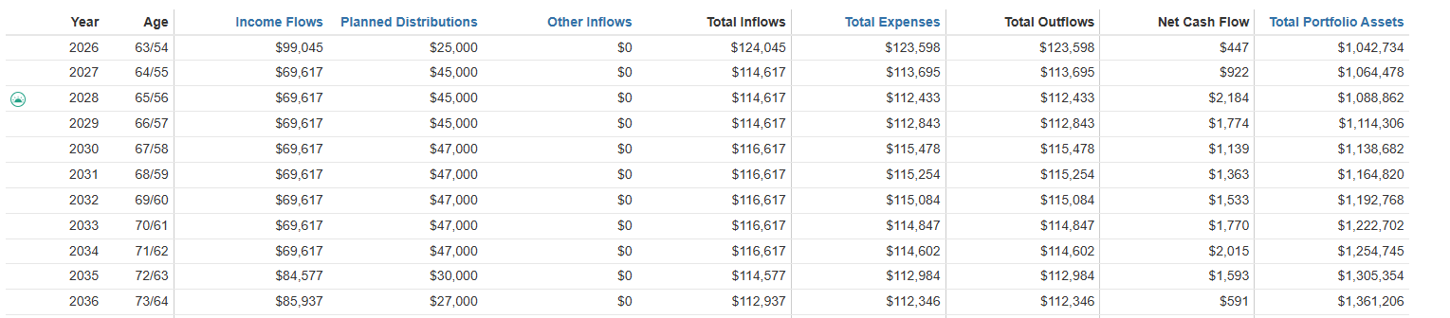
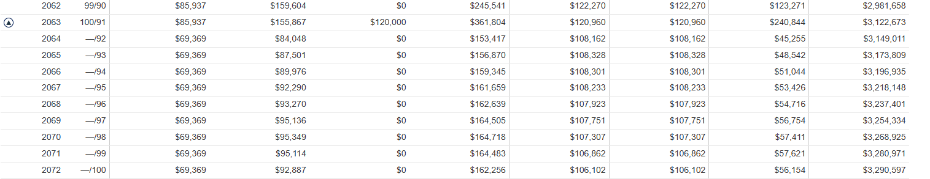
BASE PLAN
Lifetime Cash Flow
PARADIEM | FAMILY CAPITAL ARCHITECTURE
Paradiem, LLC is a Registered Investment Advisor.
CONFIDENTIAL — NOT FOR DISTRIBUTION

Slide 29
LTC ANNUITY
$300,000 LTC Annuity
$15,038 annual income for your joint life
Income doubler triggered by 2 of 6 ADLs – $30,076 for up to 5 years
Four-year waiting period before enhanced benefits become available
Non-Concurrent Enhanced Benefit: one spouse can use part of the enhanced period and the other still retains remaining eligibility
Enhanced payouts continue even if account value reaches $0
PARADIEM | FAMILY CAPITAL ARCHITECTURE
Paradiem, LLC is a Registered Investment Advisor.
CONFIDENTIAL — NOT FOR DISTRIBUTION

Slide 30
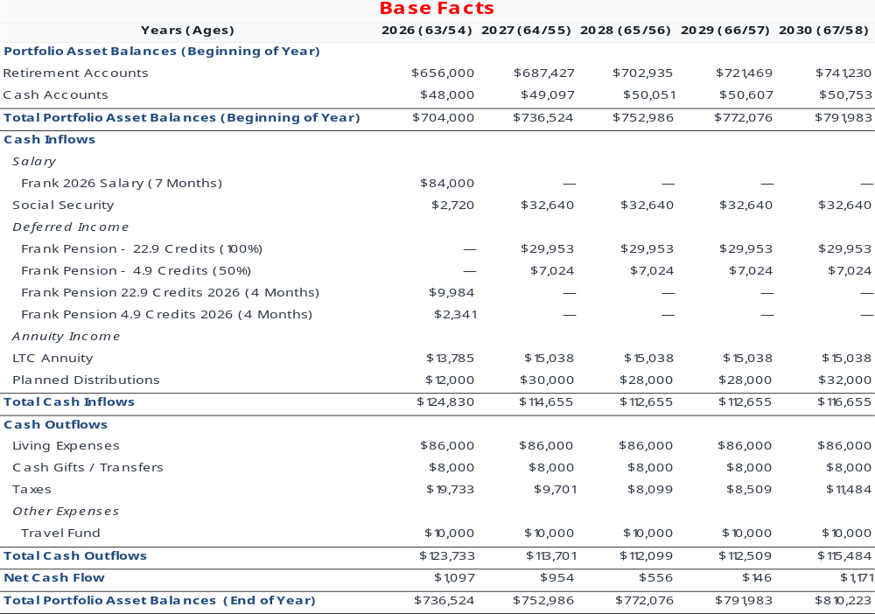
$300,000 LTC ANNUITY
5-Year Cash Flow
PARADIEM | FAMILY CAPITAL ARCHITECTURE
Paradiem, LLC is a Registered Investment Advisor.
CONFIDENTIAL — NOT FOR DISTRIBUTION

Slide 31
$300,000 LTC ANNUITY
5 Year Cash Needs
UPCOMING CASH NEED
YEAR 1 CASH ON HAND
$12K
$16K
YEAR 2
YEAR 3
YEAR 4
YEAR 5
2027
2028
2029
2030
$30K
$28K
$28K
$32K
PARADIEM | FAMILY CAPITAL ARCHITECTURE
Paradiem, LLC is a Registered Investment Advisor.
CONFIDENTIAL — NOT FOR DISTRIBUTION

Slide 32
5 Year Cash Needs
$300,000 LTC ANNUITY
Retirement Cash Need: $12K
Year 1 Cash on Hand: $16K
$30K
$28K
$28K
$32K
Year 2
Year 3
Year 4
Year 5
2027
2028
2029
2030
PARADIEM | FAMILY CAPITAL ARCHITECTURE
Paradiem, LLC is a Registered Investment Advisor.
CONFIDENTIAL — NOT FOR DISTRIBUTION

Slide 33
$300,000 LTC ANNUITY
Teeves Family Proposed Ownership
PORTFOLIO COMPOSITION
PROPOSED OWNERSHIP BREAKDOWN
STRATEGY
MANAGER
ALLOC
AMOUNT
Dividends
Paradiem Dividend Strategy
64.4%
$611,800
Dividends
64.4%
$611,800
Growth
Paradiem Growth Strategy
27.6%
$262,200
Growth
27.6%
$262,200
Cash
Cash
8.0%
$76,000
Cash
TOTAL
100%
$950,000
8.0%
$76,000
TOTAL
$950,000
PARADIEM | FAMILY CAPITAL ARCHITECTURE
Paradiem, LLC is a Registered Investment Advisor.
CONFIDENTIAL — NOT FOR DISTRIBUTION

Slide 34
PERFORMANCE ANALYSIS
Performance Audit
Current Portfolio
Potential Portfolio
8.68%
10.23%
Potential Annual Return
Potential Annual Return
0.84%
1.64%
Annual Dividend Yield
Annual Dividend Yield
9.52%
11.87%
Total Potential Return
Total Potential Return
Projections are hypothetical and do not reflect actual results. Past performance is no guarantee of future results. Calculated using Riskalyze methodology.
PARADIEM | FAMILY CAPITAL INVESTMENT
CONFIDENTIAL — NOT FOR DISTRIBUTION

Slide 35
RISK ASSESSMENT
Abrams Family — Lifeboat Drill
95% Probability Range — 6-Month Horizon
-17.25%
$950,000
+27.90%
-$163,000 Potential Loss
CURRENT PORTFOLIO
+$265,000 Potential Gain
Current
The 95% Probability Range was calculated using a long-term average of 10.4% for the S&P 500, 0bps change in the Ten-Year US Treasury Rate, and correlation and volatility data from 2008 to present. Riskalyze uses actual historical data to calculate the statistical probabilities
shown. For securities calculated using Average Annual Return, the Average Return will be calculated using actual price history from June 2004-present or inception. We calculate the annualized return number as ( final price / initial price ) ^ ( 1 / number of years ) - 1. Riskalyze
does not provide investment analysis on investments with less than 6 months of historical performance. In instances where an investment’s inception is more recent than January 1, 2008 and greater than 6 months Riskalyze will use correlation statistics from the investments
actual trading history to extrapolate missing volatility data. In most cases the extrapolation calculation increases the risk presented in the investment analysis as a means of protecting the investor. Investments with an inception more recent than January 1, 2008 are highlighted
with an information icon . The Six Month 95% Probability Range is calculated from the standard deviation of the portfolio (via covariance matrix), and represents a hypothetical statistical probability, but there is no guarantee any investments would perform within the range. There
is a 5% probability of greater losses. Riskalyze does not use any Monte Carlo or any other type of simulations. ​
The underlying data is updated as of the previous day’s market close price, and the results may vary with each use and over time. The investments considered were determined by the financial representative.​
IMPORTANT: The projections or other information generated by Riskalyze regarding the likelihood of various investment outcomes are hypothetical in nature, do not reflect actual investment ​
results and are not guarantees of future results. These figures may exclude commissions, sales charges or fees which, if included, would have had a negative effect on the annual returns.
PARADIEM | FAMILY CAPITAL ARCHITECTURE
Paradiem, LLC is a Registered Investment Advisor.
CONFIDENTIAL — NOT FOR DISTRIBUTION

Slide 36
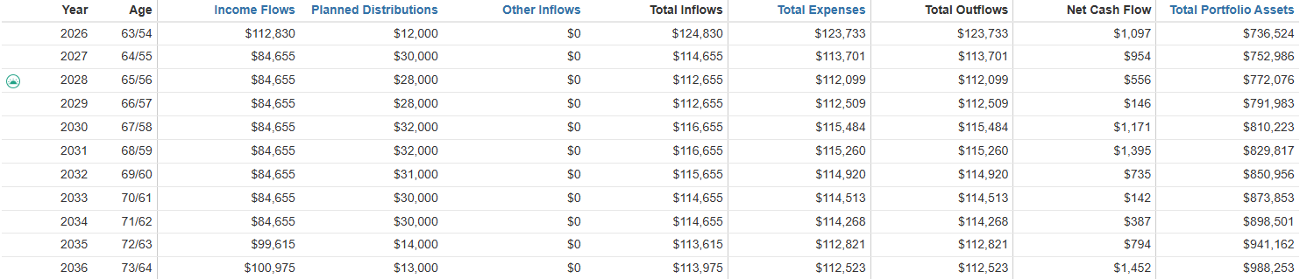
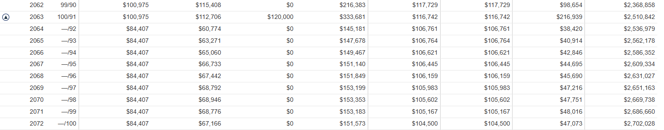
$300,000 LTC ANNUITY
Lifetime Cash Flow
PARADIEM | FAMILY CAPITAL ARCHITECTURE
Paradiem, LLC is a Registered Investment Advisor.
CONFIDENTIAL — NOT FOR DISTRIBUTION

Slide 37
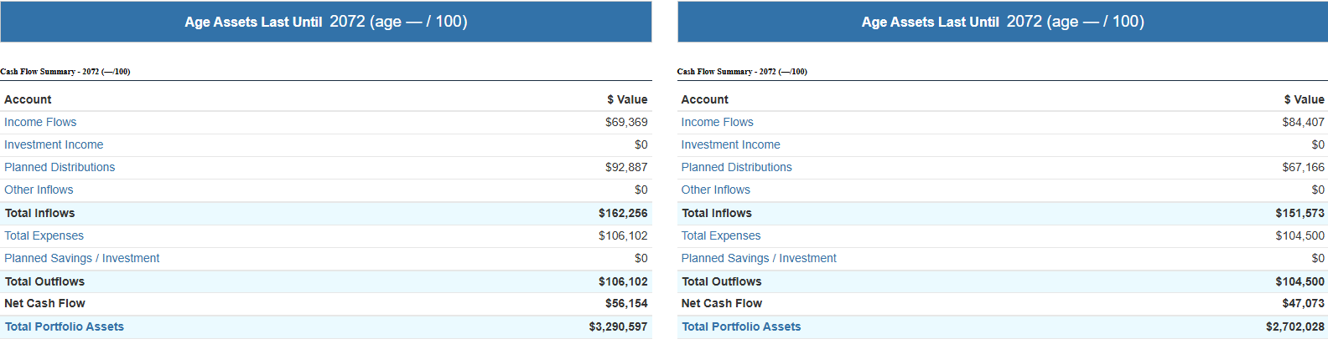
BASE PLAN VS. ANNUITY
Lifetime Cash Flow
Base Plan: $3,290,000 LTC Annuity: $2,702,000
PARADIEM | FAMILY CAPITAL ARCHITECTURE
Paradiem, LLC is a Registered Investment Advisor.
CONFIDENTIAL — NOT FOR DISTRIBUTION

Slide 38
PLAN SUMMARY
Plan Summary
Modeled 100% Participant Spouse on Pension 1 and 50% Participant Spouse on Pension 2.
Begin Social Security at age 63.
Withdrawal from your IRA to keep lifestyle spending at $96,000/year.
Based on the projected cash flow, you would be better off self-funding any Long Term Care needs.
By the time of your projected death, your estate is projected to have ~$3,200,000 in total portfolio assets.
PARADIEM | FAMILY CAPITAL ARCHITECTURE
Paradiem, LLC is a Registered Investment Advisor.
CONFIDENTIAL — NOT FOR DISTRIBUTION

Slide 39
Timeline and
Next Steps
PARADIEM | FAMILY CAPITAL ARCHITECTURE
CONFIDENTIAL — NOT FOR DISTRIBUTION

Slide 40
TIMELINE
Timeline
First Year
Paste in from Excel
PARADIEM | FAMILY CAPITAL ARCHITECTURE
CONFIDENTIAL — NOT FOR DISTRIBUTION

Slide 41
ACTION PLAN
Next Steps
01
Cash Flow and Financial Analysis
02
Generational Impact Retreat
03
Finalize Goals and Intentions
04
Introduction to Advisors
05
Paradiem Planning Day
PARADIEM | FAMILY CAPITAL ARCHITECTURE
CONFIDENTIAL — NOT FOR DISTRIBUTION

