Slide 1

Family Capital Gap Analysis
Mr. and Mrs. ______
Aligning Family & Capital With a 100-Year Vision
Presented | March 3rd, 2026
PARADIEM | FAMILY CAPITAL ARCHITECTURE
Paradiem, LLC is a Registered Investment Advisor.
CONFIDENTIAL — NOT FOR DISTRIBUTION

Slide 2
DISCLOSURES
Legal Disclosures & Important Information
Paradiem, LLC is a Registered Investment Advisor.
This presentation is provided for informational and educational purposes only and is intended solely for the recipient. It is not intended as, and should not be construed as, personalized investment advice, a recommendation, or an offer to buy or sell any security or to adopt any investment strategy.
Any references to investment strategies, portfolio construction, or planning concepts are general in nature and may not be suitable for all individuals. Investment decisions should be made based on an individual’s specific financial situation, objectives, risk tolerance, and time horizon, and in consultation with appropriate financial, tax, and legal advisors.
All investing involves risk, including the potential loss of principal. Past performance is not indicative of future results. Any forward-looking statements, projections, or scenario analyses are hypothetical in nature, subject to significant limitations, and do not reflect actual results. There is no guarantee that any investment objective or strategy will be achieved.
Where performance results are shown or discussed, additional information regarding calculation methodologies, time periods, benchmarks, and material assumptions is available upon request. Any comparisons to benchmarks or indices are provided for illustrative purposes only, and such indices may differ significantly from the strategy described.
Paradiem, LLC may utilize third-party data, research, or tools believed to be reliable; however, the accuracy and completeness of such information cannot be guaranteed. Any opinions expressed are as of the date of the presentation and are subject to change without notice.
Advisory services are only offered to clients or prospective clients where Paradiem and its representatives are properly licensed or exempt from registration.
Additional information about Paradiem, LLC including its Form ADV Part 2A (Firm Brochure), is available upon request or at www.adviserinfo.sec.gov.
PARADIEM | FAMILY CAPITAL ARCHITECTURE
CONFIDENTIAL — NOT FOR DISTRIBUTION

Slide 3
INVESTMENT PHILOSOPHY
Two Kinds
of Return
You can have strong returns...
and still fail your family long-term.
RETURN ON INVESTMENT
Preparing the Money for the Family
Most advisors stop here.
RETURN ON INTENTION
Preparing the Family for the Money
Where we go further.
PARADIEM | FAMILY CAPITAL ARCHITECTURE
Paradiem LLC. is a Registered Investment Advisor.
CONFIDENTIAL — NOT FOR DISTRIBUTION

Slide 4
OUR PROCESS
Family Capital Architecture
01
02
03
Family Capital
Assessment
Family Capital
Gap Analysis
Family Capital
Blueprint
Mapping the current state of your family and capital.
Deep diagnostic identifying gaps between where you are and where you should be.
Your comprehensive multi-generational wealth and legacy roadmap.
PREVIOUS
TODAY
POTENTIAL NEXT STEP
PARADIEM | FAMILY CAPITAL ARCHITECTURE
Paradiem LLC. is a Registered Investment Advisor.
CONFIDENTIAL — NOT FOR DISTRIBUTION
CONFIDENTIAL — NOT FOR DISTRIBUTION

Slide 5

What you said
you want.
PARADIEM | FAMILY CAPITAL ARCHITECTURE
Paradiem LLC. is a Registered Investment Advisor.
CONFIDENTIAL — NOT FOR DISTRIBUTION

Slide 6
Goals and Intentions
Maintain our annual lifestyle spending at $425,000
Maintain no less than $250,000 in personal emergency reserves
Support Natalie’s healing and next steps while remaining attentive to the needs of the whole family
Strengthen family unity and communication
Sell our Fort Worth lake property and invest up to $7,000,000 for a home in Montana
Establish a coordinated advisory team
Build margin and bandwidth for Clay in his business involvement
Equip our children and grandchildren to steward future family wealth and responsibility
Provide an inheritance of $25,000,000 to each of our children through trust structures.
PARADIEM | FAMILY CAPITAL ARCHITECTURE
Paradiem LLC. is a Registered Investment Advisor.
CONFIDENTIAL — NOT FOR DISTRIBUTION

Slide 7
Goals and Intentions
Maintain our annual lifestyle spending at $425,000
Maintain no less than $250,000 in personal emergency reserves
Support Natalie’s healing and next steps while remaining attentive to the needs of the whole family
Strengthen family unity and communication
Sell our Fort Worth lake property and invest up to $7,000,000 for a home in Montana
Establish a coordinated advisory team
Build margin and bandwidth for Clay in his business involvement
Equip our children and grandchildren to steward future family wealth and responsibility
Provide an inheritance of $25,000,000 to each of our children through trust structures.
PARADIEM | FAMILY CAPITAL ARCHITECTURE
Paradiem LLC. is a Registered Investment Advisor.
CONFIDENTIAL — NOT FOR DISTRIBUTION

Slide 8
FAMILY CAPITAL GAP ANALYSIS
Gap Analysis of Your Current Goals
Based on today's assessment, here is where your current plan stands:
5
Goals Met
17
CURRENT PLAN STATUS
Total Goals
12
Goals Missed
OPPORTUNITY TO IMPROVE
TOTAL COST OF INACTION:
$4,019,000
PARADIEM | FAMILY CAPITAL ARCHITECTURE
Paradiem LLC. is a Registered Investment Advisor.
CONFIDENTIAL — NOT FOR DISTRIBUTION

Slide 9
Goals and Intentions
Analysis
We wish to maintain our annual lifestyle spending at $300,000.
Observations
Based on your current income, you will be able to maintain your lifestyle spending at $300,000.
You mentioned that you would like to have a budget for spending but do not currently have one.
PARADIEM | FAMILY CAPITAL ARCHITECTURE
Paradiem LLC. is a Registered Investment Advisor.
CONFIDENTIAL — NOT FOR DISTRIBUTION

Slide 10
Goals and Intentions
Analysis
We would like to gain clarity on the right amount of emergency reserves to maintain personally and in the business.
Observations
Josh mentioned having $30,000 in personal reserves and keeping a couple hundred thousand in business reserves.
Deb mentioned wanting to have $1,000,000 in business reserves.
This is approximately 1 month of operational expenses.
You are not aligned regarding the amount of reserves.
Potential Challenges
In a downturn you would need cash reserves or access to capital to make payroll and cover your business expenses.
In that situation, it may be challenging to pull money out of the business to cover personal expenses.
PARADIEM | FAMILY CAPITAL ARCHITECTURE
Paradiem LLC. is a Registered Investment Advisor.
CONFIDENTIAL — NOT FOR DISTRIBUTION

Slide 11
Goals and Intentions
Analysis
We desire to provide an inheritance to our children that allows them to live a "good life" while living and giving generously.
Observations
Deb described the "good life" as your children make a good life partner choice, they feel confident and equipped enough educationally and emotionally, to be able to go out and work and provide for themselves.
Character work, even more than money is important to get right.
Your current documents provide an inheritance to your children when you both pass away, there are opportunities to do some lifetime giving to help along the way.
Potential Challenges
You may be missing out on opportunities to bless your children during your lifetime, when they need it most, and sharing wisdom and guidance along the way.
PARADIEM | FAMILY CAPITAL ARCHITECTURE
Paradiem LLC. is a Registered Investment Advisor.
CONFIDENTIAL — NOT FOR DISTRIBUTION

Slide 12
Goals and Intentions
Analysis
We desire to provide opportunities to our children that allow them to develop wealth for themselves so they may take care of their lifestyle needs.
Observations
Your current plan provides your children their inheritance after you both pass away.
Based on your current net worth, each child would receive approximately $12.2 million if you both pass away.
Several of your children have expressed interest in working in the business.
It is unclear what you would want to do if one of your children changes their minds and wants to work for another business or start their own business.
Potential Challenges
With only testamentary inheritance, you may be limited in the opportunities you can provide your children.
If you both were to pass away, all of your children would be co-owners of your business regardless of whether they worked in the business or not. This often leads to frustration and potentially damage relationships.
PARADIEM | FAMILY CAPITAL ARCHITECTURE
Paradiem LLC. is a Registered Investment Advisor.
CONFIDENTIAL — NOT FOR DISTRIBUTION

Slide 13
Goals and Intentions
Analysis
We wish to restructure our children's savings & checking accounts so they are able to only spend what they earn.
Observations
You currently have accounts set up for each of your children where they have access to all the funds they are paid out of the business and you both are actively contributing to.
Levi, for example, earned a lot of money over the summer but also spent a lot.
There are opportunities for you to gain clarity on how you would like to provide financially for your children and optimize the structure and communication to your children.
Potential Challenges
Currently, your children have full access and the ability to spend everything in their accounts.
There could be frustration and the breakdown of communication around these intended blessings.
PARADIEM | FAMILY CAPITAL ARCHITECTURE
Paradiem LLC. is a Registered Investment Advisor.
CONFIDENTIAL — NOT FOR DISTRIBUTION

Slide 14
Goals and Intentions
Analysis
We would like to provide our daughters and daughters-in-law an opportunity to be stay-at-home parents if they desire to be.
Observations
There is not currently anything set up to provide for this.
You don't have an amount of supplemental income you would want to provide annually for each mother.
For example, Lydia currently makes $95,000 a year working for the company.
Potential Challenges
Especially living in the Bay area, the cost of living is very high. Most likely, your daughters and daughters-in-law would need to work.
PARADIEM | FAMILY CAPITAL ARCHITECTURE
Paradiem LLC. is a Registered Investment Advisor.
CONFIDENTIAL — NOT FOR DISTRIBUTION

Slide 15
Goals and Intentions
Analysis
We would like to provide a pathway for our children to be involved in the business if they desire to be.
Observations
All children, with the exception of Nathaniel are showing some sort of interest in working in the business.
Lydia is actively working in the business, and Josh said she is likely able to do everything that he can do.
Abigail and Levi are looking at colleges currently so there would be some time before they were ready.
Potential Challenges
Without a clear pathway, it may be difficult for your children to determine if, when, where and how they best fit in the business.
If this is done poorly, it could damage the "sweetness" of the business and family relationships.
PARADIEM | FAMILY CAPITAL ARCHITECTURE
Paradiem LLC. is a Registered Investment Advisor.
CONFIDENTIAL — NOT FOR DISTRIBUTION

Slide 16
Goals and Intentions
Analysis
We wish to cultivate in our children the character to feel confident and equipped enough educationally and emotionally to be able to work and provide for themselves.
Observations
In the retreat you mentioned that there is an opportunity to be more intentional with teaching your children how to better spend, save and give.
You mentioned your children's character, in regards to money, may be heading in a direction you both wouldn't want to encourage.
You both also feel you've intentionally taught your children how to make wise financial decisions.
12.83% of generational wealth is destroyed due to unprepared heirs
Potential Cost of Inaction $7,795,000
PARADIEM | FAMILY CAPITAL ARCHITECTURE
Paradiem LLC. is a Registered Investment Advisor.
CONFIDENTIAL — NOT FOR DISTRIBUTION

Slide 17
Goals and Intentions
Analysis
We would like to give 10% of the total revenue of the business each year.
Observations
In 2022, you gave 1.38% of your gross profit ($184,000).
In 2023, you gave 2% of your gross profit ($300,000).
In 2024, you are projecting to generate 27 million of total revenue. Your gross profit will likely be around 15.4 million.
If you were to give 10% of your gross profit, this would be $1,540,000 of charitable giving.
Potential Challenges
There is a $1.2 million difference between your current giving and desired level of giving at a projected gross profit of $15.4 million.
PARADIEM | FAMILY CAPITAL ARCHITECTURE
Paradiem LLC. is a Registered Investment Advisor.
CONFIDENTIAL — NOT FOR DISTRIBUTION

Slide 18
Goals and Intentions
Analysis
In 2024, we would like to travel to Uganda to support Hope Filled Hearts 4 Africa, and create the opportunity for our children to come as well.
Observations
You do not have a plan for this to happen in 2024.
It will be necessary to determine what the cost to take the family will be.
Potential Challenges
There may be an opportunity to make portions of this trip tax deductible.
PARADIEM | FAMILY CAPITAL ARCHITECTURE
Paradiem LLC. is a Registered Investment Advisor.
CONFIDENTIAL — NOT FOR DISTRIBUTION

Slide 19
Goals and Intentions
Analysis
We would like to take a family trip to Israel after the war is over.
Observations
You do not have a plan for this to happen.
It will be necessary to determine what the cost to take the family will be.
It will be beneficial to begin having discussions with the family to discuss your intentions and their desires for participating in this trip.
PARADIEM | FAMILY CAPITAL ARCHITECTURE
Paradiem LLC. is a Registered Investment Advisor.
CONFIDENTIAL — NOT FOR DISTRIBUTION

Slide 20
Goals and Intentions
Analysis
We would like to include our children in our generosity.
Observations
You both scored this as a 4/5 on your whole family being included in your generosity currently.
However, in our retreat, you both mentioned that you don't currently have giving meetings, and that it would be powerful to do that.
You both shared that your family is generous, so the heart is there.
PARADIEM | FAMILY CAPITAL ARCHITECTURE
Paradiem LLC. is a Registered Investment Advisor.
CONFIDENTIAL — NOT FOR DISTRIBUTION

Slide 21
Goals and Intentions
Analysis
We would like to determine if there is a tax-efficient way to provide for our parents' needs.
Observations
You are providing $3,000 a month to Josh's parents for their support.
You are paying part of Deb's mom's mortgage at $1,700 a month.
This $56,400 is currently being paid with after tax dollars.
Potential Cost of Inaction $369,000+
At a federal marginal tax rate of 37%, you could save $21,000 annually if these expenses could be paid with pre-tax dollars.
PARADIEM | FAMILY CAPITAL ARCHITECTURE
Paradiem LLC. is a Registered Investment Advisor.
CONFIDENTIAL — NOT FOR DISTRIBUTION

Slide 22
Goals and Intentions
Analysis
We would like to create a formalized business succession strategy that protects the "sweetness" that makes Bee Green unique.
Observations
You mentioned that a strategy is needed to determine the timing and method of transferring the business.
You don't have a written succession plan.
Without a formalized plan in place, if your entire immediate family were to pass away, the business interest would pass according to California intestate law.
Currently the demand for businesses in your industry is very high, and the outlook for continued demand is very strong.
Potential Challenges
Without a thorough understanding of valuation, creating an optimal succession and estate strategy will be difficult.
PARADIEM | FAMILY CAPITAL ARCHITECTURE
Paradiem LLC. is a Registered Investment Advisor.
CONFIDENTIAL — NOT FOR DISTRIBUTION

Slide 23
Goals and Intentions
Analysis
We wish to eliminate all inheritance taxes on gifting our children their inheritance.
Observations
Your current estate plan directs all of your assets to your children and creates a significant estate tax issue.
If you were both to pass away today, $22,438,000 would be due in estate taxes.
If you pass away after 2025, your estate taxes increase to $27,726,000 due to changes in the Applicable Exclusion Amount.
Your estate does not have the liquidity to pay the estate tax bill.
Potential Cost of Inaction $22,438,000
This is your current projected estate tax amount. There is typically a 30% discount applied to unplanned business sales: $12,416,000.
PARADIEM | FAMILY CAPITAL ARCHITECTURE
Paradiem LLC. is a Registered Investment Advisor.
CONFIDENTIAL — NOT FOR DISTRIBUTION

Slide 24
Goals and Intentions
Analysis
We wish to minimize all capital gains taxes on the sale of our appreciated assets.
Observations
Without proper planning, you will pay capital gains, depreciation recapture, and state income taxes on the sale of your business.
Potential Cost of Inaction $11,651,000
If you were to sell the business for $38,000,000 you would be subject to 20% federal tax on the gain, 25% for depreciation recapture and up to 12.3% state income taxes.
PARADIEM | FAMILY CAPITAL ARCHITECTURE
Paradiem LLC. is a Registered Investment Advisor.
CONFIDENTIAL — NOT FOR DISTRIBUTION

Slide 25
Goals and Intentions
Analysis
We wish to minimize our personal and business income taxes through real estate strategies and other creative, traditional and charitable planning.
Observations
Based on your 2022 federal tax return, you are at the marginal tax rate 37% and your average tax rate 31.5%.
In 2022, you had charitable deductions of 11% of your adjusted gross income (AGI).
You anticipate paying more taxes in 2024 and beyond than you have in previous years.
Potential Cost of Inaction $2,090,000
If your income taxes were to be reduced by 12.67% annually, this would result in $47,500 in annual tax savings. Over your lifetime, this would total $2,090,000.
PARADIEM | FAMILY CAPITAL ARCHITECTURE
Paradiem LLC. is a Registered Investment Advisor.
CONFIDENTIAL — NOT FOR DISTRIBUTION

Slide 26
Goals and Intentions
Analysis
We wish to strengthen our marriage by attending Christian marriage retreats and/or counseling sessions.
Observations
Based on your relational survey, there is an opportunity for growth in how you communicate and handle conflict.
Not being so busy, really taking time to have meaningful conversations, lessons, and emotional vulnerability were all mentioned as ways your family could improve your communication.
There are some powerful opportunities for our offerings to partner well with marriage retreats and/or marital counseling.
PARADIEM | FAMILY CAPITAL ARCHITECTURE
Paradiem LLC. is a Registered Investment Advisor.
CONFIDENTIAL — NOT FOR DISTRIBUTION

Slide 27
25 Stock Growth Strategy
RETURNS (AS OF 9/30/2026)
1-MO
3-MO
TR 8-MO
GROSS
-1.52%
-0.80%
22.81%
NET
-1.65%
-1.17%
21.58%
iShares Core S&P U.S.
Growth ETF (IUSG)
1.78%
3.14%
14.89%
State Street S&P 500
ETF Trust (SPY)
-0.33%
2.38%
11.07%
Paradiem, LLC is a Registered Investment Advisor. Performance is based on actual client accounts that are invested in Paradiem’s Growth strategy.
Past performance is no guarantee of future results. Returns presented include the reinvestment of all income. Gross-of-fee performance includes trading expenses and custodial expenses. Net-of-fee performance includes actual account-level gross returns, less a model investment management fee. The model fee is deducted monthly from composite returns at the rate of 1/12 of Paradiem’s highest annual fee tier. The highest rate of our annual fixed fee is 1.5%.
The iShares Core S&P U.S. Growth ETF seeks to track an index composed of U.S. large and mid-cap companies, selected using metrics such as above-average earnings and revenue growth. The fund provides low-cost, targeted exposure to U.S. large and mid-cap growth stocks.
The State Street SPDR S&P 500 ETF Trust is an exchange-traded fund (ETF) that tracks the Standard & Poor’s 500 (S&P 500) index. It does this by holding a portfolio of stocks in companies that are included in the S&P 500.

Slide 28
SIMPLICITY OVER COMPLEXITY
25 Stock Dividend Strategy Returns & Statistics
ANNUALISED RETURNS (AS OF 9/30/2026)
YTD
1-YR
3-YR
5-YR
10-YR
GROSS
13.55%
17.11%
20.98%
16.73%
14.54%
NET
12.28%
15.37%
19.18%
14.99%
12.84%
iShares Select Dividend ETF (DVY)
10.33%
10.83%
16.33%
9.66%
9.74%
State Street S & P 500 ETF Trust (SPY)
12.71%
15.71%
22.76%
13.70%
15.23%
STATISTICS vs. iShares Select Dividend ETF (DVY)
1-YR
3-YR
5-YR
10-YR
UP-MARKET CAPTURE
115.84%
102.17%
108.19%
109.09%
DOWN-MARKET CAPTURE
94.05%
84.67%
85.57%
97.10%
Paradiem, LLC is a Registered Investment Advisor. Performance is based on actual client accounts that are invested in Paradiem’s Dividend strategy.
Past performance is no guarantee of future results. Returns presented include the reinvestment of all income. Gross-of-fee performance includes trading expenses and custodial expenses. Net-of-fee performance includes actual account-level gross returns, less a model investment management fee. The model fee is deducted monthly from composite returns at the rate of 1/12 of Paradiem’s highest annual fee tier. The highest rate of our annual fixed fee is 1.5%.
The iShares Select Dividend ETF fund generally will invest at least 80% of its assets in the component securities of its underlying index and in investments that have economic characteristics that are substantially identical to the component securities of its underlying index. The underlying index measures the performance of the U.S.’s leading stocks by dividend yield.
The State Street SPDR S&P 500 ETF Trust is an exchange-traded fund (ETF) that tracks the Standard & Poor’s 500 (S&P 500) index. It does this by holding a portfolio of stocks in companies that are included in the S&P 500.
PARADIEM | FAMILY CAPITAL ARCHITECTURE
Paradiem, LLC is a Registered Investment Advisor.
CONFIDENTIAL — NOT FOR DISTRIBUTION

Slide 29
ADVISORY FEES
Our Fees
0.03%
Expense Ratio
(in addition to advisory fee)
Assets
Fee Schedule*
First $1 million
1.50%
Next $4 million
1.25%
Next $5 million
1.00%
1.48%
Your Total Fee
(based on $1,278,290 AUM)
Next $20 million
0.75%
All Additional Funds
0.50%
PARADIEM | FAMILY CAPITAL INVESTMENT
Paradiem LLC. is a Registered Investment Advisor.
CONFIDENTIAL — NOT FOR DISTRIBUTION

Slide 30
Add in the Current INVESTMENT SLIDES when building this out for clients
PARADIEM | FAMILY CAPITAL
Paradiem LLC. is a Registered Investment Advisor.

Slide 31
FINANCIAL OVERVIEW
Your Current Balance Sheet
Paste in from the excel template
PARADIEM | FAMILY CAPITAL ARCHITECTURE
Paradiem LLC. is a Registered Investment Advisor.
CONFIDENTIAL — NOT FOR DISTRIBUTION

Slide 32
FINANCIAL OVERVIEW
Update with Client names
Estate Tax Information
Husband’s
Wife's
Applicable Credit Amount Used
$0
Applicable Credit Amount Used
$0
GST Exemption Used
$0
GST Exemption Used
$0
Applicable Credit Available
$15,000,000
Applicable Credit Available
$15,000,000
GST Exemption Available
$15,000,000
GST Exemption Available
$15,000,000
PARADIEM | FAMILY CAPITAL ARCHITECTURE
Paradiem LLC. is a Registered Investment Advisor.
CONFIDENTIAL — NOT FOR DISTRIBUTION

Slide 33
Your Current Estate Flow Chart
PARADIEM | FAMILY CAPITAL ARCHITECTURE
Paradiem LLC. is a Registered Investment Advisor.
CONFIDENTIAL — NOT FOR DISTRIBUTION

Slide 34
Paste in from the powerpoint slide
Joshua & Deborah Fookes
$72,440,000
(3) Josh’s Applicable Exclusion
to Trust
$13,610,000
(1) Retirement, Personal Property, & Life Insurance Proceeds
$12,071,000
(4) Remainder of Josh’s Estate
$20,219,000
(2) Assets
to Trust
$37,346,000
(Josh’s
Passing)
Survivor’s
Trust
$37,346,000
(5) Income and Principal
Marital Trust
$20,219,000
Deborah
$12,071,000
Bypass
Trust
$13,610,000
(6) Income and Principal
(7) Income and Principal
(9)Estate Taxes
$14,271,000
(15)Assets
to Trust
$12,132,000
(10) Estate
Taxes
$8,088,000
(8) IRD Taxes
$131,000
(13) Assets
to Trust
$23,075,000
(12) Assets
to Trust
$11,006,000
(11) Assets
to Children
$935,000
(14) Assets
to Trust
$13,610,000
(Deb’s
Passing)
IRS
$22,489,000
Children’s Trusts
$59,823,000
Fookes Children
$60,758,000
(16) Income and Principal
Notes:
At the end of this slide – Pause for Feedback
You want to say a lot of “what else?”
Repeat back using their words
Have other prompts ready ex. What is impacting you? Do you have any questions? What did you find most interesting or valuble
We’ve developed a potential pathway to address these things. Are you interested in seeing our solution?

Slide 35
CURRENT PLAN ANALYSIS
Goals and Intentions
Maintain our annual lifestyle spending at $425,000
Maintain no less than $250,000 in personal emergency reserves
Support Natalie’s healing and next steps while remaining attentive to the needs of the whole family
Strengthen family unity and communication
Sell our Fort Worth lake property and invest up to $7,000,000 for a home in Montana
Establish a coordinated advisory team
Build margin and bandwidth for Clay in his business involvement
Equip our children and grandchildren to steward future family wealth and responsibility
Provide an inheritance of $25,000,000 to each of our children through trust structures.
PARADIEM | FAMILY CAPITAL ARCHITECTURE
Paradiem LLC. is a Registered Investment Advisor.
CONFIDENTIAL — NOT FOR DISTRIBUTION

Slide 36
CURRENT PLAN ANALYSIS
Goals and Intentions
Maintain our annual lifestyle spending at $425,000
Maintain no less than $250,000 in personal emergency reserves
Support Natalie’s healing and next steps while remaining attentive to the needs of the whole family
Strengthen family unity and communication
Sell our Fort Worth lake property and invest up to $7,000,000 for a home in Montana
Establish a coordinated advisory team
Build margin and bandwidth for Clay in his business involvement
Equip our children and grandchildren to steward future family wealth and responsibility
Provide an inheritance of $25,000,000 to each of our children through trust structures.
PARADIEM | FAMILY CAPITAL ARCHITECTURE
Paradiem LLC. is a Registered Investment Advisor.
CONFIDENTIAL — NOT FOR DISTRIBUTION

Slide 37
FAMILY CAPITAL GAP ANALYSIS
Gap Analysis of Your Current Goals
Based on today's assessment, here is where your current plan stands:
5
Goals Met
17
CURRENT PLAN STATUS
Total Goals
12
Goals Missed
OPPORTUNITY TO IMPROVE
TOTAL COST OF INACTION:
$4,019,000
PARADIEM | FAMILY CAPITAL ARCHITECTURE
Paradiem LLC. is a Registered Investment Advisor.
CONFIDENTIAL — NOT FOR DISTRIBUTION

Slide 38
What's top of mind?
PARADIEM | FAMILY CAPITAL ARCHITECTURE
Paradiem LLC. is a Registered Investment Advisor.
CONFIDENTIAL — NOT FOR DISTRIBUTION

Slide 39
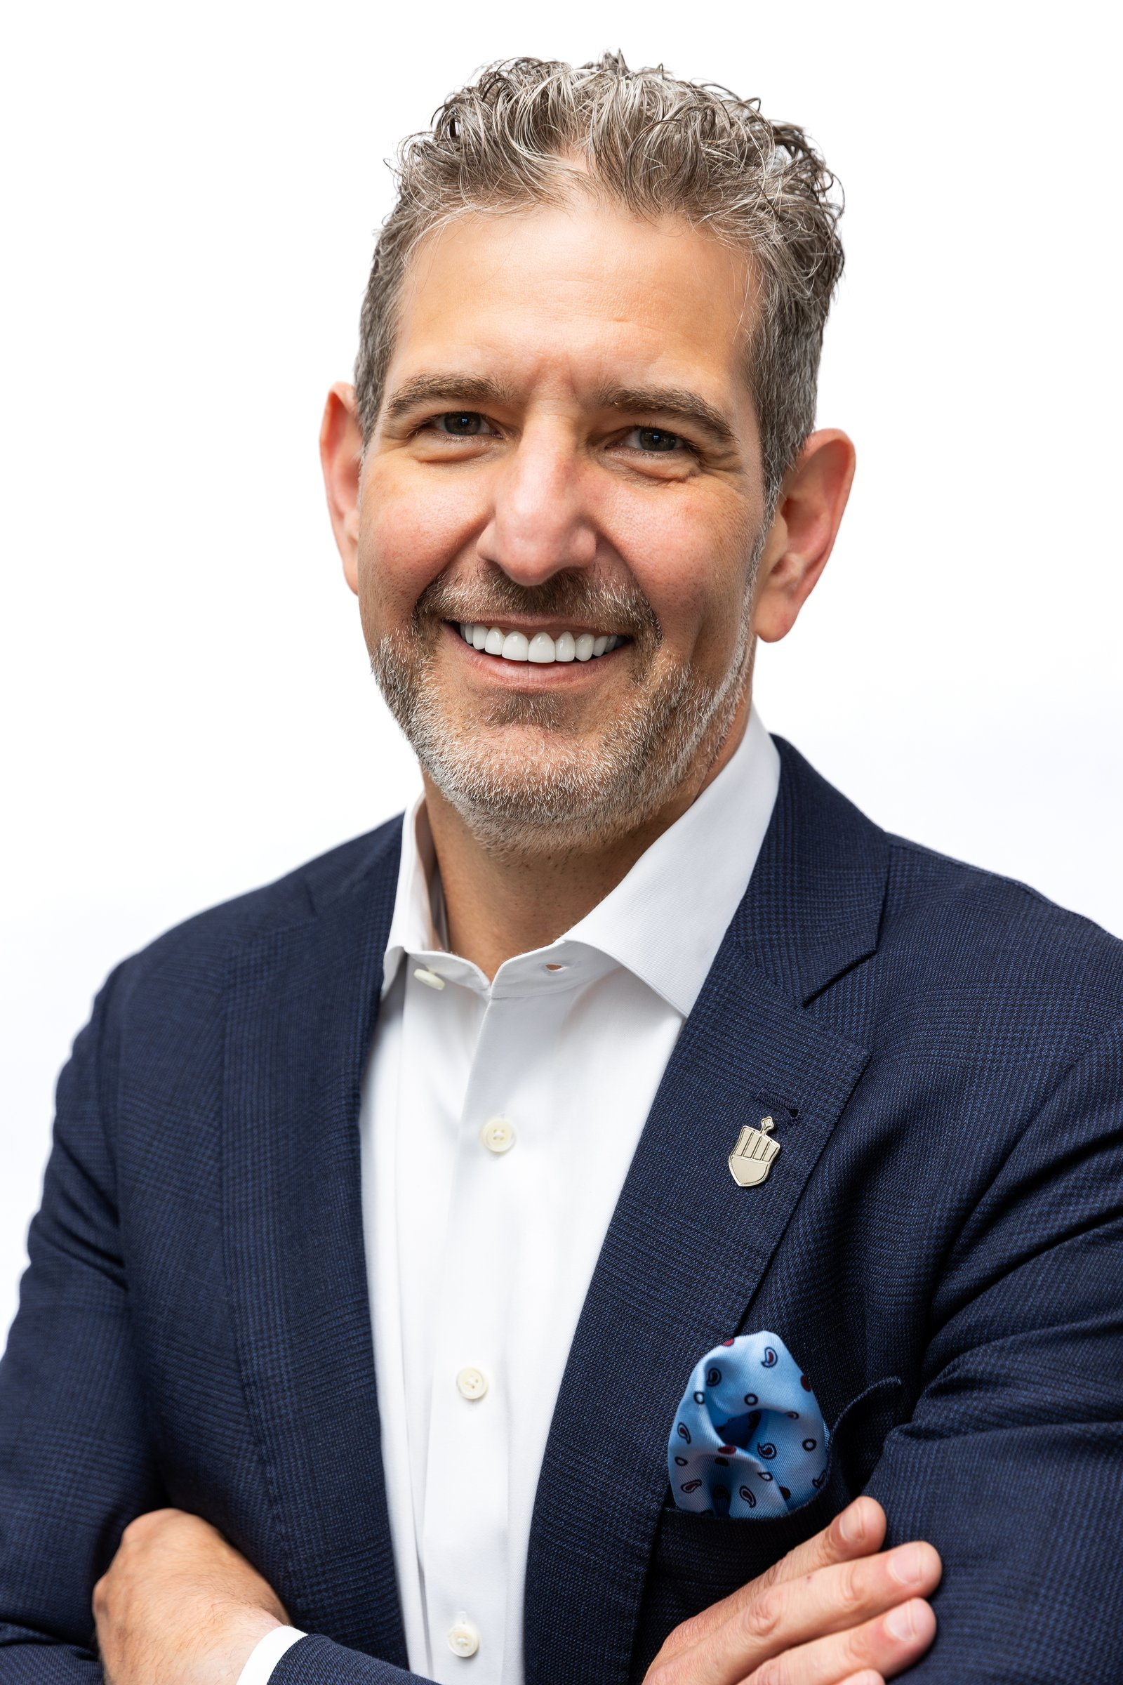
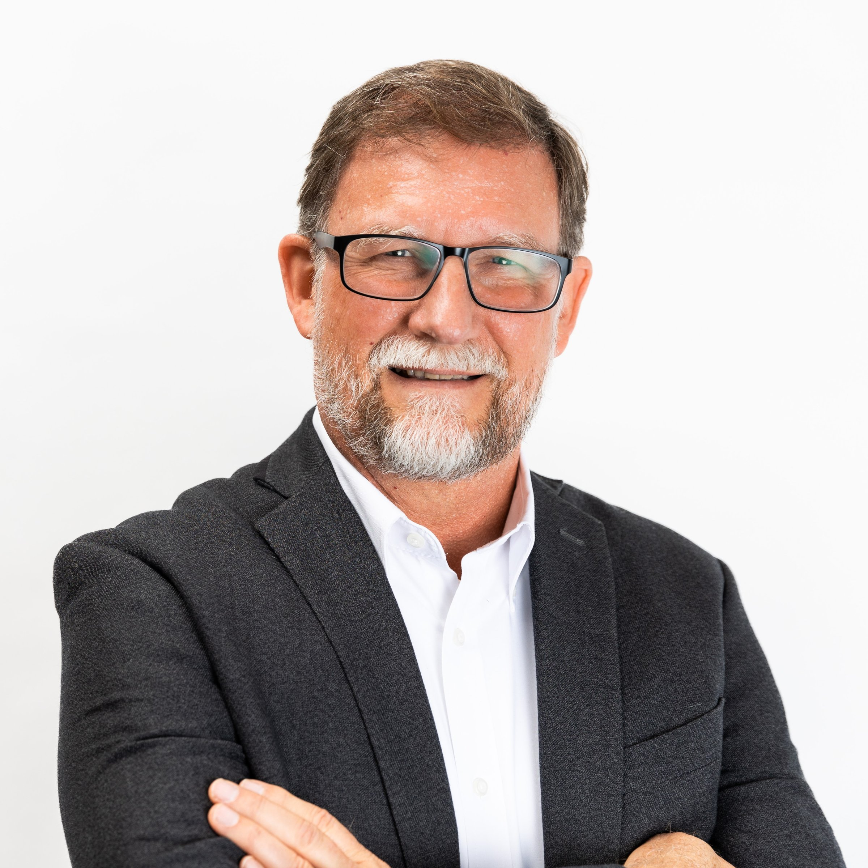
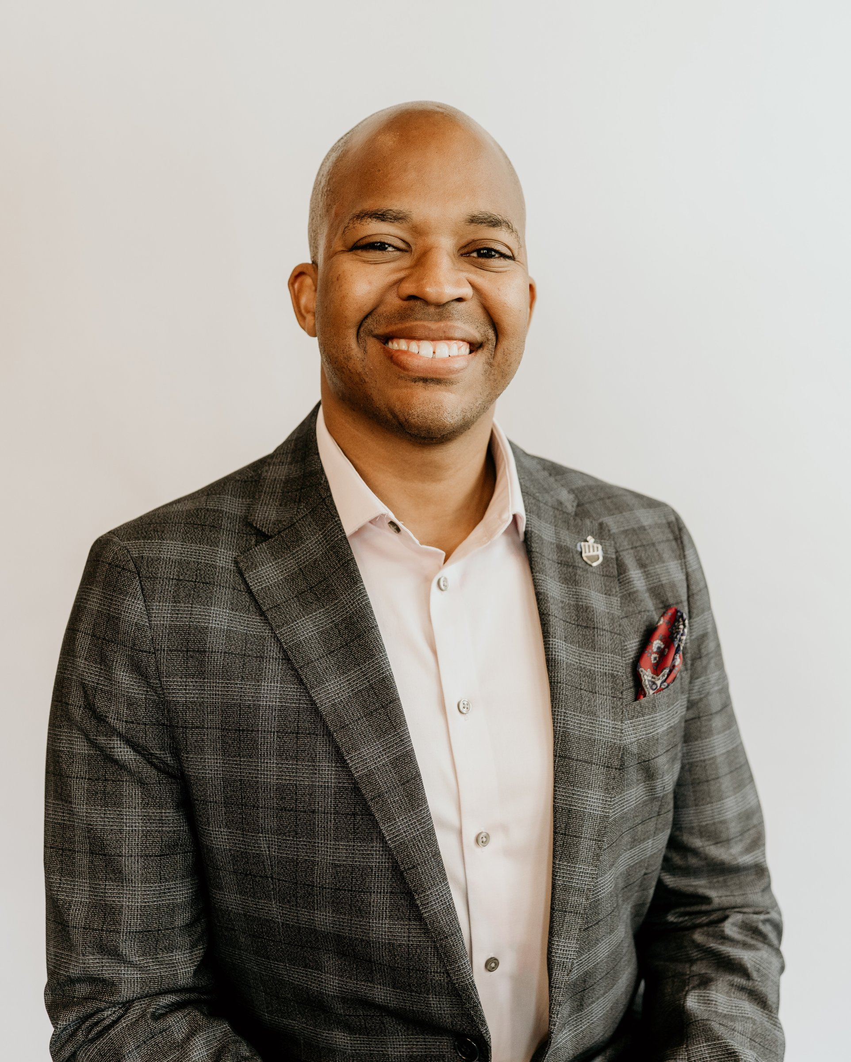
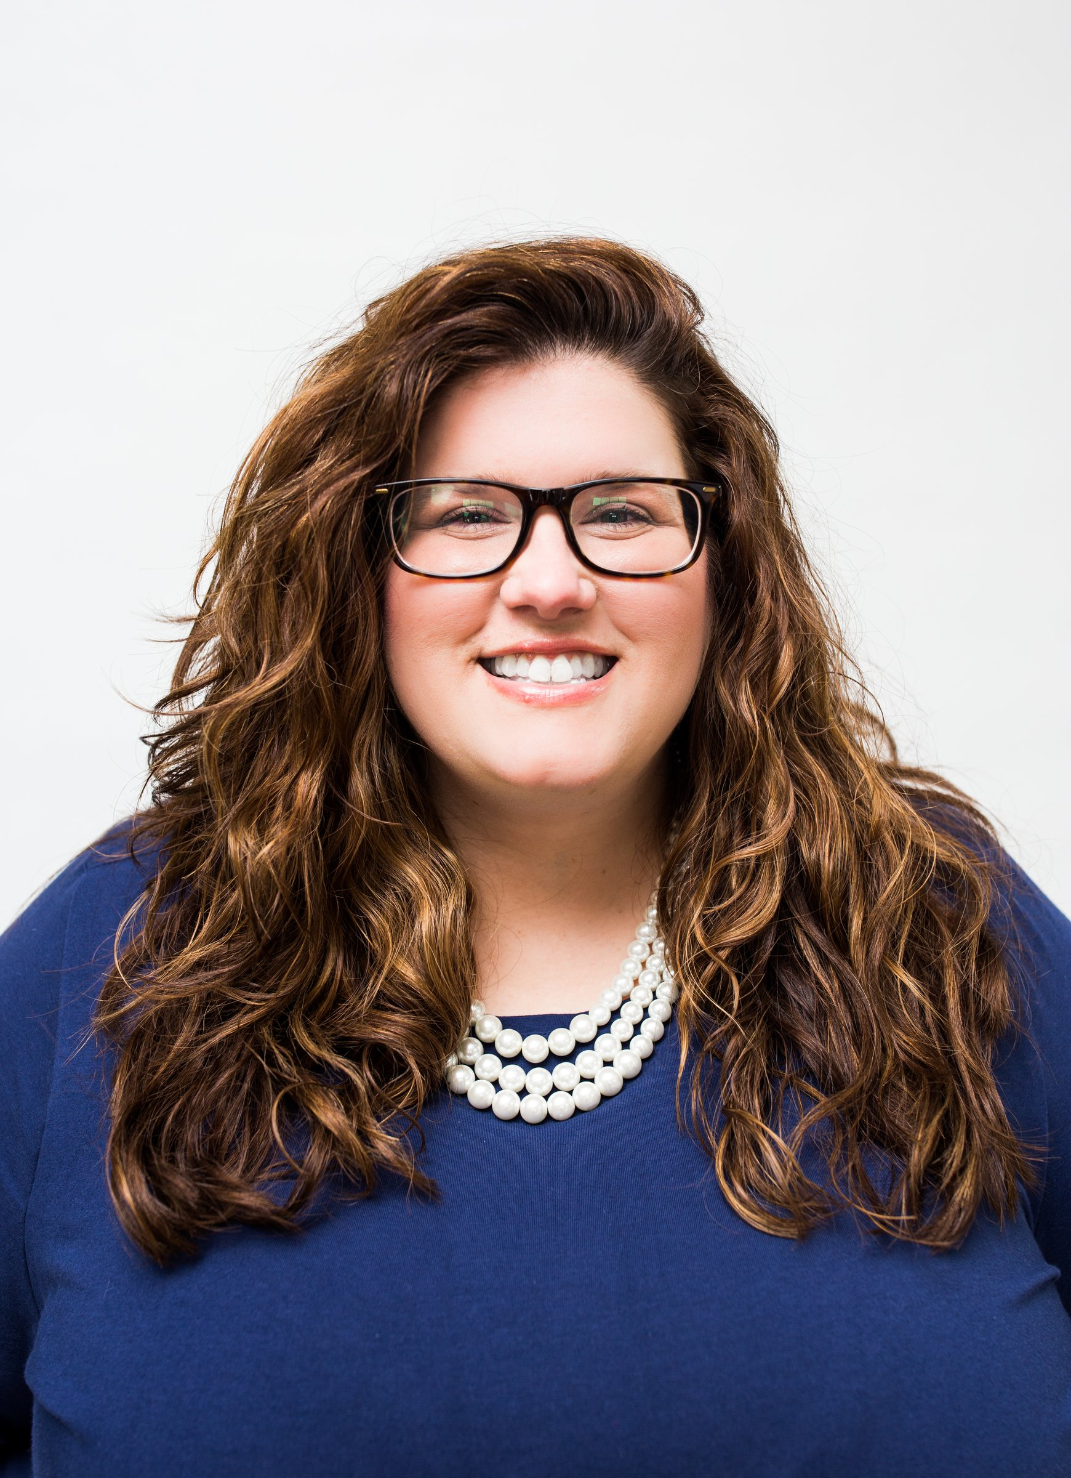
Your Team & Advocates
Eric L. Dunavant
Drew Brown
Chris Callahan
Ray Marie Fenger
Founder & President
CEO
Director of Relationship Management
Chief Compliance Officer & Director of Operations
PARADIEM | FAMILY CAPITAL ARCHITECTURE
Paradiem LLC. is a Registered Investment Advisor.
CONFIDENTIAL — NOT FOR DISTRIBUTION

Slide 40
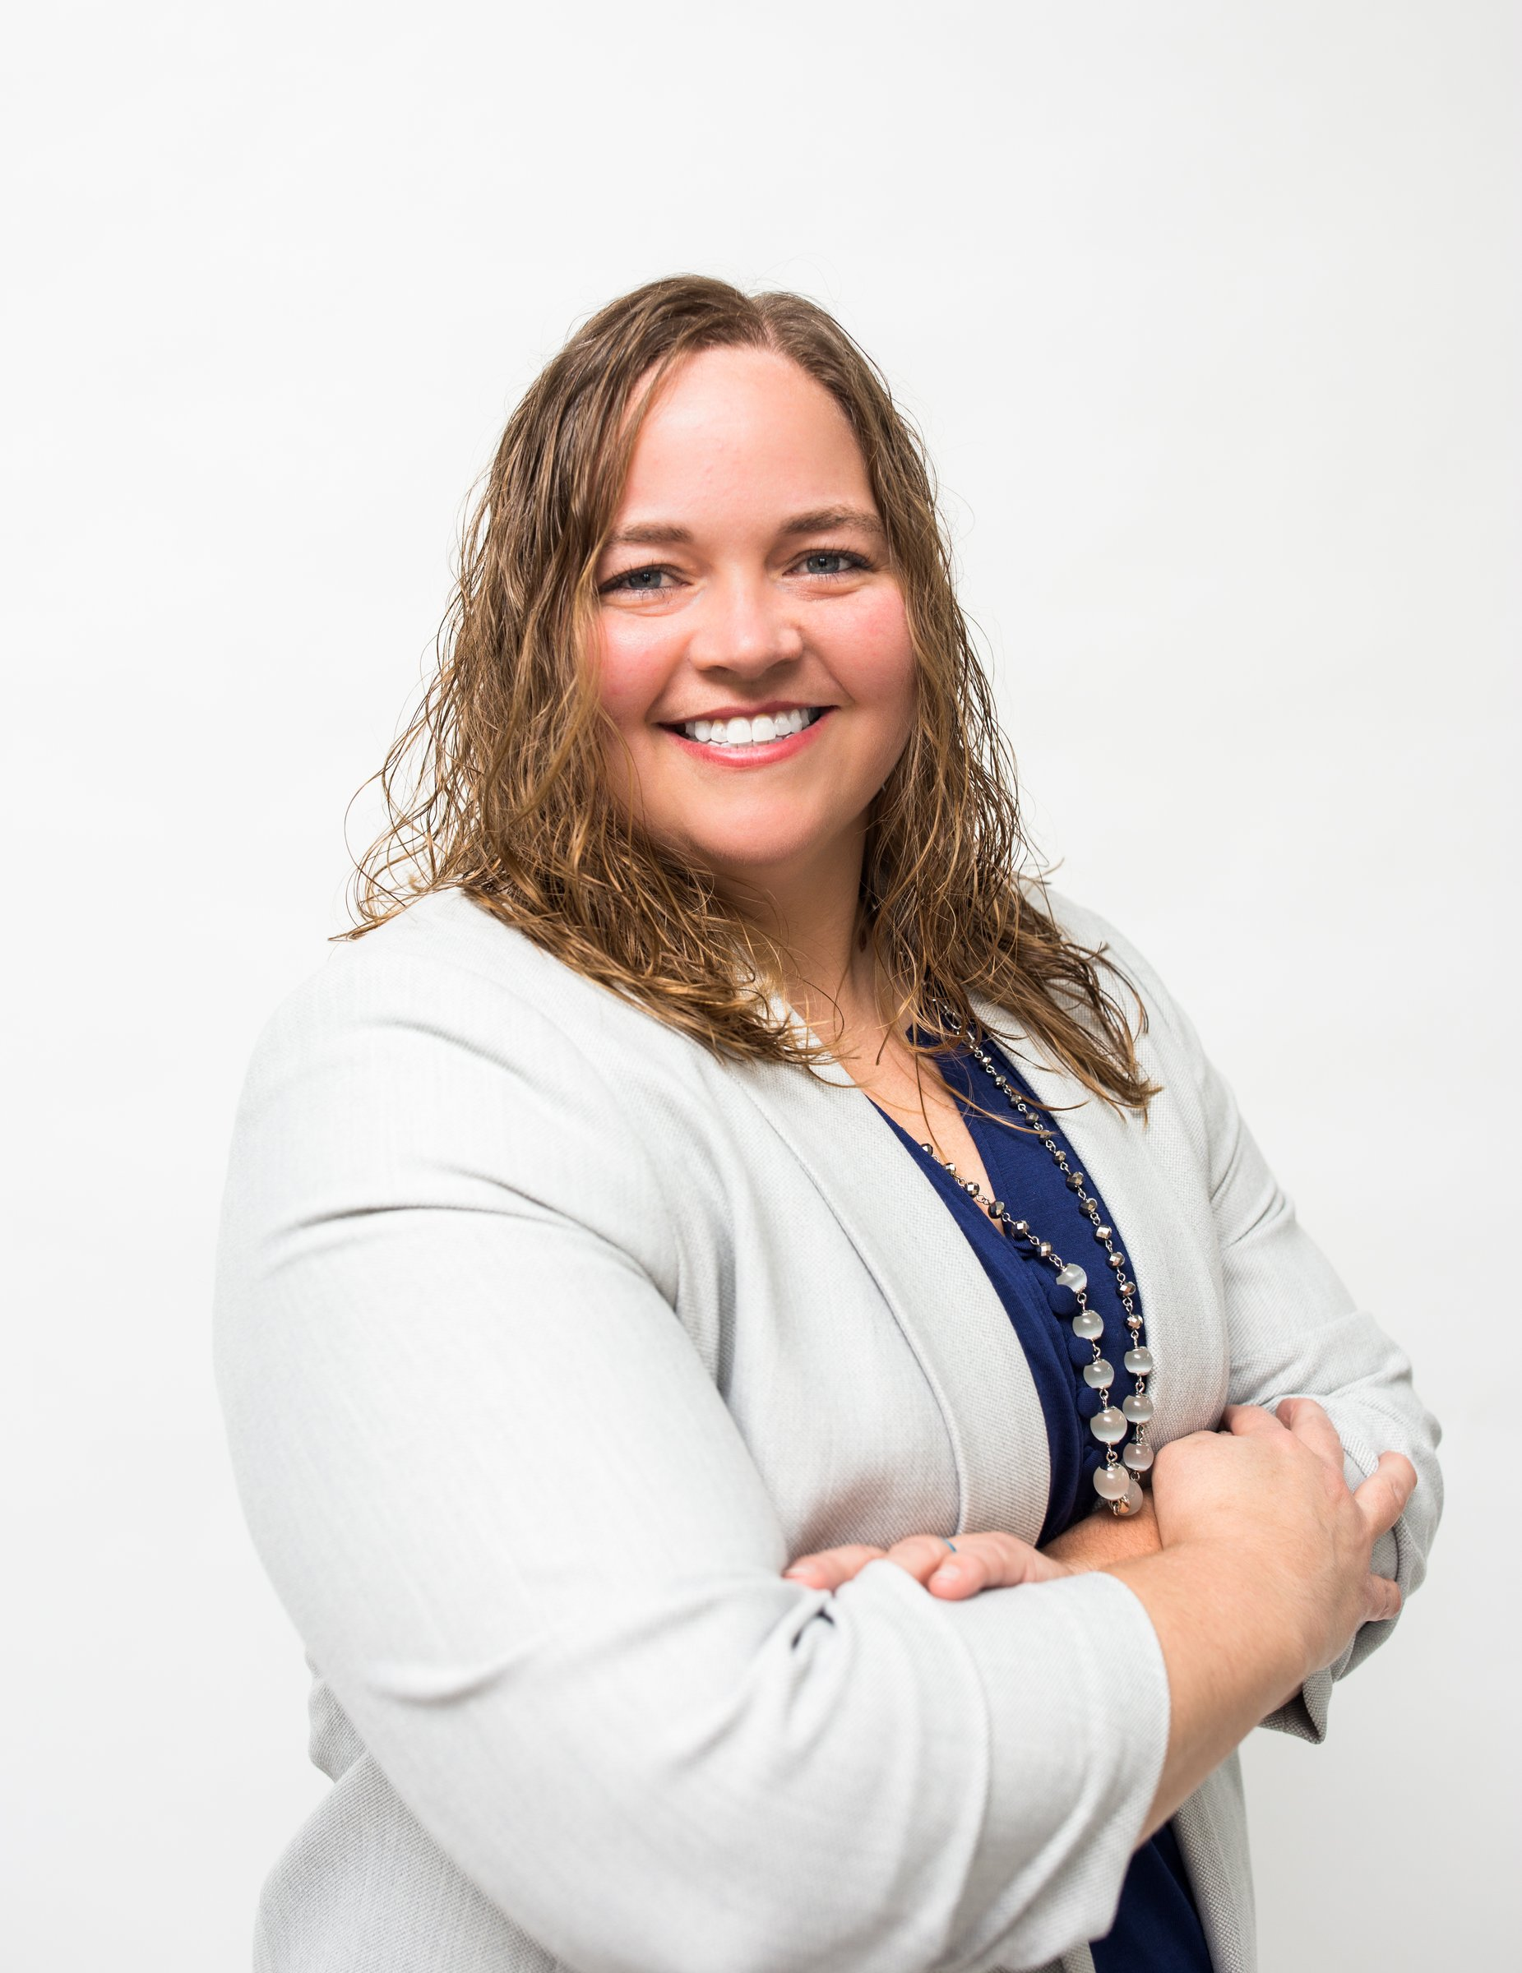
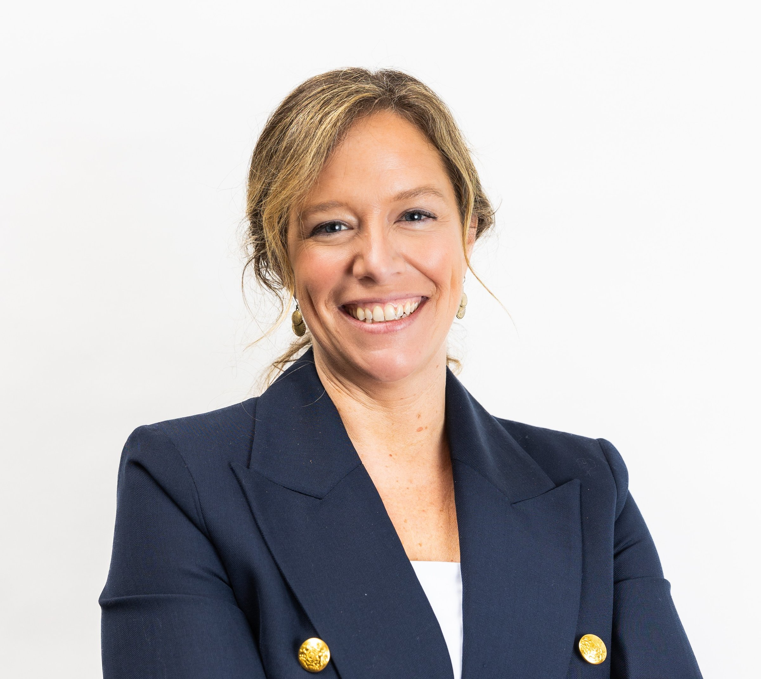
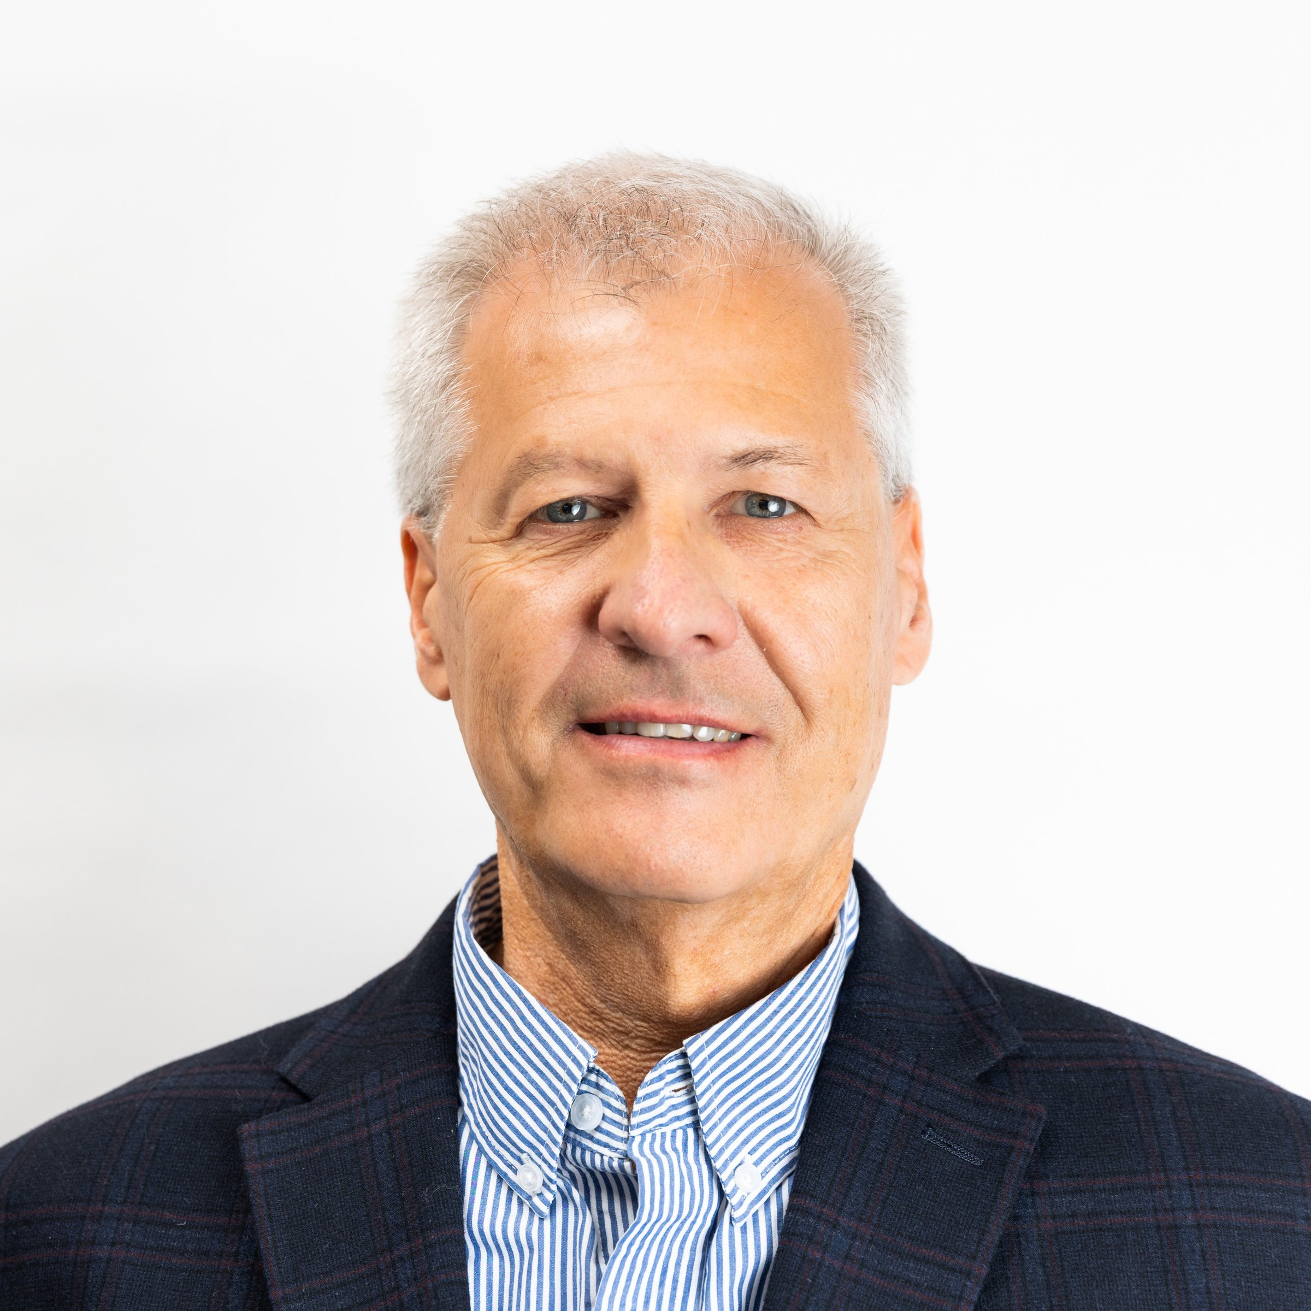
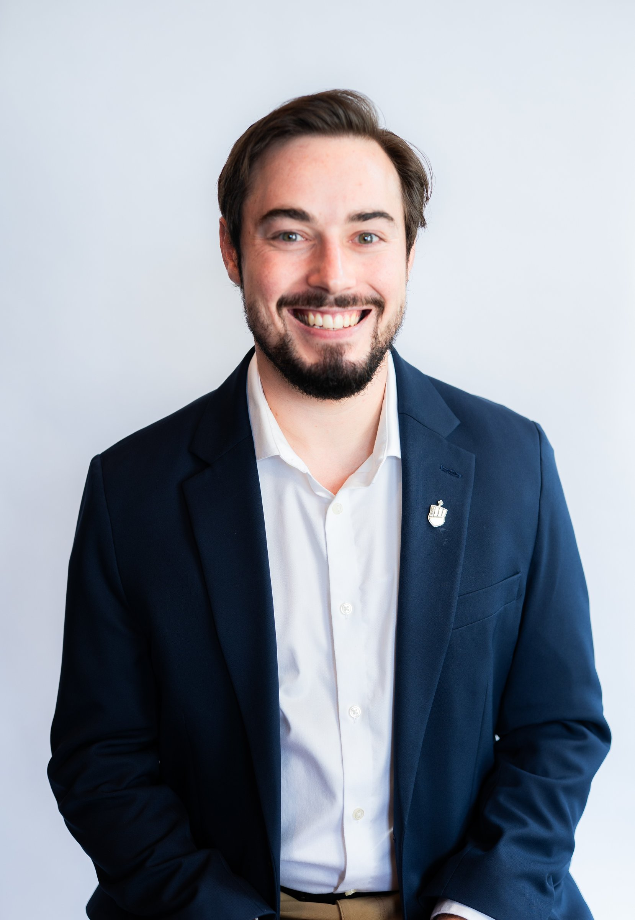
Your Team & Advocates
Dani Wauchope
Carl Drury
Thea Lowery
Caleb Kelso Jr.
Chief Planning Strategist
Senior Planning Strategist
Chief Relational Strategist
Financial Planning
Associate
PARADIEM | FAMILY CAPITAL ARCHITECTURE
Paradiem LLC. is a Registered Investment Advisor.
CONFIDENTIAL — NOT FOR DISTRIBUTION

Slide 41
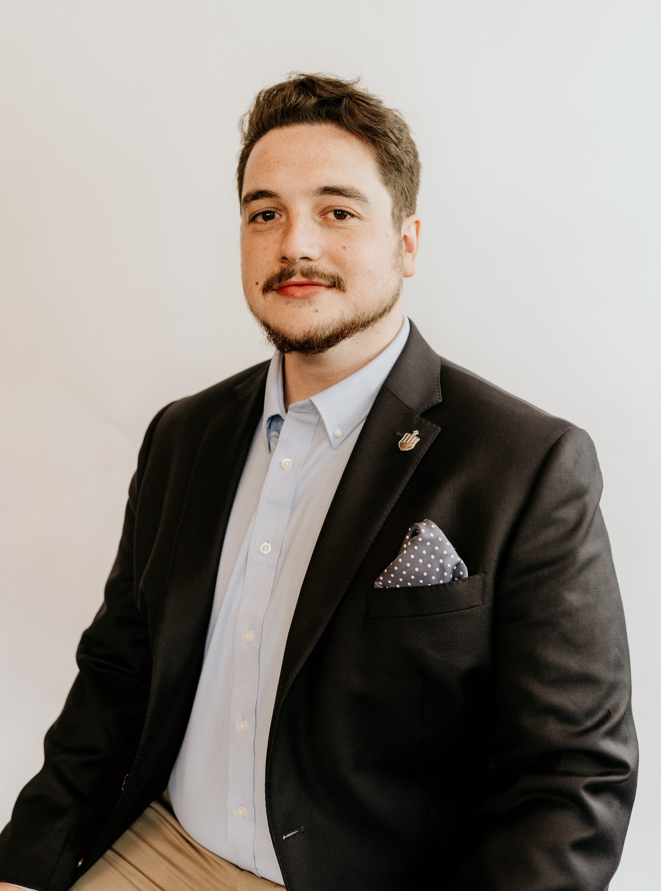
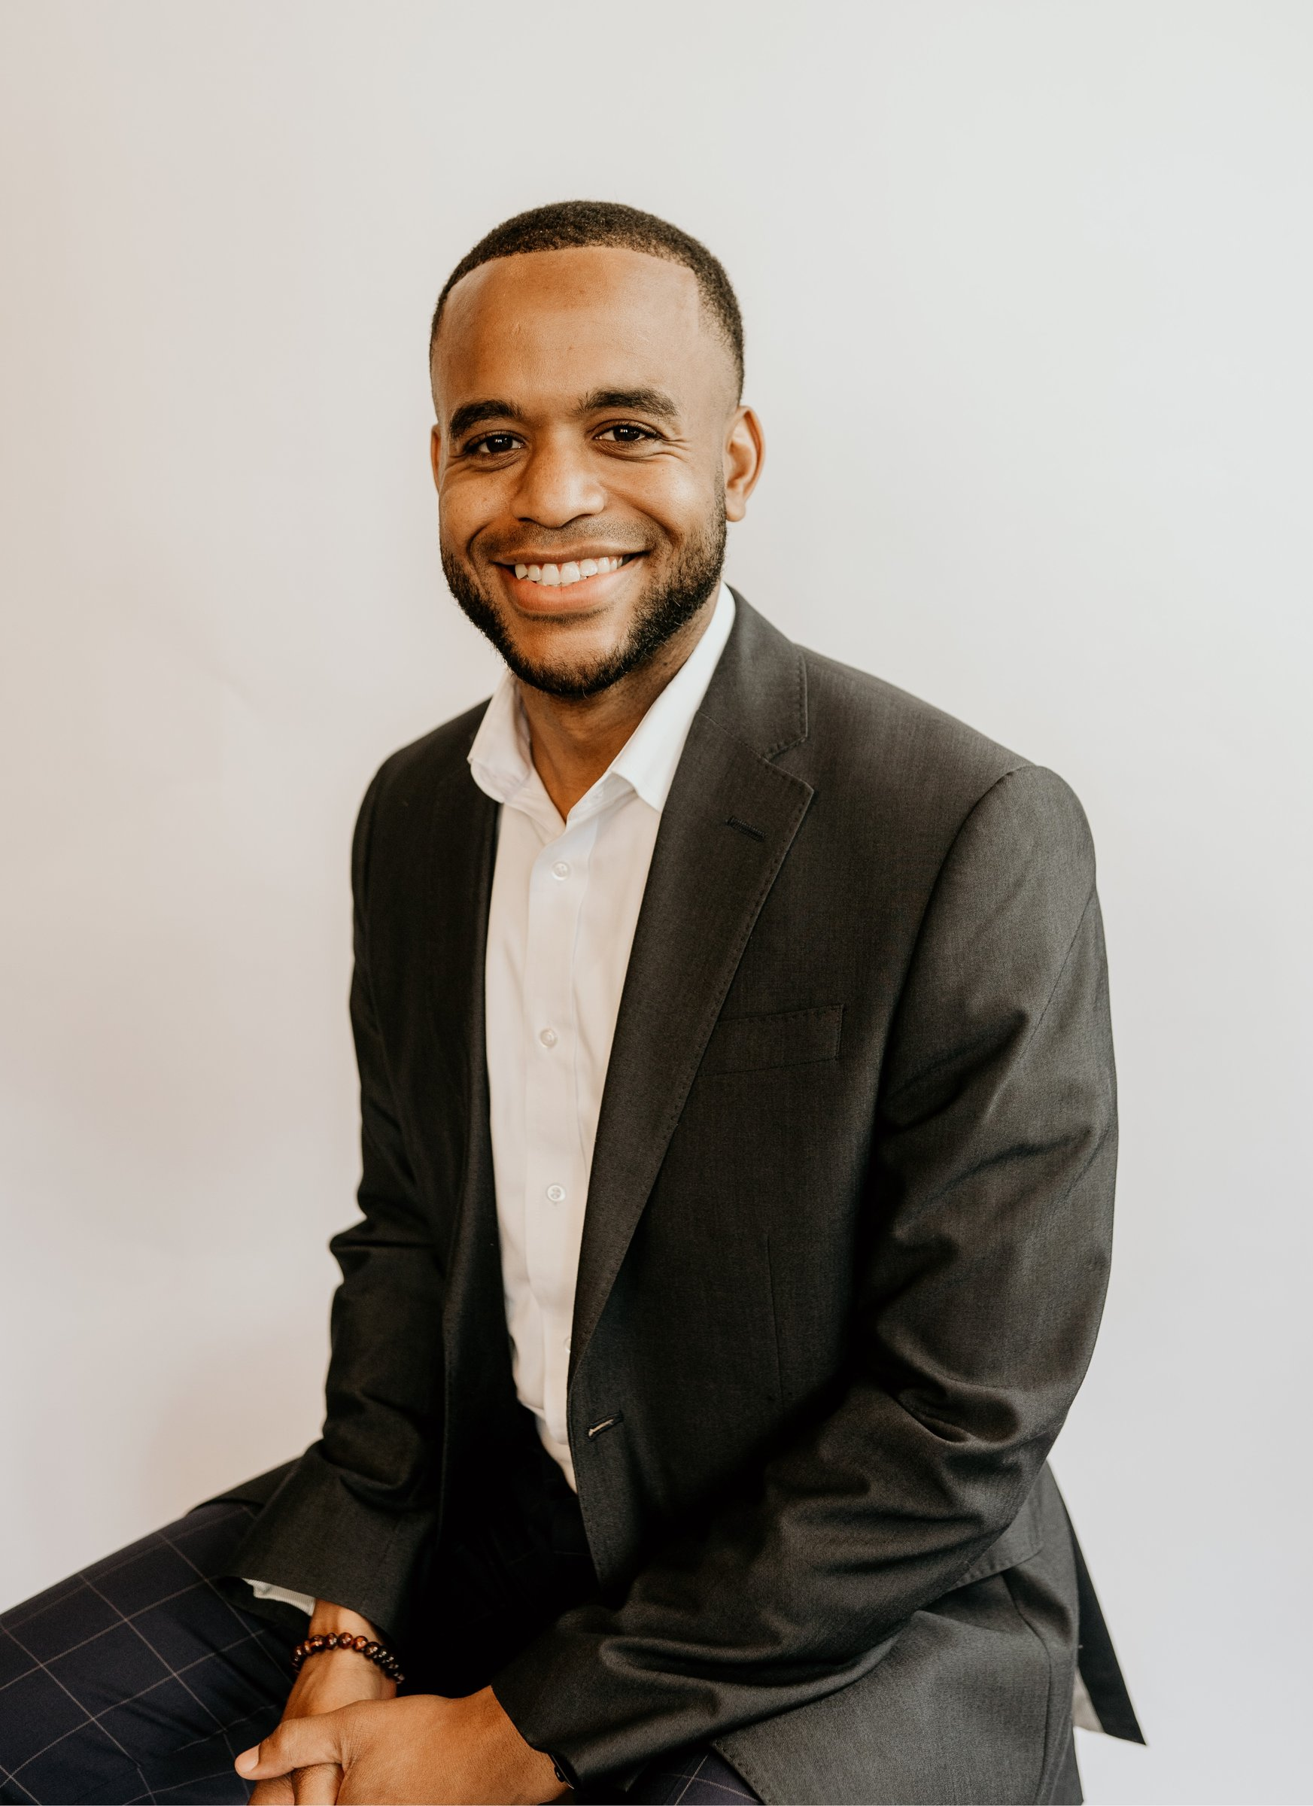
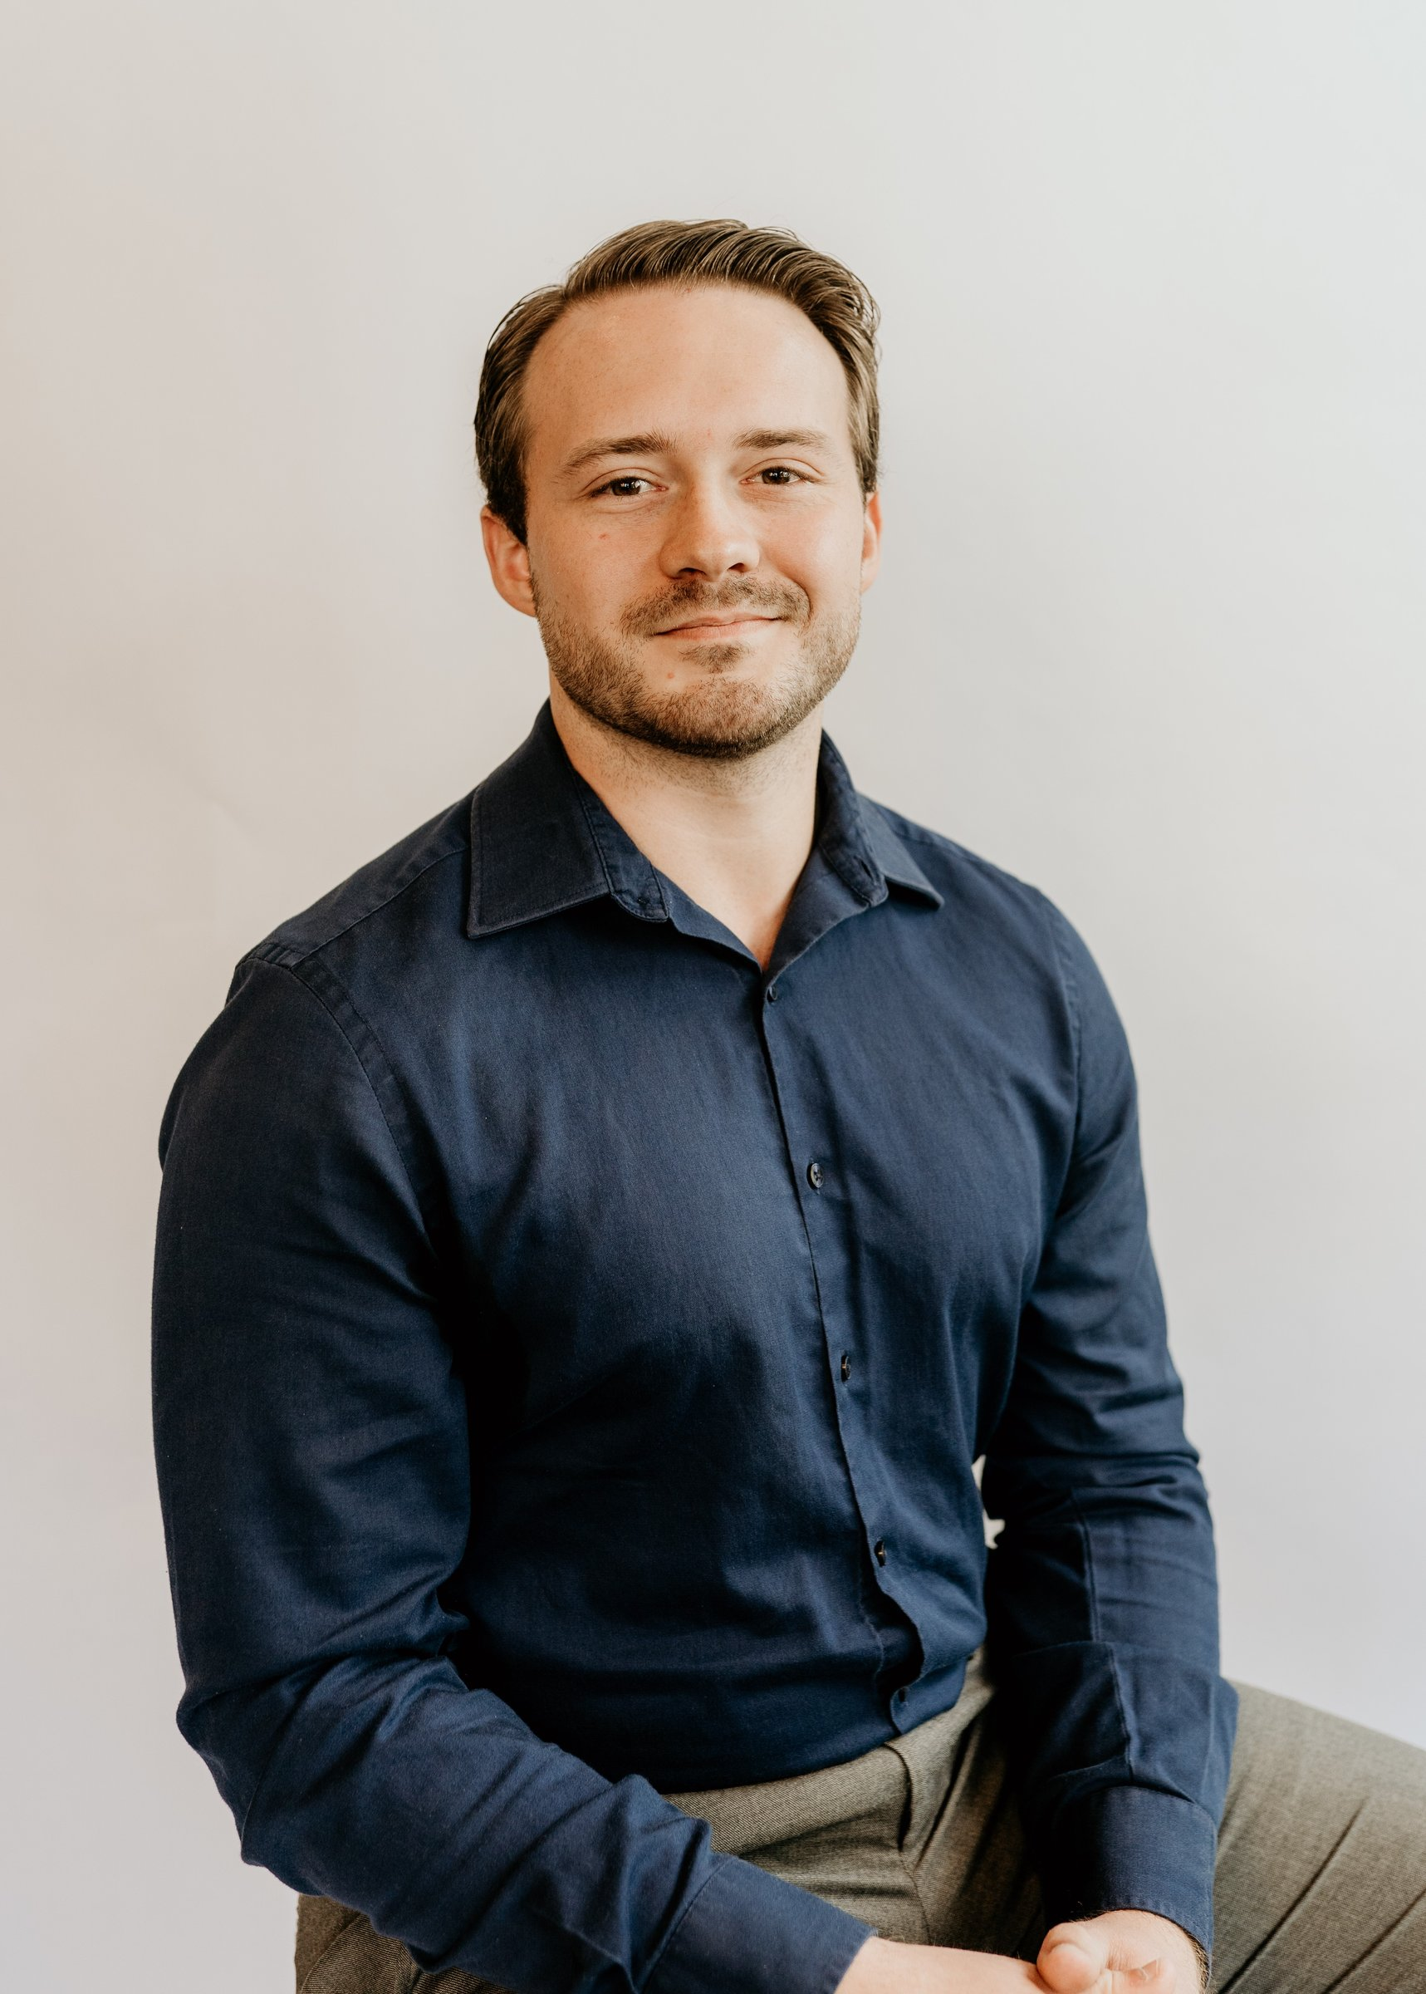
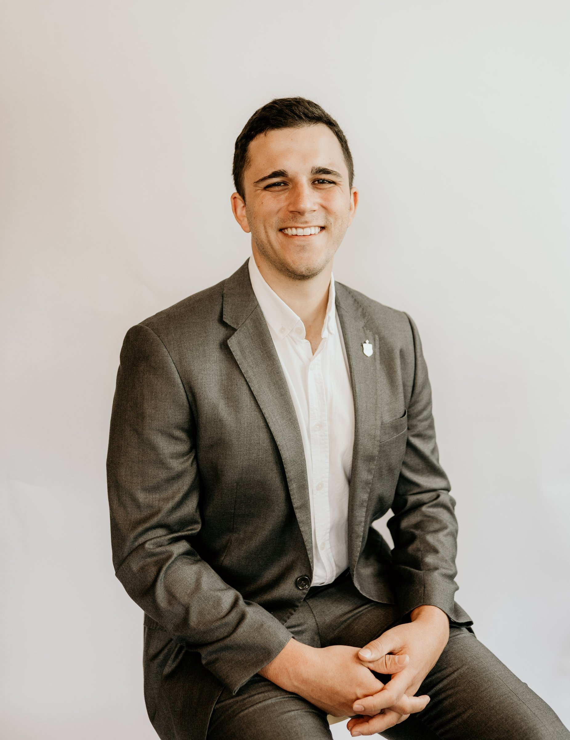
Your Team & Advocates
Matthew Sullivan
Domnic Davenport
Carson Rich
Gavin Morel
Relationship Manager
Associate Relationship Manager
Senior Research &
Trading Associate
Executive Operations Assistant
PARADIEM | FAMILY CAPITAL ARCHITECTURE
Paradiem LLC. is a Registered Investment Advisor.
CONFIDENTIAL — NOT FOR DISTRIBUTION

Slide 42
THE FULL SCOPE OF ENGAGEMENT
Family Capital Blueprint
100-Year Vision
Preparing the Family
for the Money
Preparing the Money
for the Family
Goal & Vision Alignment
Legacy Alignment
Cash Flow Prioritization
Advisory Collaboration
Inheritance Optimization
Tax Planning
Implementation Guidance
Family Advocacy
Business Strategy
Annual Calibration
Estate Planning
Community Events
Investment Strategy
Engagement Investment
Charitable Optimization
$6,500 / mo. – (1st 12 Months)
PARADIEM | FAMILY CAPITAL ARCHITECTURE
Paradiem LLC. is a Registered Investment Advisor.
CONFIDENTIAL — NOT FOR DISTRIBUTION

Slide 43
Timeline and
Next Steps
PARADIEM | FAMILY CAPITAL ARCHITECTURE
Paradiem LLC. is a Registered Investment Advisor.
CONFIDENTIAL — NOT FOR DISTRIBUTION

Slide 44
TIMELINE
Timeline
First Year
Paste in from Excel
PARADIEM | FAMILY CAPITAL ARCHITECTURE
Paradiem LLC. is a Registered Investment Advisor.
CONFIDENTIAL — NOT FOR DISTRIBUTION

Slide 45
ACTION PLAN
Next Steps
01
Cash Flow and Financial Analysis
02
Generational Impact Retreat
03
Finalize Goals and Intentions
04
Introduction to Advisors
05
Paradiem Planning Day
PARADIEM | FAMILY CAPITAL ARCHITECTURE
Paradiem LLC. is a Registered Investment Advisor.
CONFIDENTIAL — NOT FOR DISTRIBUTION

