Slide 1
Welcome to the Paper Folding Test
Use the left and right arrow keys to move through the instruction slides.
→
Next
Notes:
File > Export > png > 2000 x 1125

Slide 2
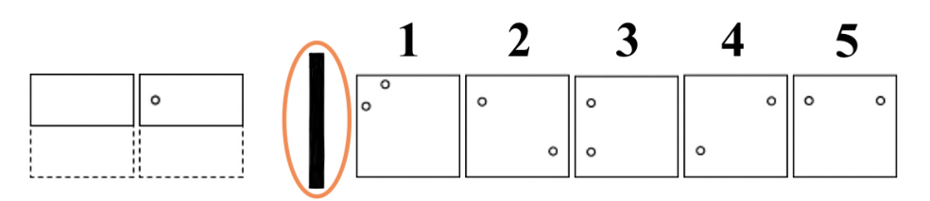
In this task, you are to imagine the folding and unfolding of pieces of paper.
In each problem, there is a vertical line (circled in orange) that separates some figures to the left and others to the right.
A sample problem is shown below.
←
Back
→
Next

Slide 3
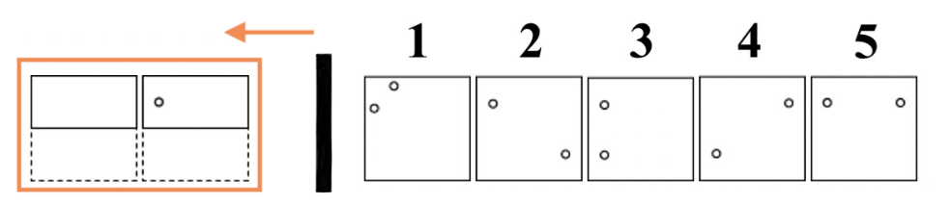
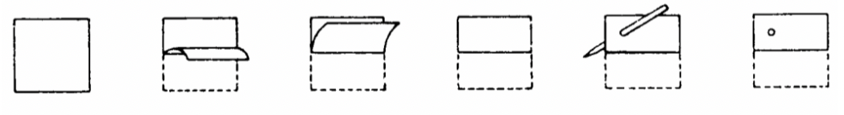
The figures to the left (boxed in orange) represent a square piece of paper being folded step-by-step, and the last of these figures on the left will have a small circle drawn on it to show where the paper has been punched.
The figures below show this folding and punching process.
←
Back
→
Next

Slide 4
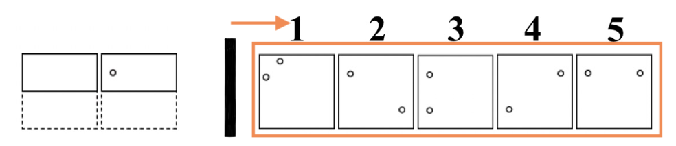
Each hole is punched through all the thicknesses of the paper at that point.
One of the five figures to the right of the vertical line (boxed in orange) shows where the holes could be when the paper is completely unfolded.
You are to decide which one of these figures has the correct placement of the holes.
←
Back
→
Next

Slide 5
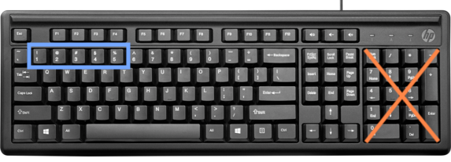
Now try the sample problem on the next slide.
Once you’ve decided which one of these figures has the correct placement of the holes, press the number (1, 2, 3, 4, or 5) on your keyboard that you feel corresponds with the correct answer.
←
Back
When you’re ready to try to sample problem, press the space bar to continue.

