Slide 1
Norheastern
University
Shopping
System
INFO5100 11236 Application
Engineer & Dev Final Project
Presentation
Presented by
Team 36:
Kunhui Zhang (1563549)
Jiawei Zou (1528516)

Slide 2
Ecosystem
Our Shopping System is to provide a
complete and comprehensive online commodity circulation paltform that integrates supply, sales, shopping, logistics and customer service, in
order to reduce the trade time and
management cost as well as the waste of
resources.

Slide 3
Shopping System
Seller
Express Company
1.Collection of multiple
management functions;
2.Connect the upstream and
downstream roles of commodities
1.Reasonably allocate orders according to order area, order status, and delivery personnel's work status ;
2.Improve delivery efficiency
Customer(Buyer)
1.User-friendly shopping experience；
2.Transparent goods information display；
3.Real-time problem feedback；

Slide 4
Problem
Statement
The continuing impact of COVID-19 has had a huge
impact on traditional commodity trade. More and more
shoppers want online and contactless delivery methods,
not just shopping in stores, and this trend is likely to
continue.
Enterprises need to make full use of e-commerce to
informatize and modernize traditional management and
business methods so that they can keep up with the trend of informatization, avoid being eliminated, and create
greater value for society.
The current online shopping system is relatively mature,
but it still lacks in the integrity of business ecology,
transparency of product information, customer service,
and logistics.

Slide 5
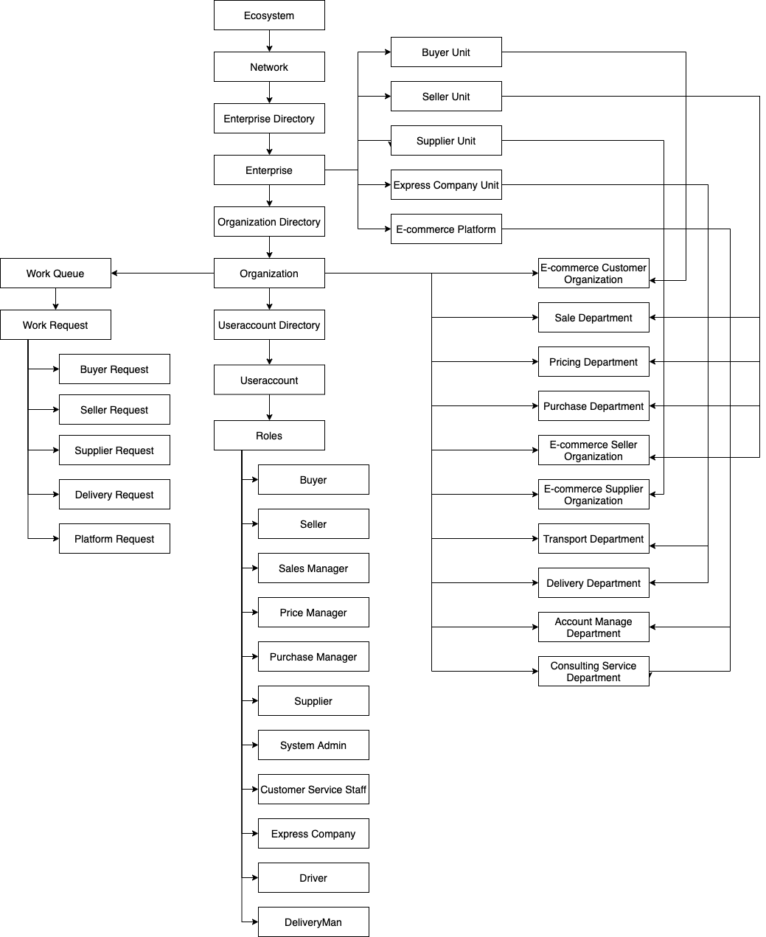

Slide 6
Next
Application Demo

