Slide 1
COMPUTER
VISION
PRESENTED BY Zhang Wanyu

Slide 2

What’s computer vision？
Computer vision is a science that studies how to make a machine "see". It refers to the use of cameras and computers instead of the human eye to identify, track and measure the target, and further do image processing, computer processing is more suitable for human eye observation or instrument detection of the image.
58%

Slide 3
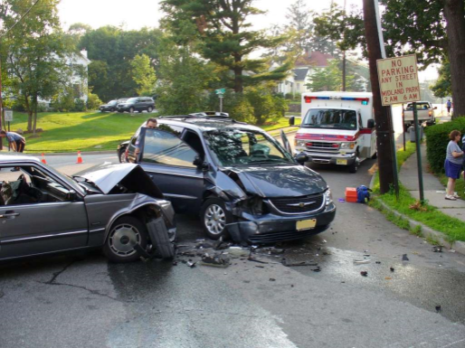
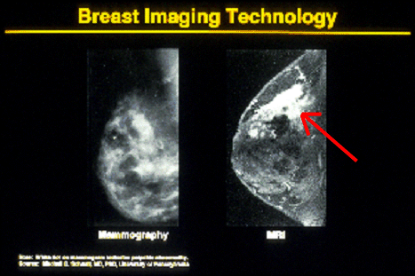


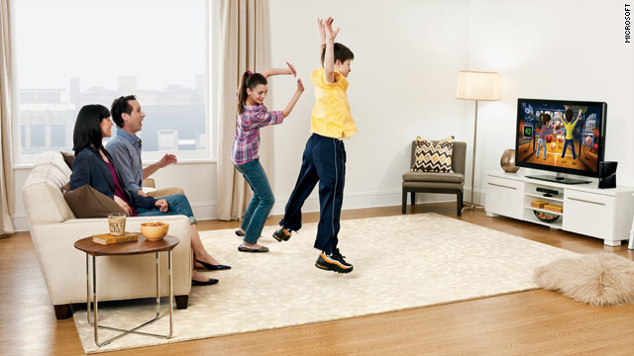

Why give computers vision?
Safety
Health
Security
Comfort
Access
Fun

Slide 4

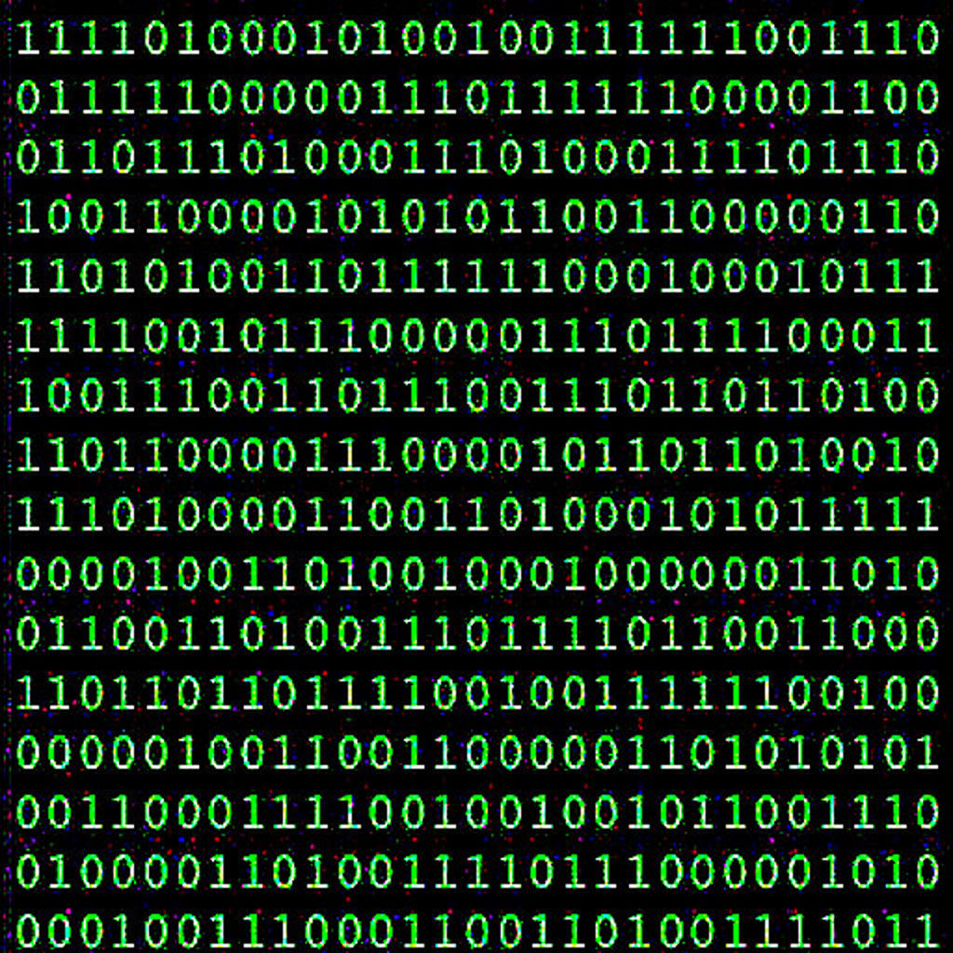
The difference between computer and human vision

Slide 5
Deep learning
Deep learning is to allow computers to simulate the way the human brain works and thus have the same ability to learn as humans.
1
2

Slide 6
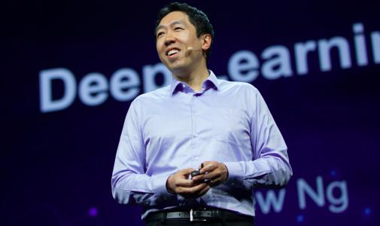
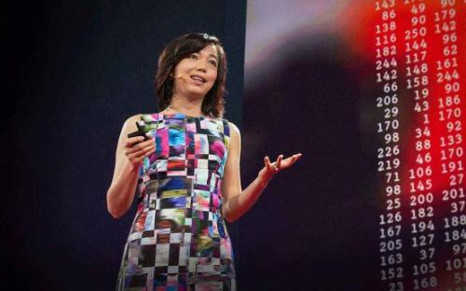

Pioneer
Andrew Ng
Fei-Fei Li
Geoffrey Hinton
。

Slide 7
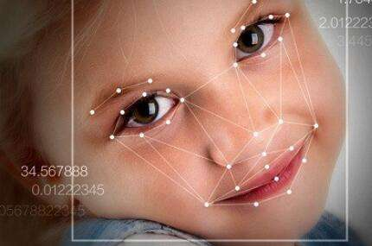
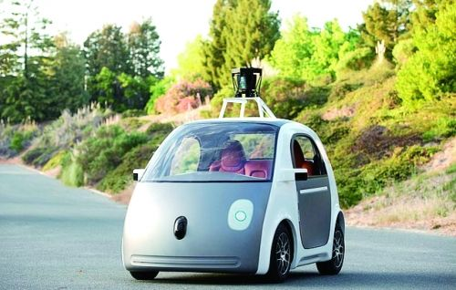
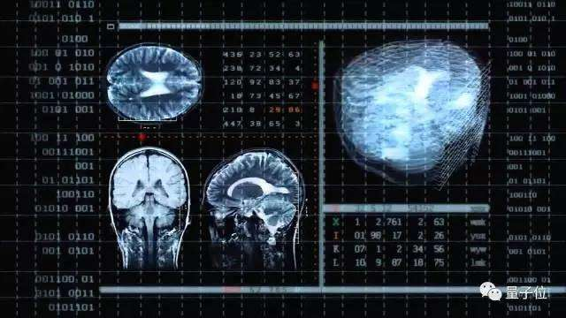
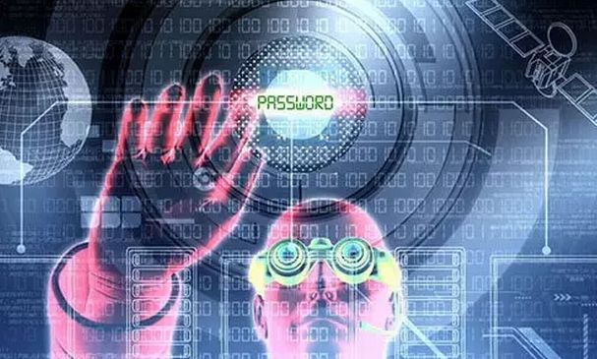
The future of computer vision
Face recognition
Automatic driving
Medical image recognition technology
Just like us

Slide 8
THANK
YOU

