Slide 1
Main effects of carried load and walking speed
N = 40 |  | Carried load
 |  | No load | 15 kg | 30 kg |  | F | p-value
Medial KJCF first peak (BW) |  | 3.07 ± 0.69 | 3.38 ± 0.83* | 3.68 ± 0.80* |  | 6.55 | 0.002
Medial KJCF second peak (BW) |  | 2.37 ± 1.11 | 2.36 ± 1.08 | 2.37 ± 0.96 |  | 0.00 | 0.999
Lateral KJCF peak (BW) |  | 2.22 ± 0.94 | 2.68 ± 0.89* | 2.79 ± 0.71* |  | 4.89 | 0.009
Total KJCF first peak (BW) |  | 3.83 ± 1.02 | 4.00 ± 1.13 | 4.30 ± 1.03 |  | 2.10 | 0.127
Total KJCF second peak (BW) |  | 4.10 ± 1.45 | 4.66 ± 1.33* | 5.26 ± 1.42*^ |  | 6.64 | 0.002
* significantly greater than no load condition. ^ significantly greater than 15 kg condition
N = 60 |  | Walking speed
 |  | Moderate | Fast |  | F | p-value
Medial KJCF first peak (BW) |  | 3.15 ± 0.78 | 3.61 ± 0.78* |  | 11.26 | 0.001
Medial KJCF second peak (BW) |  | 2.49 ± 1.03 | 2.24 ± 1.05 |  | 1.72 | 0.192
Lateral KJCF peak (BW) |  | 2.57 ± 0.92 | 2.56 ± 0.84 |  | 0.01 | 0.934
Total KJCF first peak (BW) |  | 3.75 ± 0.96 | 4.33 ± 1.10* |  | 9.59 | 0.002
Total KJCF second peak (BW) |  | 4.65 ± 1.51 | 4.69 ± 1.44 |  | 0.02 | 0.900
* significantly greater than moderate walking speed value
Notes:
There were no significant main effects of armour type

Slide 2
Medial tibiofemoral
contact force (BW)
Lateral tibiofemoral
contact force (BW)
Comparison of carried loads with data aggregated for walking speed. 15 and 30 kg loads are data from TBAS
Total tibiofemoral
contact force (BW)
Notes:
Mean ± SD

Slide 3
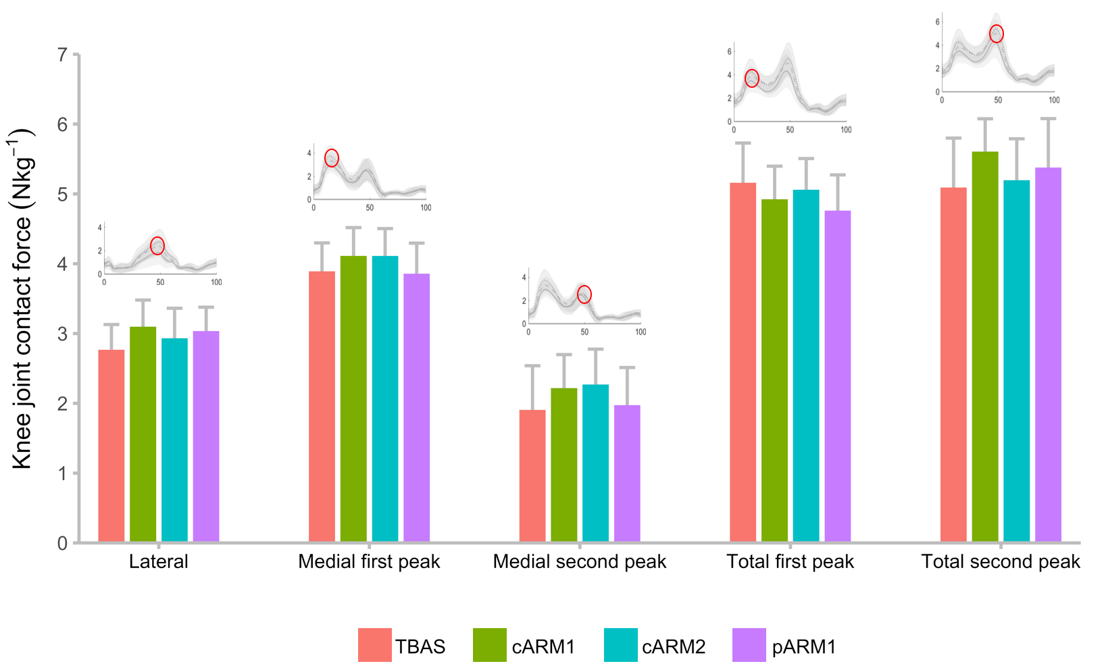
Armour type comparisons for all peak data while participants carried 30 kg and walked at the fast speed
Knee joint contact force (BW)
Notes:
Mean ± CI

Slide 4
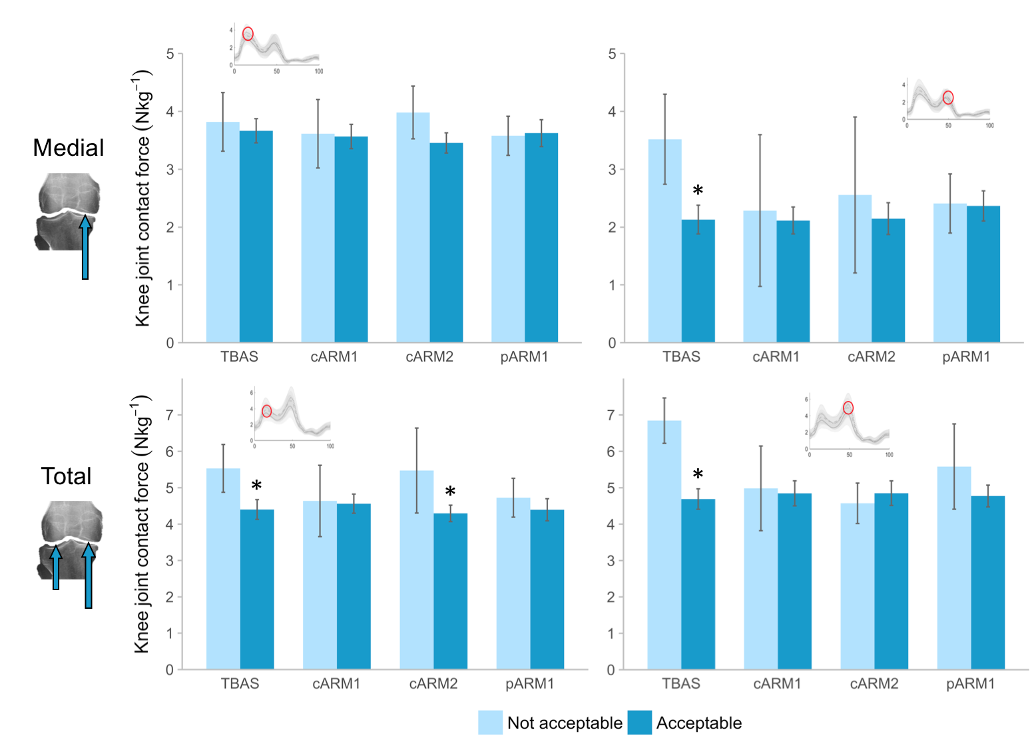
Comparisons within armour type of peak medial and total JCF
when vest fit was rated acceptable versus not acceptable
Knee joint contact force (BW)
Knee joint contact force (BW)
Notes:
Mean ± CI

