Slide 1


Pollutants and Climate: Predictive Modeling in NYC
1
By: Victor Gavrilenko, Ilay Cohen, Shay Harush, Lidor Mashiach

Slide 2
Introduction
2
What We Asked: Can pollution levels help predict temperature trends?
Why It Matters: Climate change is one of today’s biggest challenges. The COVID-19 pandemic unexpectedly gave us a “natural experiment” with reduced urban activity and pollution.
Our Focus:
Where? New York City (Bronx & Queens)
When? 2016, 2018, 2020, 2021
Why These Years? To capture pre- and during-pandemic patterns
What We Did:
Gathered pollution & weather data
Cleaned and merged into ~2,900 records
Discovered strong links: Ozone ↑ → Temperature ↑
What We Built: A neural network model (VISL) to predict temperature from pollutants — promising, but with room to grow

Slide 3
Related Work
3
He et al. (2024) Reviewed global interactions between pollutants and extreme weather events, emphasizing feedback loops. → We focus locally on NYC with real-world data and add machine learning to predict outcomes.
Berman & Ebisu (2020) Analyzed nationwide reductions in air pollutants during early COVID lockdowns. → We adopt their baseline comparison but extend the scope to weather impacts and multi-year trends.
Pitiranggon et al. (2022) Mapped NYC air pollution patterns in 2020 using spatial regression. → We expand to four pollutants, four years, and integrate ML to link pollution with temperature changes.
Liu et al. (2020) Studied pollution–weather relationships across China, highlighting seasonal effects. → We adapt their coupling strategy for NYC, with daily data and predictive modeling.
Ngarambe et al. (2021) Explored links between urban heat islands and pollution in Seoul over nine years. → We broaden the variable set to include humidity and precipitation and apply ML during the COVID period.
Notes:
הסברים:
1. “Air Pollution Interactions with Weather and Climate Extremes” –
2.

Slide 4
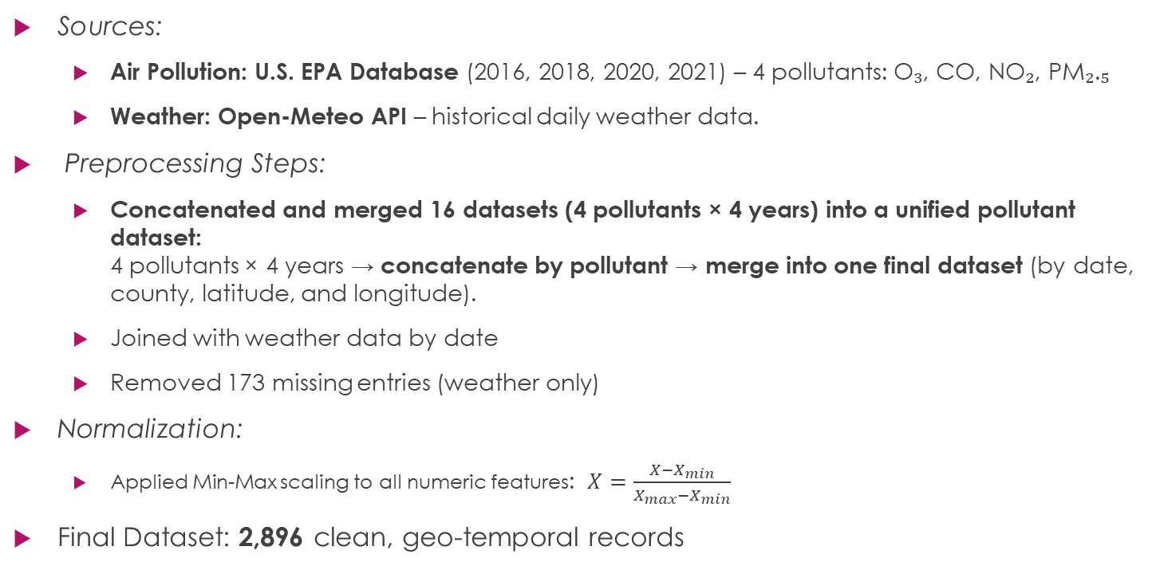
Data – Source, preprocessing & normalization
4
Sources:
Air Pollution: U.S. EPA Database (2016, 2018, 2020, 2021) – 4 pollutants: O₃, CO, NO₂, PM₂.₅
Weather: Open-Meteo API – historical daily weather data.
Preprocessing Steps:
Concatenated and merged 16 datasets (4 pollutants × 4 years) into a unified pollutant dataset: 4 pollutants × 4 years → concatenate by pollutant → merge into one final dataset (by date, county, latitude, and longitude).
Joined with weather data by date
Removed 173 missing entries (weather only)
Normalization:
Applied Min-Max scaling to all numeric features: $X=\frac{X−X_{min}}{X_{max}−X_{min}}$
Final Dataset: 2,896 clean, geo-temporal records

Slide 5
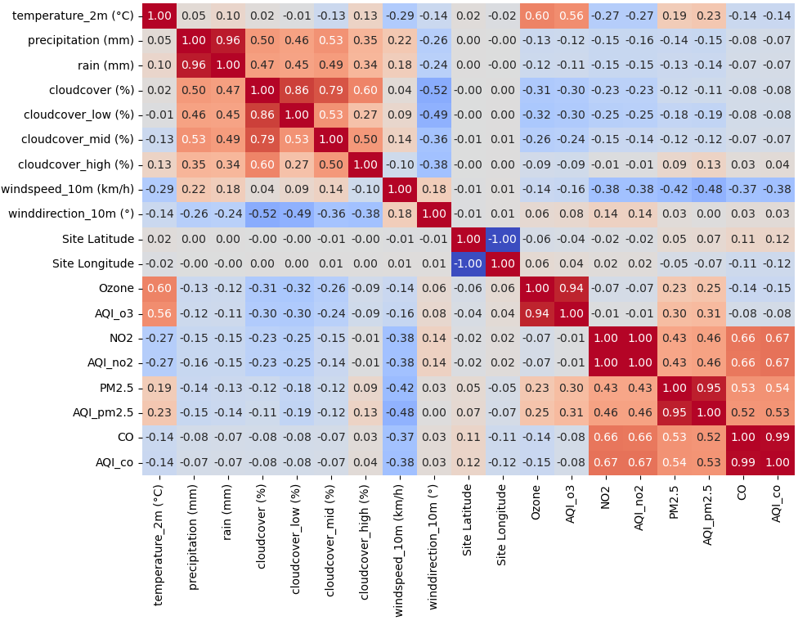
5
Data Visualization Exploratory Data Analysis – Correlations
We saw strong correlations among pollutants and between O₃ & temperature. No correlation with rain → excluded as label.

Slide 6
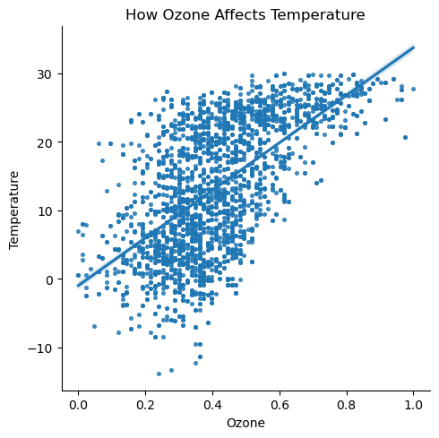
Data Visualization Correlation between Ozone and Temperature
6
Temperature tends to rise as ozone levels increase.

Slide 7
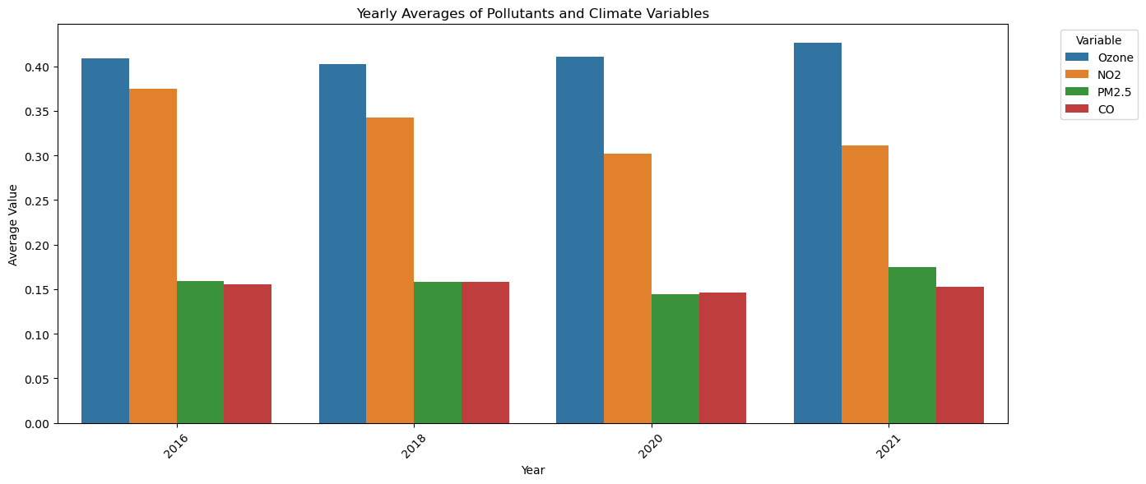
Data Visualization Yearly Trends in Pollutants
7

Slide 8
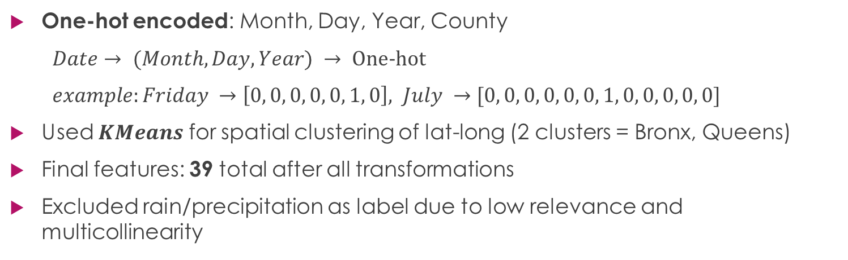
Methodology Feature Engineering & Selection
8
One-hot encoded: Month, Day, Year, County
$Date→ (Month, Day, Year) → One-hot$
$example:Friday →\left[0, 0, 0, 0, 0, 1, 0\right], July →[0, 0, 0, 0, 0, 0, 1, 0, 0, 0, 0, 0]$
Used $KMeans$ for spatial clustering of lat-long (2 clusters = Bronx, Queens)
Final features: 39 total after all transformations
Excluded rain/precipitation as label due to low relevance and multicollinearity

Slide 9
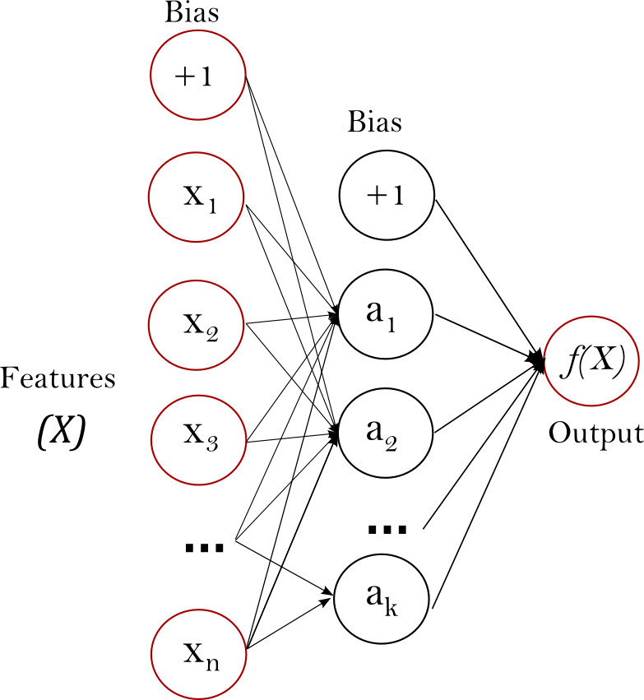
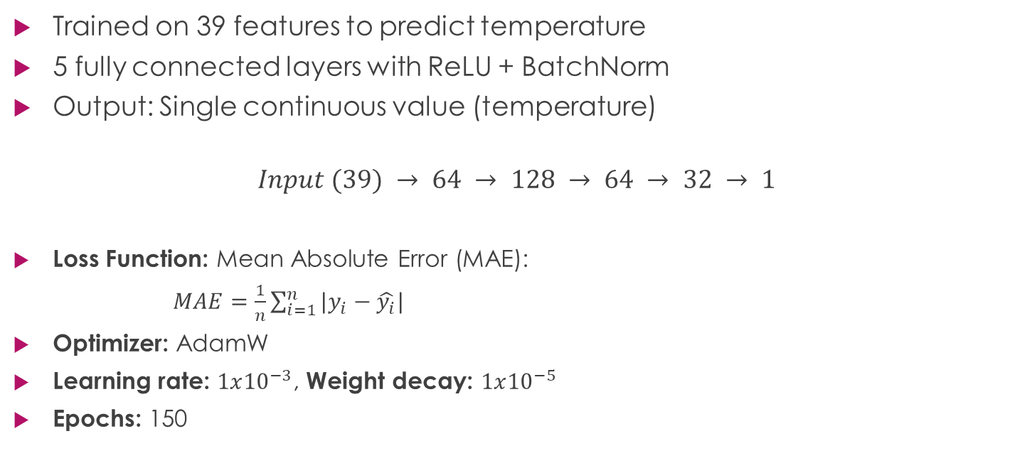
Methodology VISL: A Simple Yet Powerful MLP Model
9
Trained on 39 features to predict temperature
5 fully connected layers with ReLU + BatchNorm
Output: Single continuous value (temperature)
$$Input (39) → 64 → 128 → 64 → 32 → 1$$
Loss Function: Mean Absolute Error (MAE):
$MAE=\frac{1}{n}\sum_{i=1}^{n}{|y_{i}−\hat{y_{i}}|}$
Optimizer: AdamW
Learning rate: $1x{10}^{−3}$, Weight decay: $1x{10}^{−5}$
Epochs: 150

Slide 10
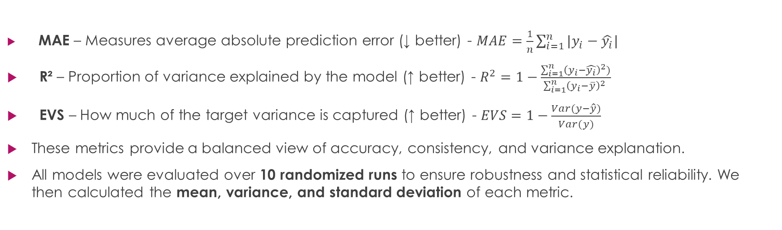
Results & Analysis Regression Metrics for Model Evaluation
10
MAE – Measures average absolute prediction error (↓ better) - $MAE=\frac{1}{n}\sum_{i=1}^{n}{|y_{i}−\hat{y_{i}}|}$
R² – Proportion of variance explained by the model (↑ better) - $R^{2}=1−\frac{\sum_{i=1}^{n}{{\left(y_{i}−\hat{y_{i}}\right)}^{2})}}{\sum_{i=1}^{n}{{\left(y_{i}−\overline{y}\right)}^{2} }}$
EVS – How much of the target variance is captured (↑ better) - $EVS=1−\frac{Var(y−\hat{y})}{Var(y)}$
These metrics provide a balanced view of accuracy, consistency, and variance explanation.
All models were evaluated over 10 randomized runs to ensure robustness and statistical reliability. We then calculated the mean, variance, and standard deviation of each metric.

Slide 11
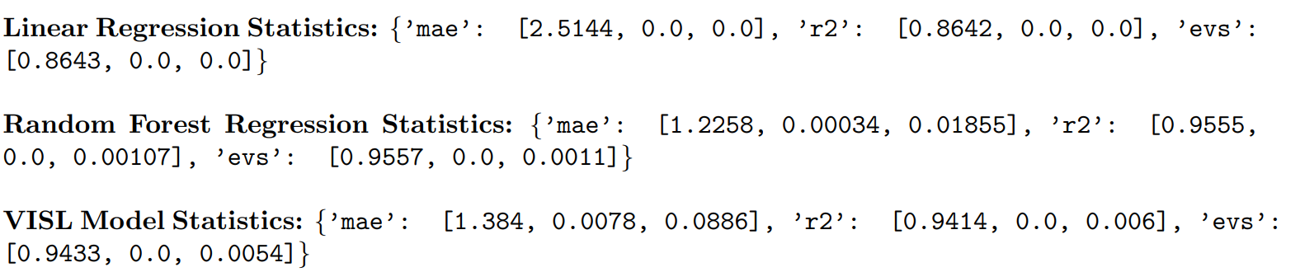


Results & Analysis (cont.) VISL vs. Baseline Models
11
$$10 randomized runs statistics→ (mean, variance, std)$$
Notes:
VISL achieves robust performance across diverse splits.
Random Forest edges out in accuracy, but VISL is more generalizable and potentially scalable.
Variance and std. dev. for VISL indicate **stable performance**, which is critical for deployment

Slide 12
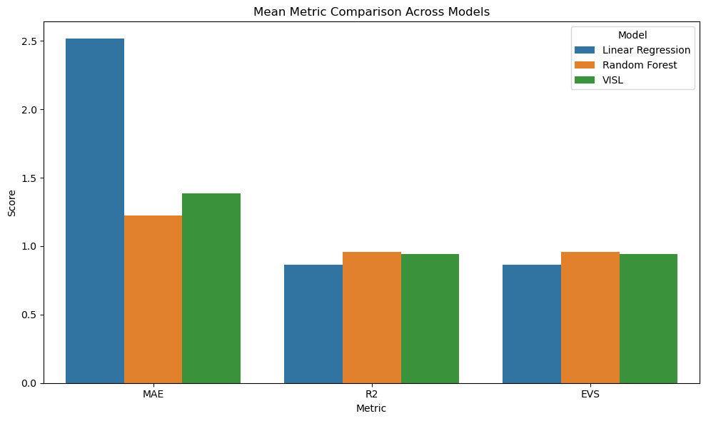

Slide 13
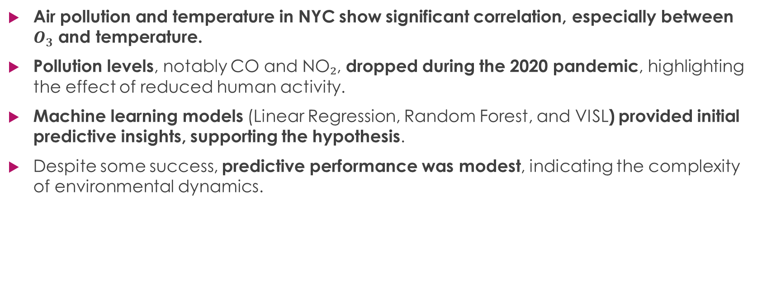
Conclusions
12
Air pollution and temperature in NYC show significant correlation, especially between $O_{3}$ and temperature.
Pollution levels, notably CO and NO₂, dropped during the 2020 pandemic, highlighting the effect of reduced human activity.
Machine learning models (Linear Regression, Random Forest, and VISL) provided initial predictive insights, supporting the hypothesis.
Despite some success, predictive performance was modest, indicating the complexity of environmental dynamics.

Slide 14
Future Work
13
Integrate external factors such as traffic density, mobility trends, or industrial activity to improve model inputs.
Enhance VISL architecture using advanced deep learning or hybrid approaches (e.g., GNNs, Transformers).
Apply causal inference techniques to move beyond correlation and uncover deeper cause-effect relationships.
Expand analysis to cities for broader generalization and comparison.

Slide 15
Any Quastions ?
14
Thank You !
Code is available at - https://github.com/Gavision97/VISL_Project.git

