Slide 1
The SOLAR ROADSTER
SCIENCE COMPETITION
LIONS PUBLIC SCHOOL,
SEC 10A, GURUGRAM

Slide 2
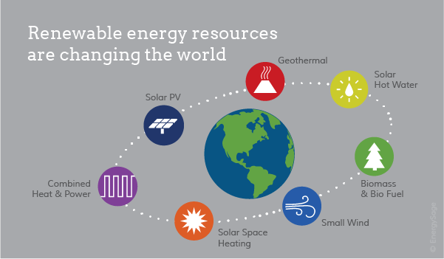
RENEWABLE SOURCE OF ENERGY

Slide 3
Solar roadster- A STEP TOWARDS A BETTER WORLD
It is a car that produces the same energy which is used by it to make the move. We are using a gear mechanism which is place on the axle. Even if due to some reason the dynamo’s are not working at that time we can turn a switch off which will displace the gear assembly and then the solar will produce the energy to keep the car moving. The extra energy produced by the car is stored and can utilized to power our homes too.

Slide 4
OBJECTIVE
The main objective of this project is to make environment healthy and sustainable, and to conserve energy for future use.

Slide 5
THE ENERGY GENERATED BY SOLAR PANEL IS STORED IN THE BATTERIES WHICH CAN BE USED FOR OTHER WORK.
TWO BATTERIES ARE PROVIDED AT THE BACK AS BACK UP.
THE ELECTRIC ENGINE IS ALSO INSTALLED IN THE CAR. ELECTRIC ENGINE IS CONSIST OF MOTOR AND GEAR ASSEMBLY AND IS DIRECTLY ATTACHED TO THE DYANMO.
TWO SERVO ARE ALSO CONNECTED TO THE DYANMO AND TURNED IT ABOUT AT AN ANGLE OF 40 DEGREE. IT CAN BE DONE BY JUST PRESSING A SWITCH WHICH IS LOCATED AT THE FRONT.

Slide 6
COMPONENTS OF THE SOLAR CAR
FOUR DYANMO (MOTOR AND GEAR )
ELECTRICAL ENGINE (MOTOR AND GEAR ASSEMBLY)
TWO SERVOS
CHASIS
SIX BATTERIES
TWO HIGH VOLT BATTERY FOR BACK UP
SWITCH (MOTOR CONTROLLER)
SOLAR PANELS

Slide 7
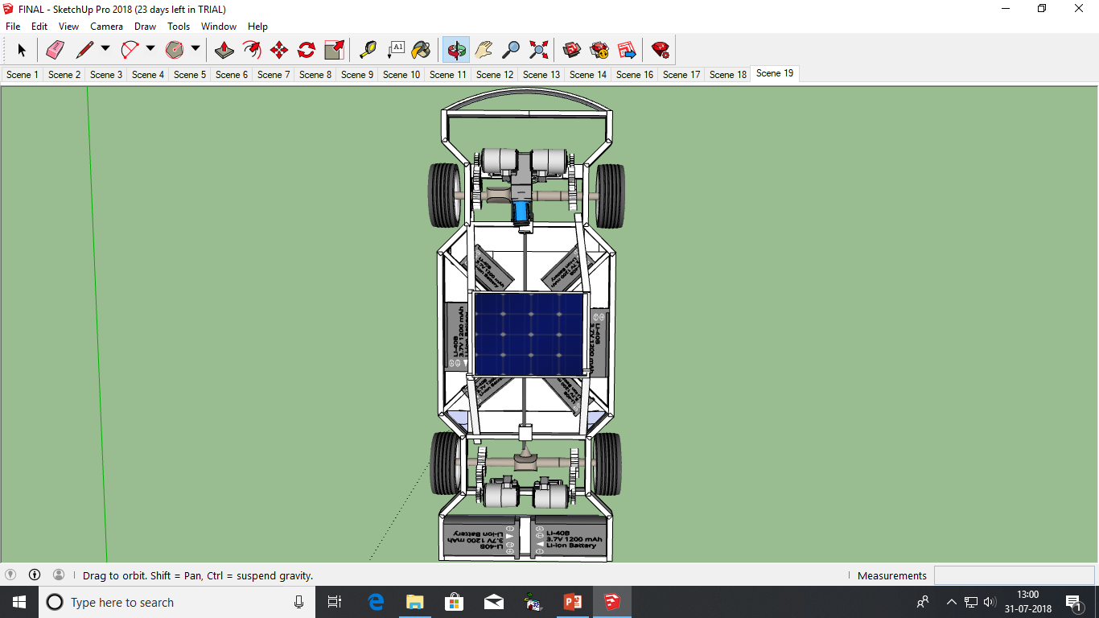
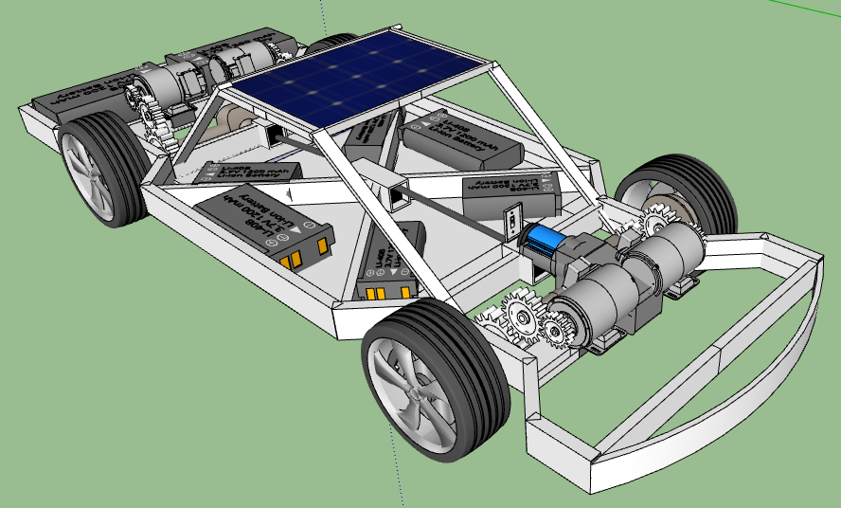
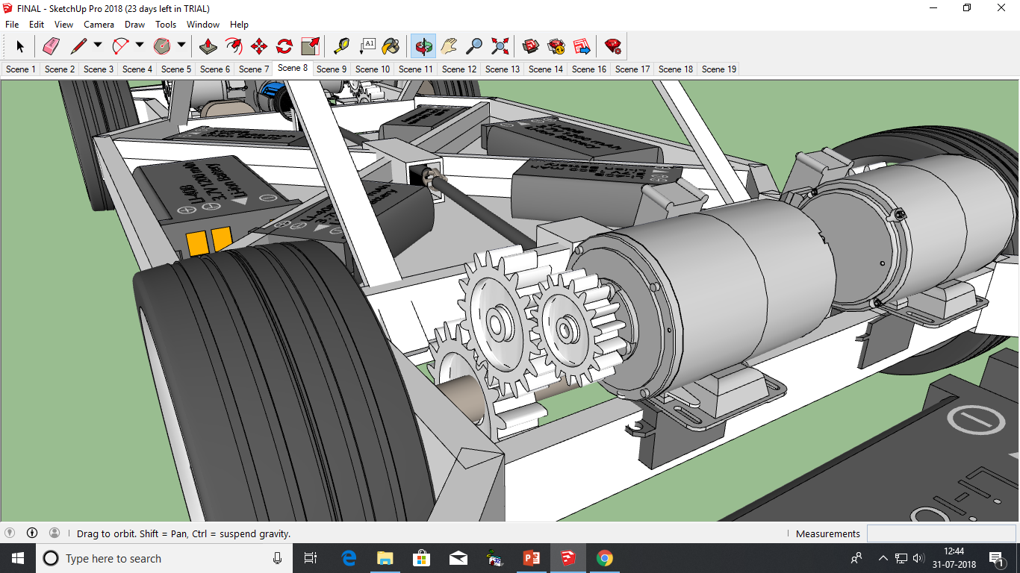

Slide 8
RESULT
From this model we will be able to produce the electric energy to run the car/model. This will not only decrease the use of amount of fossil fuel but also make the environment free of pollution. It will help to minimize the use of electricity at homes by producing the energy through solar panels. This will help us the utilize the sunlight and will help to stop the use of various resources. It also follow the path of 3rs.

Slide 9
FUTURE DIRECTIONS
Use of 3D printers to make the components which will make the car light weight.
To decrease the price by increasing the production.
Also to make the car capable for rough driving.
To make the solar panel integrated.

Slide 10
THANK YOU...

