Slide 1


E-COMMERCE-RETAIL-DATA-ANALYSIS

Slide 2
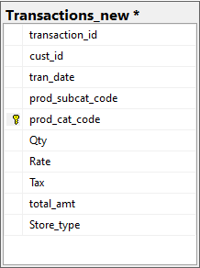
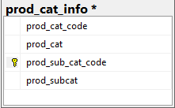
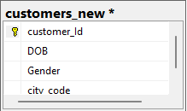
DATABASE SCHEMA

Slide 3
OBJECTIVE
E-Commerce Retail Data aimed at extracting valuable insights to improve business performance and customer experience.
To analyze customer retention and loyalty through personalized marketing strategies and incentives.
Identify the trends, patterns, customer behaviors, sales growth, profitability and transactional dynamics.
Analysis provide proper decision making and actionable recommendations for the future growth.

Slide 4

QUESTION:1
Which channel is most frequently used for Transactions?
select top 1 Store_type,count(*)as No_store_type
from Transactions_new
group by Store_type
order by No_store_type desc;

Slide 5

QUESTION:2
What is the count of Male and Female customers in the database?
select gender,count(*) as count_gender
from customers_new
group by gender;

Slide 6

QUESTION:3
From which city do we have the maximum number of customers and how many?
select top 1 city_code as city_code, count(*) as no_customers
from customers_new
group by city_code
order by count(*) desc;

Slide 7
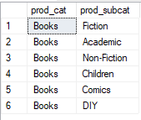
QUESTION:4
How many sub categories are there under the books category?
select prod_cat,prod_subcat
from prod_cat_info
where prod_cat='books'
order by prod_cat;

Slide 8
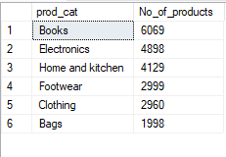
QUESTION:5
What is the maximum quantity of products ever ordered?
select P.prod_cat, count(prod_cat) as No_of_products
from Transactions_new as T
inner join prod_cat_info as P
on T.prod_cat_code = P.prod_cat_code and
T.prod_subcat_code=P.prod_sub_cat_code
group by prod_cat
order by No_of_products desc

Slide 9

QUESTION:6
What is the net total revenue generated in categories Electronics and Books?
select distinct sum(total_amt)as total_amount from Transactions_new as T
inner join prod_cat_info as P
on T.prod_subcat_code=P.prod_sub_cat_code and T.prod_cat_code = P.prod_cat_code
where prod_cat in ('Books','Electronics')

Slide 10

QUESTION:7
How many customers have >10 transactions with us excluding returns?
with ABC
as (select cust_id ,count(transaction_id)as Count_of_trans
from Transactions_new
where total_amt > 0
group by cust_id
having count(transaction_id)>10)
select count(cust_id) as Num_of_customers from ABC

Slide 11

QUESTION:8
What is the combined revenue earned from the "Electronics "and "Clothing"categories from "Flagship store“?
select sum(total_amt)as total_amount from Transactions_new as T
inner join prod_cat_info as P
on T.prod_subcat_code=P.prod_sub_cat_code and T.prod_cat_code = P.prod_cat_code
where prod_cat in ('Electronics','Clothing') and store_type='Flagship store';

Slide 12
QUESTION:9
What is the total revenue generated from "Male" customers in "Electronic" category? Output should display total revenue by prod sub cat?
select sum(total_amt) as Total_revenue from Transactions_new as T
inner join customers_new as C
on T.cust_id = C.customer_Id
inner join prod_cat_info as P
on P.prod_sub_cat_code = T.prod_subcat_code
where gender = 'M' and prod_cat = 'Electronics'

Slide 13
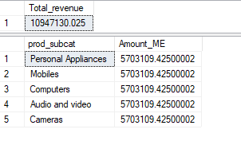
select prod_subcat,sum(total_amt) as Amount_ME from Transactions_new as T inner join customers_new as C on T.cust_id = C.customer_Id inner join prod_cat_info as P on P.prod_cat_code = T.prod_cat_code where gender = 'M' and prod_cat = 'Electronics’ group by prod_subcat

Slide 14
QUESTION:10
What is percentage of sale and returns by product sub category display only top 5 sub categories in terms of sales?
select top 5(prod_subcat),sum(total_amt)as Sales_amount from Transactions_new as T
inner join prod_cat_info as P
ON P.prod_cat_code=T.prod_cat_code and P.prod_sub_cat_code=T.prod_subcat_code
where T.total_amt>0
group by prod_subcat
order by Sales_amount desc

Slide 15
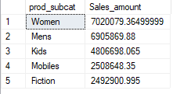
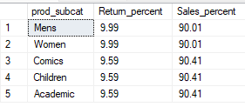
with perABS as(select top 5 (prod_subcat), ABS(sum(case when Qty<0 then Qty else 0 end)) as Returns, sum(case when Qty>0 then Qty else 0 end)as Sales from Transactions_new as T inner join prod_cat_info as P on T.prod_cat_code=P.prod_cat_code and T.prod_subcat_code = P.prod_sub_cat_code group by prod_subcat order by Sales desc) select prod_subcat,round(((returns/(returns+Sales))*100),2)as Return_percent, round(((Sales/(returns+Sales))*100),2)as Sales_percent from perABS

Slide 16

QUESTION:11
For all customers age between 25 to 35 years find what is the net total revenue generated by these customers in the last 30 days of transactions from max transaction date available in the data?
with ABC
as(select top 30(tran_date),sum(total_amt)as total_amount
from customers_new as C
inner join Transactions_new as T
on T.cust_id=C.customer_Id
where datediff(year,dob,getdate()) between 25 and 35
group by tran_date
order by tran_date desc)
select sum(total_amount) as final_revenue from ABC

Slide 17

QUESTION:12
Which product category has seen the maximum value of returns in the last 3 months of transactions?
select prod_cat,count (Qty) as No_of_returns
from Transactions_new as T
inner join prod_cat_info as P
on T.prod_cat_code = P.prod_cat_code and T.prod_subcat_code = P.prod_sub_cat_code
where total_amt<0 and datediff (month,'2014-09-01',tran_date)= 3
group by prod_cat

Slide 18

QUESTION:13
Which store_type sells the maximum products; by value of sales amount and by quantity sold?
select top 1(Store_type),count(Qty)as No_of_products,
sum (total_amt)as Amount from Transactions_new
where total_amt>0
group by Store_type
order by No_of_products desc

Slide 19

QUESTION:14
What are the categories for which average revenue is above the overall average?
select prod_cat, round(avg(total_amt), 2) as Averages from Transactions_new as T
inner join prod_cat_info as P
on T.prod_cat_code = P.prod_cat_code and T.prod_subcat_code = P.prod_sub_cat_code
group by prod_cat
having avg(total_amt) > (select avg(total_amt) from Transactions_new)

Slide 20
QUESTION:15
Find the average and total revenue by each subcategory for the categories which are among top 5 categories in terms of quantity sold?
select top 5(prod_cat), count (Qty) as Quantity_sold
from Transactions_new T
inner join prod_cat_info P
on T.prod_cat_code =P.prod_cat_code and T.prod_subcat_code = P.prod_sub_cat_code
where total_amt > 0
group by prod_cat
order by Quantity_sold desc

Slide 21
select prod_cat, prod_subcat, round(sum(total_amt), 3) as Total_amount, round(avg(total_amt), 3) as Avg_amount from Transactions_new as T inner join prod_cat_info as P on T.prod_cat_code = P.prod_cat_code and T.prod_subcat_code = P.prod_sub_cat_code where total_amt > 0 and prod_cat in ('Books', 'Electronics', 'Home and kitchen', 'Footwear', 'Clothing’) group by prod_cat, prod_subcat order by case when prod_cat= 'Books' then 1 when prod_cat= 'Electronics' then 2 when prod_cat ='Home and kitchen then 3 when prod_cat = 'Footwear' then 4 else 5 end;

Slide 22
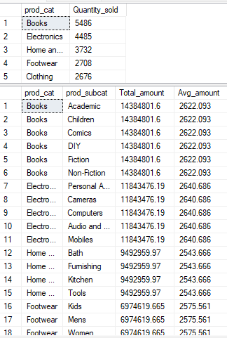

Slide 23
CONCLUSION
In this project we analyze the E-Commerce Retail Data. Data Preparation and analyzing an E-Commerce database containing tables such as 'prod cat info' , 'Transactions' and ‘customers' and finding out the business solutions for the given business objectives. We performed various tasks such as joining tables, Aggregating Data, Filtering Records and Sorting results to fulfill specific analysis requirements. Throughout the project, we demonstrated proficiency in SQL query writing, leveraging a variety of SQL functions, clauses, Operators, Analyze the dataset effectively. We Utilized Common Table Expressions(CTE), Aggregation Functions and Local Operations to extract insights such as Total revenue, Top-selling categories, and Customer behavior patterns.

Slide 24
THANK YOU
Gaya Gopan

