Slide 1
Smart Attendance System
System Architecture & Workflows

Slide 2
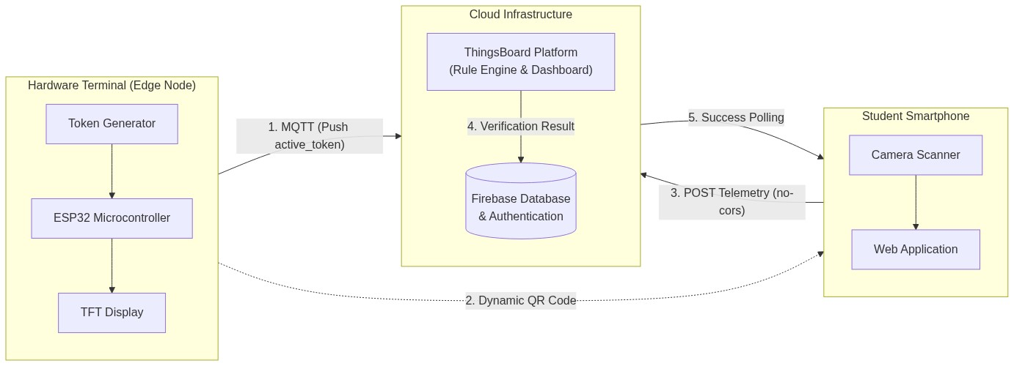
1. System Architecture

Slide 3
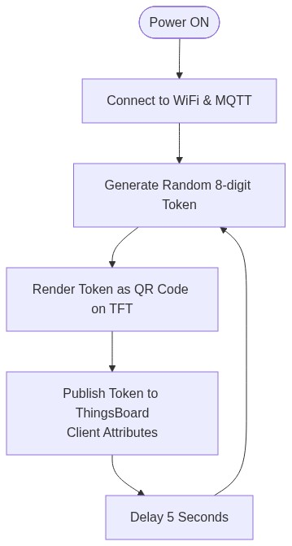
2. Hardware Logic (ESP32)

Slide 4
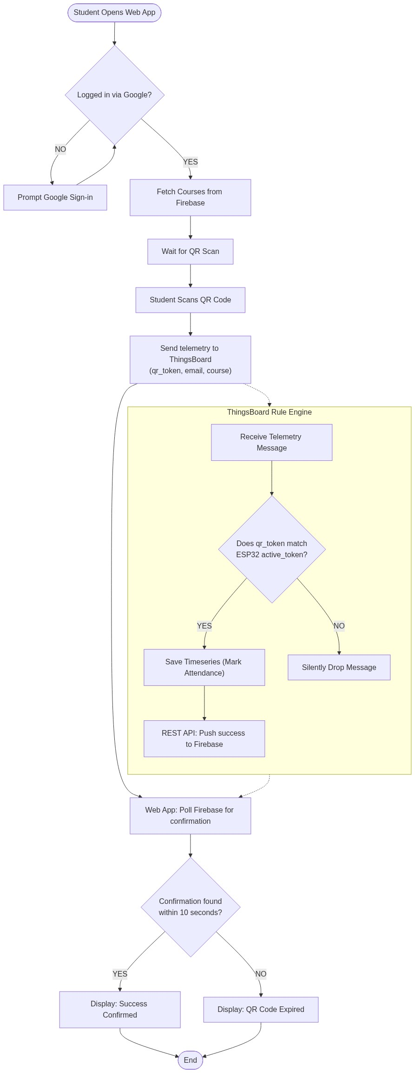
3. Student Check-in Logic

