Slide 1
Food Cone Web Application for a Restuarent

Slide 2
TABLE OF CONTENTS
Introduction
Basic Concepts
01
02
Database Design
Application Design
03
04
Cloud Hostintg
05

Slide 3
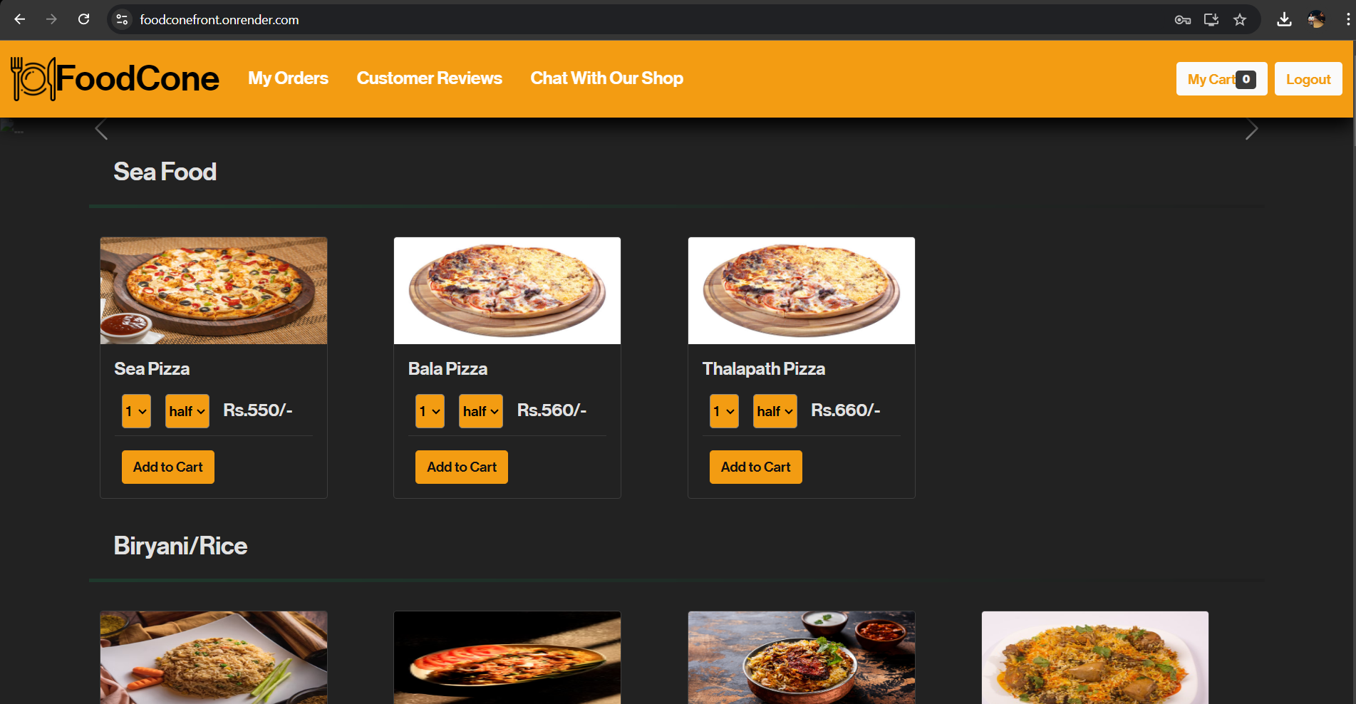
Introduction
Web Application for a Restuarent.
Shopping Cart Methodology.
MERN Project.
AWS Hosting.

Slide 4
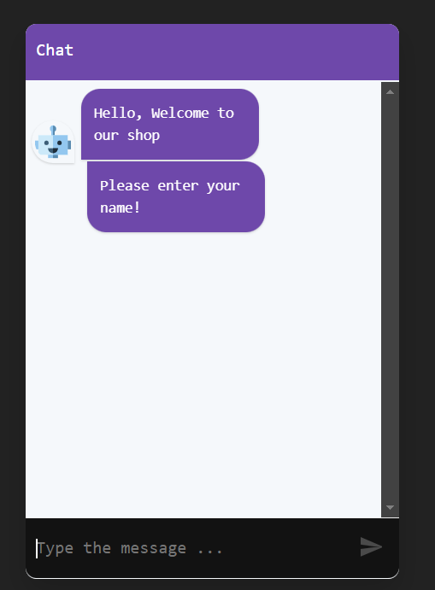
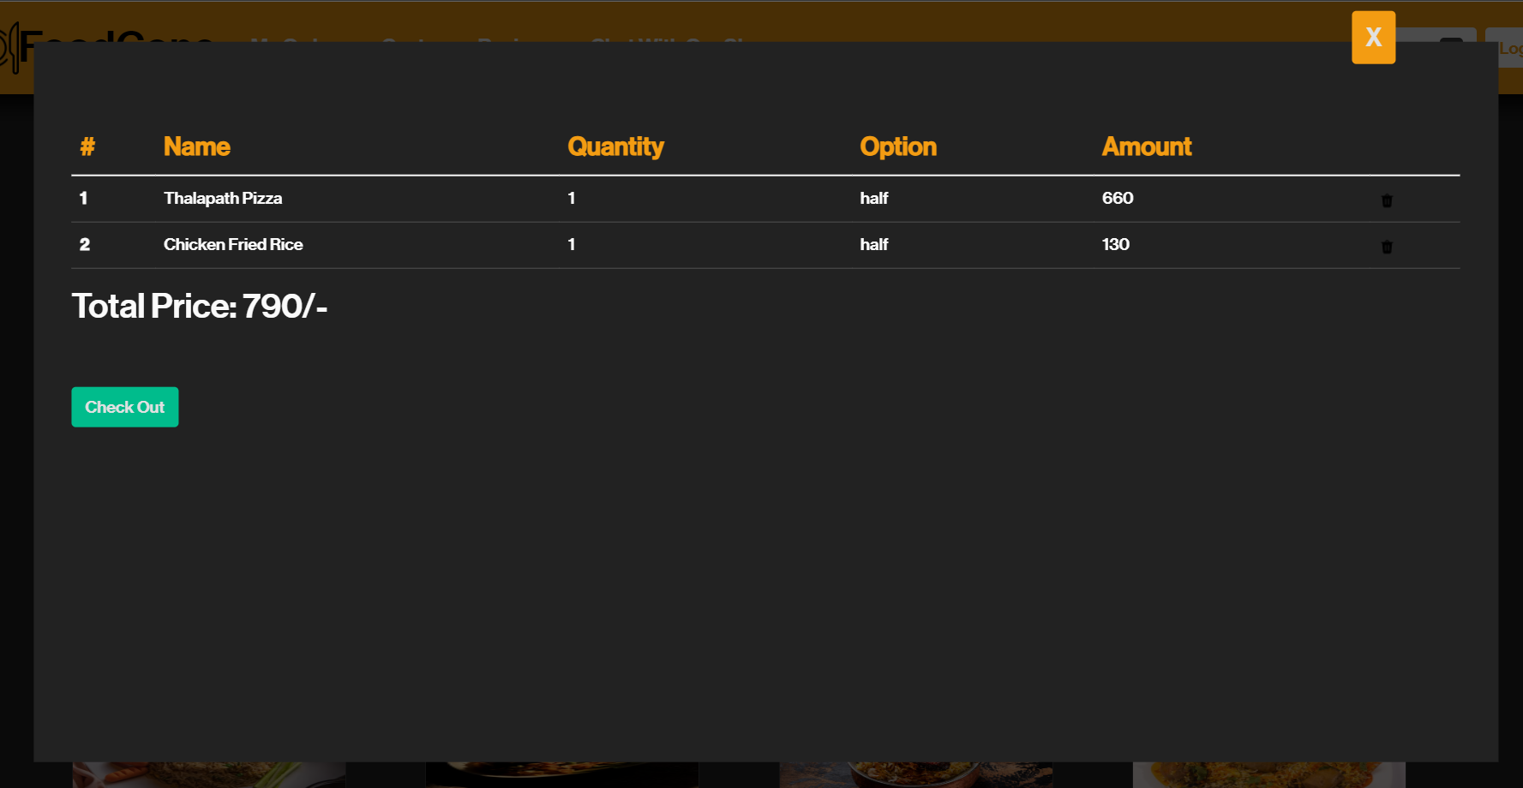
Functionalities In the System
View Items, Add Items to cart, Change quatity, remove items from cart.
Checkout after final selection.
Provide feedback, view feedback.
Chat with restuarent.

Slide 5
Functionalities In the System for Admin users
Add Items, Update Items, remove items.
View Orders.
View feedback.
Chat with Customers.
Manage Users

Slide 6
Basic Concepts of Web Application Development using MERN
DB Management
MongoDb for no sql database
MERN Stack
MongoDb
Express.js
React.js
Node.js
API Communication
RESTful APIs with Express.js
Frontend & Backend
Client side with React
Server side with Express & Node

Slide 7
Basic Concepts of Web Application Development using MERN
Asynchronous Operations
Using Promises & Async/Await
State Management
React hooks & Conext API
Component based Architecture
Reusable UI components in react

Slide 8
Database Design
Why use MongoDB ?
No SQL Flexibility
Schemaless data storage
Scalability and Performance
Advantages of MongoDB
High availability with replication
Horizontal scalability
Document oriented storage
Easy to use with JSON like documents
Key Implementations
Storing application data
Real time data updates
User authentication

Slide 9
Application Design
Client Side Architecture
Built with react.js
User Interface
User interactions and form submissions
Navigation with React Router
State management with Hooks (useState, useCart, useDispatchCart)
Communication With Server
Fetch API for http request
Asynchronous API calls

Slide 10
Application Design
Server Side Architecture
Built with node.js & Express.js
Server-side Runtime and API Construction
Event Driven, non blocking Architecture
Scalability and effectiveness
Data Storage
Stores user data, reviews, order information
JSON format documents
Mongoose ODM for data retrieval Asynchronous API calls
Real-Time Communication
WebSocket technology for instant feedback

Slide 11
Cloud Hosting

Slide 12
Thanks

