Slide 1

Apache Maven

Slide 2

What is maven ?
Maven is a powerful build tool for Java software projects. Actually, you can build software projects using other languages too, but Maven is developed in Java, and is thus historically used more for Java projects.
Purpose of maven?
The purpose of this Maven tutorial is to make you understand how Maven works. Therefore this tutorial focuses on the core concepts of Maven. Once you understand the core concepts, it is much easier to lookup the fine detail in the Maven documentation, or search for it on the internet

Slide 3
What is build tool ?
A build tool is a tool that automates everything related to building the software project.
Activities of Building a Software Project :
Generating source code (if auto-generated code is used in the project).
Generating documentation from the source code.
Compiling source code.
Packaging compiled code into JAR files or ZIP files.
Installing the packaged code on a server, in a repository or somewhere else.
Any given software project may have more activities than these needed to build the finished software. Such activities can normally be plugged into a build tool, so these activities can be automated too.
Why we automating the build process ?
The advantage of automating the build process is that you minimize the risk of humans making errors while building the software manually. Additionally, an automated build tool is typically faster than a human performing the same steps manually.

Slide 4
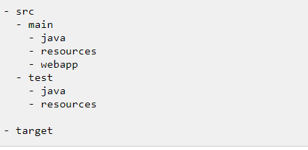
Maven Directory Structure
Maven has a standard directory structure. If you follow that directory structure for your project, you do not need to specify the directories of your source code, test code etc. in your POM file.
The src directory is the root directory of your source code and test code. The main directory is the root directory for source code related to the application itself (not test code).
The test directory contains the test source code. The java directories under main and test contains the Java code for the application itself (under main) and the Java code for the tests (under test).
The resources directory contains other resources needed by your project. This could be property files used for internationalization of an application, or something else.
The webapp directory contains your Java web application, if your project is a web application. The webapp directory will then be the root directory of the web application. Thus the webapp directory contains the WEB-INF directory etc.
The target directory is created by Maven. It contains all the compiled classes, JAR files etc. produced by Maven. When executing the clean build phase, it is the target directory which is cleaned.

Slide 5
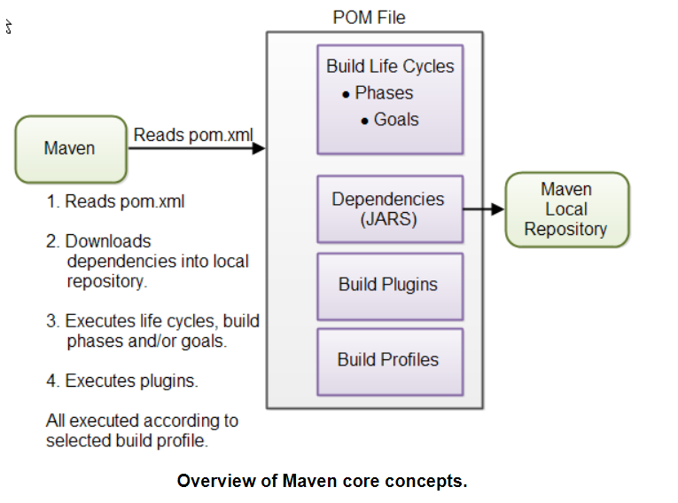
Maven Overview - Core Concepts
Maven is centered around the concept of POM files (Project Object Model).
A POM file is an XML representation of project resources like source code, test code, dependencies (external JARs used) etc. The POM contains references to all of these resources.
The POM file should be located in the root directory of the project it belongs to.

Slide 6
Overview of Maven core concepts.
POM Files
When you execute a Maven command you give Maven a POM file to execute the commands on. Maven will then execute the command on the resources described in the POM.
Build Life Cycles, Phases and Goals
* The build process in Maven is split up into build life cycles, phases and goals.
A build life cycle consists of a sequence of build phases, and each build phase consists of a sequence of goals. When you run Maven you pass a command to Maven.
This command is the name of a build life cycle, phase or goal. If a life cycle is requested executed, all build phases in that life cycle are executed.
If a build phase is requested executed, all build phases before it in the pre-defined sequence of build phases are executed too.

Slide 7
Build Plugins
Build plugins are used to insert extra goals into a build phase. If you need to perform a set of actions for your project which are not covered by the standard Maven build phases and goals, you can add a plugin to the POM file. Maven has some standard plugins you can use, and you can also implement your own in Java if you need to.
Build Profiles
Build profiles are used if you need to build your project in different ways.
For instance, you may need to build your project for your local computer, for development and test. And you may need to build it for deployment on your production environment.
These two builds may be different. To enable different builds you can add different build profiles to your POM files. When executing Maven you can tell which build profile to use.

Slide 8
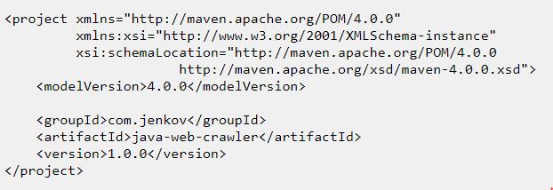
Maven POM Files
A Maven POM file (Project Object Model) is an XML file that describe the resources of the project. This includes the directories where the source code, test source etc. is located in, what external dependencies (JAR files) your projects has etc.
The POM file describes what to build, but most often not how to build it.
How to build it is up to the Maven build phases and goals.
You can insert custom actions (goals) into the Maven build phase if you need to, though.
Each project has a POM file. The POM file is named pom.xml and should be located in the root directory of your project.
A project divided into subprojects will typically have one POM file for the parent project, and one POM file for each subproject.
This structure allows both the total project to be built in one step, or any of the subprojects to be built separately

Slide 9
modelVersion
The modelVersion element sets what version of the POM model you are using. Use the one matching the Maven version you are using. Version 4.0.0 matches Maven version 2 and 3.
groupId
The groupId element is a unique ID for an organization, or a project (an open source project, for instance). Most often you will use a group ID which is similar to the root Java package name of the project. For instance, for my Java project I may choose the group ID com.virtusa.
If the project was an open source project with many independent contributors, perhaps it would make more sense to use a group ID related to the project than an a group ID related to my company. Thus, com.speedcloudplatform could be used.
The group ID does not have to be a Java package name, and does not need to use the . notation (dot notation) for separating words in the ID.
But, if you do, the project will be located in the Maven repository under a directory structure matching the group ID. Each . is replaced with a directory separator, and each word thus represents a directory. The group ID com.jenkov would then be located in a directory called MAVEN_REPO/com/virtusa.
The MAVEN_REPO part of the directory name will be replaced with the directory path of the Maven repository.

Slide 10
artifactId
The artifactId element contains the name of the project you are building. In the case of my Java project, the artifact ID would be java-project.
The artifact ID is used as name for a subdirectory under the group ID directory in the Maven repository.
The artifact ID is also used as part of the name of the JAR file produced when building the project.
The output of the build process, the build result that is, is called an artifact in Maven. Most often it is a JAR, WAR or EAR file, but it could also be something else.
versionId
The versionId element contains the version number of the project.
If your project has been released in different versions, for instance an open source API, then it is useful to version the builds.
That way users of your project can refer to a specific version of your project. The version number is used as a name for a subdirectory under the artifact ID directory. The version number is also used as part of the name of the artifact built.

Slide 11
The above groupId, artifactId and version elements would result in a JAR file being built and put into the local Maven repository at the following path (directory and file name):
MAVEN_REPO/com/virtusa/java-project/1.0.0/java-project-1.0.0.jar
If your project does not follow the standard directory structure, has external dependencies, or need special actions during building, you will need to add more elements to the POM file. These elements are listed in the Maven POM reference.
In general we can specify a lot of things in the POM which gives Maven more details about how to build your projects. See the Maven POM reference for more information about what can be specified.

Slide 12
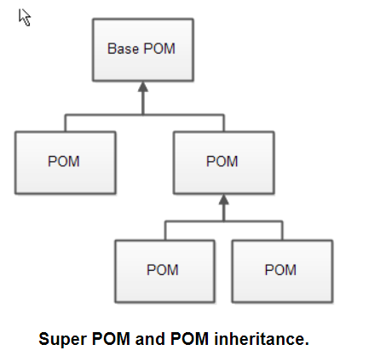
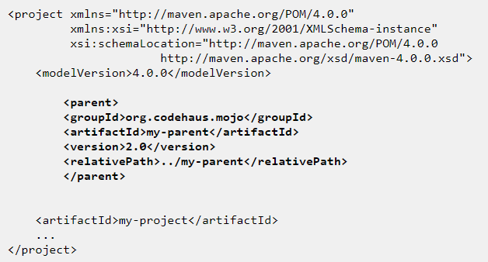
Super POM
All Maven POM files inherit from a super POM. If no super POM is specified, the POM file inherits from the base POM. Here is a diagram illustrating that:
You can make a POM file explicitly inherit from another POM file. That way you can change the settings across all inheriting POM's via their common super POM. You specify the super POM at the top of a POM file like this:

Slide 13
Effective POM
With all this POM inheritance it may be hard to know what the total POM file looks like when Maven executes. The total POM file (result of all inheritance) is called the effective POM. You can get Maven to show you the effective POM using this command:
Maven Settings File
Maven has two settings files. In the settings files you can configure settings for Maven across all Maven POM files. For instance, you can configure:
Location of local repository
Active build profile
Etc.
The settings files are called settings.xml. The two settings files are located at:
The Maven installation directory: $M2_HOME/conf/settings.xml
The user's home directory: ${user.home}/.m2/settings.xml
Both files are optional. If both files are present, the values in the user home settings file overrides the values in the Maven installation settings file.

Slide 14
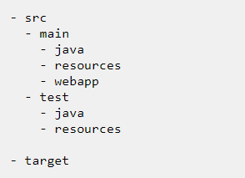
Maven Directory Structure
Maven has a standard directory structure. If you follow that directory structure for your project, you do not need to specify the directories of your source code, test code etc. in your POM file.
The src directory is the root directory of your source code and test code. The main directory is the root directory for source code related to the application itself (not test code). The test directory contains the test source code.
The java directories under main and test contains the Java code for the application itself (under main) and the Java code for the tests (under test).
The resources directory contains other resources needed by your project. This could be property files used for internationalization of an application, or something else.
The webapp directory contains your Java web application, if your project is a web application. The webapp directory will then be the root directory of the web application. Thus the webapp directory contains the WEB-INF directory etc.
The target directory is created by Maven. It contains all the compiled classes, JAR files etc. produced by Maven. When executing the clean build phase, it is the target directory which is cleaned.

Slide 15
Project Dependencies
Unless your project is small, your project may need external Java APIs or frameworks which are packaged in their own JAR files.
These JAR files are needed on the classpath when you compile your project code.
Keeping your project up-to-date with the correct versions of these external JAR files can be a comprehensive task. Each external JAR may again also need other external JAR files etc. Downloading all these external dependencies (JAR files) recursively and making sure that the right versions are downloaded is cumbersome. Especially when your project grows big, and you get more and more external dependencies.
Luckily, Maven has built-in dependency management. You specify in the POM file what external libraries your project depends on, and which version, and then Maven downloads them for you and puts them in your local Maven repository. If any of these external libraries need other libraries, then these other libraries are also downloaded into your local Maven repository.
There are four type of dependencies :
External Dependencies
Snapshot Dependencies
Transitive Dependencies
Exclude Dependency

Slide 16
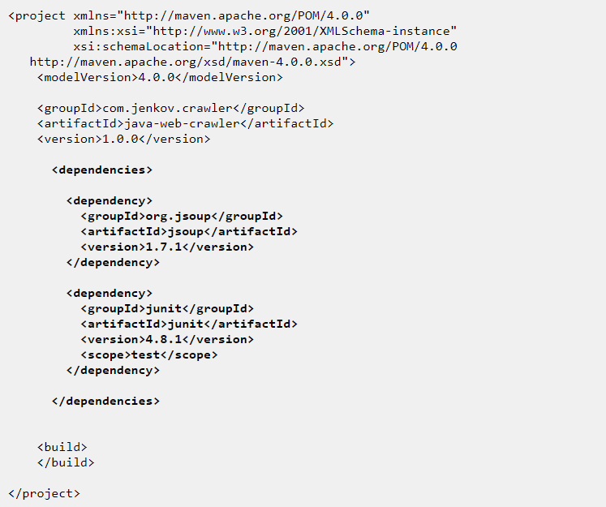

Slide 17
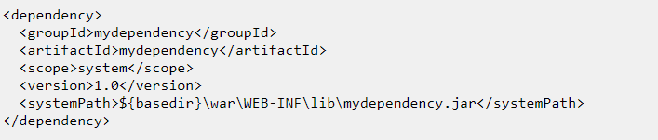
External Dependencies
An external dependency in Maven is a dependency (JAR file) which is not located in a Maven repository (neiterh local, central or remote repository). It may be located somewhere on your local hard disk, for instance in the lib directory of a webapp, or somewhere else.
The word "external" thus means external to the Maven repository system - not just external to the project.
Most dependencies are external to the project, but few are external to the repository system (not located in a repository).
The groupId and artifactId are both set to the name of the dependency.
The name of the API used, that is. The scope element value is set to system. The systemPath element is set to point to the location of the JAR file containing the dependency. The ${basedir} points to the directory where the POM is located. The rest of the path is relative from that directory.

Slide 18
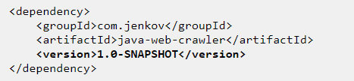
Snapshot Dependencies
Snapshot dependencies are dependencies (JAR files) which are under development.
Instead of constantly updating the version numbers to get the latest version, you can depend on a snapshot version of the project.
Snapshot versions are always downloaded into your local repository for every build, even if a matching snapshot version is already located in your local repository.
Always downloading the snapshot dependencies assures that you always have the latest version in your local repository, for every build.
You can tell Maven that your project is a snapshot version simply by appending -SNAPSHOT to the version number in the beginning of the POM (where you also set the groupId and artifactId). Here is a version element example:
<version>1.0-SNAPSHOT</version>
Notice : the -SNAPSHOT appended to the version number.
Depending on a snapshot version is also done by appending the -SNAPSHOT after the version number when configuring dependencies.

Slide 19
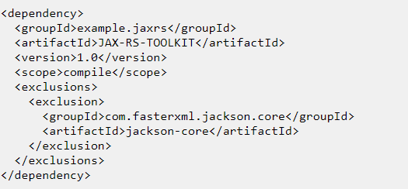
Transitive Dependencies
If your project depends on a dependency, say Dependency ABC, and Dependency ABC itself depends on another dependency, say Dependency XYZ, then your project has a transitive dependency on Dependency XYZ.
Exclude Dependency
Sometimes the direct dependencies of your project may clash with the transitive dependencies of the direct dependencies. For instance, you may be using a JAX-RS implementation which internally uses an older version of the Jackson JSON Toolkit. However, your application may be using a newer version of the Jackson JSON Toolkit. How do you know which of the two versions will be used?
A solution is to specify for the JAX-RS dependency that its dependency on the older version of the Jackson JSON Toolkit should be excluded. This is also referred to as dependency exclusion.
You specify a dependency exclusion inside the declaration of the dependency which transitive dependency you want to exclude.

Slide 20
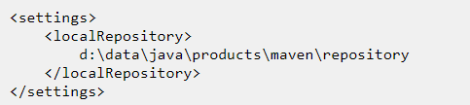
Maven Repositories
Maven repositories are directories of packaged JAR files with extra meta data. The meta data are POM files describing the projects each packaged JAR file belongs to, including what external dependencies each packaged JAR has. It is this meta data that enables Maven to download dependencies of your dependencies recursively, until the whole tree of dependencies is download and put into your local repository.
Local Repository: A local repository is a directory on the developer's computer. This repository will contain all the dependencies Maven downloads. The same Maven repository is typically used for several different projects. Thus Maven only needs to download the dependencies once, even if multiple projects depends on them (e.g. Junit).
Remote Repository
A remote repository is a repository on a web server from which Maven can download dependencies, just like the central repository. A remote repository can be located anywhere on the internet, or inside a local network.
Central Repository:
The central Maven repository is a repository provided by the Maven community. By default Maven looks in this central repository for any dependencies needed but not found in your local repository. Maven then downloads these dependencies into your local repository. You need no special configuration to access the central repository.

Slide 21
Maven Build Life Cycles, Phases and Goals
When Maven builds a software project it follows a build life cycle. The build life cycle is divided into build phases, and the build phases are divided into build goals.
Build Life Cycles
Maven has 3 built-in build life cycles. These are:
default
clean
Site
Each of these build life cycles takes care of a different aspect of building a software project. Thus, each of these build life cycles are executed independently of each other.
You can get Maven to execute more than one build life cycle, but they will be executed in sequence, separately from each other, as if you had executed two separate Maven commands.
The default life cycle handles everything related to compiling and packaging your project.
The clean life cycle handles everything related to removing temporary files from the output directory, including generated source files, compiled classes, previous JAR files etc.
The site life cycle handles everything related to generating documentation for your project. In fact, site can generate a complete website with documentation for your project.

Slide 22
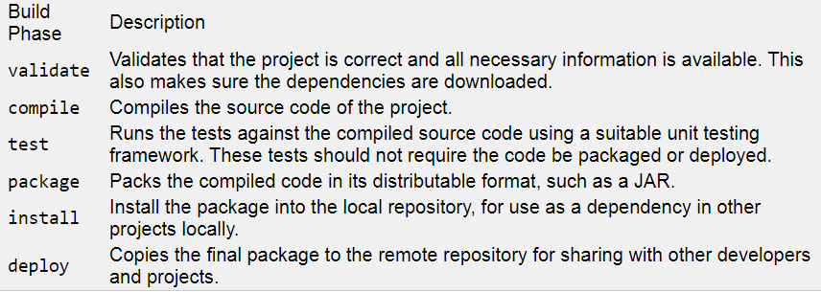
Build Phases
Each build life cycle is divided into a sequence of build phases, and the build phases are again subdivided into goals. Thus, the total build process is a sequence of build life cycle(s), build phases and goals.

Slide 23
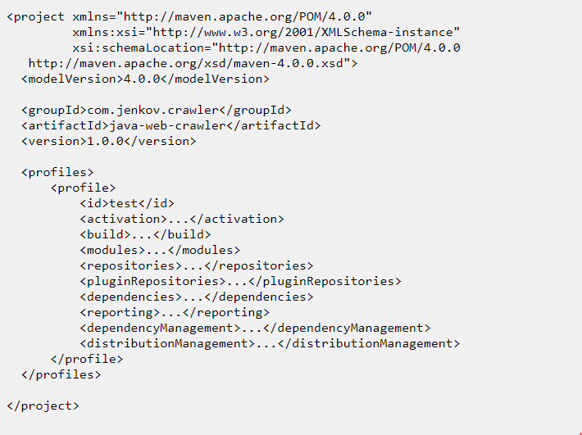
Maven Build Profiles
Maven build profiles enable you to build your project using different configurations. Instead of creating two separate POM files, you can just specify a profile with the different build configuration, and build your project with this build profile when needed.
Maven build profiles are specified inside the POM file, inside the profiles element. Each build profile is nested inside a profile element.
A build profile describes what changes should be made to the POM file when executing under that build profile.
This could be changing the applications configuration file to use etc. The elements inside the profile element will override the values of the elements with the same name further up in the POM.
Inside the profile element you can see a activation element.
This element describes the condition that triggers this build profile to be used. One way to choose what profile is being executed is in the settings.xml file. There you can set the active profile.
Another way is to add -P profile-name to the Maven command line.

Slide 24
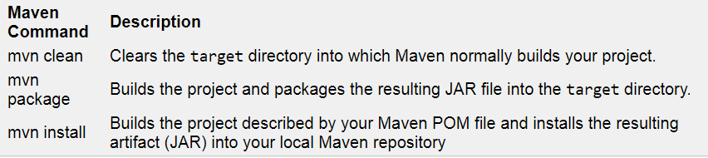
Maven Commands
Maven contains a wide set of commands which you can execute. Maven commands are a mix of build life cycles, build phases and build goals,
Maven Command Structure
A Maven command consists of two elements:
mvn
One or more build life cycles, build phases or build goals

Slide 25
Thank you !

