Slide 1


VISVESVARAYA TECHNOLOGICAL UNIVERSITY,
BELGAVI-590018, KARNATAKA
EMPLOYEE RECORD MANAGEMENT SYSTEM
at
RPLTechno IT Services Pvt Ltd, Bengaluru
By
GAYANA J R ( 4VM16CS007 )
Department of COMPUTER SCIENCE AND ENGINEERING,
VIDYA VIKAS INSTITUTE OF ENGINEERING AND TECHNOLOGY,
ALANAHALLY, MYSURU-570028

Slide 2
COMPANY PROFILE
Introduction:
RPLTechno IT Services Pvt Ltd - is one of the excellent Digital Marketing and Web Designing Company, they help the organization to grow their business through the modern techniques by bringing them in digital market and advising them the growing strategy of their business.
Mission:
To build long term relationship with our customers and clients and provide exceptional customer services by pursuing business through innovation and advanced technology.
Vision:
To provide most comprehensive, quality and personalized services that exceeds the expectations of our esteemed customers.
Clients:
It is a digital marketing and web desiging company hence it has the clients of students, professionals, business and individuals etc.
Team:
Includes the Owner, a Business Leader, an IT business leader, a Business Analyst, an IT analyst
Products:
It includes satellite multi switches, amplifiers, modulators, DVB-T-Head end, IPTV Head end, accessories.

Slide 3
INTRODUCTION
With large number of work opportunities the human workforce has increased and with growing technology everything has been computerized.
A system which can handle the data of such a large number of employees.
Employee Management System is a software which is use to manage the data of the employees such as personal details, education details, work experience etc.
This project will reduce the paper work of the company.

Slide 4
OBJECTIVE
Develop a prototype.
Develop a management system for Employment System.
Provide basic information about Employment System.

Slide 5
PROBLEM STATEMENT
In the existing system, the data of the employees such as personal details, educational details, work experience etc., are maintained manually.
There will be a lot of paper work for the company which is time consuming.
Maintaining records in registers may lead to missing of records of the employees which may in turn affect the company.

Slide 6
PROPOSED SYSTEM
A software which can handle the data of a large number of employees.
Also, perform and document risk analysis.
The software can manage the data of all the employees such as personal details, education details, work experience etc.,
It will reduce the paper work of the company. And hence, through this project, company can manage all data online.
there are mainly two modules in this software:
1. Admin module
2. User module

Slide 7
SCOPE OF WORK
SYSTEMATIC ORDER:
As the old system had a long and tedious way for keeping the records, this system helps to maintain them in a very systematic order. The software can manage the data of all the employees such as personal details, education details, work experience etc.,
REDUCED ERRORS:
This application is helpful in reducing errors while entering them and also it is easy to update them.
USER- FRIENDLY:.
It does not require any format knowledge while entering the records and hence it is user-friendly.
SECURE AND RELIABLE:
This system is secure and reliable as it is error free and user-friendly.
FAST MANAGEMENT:
Since all the records are arranged in a systematic order they can be retrieved fastly and also they can be entered fastly as they have a format while entering.

Slide 8
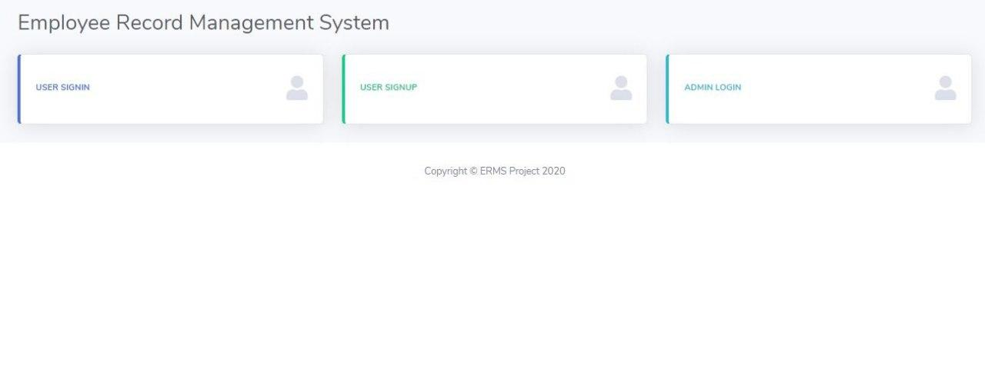
SNAPSHOTS
Fig : HOME PAGE

Slide 9
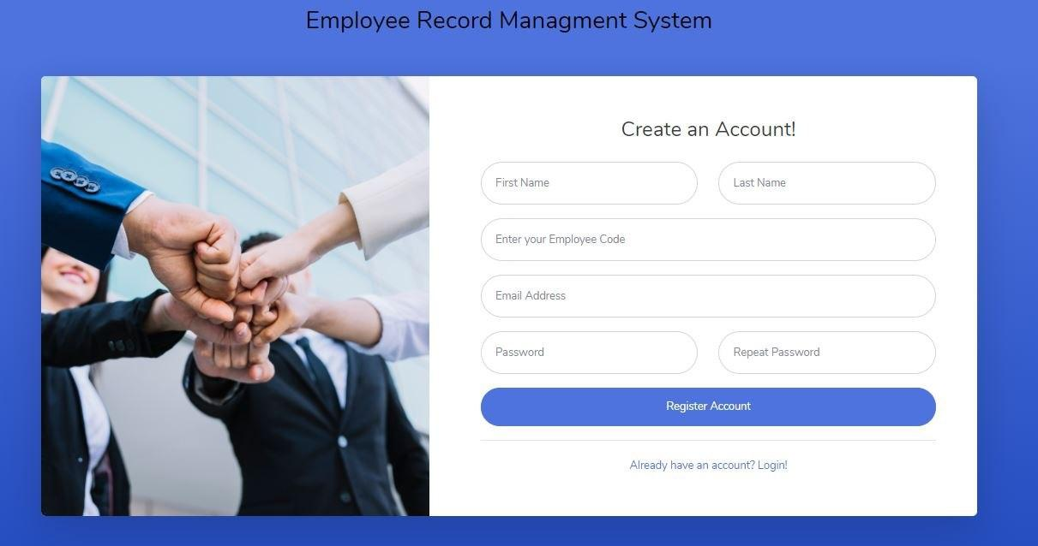
Fig : REGISTRATION PAGE FOR EMPLOYEE

Slide 10
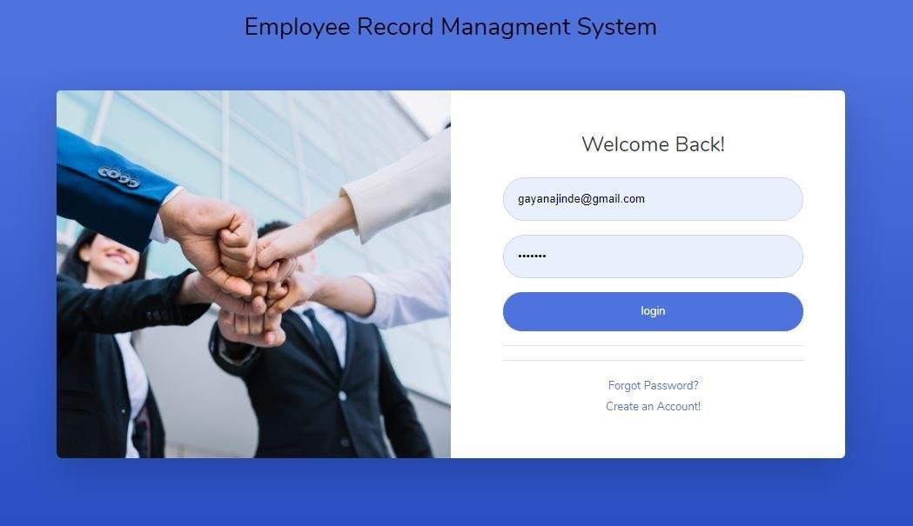
Fig : SIGN-IN PAGE FOR EMPLOYEE

Slide 11
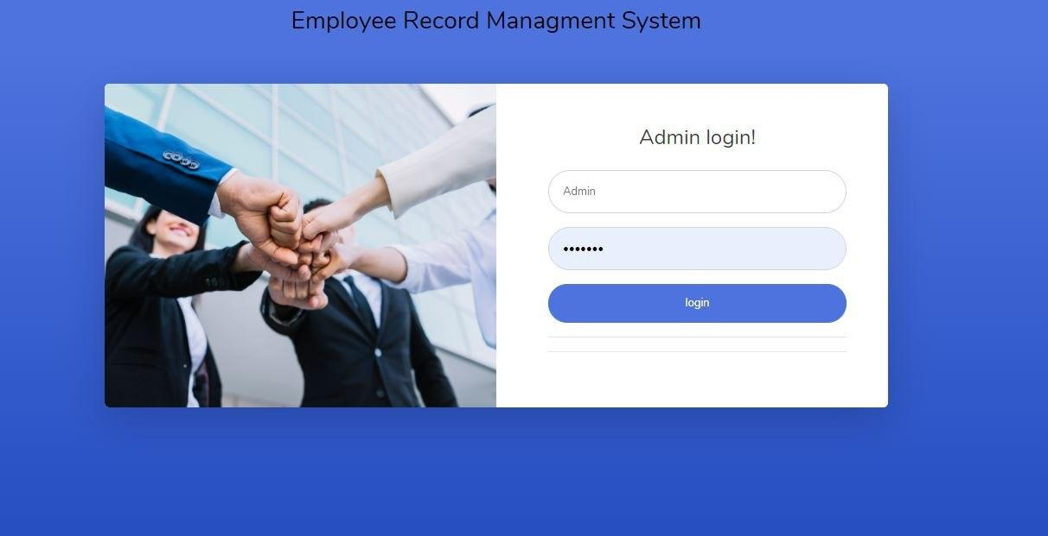
Fig : SIGN-IN PAGE FOR ADMIN

Slide 12
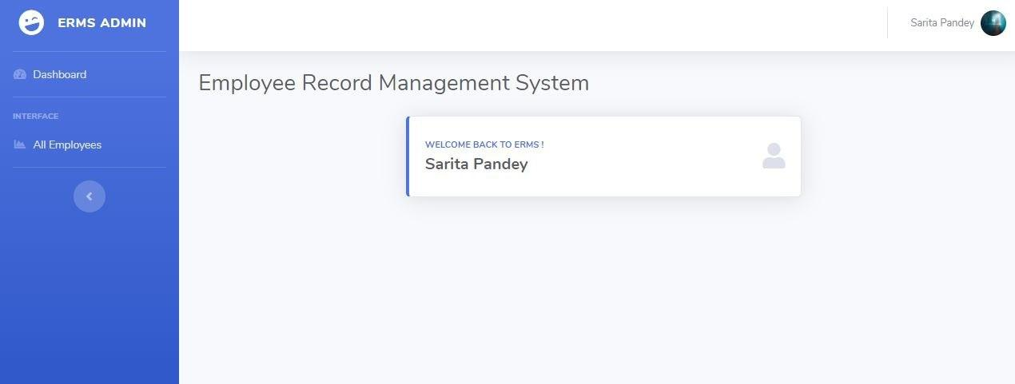
Fig :ADMIN DASHBOARD

Slide 13
CONCLUSION
The project is only a humble venture to satisfy the needs in an Institution or Organization. Several user-friendly coding are also adopted. This package shall prove to be a powerful package in satisfying all the requirements of the organization.
The objective of software planning is to provide a frame work that enables the manager to make reasonable estimates made within a limited time frame at the beginning of the software project and should be updated regularly as the project progresses.

Slide 14
THANK YOU

