Slide 1

Sensor–Text Fusion for Predictive Maintenance
Concept Presentation
Team Members:
Vadlakonda Dhruva Teja
Gayantha rukshan kuruppuarachchi
Sudarsi Amansnohith
Guided by:
Hamidreza Heidari

Slide 2
Introduction:
Unplanned machine failures cause costly downtime in production. Most predictive maintenance systems use sensor data only and ignore the written maintenance logs that technicians produce. These logs hold early warnings that sensors miss, such as “unusual noise” or “bearing worn”.
Key motivations:
Detect failures earlier by combining sensor telemetry with maintenance text
Reduce false alarms compared with sensor-only systems
Support the module goals: less downtime, better quality, safer work

Slide 3
Project Scope:
Aim:
Predict machine failures by fusing sensor telemetry with maintenance log text in a Big Data pipeline, and show whether fusion beats a sensor-only baseline.
Includes:
PySpark pipeline that turns raw telemetry into failure-relevant features
NLP classifier for free-text maintenance logs
Fused model predicting failure within the next 24 hours
Comparison of sensor-only vs fused model; GitHub repo and Streamlit demo
Out of Scope (Current Phase):
Validation using real, synchronized sensor data and maintenance logs from the same machines.

Slide 4
Objectives:
Build a scalable PySpark pipeline that turns raw machine telemetry into failure-relevant features.
Build an NLP model that classifies free-text maintenance logs into fault categories.
Fuse sensor and text features to predict whether a machine fails within the next 24 hours.
Show whether fusion beats a sensor-only baseline, measured with clear KPIs.
Deliver a reproducible GitHub repo and a Streamlit demo.

Slide 5
Data Sources:
Dataset | Role | Content
Microsoft Azure Predictive Maintenance (Kaggle) | Sensor data (Big Data) | 100 machines, hourly telemetry (voltage, rotation, pressure, vibration), errors, maintenance and failure records
Aircraft Historical Maintenance Dataset – MaintNet (Kaggle) | Text data (NLP) | 6,169 free-text maintenance logs: problem description and action taken
Both datasets are public and free, so no data collection is needed.
No public dataset holds sensor data and text logs for the same machines. The NLP model is trained on real MaintNet text; MaintNet-style log entries are then generated for each Azure maintenance and error event. This is documented openly as a limitation.

Slide 6
Literature Review:
Theme | Key sources | Why it matters
1. Fusing sensor data and text | Sensor Review 2024; PHM Society papers; Univ. of Vaasa thesis (NLP in IoT) | Early fusion beat traditional methods by 2.6–16.9%; sensor + NLP outperformed sensor-only models
2. NLP for maintenance text | MaintNet (COLING 2020); NLP tools for MaintNet (AACL 2020); Brundage et al. on TLP; TLP for PHM (2024) | Logs use messy logbook language; standard NLP fails, so adapted methods are needed
3. Predictive maintenance and Big Data | Krupitzer et al. survey; PM systems survey (arXiv); PeerJ CS 2024; Guidotti et al. review | Background; Big Data is a core element; public datasets are scarce, supporting the use of Kaggle data

Slide 7
Technology Stack:
Area | Tools
Big Data processing | PySpark
NLP | spaCy or NLTK, scikit-learn (TF-IDF)
Modelling | scikit-learn, XGBoost
Visualisation and demo | matplotlib, seaborn, Streamlit
Collaboration | GitHub (repo, issues board), Jupyter notebooks

Slide 8
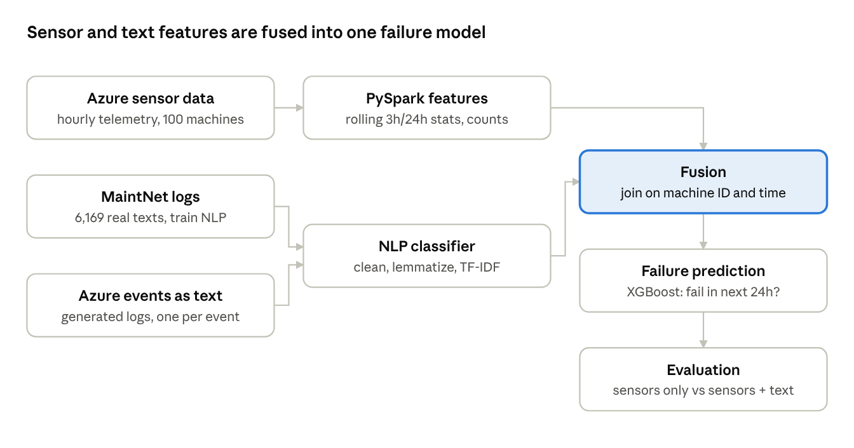
Project flow chart:

Slide 9
Working Methodology:
Step 1: Data Preparation
• Load Azure telemetry, errors, maintenance and failure records in PySpark
• Build rolling 3h/24h statistics and event counts
Step 2: NLP Model
• Clean, lemmatize and vectorize (TF-IDF) 6,169 MaintNet logs
• Classify faults; map to mechanical, electrical, hydraulic
• Generate and classify logs for Azure events
Step 3: Fusion and Prediction
• Join sensor and text features on machine ID and time
• Train XGBoost to predict failure in the next 24 hours, on sensors only and on fused features
Step 4: Evaluation and Demo
• Time-based train/test split
• Compare recall, precision, F1 and downtime avoided
• Present results in a Streamlit demo

Slide 10
KPIs and Evaluation:
Main result: sensor-only baseline vs fused sensor-plus-text model, on a time-based train/test split.
Recall on failures: share of real failures caught (primary KPI)
Precision / false alarm rate: share of alarms that were real failures
F1-score per component
NLP classifier accuracy and F1 on MaintNet fault categories
Estimated downtime avoided: failures caught × average repair time

Slide 11
Risks and Limitations:
Risk | Mitigation
Text logs for Azure machines are semi-synthetic | Train NLP on real MaintNet text; report the generation method openly; ask the lecturer about real factory logs
Azure sensor data is simulated | Treat results as proof of concept; name it under limitations
Failures are rare (class imbalance) | Use class weights or resampling; report recall, not only accuracy
Domain gap between aviation text and factory machines | Map MaintNet categories to generic fault types (mechanical, electrical, hydraulic)

Slide 12
Bill of Materials (BOM):
Component | Specifications | Quantity | Cost
Sensor dataset | Microsoft Azure Predictive Maintenance (Kaggle) | 1 | Free
Text dataset | Aircraft Historical Maintenance – MaintNet (Kaggle) | 1 | Free
Software | Open source (PySpark, scikit-learn, XGBoost, Streamlit, …) | - | Free
Compute / hardware | Existing student laptop or university computer; CPU-based processing | 1 | Free

Slide 13
Expected Outcomes:
Scalable PySpark pipeline producing failure-relevant sensor features
NLP classifier for maintenance logs with reported accuracy and F1
Fused model predicting failures in the next 24 hours
Clear comparison of fused vs sensor-only model on recall, precision and F1
Reproducible GitHub repo and Streamlit demo

Slide 14
Safety & Ethical Checklist:
Software-only project; no physical machinery risk
Public datasets only (Kaggle); no data collection from people
Semi-synthetic text logs and simulated sensor data are disclosed openly as limitations
Reproducibility ensured through a public GitHub repository.
Data leakage, class imbalance and potential model bias are considered during evaluation.
Results and limitations are reported transparently and reproducibly.

Slide 15
Future Work:
Real-world validation: Evaluate the fused model using synchronized sensor telemetry and maintenance logs from the same industrial machines.
Real-time monitoring: Integrate streaming sensor data using technologies such as Apache Kafka and Spark Structured Streaming.
Advanced fusion: Investigate transformer-based text embeddings and more sophisticated multimodal fusion techniques.
Explainable predictions: Use SHAP or similar methods to identify which sensor signals and text features influence each prediction.
Deployment and scalability: Extend the Streamlit proof of concept into a continuously monitored maintenance decision-support system.

Slide 16
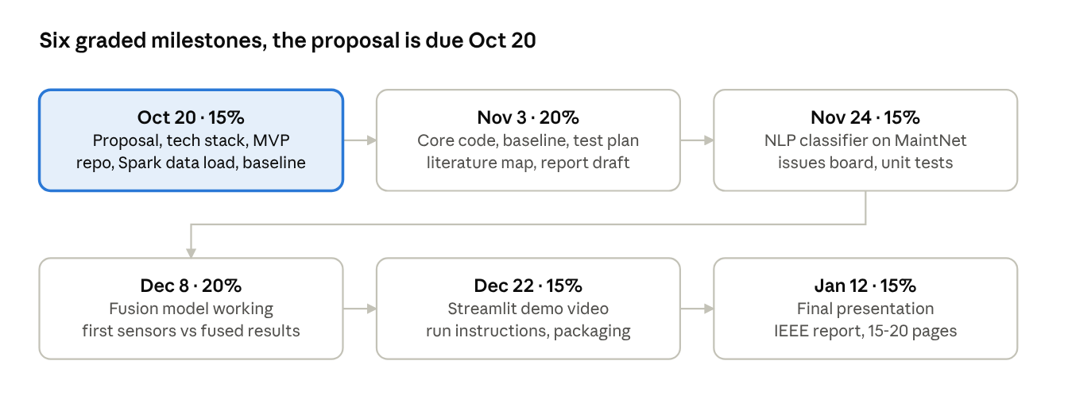
Milestones:
Dates and weights follow the module’s assessment plan. Phase 1 includes a 10-minute presentation per team.

Slide 17
Bibliography
F. Akhbardeh, T. Desell, M. Zampieri, “MaintNet: A Collaborative Open-Source Library for Predictive Maintenance Language Resources,” COLING 2020 System Demonstrations. arXiv:2005.12443
F. Akhbardeh, T. Desell, M. Zampieri, “NLP Tools for Predictive Maintenance Records in MaintNet,” AACL-IJCNLP 2020 System Demonstrations.
F. Boylu Uz, “Predictive Maintenance Modelling Guide,” Microsoft Cortana Intelligence Gallery.
Microsoft Azure Predictive Maintenance dataset, Kaggle.
Chen, T., & Guestrin, C. (2016). “XGBoost: A Scalable Tree Boosting System.” Proceedings of the 22nd ACM SIGKDD International Conference on Knowledge Discovery and Data Mining, 785–794. https://doi.org/10.1145/2939672.2939785
Pedregosa, F., et al. (2011). “Scikit-learn: Machine Learning in Python.” Journal of Machine Learning Research, 12, 2825–2830. https://www.jmlr.org/papers/v12/pedregosa11a.html
Zaharia, M., et al. (2016). “Apache Spark: A Unified Engine for Big Data Processing.” Communications of the ACM, 59(11), 56–65. https://doi.org/10.1145/2934664

Slide 18
Thank You
Repository

