Slide 1
Q2 2021 Summary Report
XYZ Pension Scheme

Slide 2
Investment performance to 30 June 2021
Overall performance
 | 3 months | 1 year | Inception (pa)
Asset return (%) | 5.6% | 7.7% | 14.0%
Liability benchmark (%) | 3.1% | -6.7% | -3.6%
Outperformance (%) | 2.4% | 14.4% | 17.6%
The Scheme’s assets outperformed the gilts liabilities over the quarter by 2.4%. Investment performance relative to gilts is well above target (2.7%) over 1 year (14.4%) and since inception (17.6%, annualised).
The growth portfolio returned 4.0% during Q2 with most asset classes benefitting from the continued economic recovery from the effects of the pandemic. Economies continued to reopen, monetary policy in most regions remained accommodative and, in most cases, economic data pointed to a faster-than-expected recovery.
Within the growth portfolio, alternative investments had a strong quarter with global REITs and commodities leading the way, with equities also having another strong quarter (in particular Europe ex-UK and the US).
Within the dynamic strategies, both the Alternative and Market components performed well although the Tactical strategies made a small loss over the period with relative value equity trades detracting from performance.
Gilt yields fell over the period leading to a rise in Scheme liabilities. LDI assets increased in value as expected in order to match this rise.
Asset class performance
 | 3 months | 1 Year
Scheme Performance | 5.6% | 7.7%
Total Growth | 4.0% | 15.3%
Equities | 5.4% | 28.0%
Corporate Bonds | 2.6% | -0.1%
Sovereign Bonds | 2.0% | -1.4%
Alternatives | 4.8% | 12.3%
Dynamic Strategies | 2.0% | 13.9%
Total Matching | 13.3% | -24.7%
LDI Funds & Cash | 13.3% | -24.7%
Liability Benchmark | 3.1% | -6.7%

Slide 3
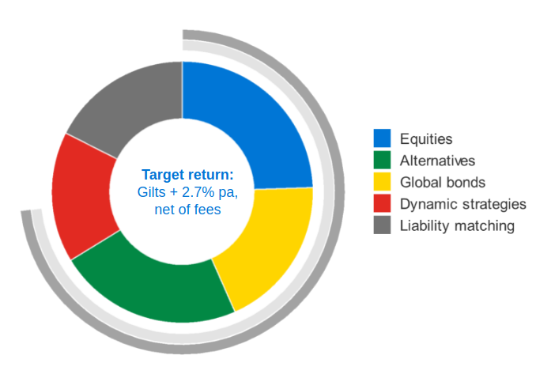
Asset allocation at 30 June 2021
 |  | 31 March 2021 | 30 June 2021
EQUITIES | UK Equity | 1.8% | 1.8%
 | North America Equity | 1.8% | 1.9%
 | Europe (ex UK) Equity | 3.0% | 2.7%
 | Japan Equity | 2.9% | 2.8%
 | Asia Pacific ex-Japan Equity | 1.7% | 1.7%
 | Emerging Markets Equity | 3.4% | 3.6%
 | Global Developed Small Cap Equity | 2.7% | 2.7%
 | Smart beta equity | 5.9% | 5.6%
GLOBAL BONDS | ‘Fallen Angels’ Credit | 5.1% | 5.7%
 | UK Investment Grade Credit | 3.1% | 4.9%
 | Euro Investment Grade Credit | 0.3% | 0.7%
 | US Investment Grade Credit | 2.2% | 2.2%
 | Overseas Government Bonds | 7.2% | 5.5%
ALTERNATIVES | Property | 3.4% | 3.4%
 | Listed Private Equity | 1.8% | 1.7%
 | High Yield Bonds | 4.0% | 3.9%
 | Listed Infrastructure | 4.1% | 3.6%
 | Global REITs | 4.5% | 4.4%
 | Emerging Market Bonds (Local) | 4.1% | 4.2%
 | Emerging Market Bonds (USD) | 1.8% | 1.9%
 | Commodities | 1.4% | 1.5%
DYNAMIC STRATEGIES | Multi-Asset Target Return (MATR) | 16.5% | 16.2%
LIABILITY-MATCHING | Liability-matching credit | 0.0% | 0.0%
 | Liability driven investment strategies | 17.4% | 17.5%
 | Interest rate hedge ratio* | 74% | 73%
 | Inflation hedge ratio* | 74% | 73%
 | *(% of funded liabilities)
We are comfortable that the asset allocation remains in line with the Scheme’s target return. The Scheme has exposure to a diversified portfolio of growth assets, and the majority of liability interest rate interest rate and inflation risk has been hedged.
Overall growth and matching allocations remained largely unchanged over the quarter, though adjustments were made within the global bond portfolio.
The allocation remains within permitted tolerances.

