Slide 1
Gayashan Sameera SSE Minuwangoda

Slide 2
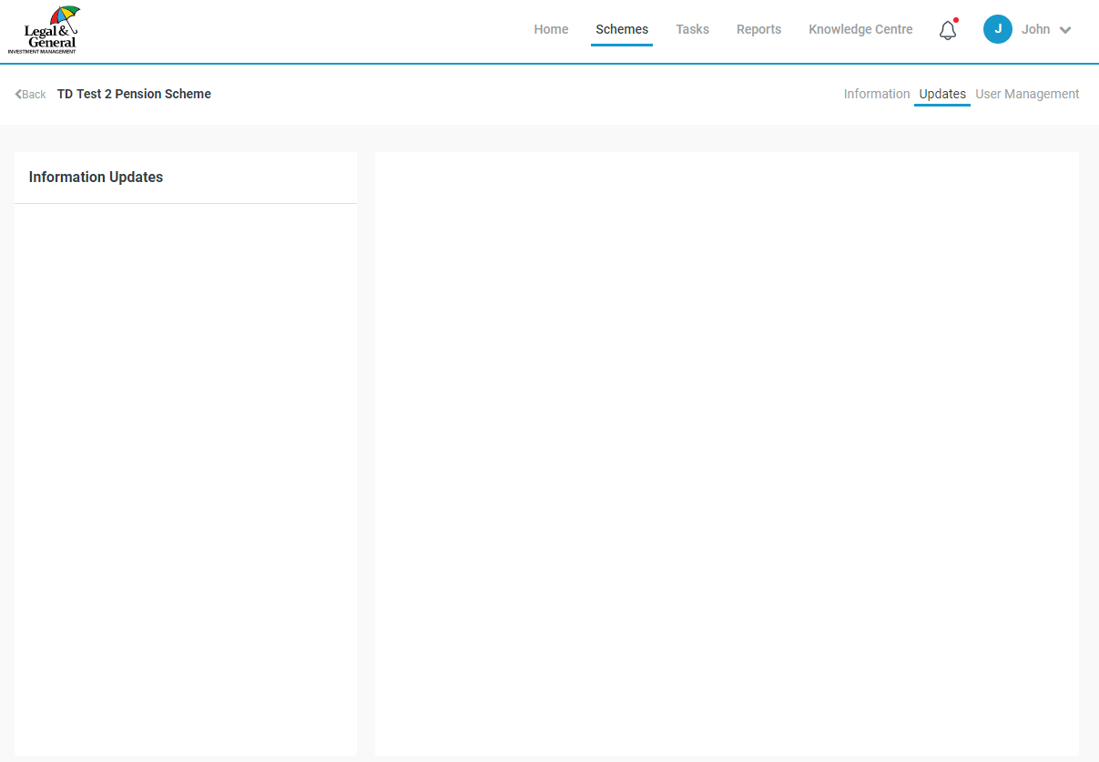
Workflow landing page

Slide 3
React , Node , AWS serverless

Slide 4
Sample table to delete

Slide 5
Sample table to delete row
Header 1 | Header 2 | Header 3 | Header 4 | Header 5
11 | 12 | 13 | 14 | 15
31 | 32 | 33 | 34 | 35

Slide 6
Sample table to delete column
Header 1 | Header 2 | Header 3 | Header 5
11 | 12 | 13 | 15
21 | 22 | 23 | 25
31 | 32 | 33 | 35

Slide 7
Loop sample data
Kamal 12 Amal 22 Nuwan 32 Sama 12 Amara 22 Nayana 32 Colombo 1 Colombo 2 Colombo 3

Slide 8
cashflow year | cashflow fixed | cashflow real
2020 | 1 | 123123
2020 | 2 | 123123
2020 | 3 | 123123
2020 | 4 | 123123
2020 | 5 | 123123
2020 | 6 | 123123
2020 | 7 | 123123
2020 | 8 | 123123
2020 | 9 | 123123
2020 | 10 | 123123
cashflow year | cashflow fixed | cashflow real
2020 | 11 | 123123
2020 | 12 | 123123
2020 | 13 | 123123
2020 | 14 | 123123
2020 | 15 | 123123
2020 | 16 | 123123
2020 | 17 | 123123
2020 | 18 | 123123
2020 | 19 | 123123
2020 | 20 | 123123
cashflow year | cashflow fixed | cashflow real
2020 | 21 | 123123
2020 | 22 | 123123
2020 | 23 | 123123
2020 | 24 | 123123
2020 | 25 | 123123
2020 | 26 | 123123
2020 | 27 | 123123
2020 | 28 | 123123
2020 | 29 | 123123
2020 | 30 | 123123
cashflow year | cashflow fixed | cashflow real
2020 | 31 | 123123
2020 | 32 | 123123
2020 | 33 | 123123
2020 | 34 | 123123
2020 | 35 | 123123
2020 | 36 | 123123
2020 | 37 | 123123
2020 | 38 | 123123
2020 | 39 | 123123
2020 | 40 | 123123

Slide 9
cashflow year | cashflow fixed | cashflow real
2020 | 41 | 123123
2020 | 42 | 123123
2020 | 43 | 123123
2020 | 44 | 123123
2020 | 45 | 123123
2020 | 51 | 123123
2020 | 52 | 123123
2020 | 53 | 123123
2020 | 54 | 123123
2020 | 55 | 123123
cashflow year | cashflow fixed | cashflow real
2020 | 56 | 123123
2020 | 57 | 123123
2020 | 58 | 123123
2020 | 59 | 123123
2020 | 510 | 123123
2020 | 151 | 123123
2020 | 512 | 123123
2020 | 153 | 123123
2020 | 154 | 123123
2020 | 155 | 123123
cashflow year | cashflow fixed | cashflow real
2020 | 61 | 123123
2020 | 62 | 123123
2020 | 63 | 123123
2020 | 64 | 123123
2020 | 65 | 123123
2020 | 66 | 123123
2020 | 67 | 123123
2020 | 68 | 123123
2020 | 69 | 123123
2020 | 170 | 123123
cashflow year | cashflow fixed | cashflow real
2020 | 171 | 123123
2020 | 172 | 123123
2020 | 173 | 123123
2020 | 174 | 123123
2020 | 175 | 123123
2020 | 17 | 123123
2020 | 82 | 123123
2020 | 83 | 123123
2020 | 84 | 123123
2020 | 85 | 123123

Slide 10
cashflow year | cashflow fixed | cashflow real
2020 | 86 | 123123
2020 | 87 | 123123
2020 | 88 | 123123
2020 | 89 | 123123
2020 | 190 | 123123
2020 | 191 | 123123
2020 | 192 | 123123
2020 | 193 | 123123
2020 | 194 | 123123
2020 | 195 | 123123
cashflow year | cashflow fixed | cashflow real
2020 | 17 | 123123
2020 | 82 | 123123
2020 | 83 | 123123
2020 | 84 | 123123
2020 | 85 | 123123
2020 | 86 | 123123
2020 | 87 | 123123
2020 | 88 | 123123
2020 | 89 | 123123
2020 | 190 | 123123
cashflow year | cashflow fixed | cashflow real
2020 | 191 | 123123
2020 | 192 | 123123
2020 | 193 | 123123
2020 | 194 | 123123
2020 | 195 | 123123
2020 | 1 | 123123
2020 | 2 | 123123
2020 | 3 | 123123
2020 | 4 | 123123
2020 | 5 | 123123
cashflow year | cashflow fixed | cashflow real
2020 | 6 | 123123
2020 | 7 | 123123
2020 | 8 | 123123
2020 | 9 | 123123
2020 | 10 | 123123
2020 | 11 | 123123
2020 | 12 | 123123
2020 | 13 | 123123
2020 | 14 | 123123
2020 | 15 | 123123

Slide 11
cashflow year | cashflow fixed | cashflow real
2020 | 16 | 123123
2020 | 17 | 123123
2020 | 18 | 123123
2020 | 19 | 123123
2020 | 20 | 123123
2020 | 21 | 123123
2020 | 22 | 123123
2020 | 23 | 123123
2020 | 24 | 123123
2020 | 25 | 123123
cashflow year | cashflow fixed | cashflow real
2020 | 26 | 123123
2020 | 27 | 123123
2020 | 28 | 123123
2020 | 29 | 123123
2020 | 30 | 123123
2020 | 31 | 123123
2020 | 32 | 123123
2020 | 33 | 123123
2020 | 34 | 123123
2020 | 35 | 123123
cashflow year | cashflow fixed | cashflow real
2020 | 36 | 123123
2020 | 37 | 123123
2020 | 38 | 123123
2020 | 39 | 123123
2020 | 40 | 123123
2020 | 41 | 123123
2020 | 42 | 123123
2020 | 43 | 123123
2020 | 44 | 123123
2020 | 45 | 123123
cashflow year | cashflow fixed | cashflow real
2020 | 51 | 123123
2020 | 5112 | 123123
2020 | 5113 | 123123
2020 | 5114 | 123123
2020 | 5115 | 123123
2020 | 5116 | 123123
2020 | 5117 | 123123
2020 | 58 | 123123
2020 | 5911 | 123123
2020 | 51110 | 123123

Slide 12
cashflow year | cashflow fixed | cashflow real
2020 | 15111 | 123123
2020 | 5112 | 123123
2020 | 1513 | 123123
2020 | 1514 | 123123
2020 | 1515 | 123123
2020 | 611 | 123123
2020 | 612 | 123123
2020 | 6113 | 123123
2020 | 614 | 123123
2020 | 615 | 123123
cashflow year | cashflow fixed | cashflow real
2020 | 616 | 123123
2020 | 617 | 123123
2020 | 618 | 123123
2020 | 619 | 123123
2020 | 1170 | 123123
2020 | 1171 | 123123
2020 | 1172 | 123123
2020 | 1173 | 123123
2020 | 1714 | 123123
2020 | 1715 | 123123
cashflow year | cashflow fixed | cashflow real
2020 | 1117 | 123123
2020 | 812 | 123123
2020 | 813 | 123123
2020 | 814 | 123123
2020 | 815 | 123123
2020 | 816 | 123123
2020 | 817 | 123123
2020 | 818 | 123123
2020 | 819 | 123123
2020 | 1910 | 123123
cashflow year | cashflow fixed | cashflow real
2020 | 1911 | 123123
2020 | 1912 | 123123
2020 | 1913 | 123123
2020 | 1914 | 123123
2020 | 1915 | 123123
2020 | 117 | 123123
2020 | 812 | 123123
2020 | 813 | 123123
2020 | 814 | 123123
2020 | 815 | 123123

Slide 13
cashflow year | cashflow fixed | cashflow real
2020 | 816 | 123123
2020 | 187 | 123123
2020 | 818 | 123123
2020 | 189 | 123123
2020 | 1190 | 123123
2020 | 1911 | 123123
2020 | 1192 | 123123
2020 | 1913 | 123123
2020 | 1941 | 123123
2020 | 1915 | 123123

