Slide 1
{{var1}} {{var2}}
CONFIDENTIAL
Notes:
<number>

Slide 2
{{var3}} {{var4}}

Slide 3
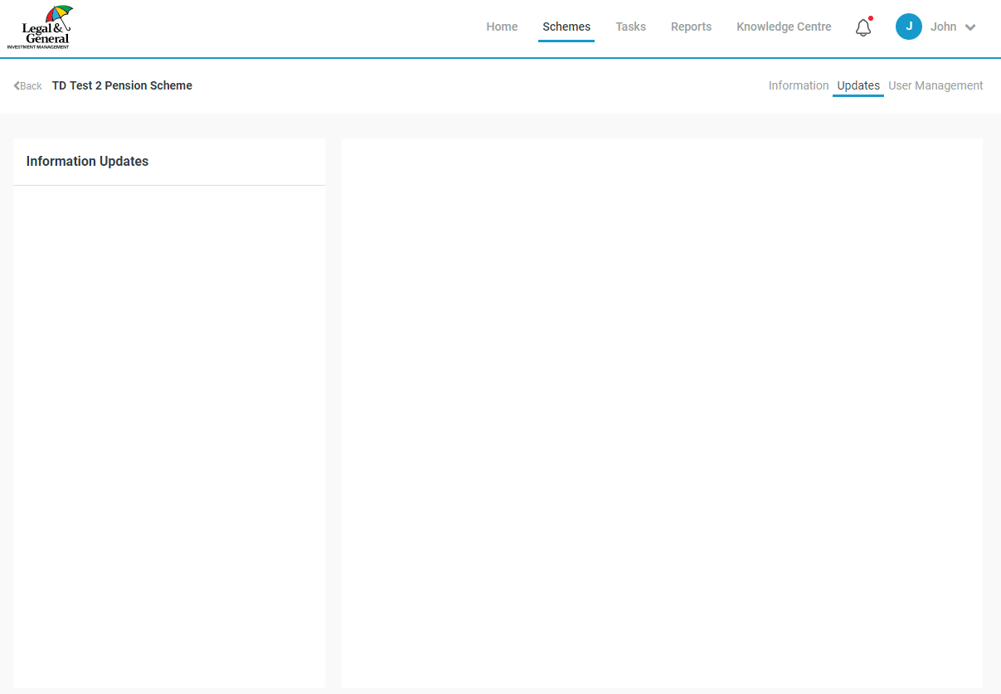


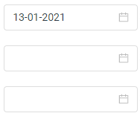
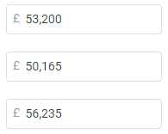

{{var5}}
{{var6}}
Input non-LGIM assets
Update non-LGIM assets
Add details of non-LGIM assets and associated valuation dates:
Input non-LGIM assets
+ Add new date
Approve non-LGIM assets
Date
Value
Hide detail
This section should open up when the user has clicked on the ‘Edit detail’ button for a given date.
If the user has not added any detail, the user should just see the ‘add new fund button’ when they click on ‘Edit detail’. By default the system will model the value provided as 100% cash if the breakdown is not provided.
When the user creates new dates, the underlying detail should be automatically populated to be the same as the most recent previous date. This would mean that they could just update the asset value without having to edit the underlying breakdown.
The ‘Fund classification’ should be chosen from a drop-down list of options.
The PV01 and IE01 boxes should only appear if the user selects the ‘LDI’ drop-down option for a given row.
23-12-2020
Value
Allocation
Fund name
Fund classification
BlackRock equities
Global equity
30.0 %
15-11-2020
Value
Schroders equities
UK equity
20.0 %
Insight LDI
LDI
30.0 %
PV01
£ 35,000
IE01
£ 20,000
Insight credit
UK corporate bonds
20.0 %
+ Add new fund
Total
100.0 %
<number>
Date
23-12-2020
Value
Edit detail
15-11-2020
Etc. Dates continue below
Value
Notes:
<number>

Slide 4
{{var7}}
Information button text
Top information button text
PV01 and IE01 information button text
{{var10}}
{{var11}}
{{var12}}
{{var13}}
{{var14}}
<number>
Notes:
<number>

Slide 5
Active Client page – External assets
List of asset types for dropdown (Draft - still tbc)
Global equity
UK equity
US equity
European equity
Japanese equity
Asia Pacific equity
Emerging market equity
Private equity
Property
REITs
Infrastructure
Commodities
High yield bonds
Emerging market debt
Global corporate bonds
UK corporate bonds
Global sovereign bonds
Gilts
Index-linked gilts
LDI
Cash
Other growth asset
tbc – include hedged/unhedged?
<number>
Notes:
<number>

