Slide 1
LGIM Bridge External asset workflow
CONFIDENTIAL
Notes:
<number>

Slide 2
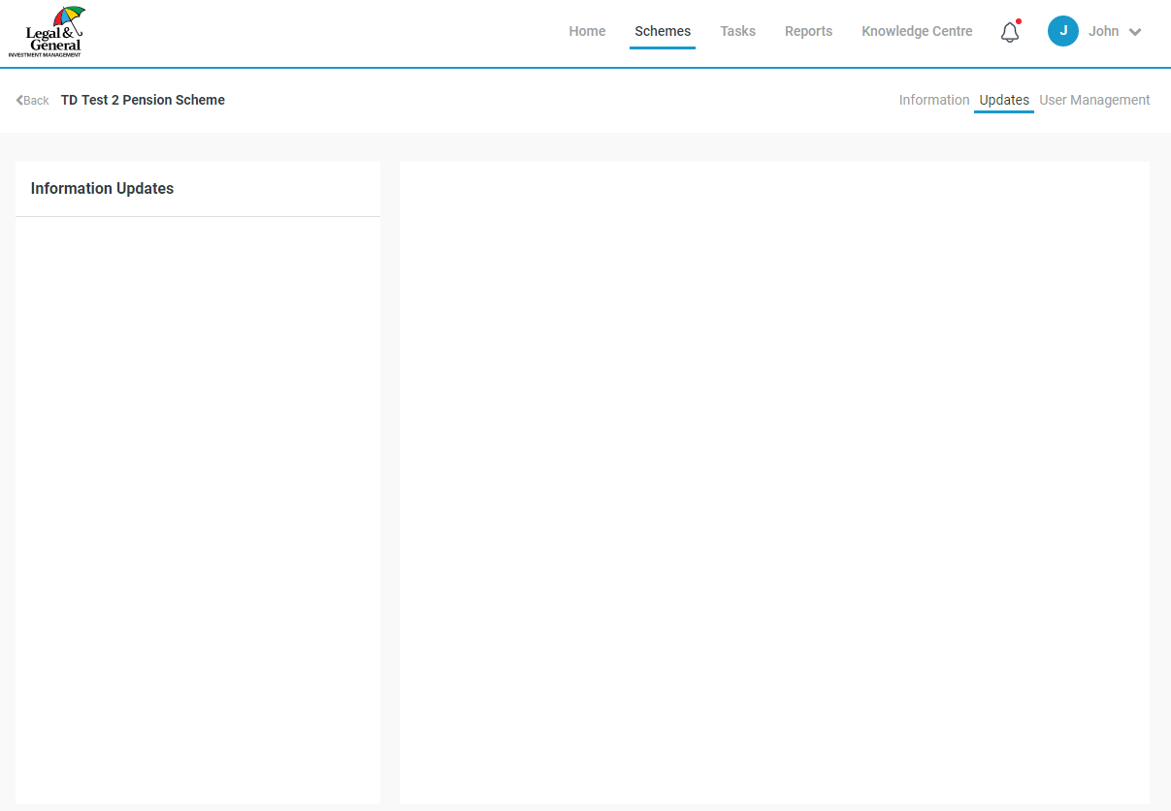
Active Client page – External assets LGIM/Client user

Slide 3


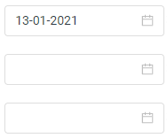
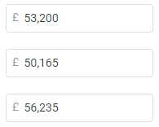

Active Client page – External assets
LGIM/Client user – when the user clicks on ‘Edit detail’ for a date
Input non-LGIM assets
Update non-LGIM assets
Add details of non-LGIM assets and associated valuation dates:
Input non-LGIM assets
+ Add new date
Approve non-LGIM assets
Date
Value
Hide detail
This section should open up when the user has clicked on the ‘Edit detail’ button for a given date.
If the user has not added any detail, the user should just see the ‘add new fund button’ when they click on ‘Edit detail’. By default the system will model the value provided as 100% cash if the breakdown is not provided.
When the user creates new dates, the underlying detail should be automatically populated to be the same as the most recent previous date. This would mean that they could just update the asset value without having to edit the underlying breakdown.
The ‘Fund classification’ should be chosen from a drop-down list of options.
The PV01 and IE01 boxes should only appear if the user selects the ‘LDI’ drop-down option for a given row.
23-12-2020
Value
Allocation
Fund name
Fund classification
BlackRock equities
Global equity
30.0 %
15-11-2020
Value
Schroders equities
UK equity
20.0 %
Insight LDI
LDI
30.0 %
PV01
£ 35,000
IE01
£ 20,000
Insight credit
UK corporate bonds
20.0 %
+ Add new fund
Total
100.0 %
<number>
Date
23-12-2020
Value
Edit detail
15-11-2020
Etc. Dates continue below
Value
Notes:
<number>

Slide 4
Active Client page – External assets
Information button text
Top information button text
PV01 and IE01 information button text
If the scheme holds assets which are not managed by LGIM, details can be entered here. This information will be used for tracking the funding level, and also for overall portfolio risk analysis and funding level projections.Enter the value of non-LGIM assets held at different dates. We will roll the asset value forward in an approximate manner between dates provided.By default any asset values provided will be treated as cash for both funding level tracking and risk analysis purposes. However, if you click on ‘Edit details’ for a given asset value then you will be able to provide a breakdown of the value by fund and asset class. If this information is provided then we will roll forward the asset value in line with index returns for the relevant asset class, and will include the external assets within overall portfolio risk analysis. Once you have entered the breakdown of the asset value at one date, this breakdown will be carried forward to subsequent dates by default, unless you choose to edit the detail within these later dates (for example, following a significant change in the portfolio). This enables you to quickly update the value of non-LGIM assets without having to re-enter the underlying detail at every date.
PV01 and IE01 data should be available from your LDI provider. Note that positive numbers should typically be entered.
PV01 - Please enter the increase in asset value that would expected in £ terms if interest rates fell 0.01%.
IE01 - Please enter the increase in asset value that would expected in £ terms if price inflation expectations increased 0.01%.
If you do not know this information then you can simply leave these boxes blank, and we will treat the LDI assets as cash.
<number>
Notes:
<number>

Slide 5
Active Client page – External assets
List of asset types for dropdown (Draft - still tbc)
Global equity
UK equity
US equity
European equity
Japanese equity
Asia Pacific equity
Emerging market equity
Private equity
Property
REITs
Infrastructure
Commodities
High yield bonds
Emerging market debt
Global corporate bonds
UK corporate bonds
Global sovereign bonds
Gilts
Index-linked gilts
LDI
Cash
Other growth asset
tbc – include hedged/unhedged?
<number>
Notes:
<number>

