Slide 1
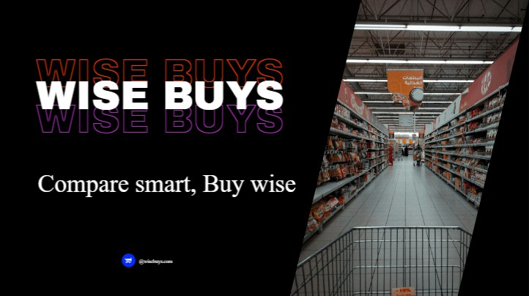

Slide 2
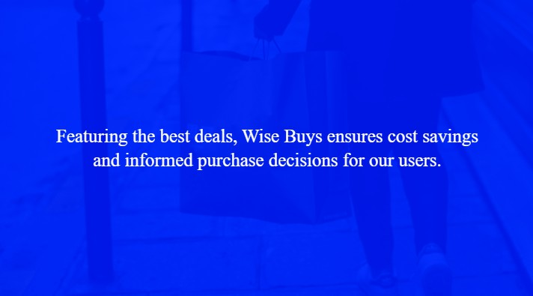

Slide 3
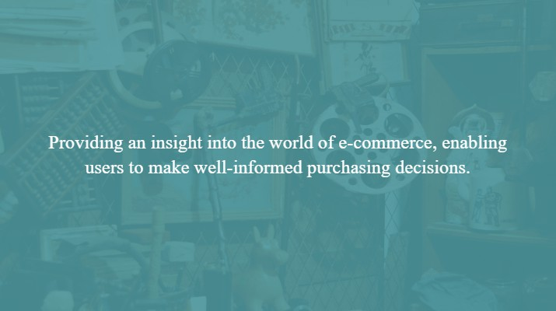

Slide 4
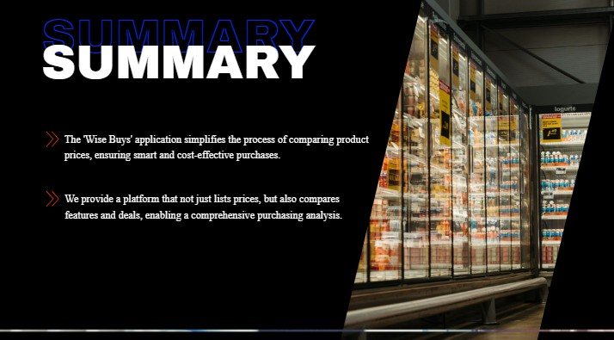

Slide 5
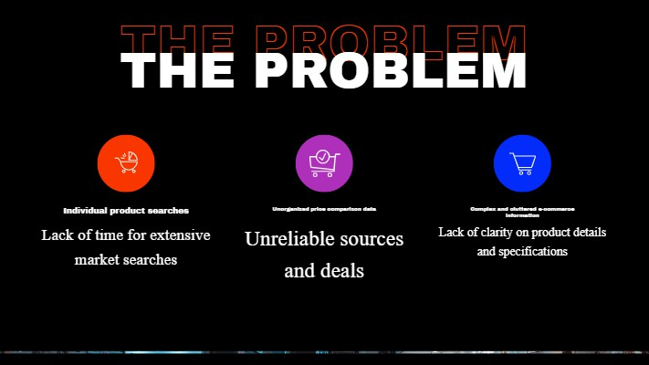

Slide 6
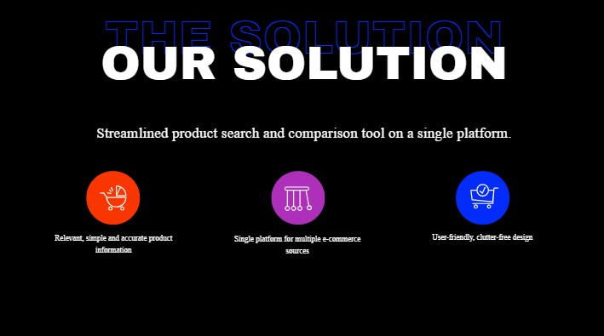

Slide 7
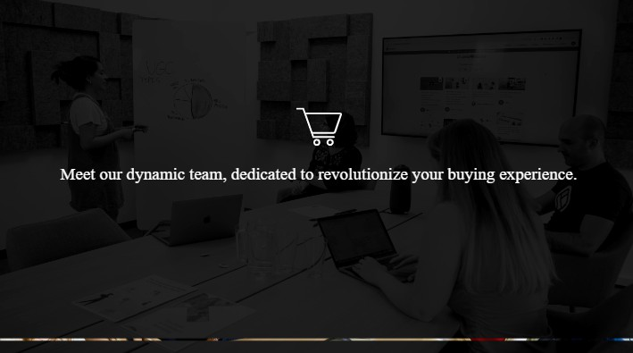

Slide 8
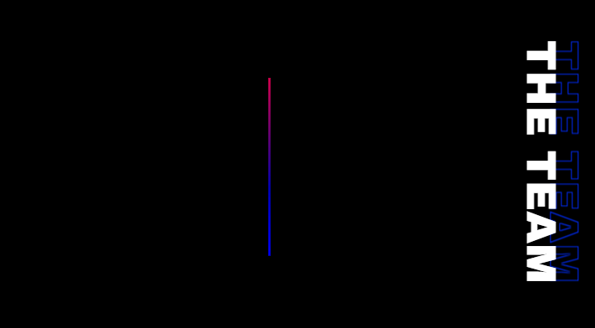
Farthash
aAyisha Saniya
https://www.linkedin.com/in/ayisha-saniya-1b5163258?utm_source=share&utm_campaign=share_via&utm_content=profile&utm_medium=android_app
https://www.linkedin.com/in/farthash-m-1b1462257?utm_source=share&utm_campaign=share_via&utm_content=profile&utm_medium=ios_app
Gayathri Jayan
https://www.linkedin.com/in/gaya3-jayan?utm_source=share&utm_campaign=share_via&utm_content=profile&utm_medium=android_app
Drushya Jolly
https://www.linkedin.com/in/drushya-jolly-350a83212?utm_source=share&utm_campaign=share_via&utm_content=profile&utm_medium=android_app

Slide 9

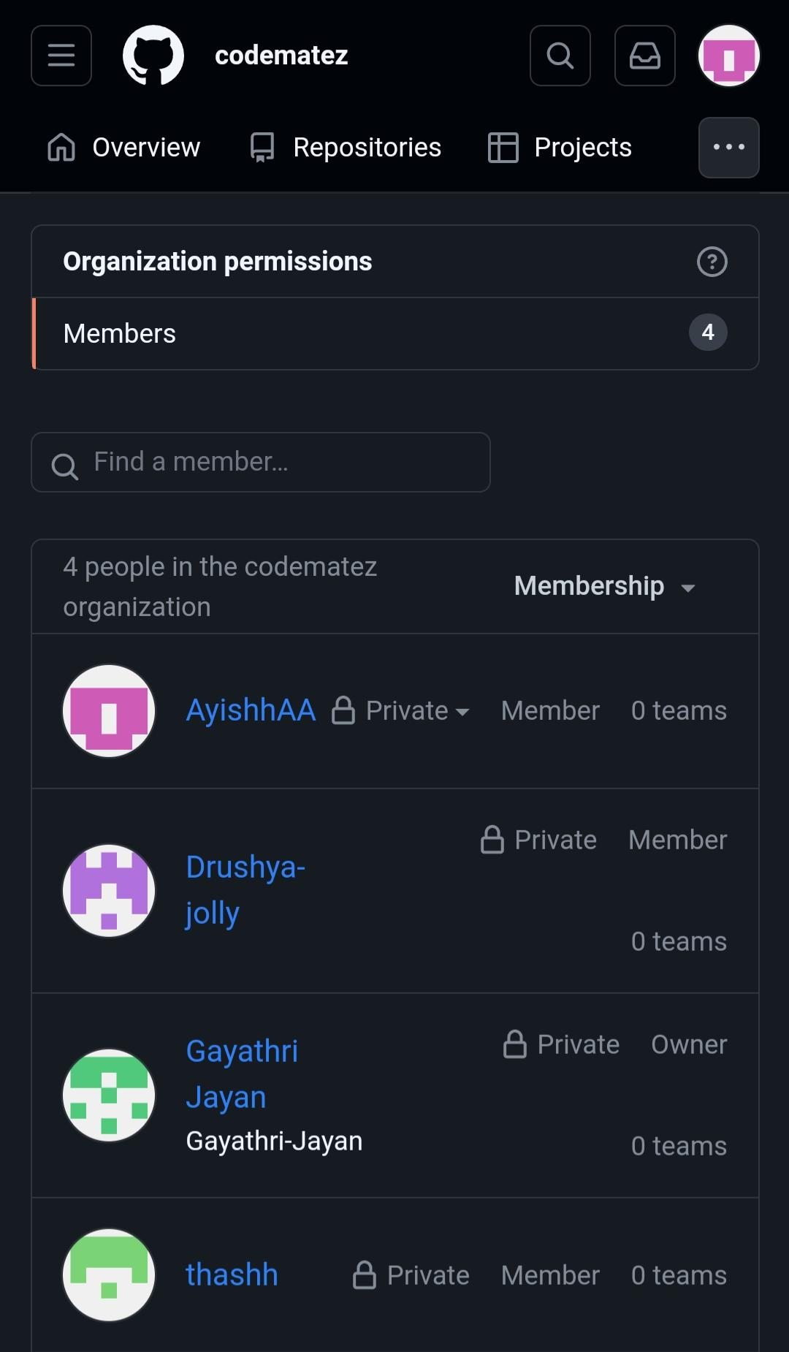
Keyword-based product search.
Display price comparison from at least two retailers.Simple product detail page with a link to the retailer.
Resources:
Python (Beautiful Soup for web scraping), JavaScript (for frontend),
Firebase or MongoDB (for database)

Slide 10


