Slide 1

Project Title:
Extracting E-book data and performing Sentiment Analysis
Name of the team | P_109 Group_3
Date of formed | 08/04/2022
Mentor | Karthik /Dhanya
Team Members | Mr. Kamavarapu mani prasanna kumar Mr. Sannapagunta satya simha reddy Mr. Vamshi M Mr. Rajesh K G Miss. Gayathri M Mr. Rohan Shet Mr. Pranav sunil chaudhari Miss. Varsha
Meeting Days | Two meetings every week
Meeting Duration | 1 Hour

Slide 2
Business Problem:
Extract E-Book data of any and perform sentimental analysis with an model accuracy of 75%
Business Objective:
To extract E-books of your choice and extract summary ,categorize summary as positive, negative or neutral. Build a NLP model to achieve the said objective with accepted accuracy of 75% and above.

Slide 3
Project Architecture / Project Flow
Web Scraping & Summary Extraction
2. Data Cleaning
● Looking NAN values
● Renaming the columns, and reassigning values for better readability
3 Preprocessing Text
i. Removing Punctuation
ii. Removing Stop words
iii. Lemmatization and Stemming
iv. Tokenization
4 Exploratory Data Analysis
i. Percentage of summary in each category
ii. Common Phrases used in summary according to categories
iii. Wordcloud:Most repeated words in each category
iv. Correlation between summary and sentiment
5. Feature Extraction
i. Bag of Words
ii. TF-IDF

Slide 4
Project Architecture / Project Flow
6. Model Building
Handling Imbalance data[SMOTE, ADASYN]
Logistic Regression
Grid Search CV
Decision Trees
Random Forest
Linear SVC
Naive Bayes
Ada Boosting Classifier
XG Boosting Classifier
Gradient Boosting Classifier
Light GB Classifier

Slide 5
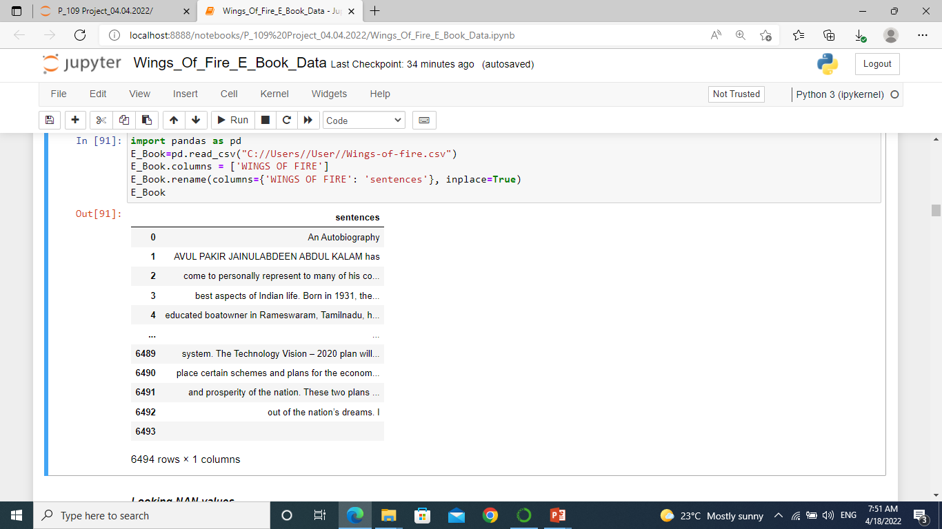
Data Set Details
Dataset: Webscrapped E_Book_Summary Data
6494 observations and 1 features[title Sentences]
Dataset there is no NAN values

Slide 6

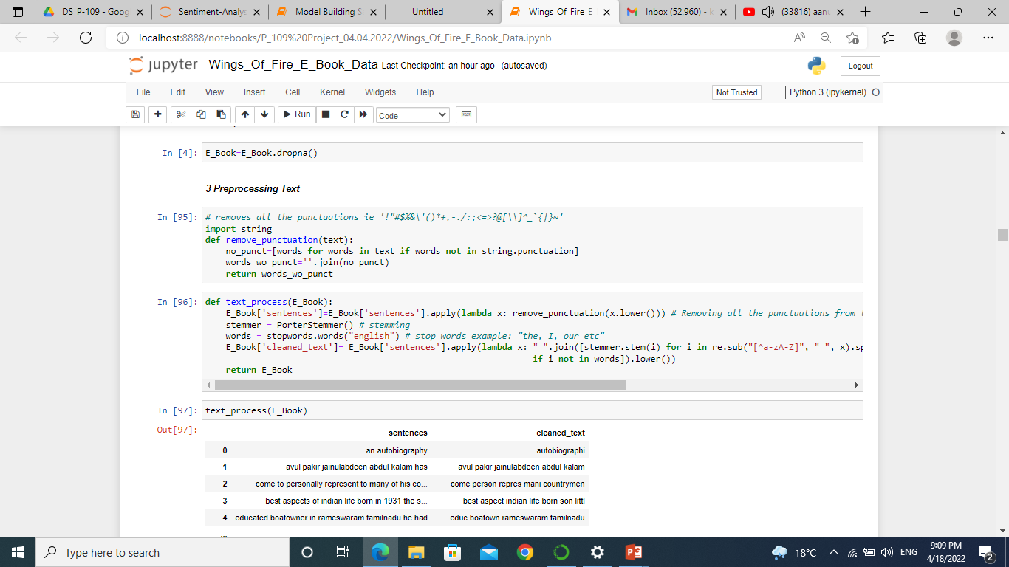
Exploratory Data Analysis(EDA)
Removing Punctuation
Stemming

Slide 7
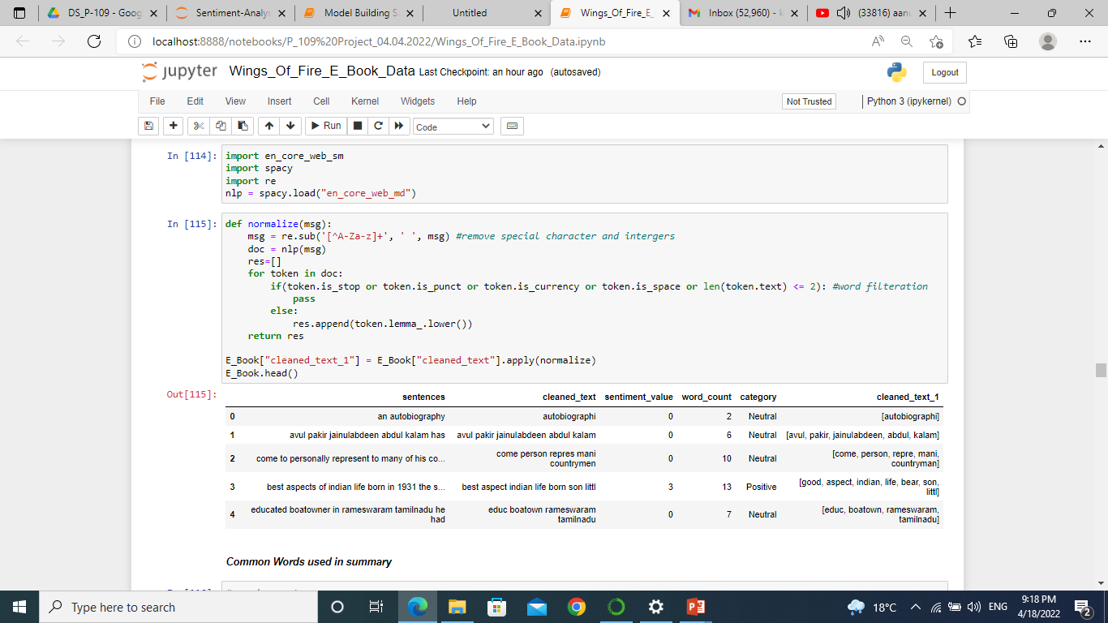

Slide 8
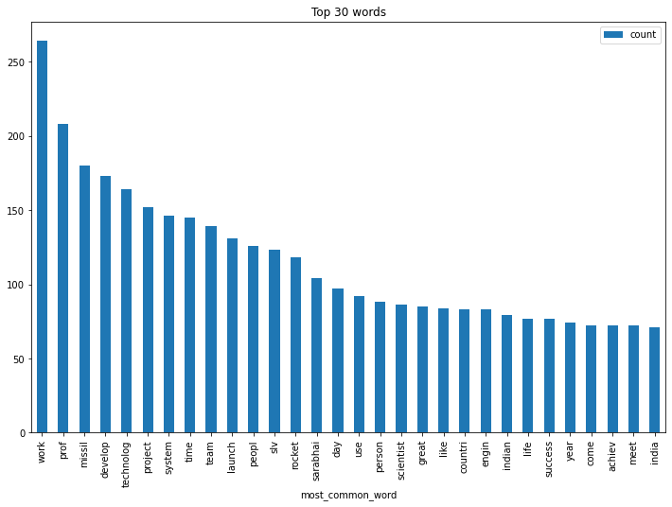
Bar plot Visualization

Slide 9
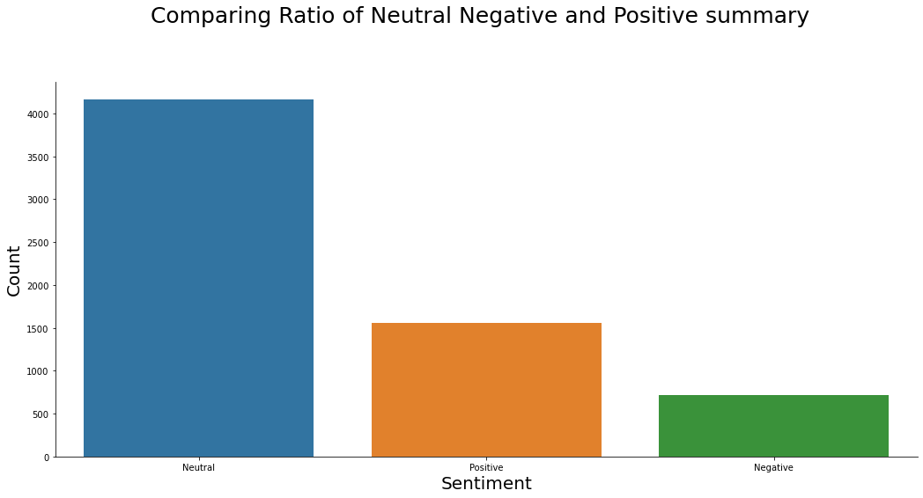
Ratio Comparison For Neutral, Negative & Positive Sentence

Slide 10
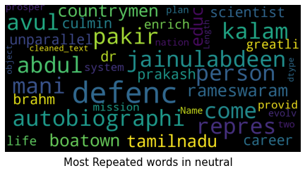
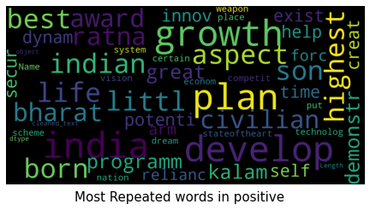
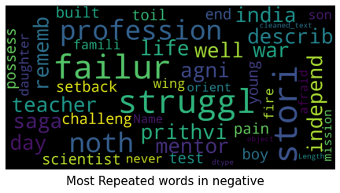
Most Repeated Words In Each Category

Slide 11
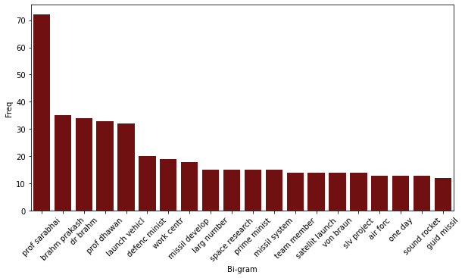
Bigram Using Bar plot

Slide 12
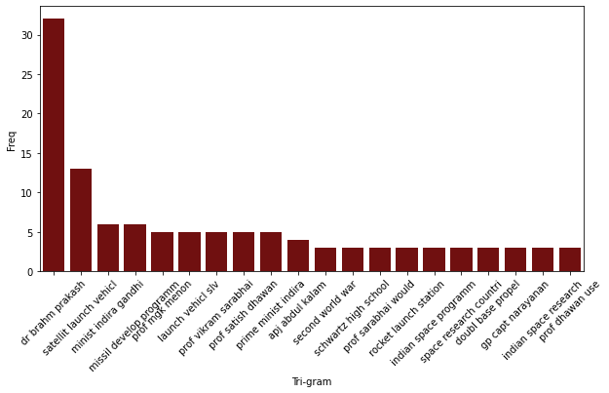
Trigram Using Bar plot

Slide 13
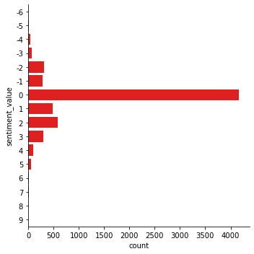
Cat plot For Sentiment Value

Slide 14
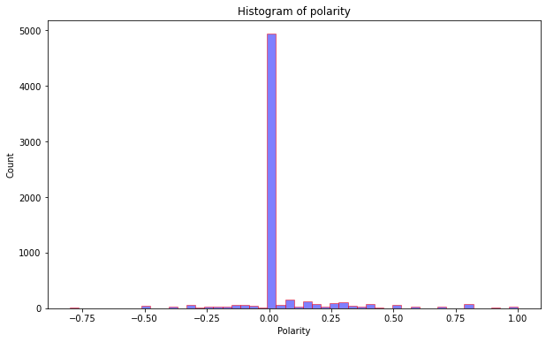
Histogram Of Polarity

Slide 15
Model Building
In this project, We investigate the usage of different models to predict accuracy of summary extracted book
Logistics Regression
Decision Tree
Random Forest
Naïve Bayes
Linear SVC
Ada boosting classifier
XG boost classifier
Gradient Boost classifier
Light Gradient Boost classifier

Slide 16

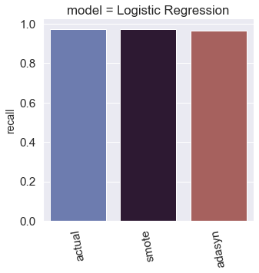
Model Building On E Book Data
Model_1-Logistics Regression
Actual Test Accuracy : 0.87885462
SMOTE Test Accuracy : 0.96475770
ADASYN Test Accuracy : 0.95594713
Algorithm vs Testing Accuracy

Slide 17

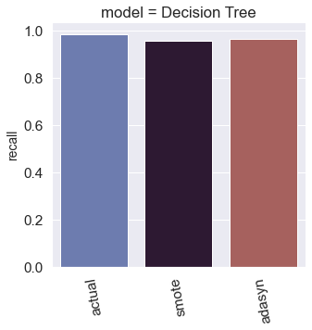
Model_2-Decision Tree
Actual Test Accuracy : 0.76211453
SMOTE Test Accuracy : 0.93832599
ADASYN Test Accuracy : 0.95594713
Algorithm vs Testing Accuracy

Slide 18

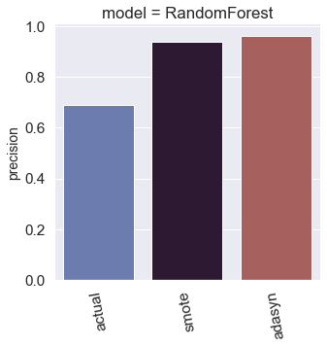
Model_3-Random forest
Actual Test Accuracy : 0.69162995
SMOTE Test Accuracy : 0.94713656
ADASYN Test Accuracy : 0.95594713
Algorithm vs Testing Accuracy

Slide 19
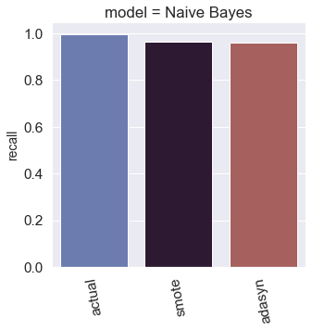
Model_4-Naive Bayes
Actual Test Accuracy : 0.78414096
SMOTE Test Accuracy : 0.96035242
ADASYN Test Accuracy : 0.95814977
Algorithm vs Testing Accuracy

Slide 20
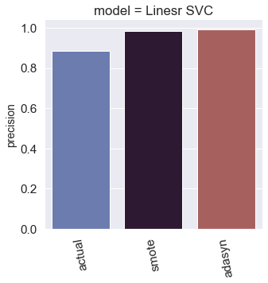
Model_5-Linear SVC
Actual Test Accuracy : 0.88766519
SMOTE Test Accuracy : 0.97356828
ADASYN Test Accuracy : 0.97797356
Algorithm vs Testing Accuracy

Slide 21

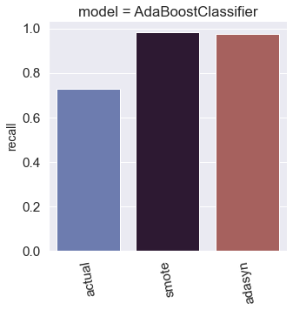
Model_6-Ada Boost Classifier
Actual Test Accuracy : 0.77973568
SMOTE Test Accuracy : 0.83039647
ADASYN Test Accuracy : 0.82158590
Algorithm vs Testing Accuracy

Slide 22
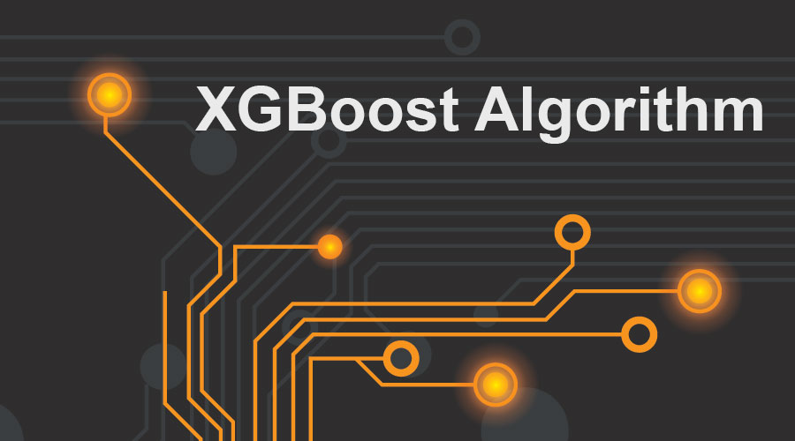
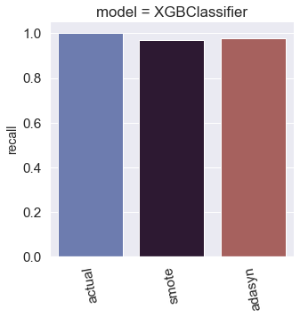
Model_7-XGB Classifier
Actual Test Accuracy : 0.70264317
SMOTE Test Accuracy : 0.89207048
ADASYN Test Accuracy : 0.887665191
Algorithm vs Testing Accuracy

Slide 23
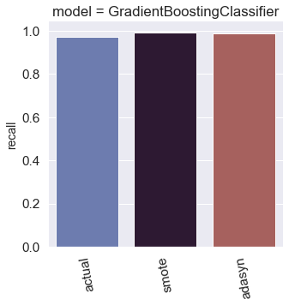
Model_8-Gradient Boosting Classifier
Actual Test Accuracy : 0.78854625
SMOTE Test Accuracy : 0.85462555
ADASYN Test Accuracy : 0.852422902
Algorithm vs Testing Accuracy

Slide 24
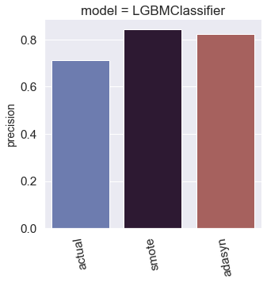
Model_9-Light Gradient Boosting Classifier
Actual Test Accuracy : 0.70925110
SMOTE Test Accuracy : 0.83259911
ADASYN Test Accuracy : 0.81718061
Algorithm vs Testing Accuracy

Slide 25
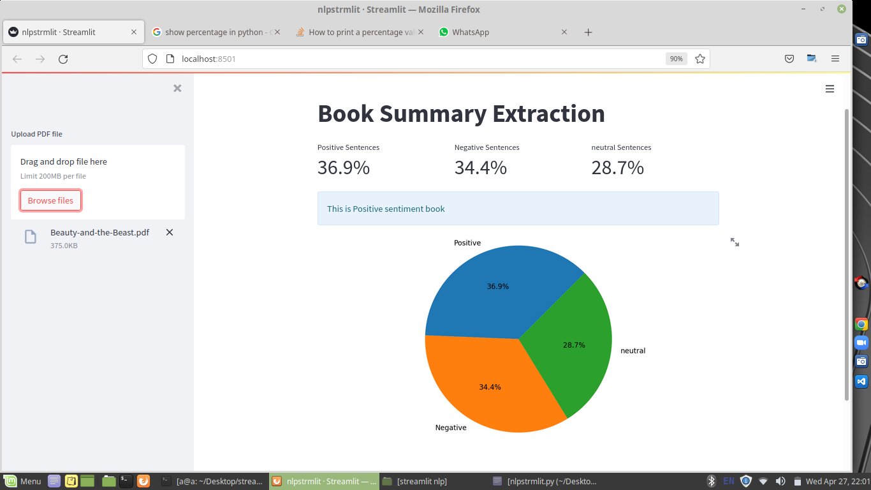
Sentiment Analysis For Book Summary Extraction

Slide 26
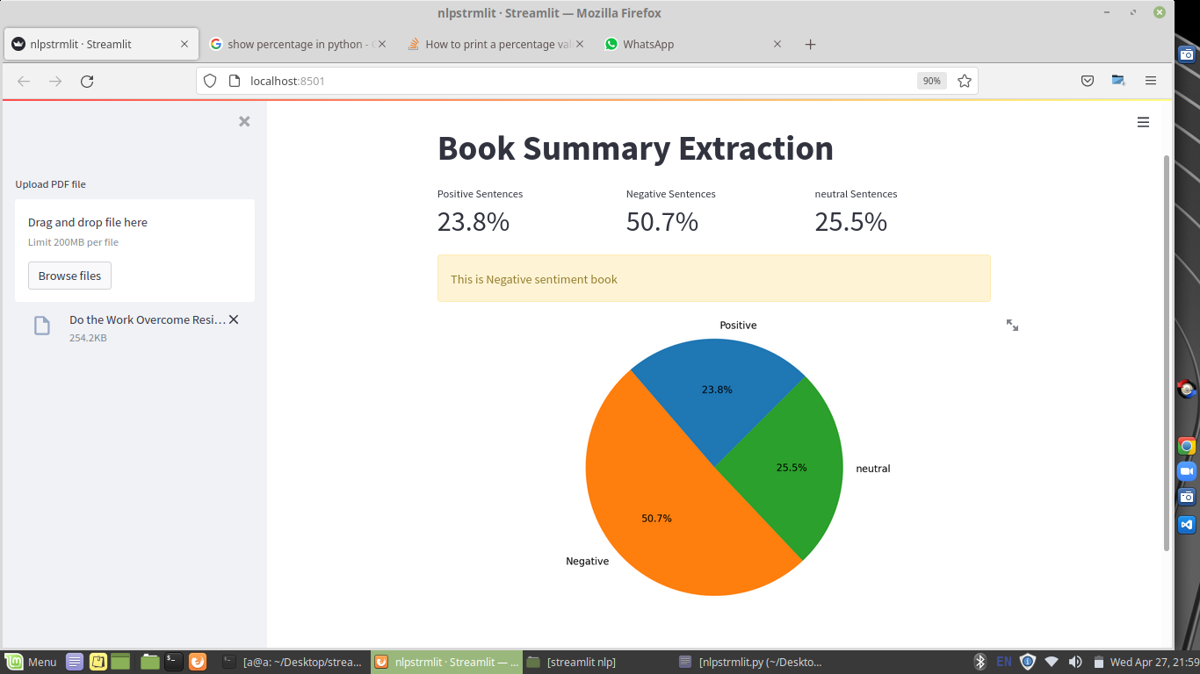
Sentiment Analysis For Book Summary Extraction

Slide 27
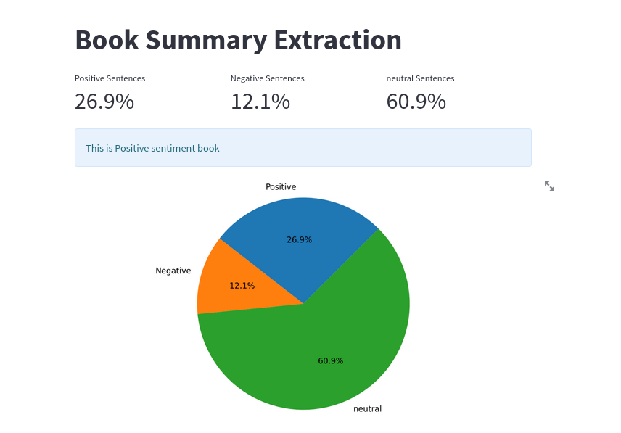
Sentiment Analysis For Book Summary Extraction

Slide 28


