Slide 1

Neural Networks and Deep Learning- Assignment Feed Forward – Back propagation Neural network Implementation
Gayathri Mol Shajimon
Reg No:2201829

Slide 2
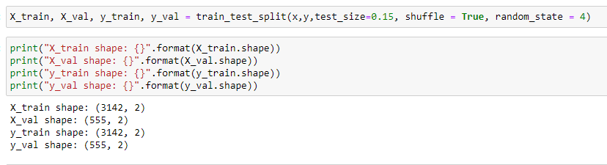
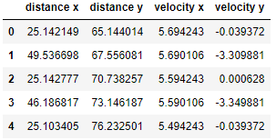
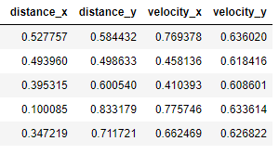
Partition of Data
Partitioned data in to training and validation data in to 85 % training and 15% validation
Processing of file includes :
Null check
Outlier check
Normalisation of row data
Before normalisation
After normalisation

Slide 3
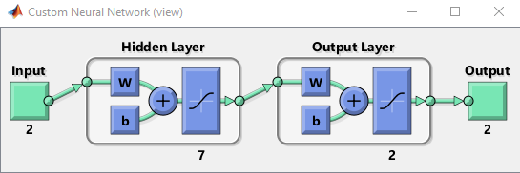
Architecture and Size Comparison
Architecture used contains 2 input, 2 output, and 7 hidden neuron
Optimum value of hidden neuron, learning rate and momentum was calculated using math lab and followed the same values in feed forward and back propagation.

Slide 4
Feed Forward & Back propagation Neural Network
Calculated V value using the input value and weights in the input layer
Find activation function using the calculated V value
Calculated V value in the output layer using activation function values and weights in the output layer.
Predicted output value can be obtained by finding the activation function in the output layer
Error can be calculated by subtracting actual and predicted
Find Out gradient and use the same for finding delta weight and update the weight in output layer
Find local gradient and using it find the delta weight to update the weights in input layer

Slide 5
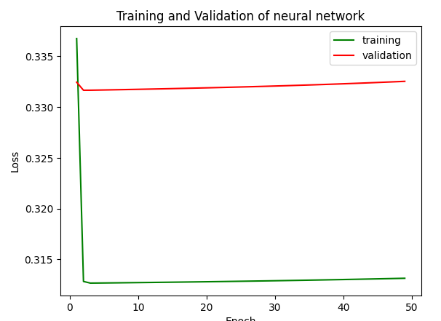
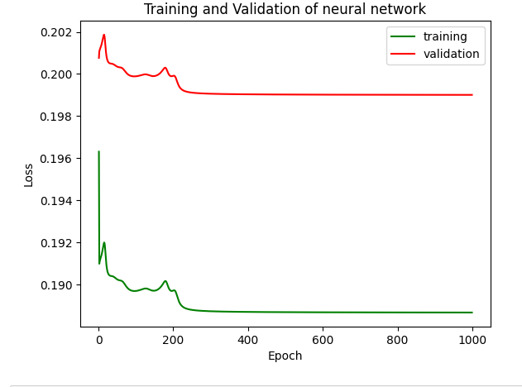
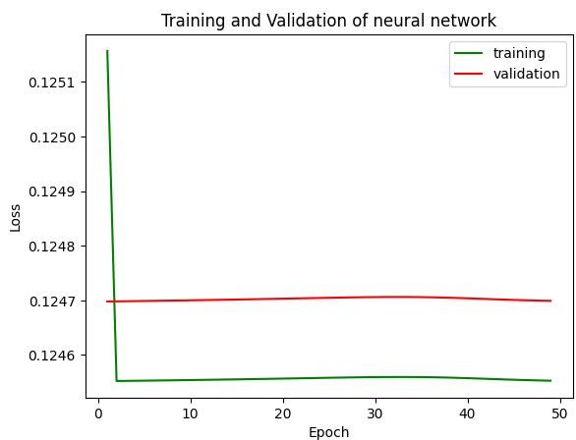
Size Comparison
Compared files with 200, 1000, 3000, 29000 data rows .
Below showed is 200, 1000 showed inconsistent graph and 29000 data causing early convergence. Error is less in large data set and high in low data set
200 rows
1000 rows
29000 rows

Slide 6
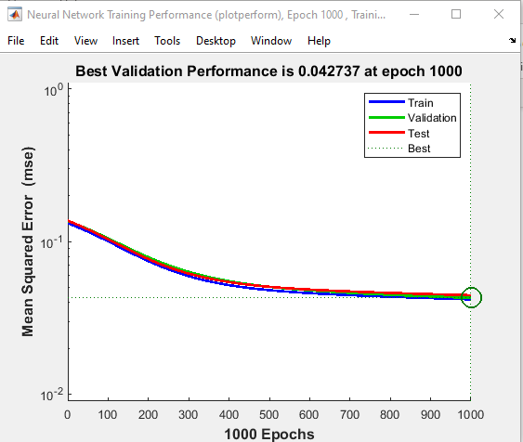
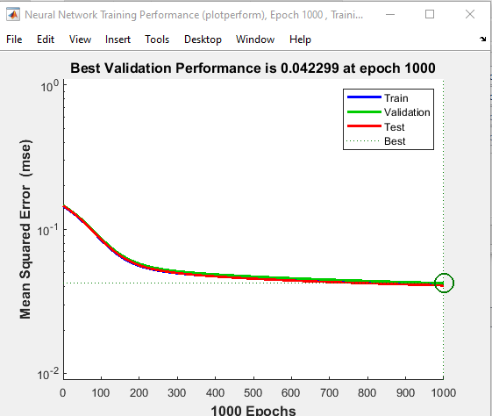
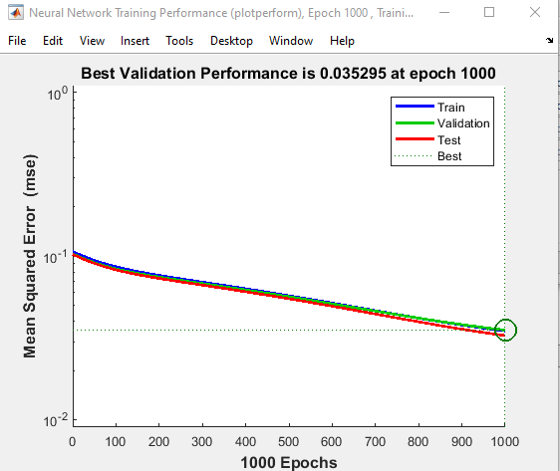
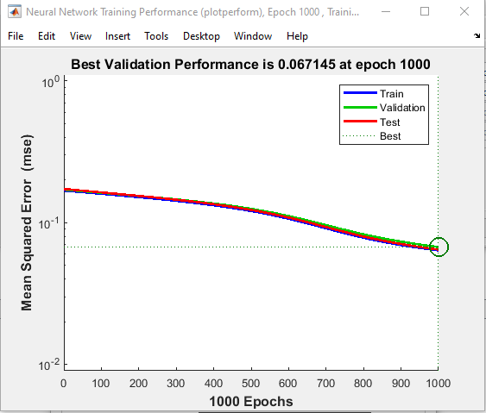
Find Optimal Hidden Neuron Count
HDN = 5
HDN = 6
Increase in number of hidden neuron decreases the error but can cause overfitting , to few hidden neuron can cause under fitting
HDN = 7
HDN = 8

Slide 7
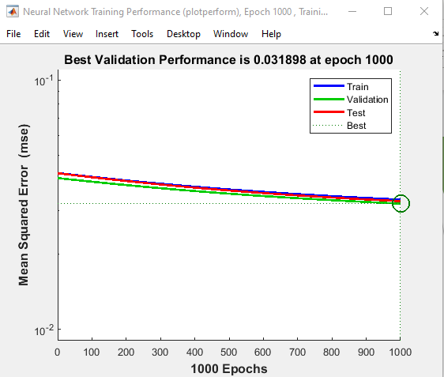
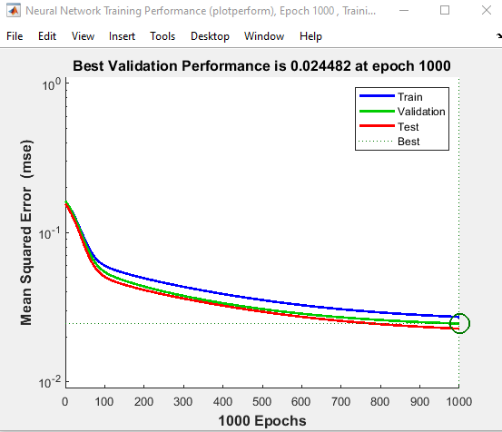
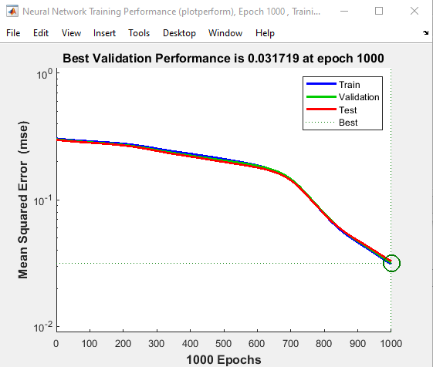
Optimise Learning Rate
As error is minimum when my Hidden neuron count is 7, will make it constant and change lr value and find the optimal error.
lr = .02
lr = .03
lr = .04
Increase in learning rate can cause the model to converge quickly to a sub optimal solution and too small can cause process to get sucked.

Slide 8
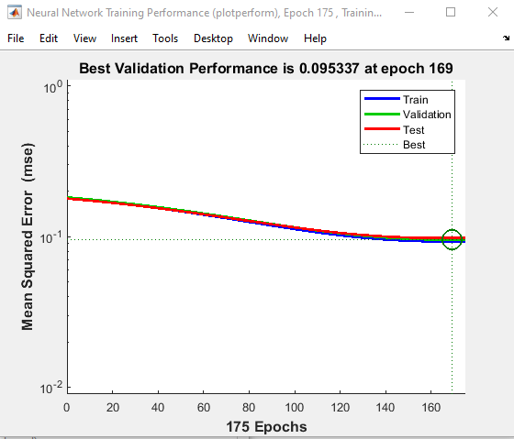
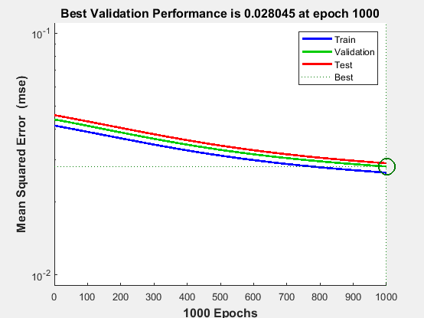
Momentum Value optimization
Making hidden neuron count and learning rate as constant need to optimise momentum value (now hdn – 7 , lr - .03). As error is increasing while trying with .8 and 1 , chose mc = .9 as optimum value of momentum
mc - .8
mc - 1
Small value in momentum can slow down the training process and large value can cause convergence very fast

Slide 9
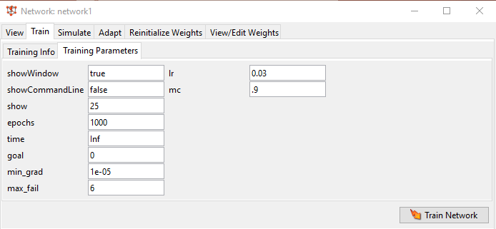
Parameters after Optimization

Slide 10
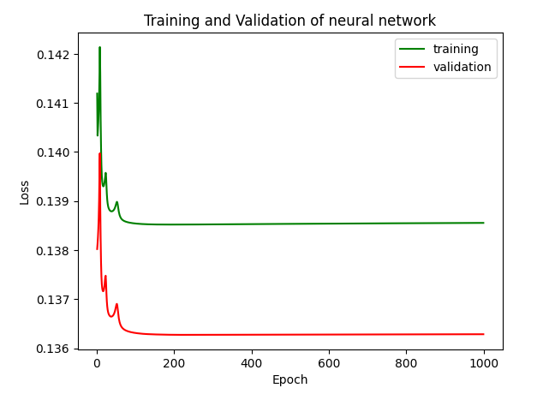
RMSE Value Calculation & Stopping Criteria
Absolute average value of error in each row in an epoch is used for RMSE calculation
RMSE = Square root(square(mean(average error)))
RMSE value of each epoch is used to plot the graph
Stopping criteria used is the minimum RMSE value of validation data

