Slide 1
BLOCKCHAIN

Slide 2
Agenda
BLOCKCHAIN?
HOW IT WORKS-FLOW DIAGRAM
FEATURES OF BLOCKCHAIN
TECHNOLOGY AND CATEGORY IN BLOCKCHAIN
BLOCKCHAIN IN E-PUBLISHING
HOW IT WORKS IN E-PUBLISHING
CONCLUSION

Slide 3
Blockchain
Blockchain is a technology that allows data to be stored and exchanged on a peer-to-peer(P2P) basis on Distributed Ledger Technology (DLT)
Blockchain data can be consulted, shared and secured to consensus-based algorithms.
It is used in a decentralised manner and removes the need for intermediaries, or "trusted third parties".

Slide 4
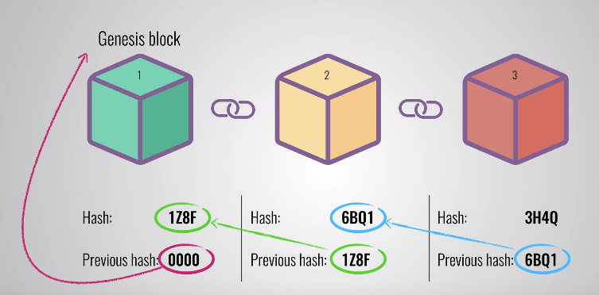
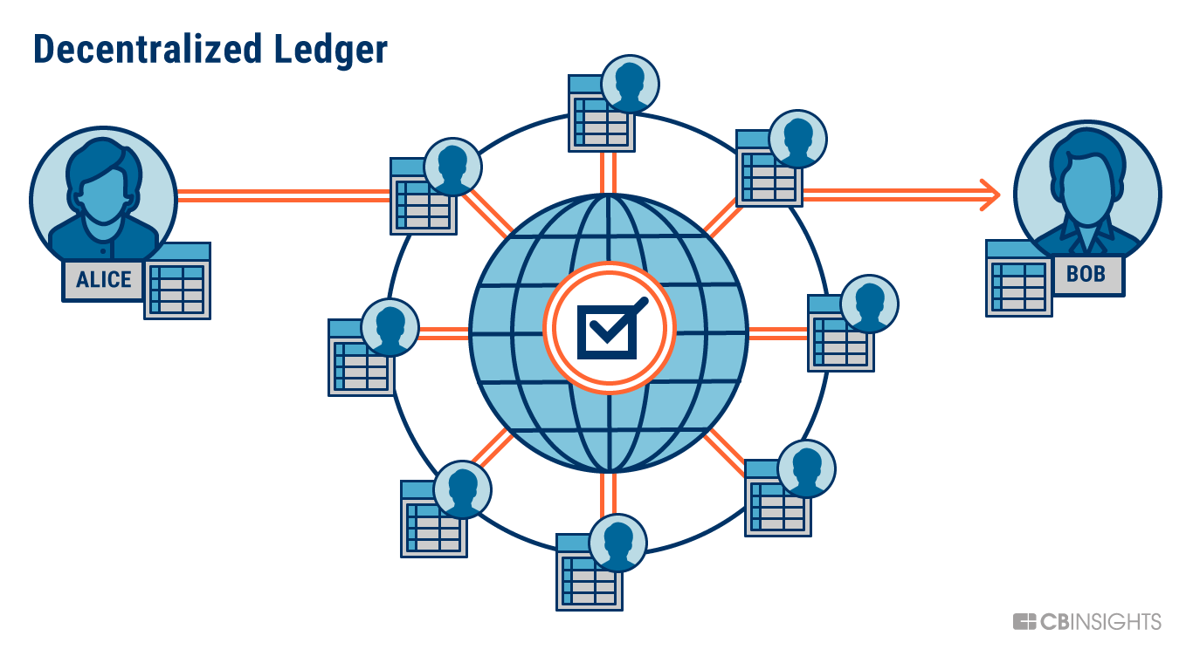
Blockchain…
Blocks
Data
Hash
Previous hash
Ledgers
Database----holds the transaction details
Decentralized ledger –there is no central authority like banks
A shared ledger technology allowing any participant in the business network to see the system of record.

Slide 5
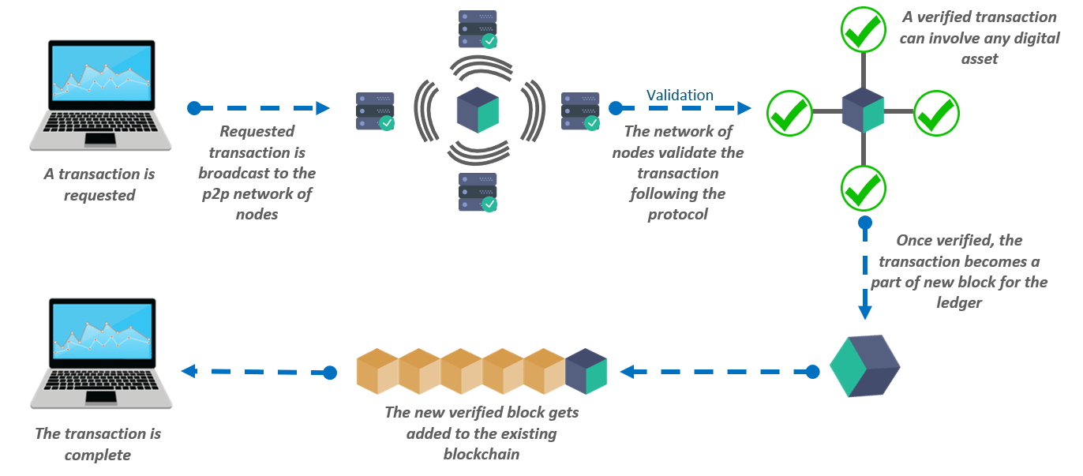
Blockchain-How It Works

Slide 6
Features Of Blockchain
Distributed Public Ledger
Hash Encryption
Proof of Work
Incentives for Validation

Slide 7
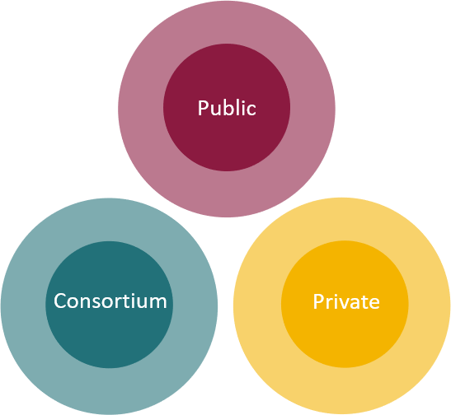
Technology And Category In Blockchain
3 TECHNOLOGIES
3 CATEGORIES
Private key cryptography
To secure identities and hash functions to make blockchain immutable.
P2P network
P2P machines on the network help in maintaining the consistency of the distributed ledger.
Digital signature
Blockchain program
The program gives the blockchain its protocol based on the requirements

Slide 8
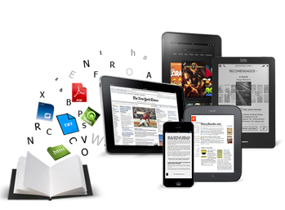

Blockchain In E-publishing
In publishing, blockchain could impact sales, rights management, licensing, contracts and much more.
Blockchain publishing can ultimately help to prevent several issues like piracy, copyright infringement, and the lack of transparency in royalty distributions.
Stored the record of products and rights.

Slide 9
Blockchain In E-publishing…
Definitive ledger of publishing rights
Ledger of rights could become the definitive source for searching and establishing the authoritative rights holder.
This shared ledger means that there’s no one single company that’s holding the data and that the ledger itself is always an accurate reference.
Blockchain management of rights, content can be embedded with rights information, and smart contracts can be created that allow for easy sharing, licensing, and usage.

Slide 10
How It Works In E-publishing
Copyrights
Smart Contracts
Smart Wallets
Privacy

Slide 11

COPYRIGHTS (Source Authentication)
Today, content can be republished without reference to its original source, making piracy easy.
Blockchain technology, source authentication becomes possible because each user has his own identity, and every block of information created has a link to a previous block and a timestamp that cannot be changed retroactively.
By establishing identities and keeping track of what happens to a specific content or publication
Who published the original material, when and where becomes indisputable.

Slide 12
COPYRIGHTS…
Two main technologies that have significant use for the improvement of copyright: timestamping and hashing.
Trusted Timestamping
Trusted Timestamping understood as the process of securely keeping track of the creation and modification time of a document is an indispensable tool in the business world.
Hashing
Hash function forms the basis of the security and immutability of blockchain.

Slide 13
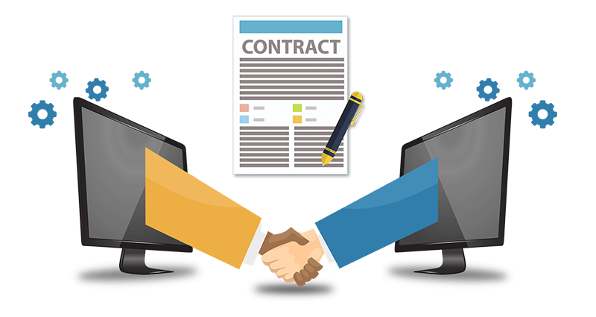
SMART CONTRACTS (Contract Rights and Property Rights)
In publishing, smart contracts can be used to represent ownership of an intellectual property and efficiently allocate payments like royalties.

Slide 14
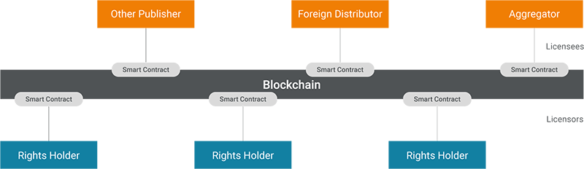
SMART CONTRACTS…
Rights Licensing and Royalty Processing
Why Trust a Smart Contract?
They’re immutable
They’re distributed

Slide 15


SMART CONTRACTS…
Blockchain Platforms for Writing Smart Contracts
Ethereum is the most prominent smart contract framework.
This framework, programmed in the Solidity language(Golang + python)
In Hyperledger,“chaincode” as a synonym for smart contract. A chaincode typically handles business logic agreed to by members of the network, so it may be considered as a smart contract. These chaincodes are written in (Golang + java)

Slide 16
SMART WALLETS (Small Payments Made Easy)
Smart wallets are electronic wallets that can be used by authors, publishers, booksellers, wholesalers and digital platforms to accept and make small payments or micro-payments related to the price of an e-book, article or even podcast.

Slide 17

PRIVACY (Owning Your Data)
The privacy of its users has been in a consistent and steep decline.
Blockchain technology aims at reinstating this right enabling its users to ‘own’ and have access to what they say. Messages and content can be exchanged across the network, disassociating the identities of its users from their behavioural data and therefore ensuring privacy.

Slide 18


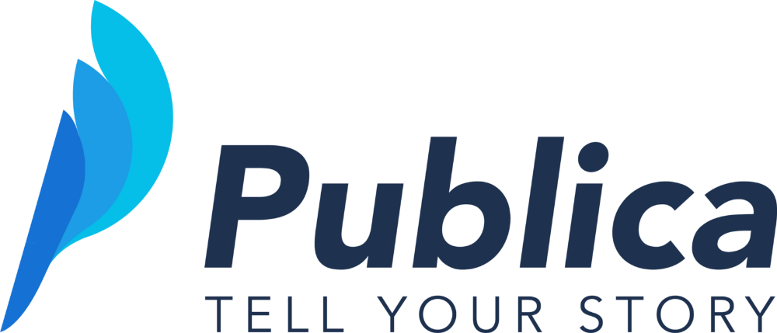
Blockchain Based E-publishing Websites

Slide 19
Conclusion
The distributed ledger functionality coupled with security of Blockchain, makes it very attractive technology to solve the current Financial as well as non-financial business problems.
Blockchain technology seems promising. It ensures safety, security, participation and transparency and could have very interesting implications in publishing.

Slide 20
Thank you

