Slide 1
CarDekho Used Car Price Prediction
R.GAYATHRI
DW74

Slide 2
PROBLEM STATEMENT
To create a data science solution for predicting used car prices accurately
To analyze a diverse dataset including car model, no. of owners, age, mileage, fuel type, kilometers driven, features and location

Slide 3
TOOLS USED:
Jupyter Notebook:
Python scripting
Data cleaning
EDA
Model training and evaluation
Microsoft PowerBI:
Data visualization

Slide 4
Approaches:
Initial check of data set
Data loading
Checking for null values
Data cleaning
Dropping unwanted attributes
Conversion of categorical data to numerical data
Ensuring data quality and relevance
Converting the processed data frame to csv file in system.
EDA
Category wise checking on count.
Box plots for knowing the data points range of distribution and to know outliers
x

Slide 5
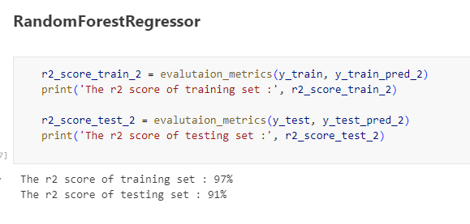
Approaches:
Model training:
Knowing the target variable and type of learning to be used
Preparing data frames for train test split
Encoding of categorical variable
Calling out for various models and checking for R2score or F1 score
Identifying the best model.

Slide 6
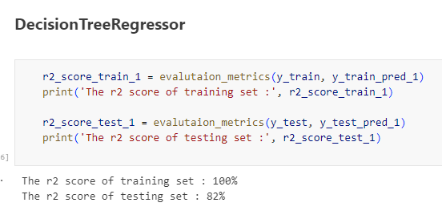
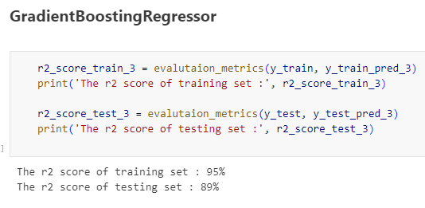

Slide 7
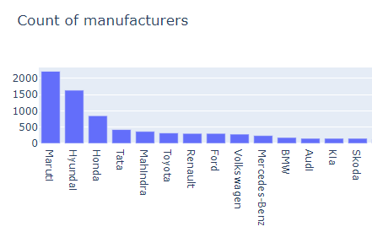
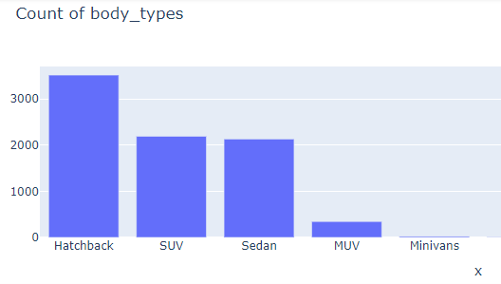
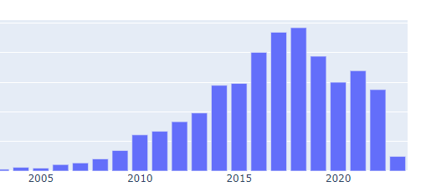
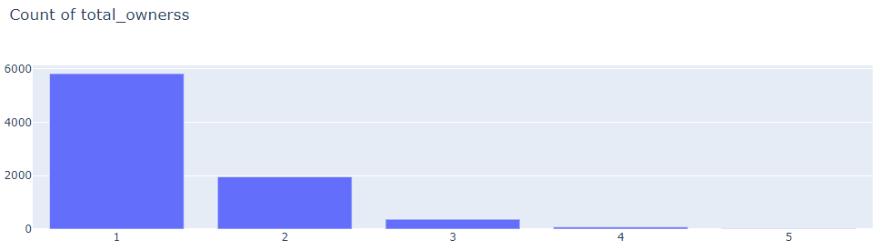
DATA DRIVEN INSIGHTS:

Slide 8
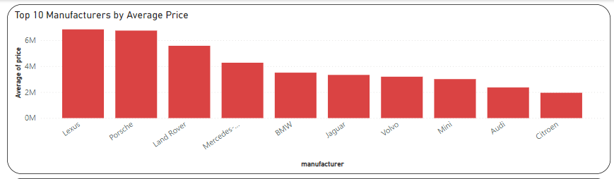

Slide 9
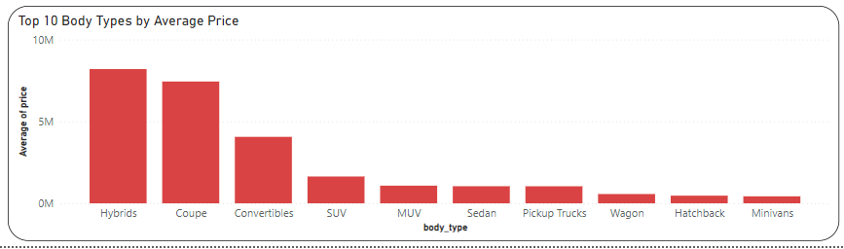
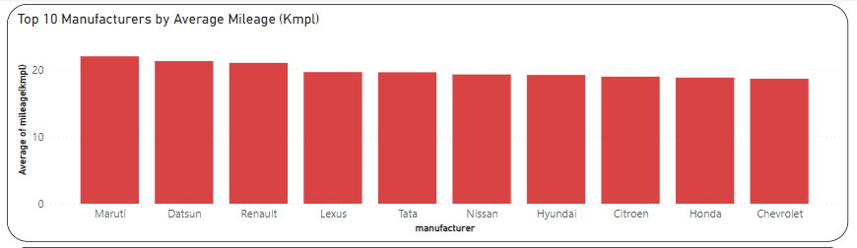

Slide 10
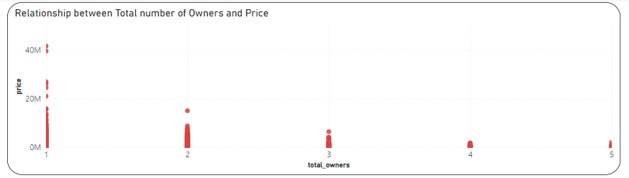
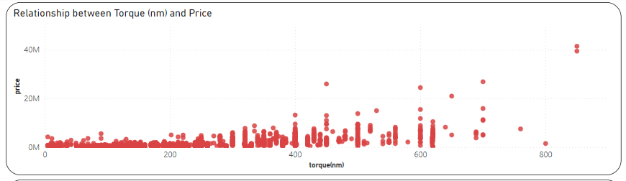

Slide 11
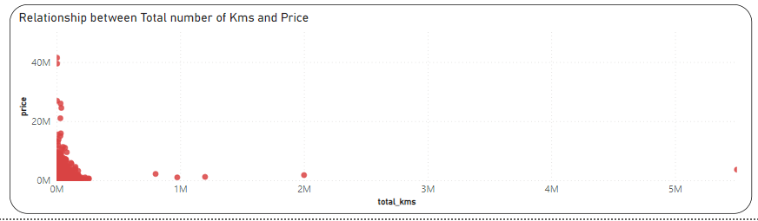
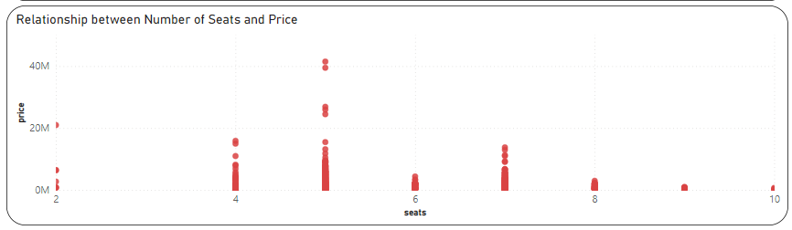

Slide 12
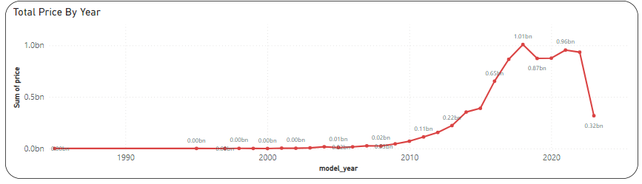

Slide 13
THANK YOU AND HAVE A GOOD DAY

