Slide 1
AI-BASED AUTOMATED STUDY MATERIAL GENERATION AND MANAGEMENT SYSTEM FOR ENGINEERING STUDENTS
PRESENTED BY
Purnima.G (810022104061)
Gayathri.K (810022104111)
GUIDED BY
Dr.T.Mithila
Department of Computer
Science and Engineering

Slide 2
INTRODUCTION
This project presents an advanced AI-driven platform designed to modernize the creation and management of academic study materials, specifically for engineering students under the Anna University curriculum. Developed using the Flask framework and powered by the high-speed Groq LPU Inference Engine with Meta’s Llama-3 models, the system automates the generation of comprehensive resources, including structured notes, coding examples, MCQs and Bloom’s Taxonomy-based assessments. Unlike traditional AI tools, the platform incorporates a robust three-tier portal architecture for Students, Faculty, and Admins, featuring a mandatory faculty verification pipeline and plagiarism detection. This ensures that every piece of content is not only generated instantly but is also accurate, original, and academically verified, significantly reducing faculty workload while enhancing the personalized learning experience for students.

Slide 3
PROBLEM STATEMENT
The rapid growth and evolution of engineering curriculam demand consistent, high-quality, and timely academic resources for students. However, traditional methods of preparing study materials remain inefficient, as they are time-consuming, inconsistent in quality, and heavily dependent on manual faculty effort. Furthermore, while generic AI tools exist, they often lack syllabus specificity and can produce inaccurate information. This creates a significant gap in the educational pipeline, where students lack immediate access to verified, personalized practice materials, and faculty are overburdened with repetitive content creation tasks. There is a critical need for an automated system that can generate high-quality, syllabus-aligned resources while maintaining academic integrity through a structured verification process."

Slide 4
OBJECTIVES
Automation of Content Generation: To automate the creation of high-quality, syllabus-specific study materials using the Groq LPU and Llama-3 models.
Dual-Verification Pipeline: To implement a structured "Human-in-the-loop" workflow where generated materials are reviewed and verified by faculty before publication.
Comprehensive Material Suite: To provide a complete set of resources, including summaries, short notes, coding examples, Bloom’s Taxonomy questions, and YouTube links.
Plagiarism Detection: To ensure the originality and integrity of all AI-generated content using Cosine Similarity metrics.
User-Centric Portals: To develop dedicated interfaces for Admins, Faculty, and Students for seamless academic management and learning.

Slide 5
PROPOSED SYSTEM
Three-Tier Role-Based Portal: A comprehensive web architecture with specialized interfaces for Students, Faculty, and Admins.
High-Speed AI Engine: Integration of the Groq LPU Inference Engine and Meta’s Llama-3 for near-instant generation of high-quality study materials.
Human-in-the-Loop Verification: A unique pipeline where generated content is held in a "Pending" state until it is reviewed, edited, or approved by subject-matter experts (Faculty).
Automated Feedback Loop: If a resource is rejected by faculty, the system automatically triggers AI regeneration using the faculty's feedback as context.
Integrity & Quality Control: Real-time Plagiarism Detection (Cosine Similarity) and multi-level assessment generation (Bloom's Taxonomy).
Dynamic Notification System: Automated broadcasting of new verified materials via SMTP Email alerts and in-app notifications.

Slide 6
EXISTING SYSTTEM VS PROPOSED SYSTEM
Existing System | Limitation | Proposed System
Generative AI (ChatGPT/Gemini) | General-purpose; lacks syllabus specificity and Anna University (AU) format. | Context-Aware AI: Custom prompts engineered for specific AU patterns and Bloom’s Taxonomy.
University Portals | Static repositories | Dynamic Generation: Full suite of notes, MCQs, coding examples, and Part-A/B/C questions generated on-demand.
Online Learning (YouTube) | Passive video content; no structured textual notes or self-assessment. | Integrated Resource Hub: Structured text, YouTube link mapping, and interactive MCQs in one platform.
Manual Faculty Notes | Rigid and difficult to update; lacks personalization for different student needs. | Topic-Specific Delivery: Personalized materials generated and delivered instantly based on student topic requests.
Generic AI Tools | No quality gate; prone to "hallucinations" or incorrect academic data. | Human-in-the-Loop Verification: A mandatory Faculty review and edit pipeline to ensure 100% academic accuracy.

Slide 7
LITERATURE SURVEY
Recent IEEE studies highlight the growing role of Generative AI in education, particularly in personalized learning and automated content generation.Existing research demonstrates that generative AI improves learner engagement and reduces faculty workload by generating dynamic educational resources.However, most systems are review-based or conceptual and lack syllabus alignment, Bloom’s Taxonomy integration, and structured academic formatting.These limitations motivate the proposed system, which focuses on curriculum-oriented and exam-ready study material generation.

Slide 8
Author Name | Title | Year and Publisher | Limitation | Future Scope | Achievement
Meghana Puvvadi, Sai Kumar Arava, Adarsh Santoria, Sesha Sai Prasanna Chennupati, Harsha Vardhan Puvvadi | Generative AI for Personalized Learning and Education | 2023,IEEE | Focuses mainly on conceptual discussion; Lacks syllabus- aligned structured system implementation | Development of curriculum- based and Bloom’s Taxonomy-driven automated study material generation systems | Demonstrates how generative AI enables personalized learning and adaptive educational content
Vinutha K, Anaya Singh Gopal, Manjunath T N, Sinchana R P, S. Nithyashri | Dynamic Content Generation for Learning Management System Using Generative AI | 2024, IEEE | Does not enforce Bloom’s Taxonomy or syllabus-based academic structuring | Integration of Bloom’s Taxonomy, syllabus control, and exam-oriented content generation | Proposes an AI-based system for dynamic study content generation within an LMS

Slide 9
Author Name | Title | Year and Publisher | Limitation | Future Scope | Achievement
MAHMOUD BIDRY, MOHAMED HANINE, ABDELLAH OUAGUID,AND WAEAL J. OBIDALLAH | Transforming Education with Generative AI: A Comprehensive Review of Advancements, Challenges, and Future Opportunities | 2025, IEEE | Limited experimental validation; focuses more on theoretical discussion | Implementation of syllabus- aligned and assessment- driven generative AI educational systems | Highlights advancements of generative AI in tutoring, assessment, and content creation
Xu Yuan, Zhihan Ding, Zhenyi Zhang, Yanbing Zhou, Liuxu Zhou, Zigang Ge | Personalized Learning Resources Created by Generative Artificial Intelligence: A Systematic Review | 2024, IEEE | Focuses on review and analysis; does not propose a concrete implementation model | Design of real- world personalized learning systems using generative AI | Systematically analyzes how generative AI improves Personalized learning and Learner engagement

Slide 10
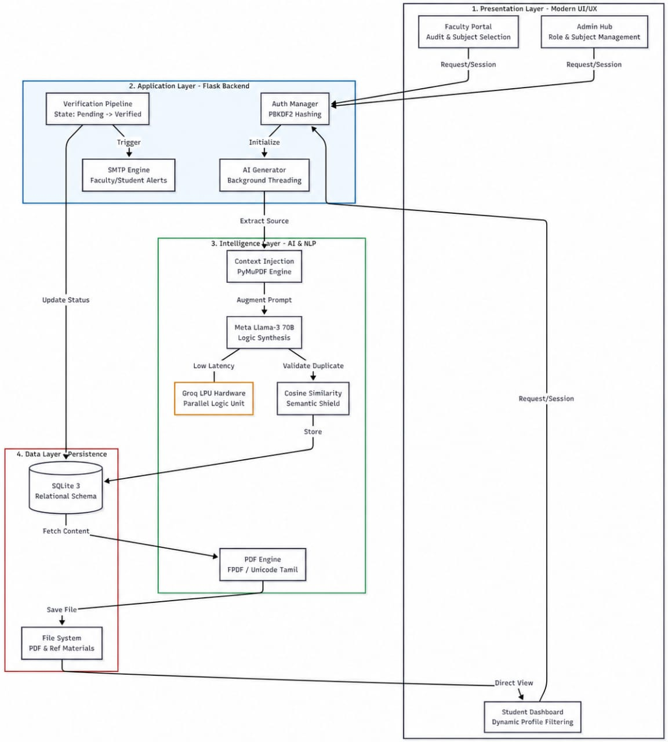
SYSTEM ARCHITECTURE

Slide 11
WORKFLOW OF SYSTEM ARCHITECTURE:
Request: A student requests a topic through the Presentation Layer.
Process: The Flask Backend triggers the AI Generator in a background thread.
Generate: The Intelligence Layer fetches context, runs it through Llama-3 on Groq, checks for duplicates, and creates a PDF.
Verify: The material enters the Verification Pipeline. Once Faculty approves it, the SMTP Engine notifies the students.
Access: The student fetches the verified material from the Data Layer via their dashboard.

Slide 12
TECHNOLOGY STACK
Backend Framework: Python / Flask (Lightweight, scalable web server).
AI & Inference: Meta Llama-3 (70B) powered by the Groq LPU (Language Processing Unit) for ultra-fast response times.
Database Management: SQLite 3 with SQLAlchemy ORM (Relational data persistence).
Frontend Technologies: HTML5, CSS3, JavaScript (Responsive and interactive UI).
PDF Processing: FPDF (Dynamic PDF creation) and PyMuPDF (Extracting context from existing PDFs).
NLP & Integrity: Scikit-learn (Utilizing TF-IDF Vectorization and Cosine Similarity for plagiarism detection).
Communication: Flask-Mail (SMTP) for automated email alerts and notifications.
Security: Werkzeug (Implementing PBKDF2 password hashing).

Slide 13
SOFTWARE REQUIREMENTS:
Operating System: Windows 11
Programming Language: Python 3.9 or higher.
Web Framework: Flask (Python-based micro-framework).
Database Management System: SQLite 3 (Relational Database).
AI Inference Platform: Groq API (for Llama-3 access).
Development Environment: VS Code (Visual Studio Code).
Web Browser: Modern browser (Google Chrome, or Microsoft Edge).
Key Libraries: SQLAlchemy, Flask-Login, Flask-Mail, FPDF, Scikit-learn.

Slide 14
HARDWARE REQUIREMENTS:
Processor: Intel Core i3 (10th Gen) or AMD Ryzen 3 equivalent (Minimum); Core i5 or higher (Recommended).
Memory (RAM): 8 GB RAM (Minimum) to handle concurrent background threading.
Storage: 256 GB SSD (for fast read/write of PDF materials and database).
Internet Connectivity: High-speed internet connection (Minimum 5 Mbps) for real-time AI API calls.

Slide 15
ALGORITHMS USED
Algorithm 1: Intelligent Content Synthesis & Verification
Phase 1: Semantic Redundancy Check: Uses Cosine Similarity to detect if a topic has already been verified, saving computational costs.
Phase 2: Context Injection: Programmatically extracts text from reference PDFs to ground the AI's response in "Source-of-Truth" data.
Phase 3: State-Transition Model: Stages AI drafts as "Pending" until a Faculty member Reviews, Edits, or Approves the content.
Algorithm 2: Dynamic Academic Filtering (Zero-Search Logic)
Implements Session-Based Profiling to automatically execute filtered SQL queries.
Ensures students are instantly presented with materials relevant only to their specific Department, Year, and Semester.

Slide 16
ALGORITHMS USED
Algorithm 3: Automated SMTP Notification & Broadcast
Identifies target student mailing lists based on subject mapping.
Executes a Linguistic Broadcast Service via secure SMTP (Simple Mail Transfer Protocol) with TLS encryption.
Algorithm 4: Automated PDF Documentation Engine
Handles the Transformation of Structured AI Data into portable binary formats using the FPDF engine.
Includes automated text sanitization and academic layout styling.
Algorithm 5: Secure RBAC Authentication Logic
Implements Role-Based Access Control (RBAC) for Student, Faculty, and Admin gateways.
Uses PBKDF2 Hash Verification to ensure cryptographically secure user authentication.

Slide 17
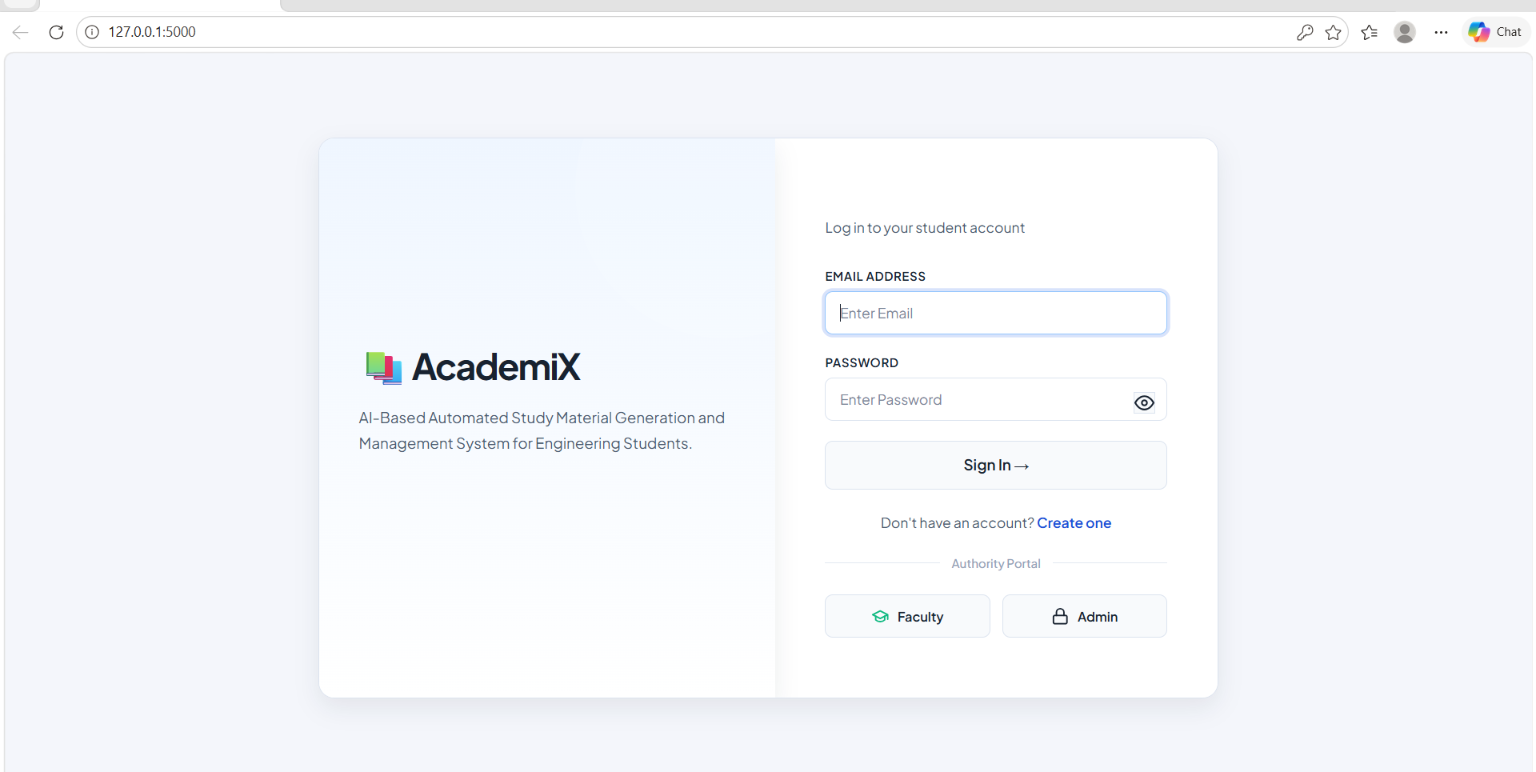
SCREENSHOTS
Login Page:

Slide 18
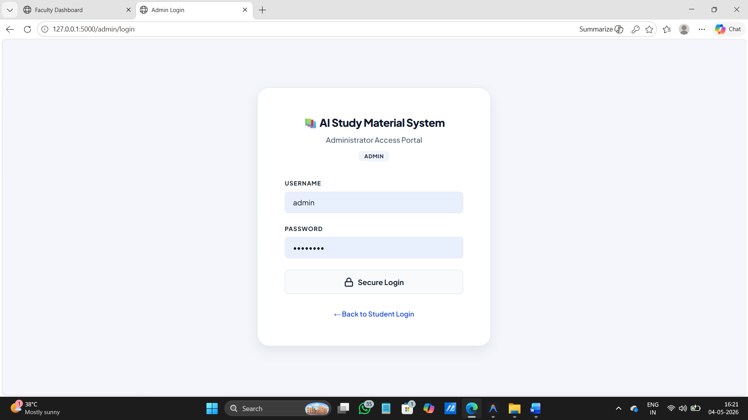
SCREENSHOTS
Admin Login :

Slide 19
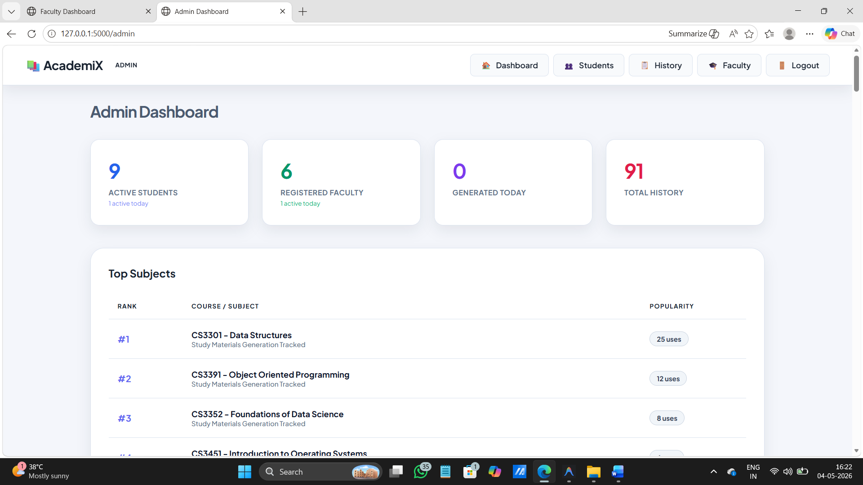
SCREENSHOTS
Admin dashboard :

Slide 20
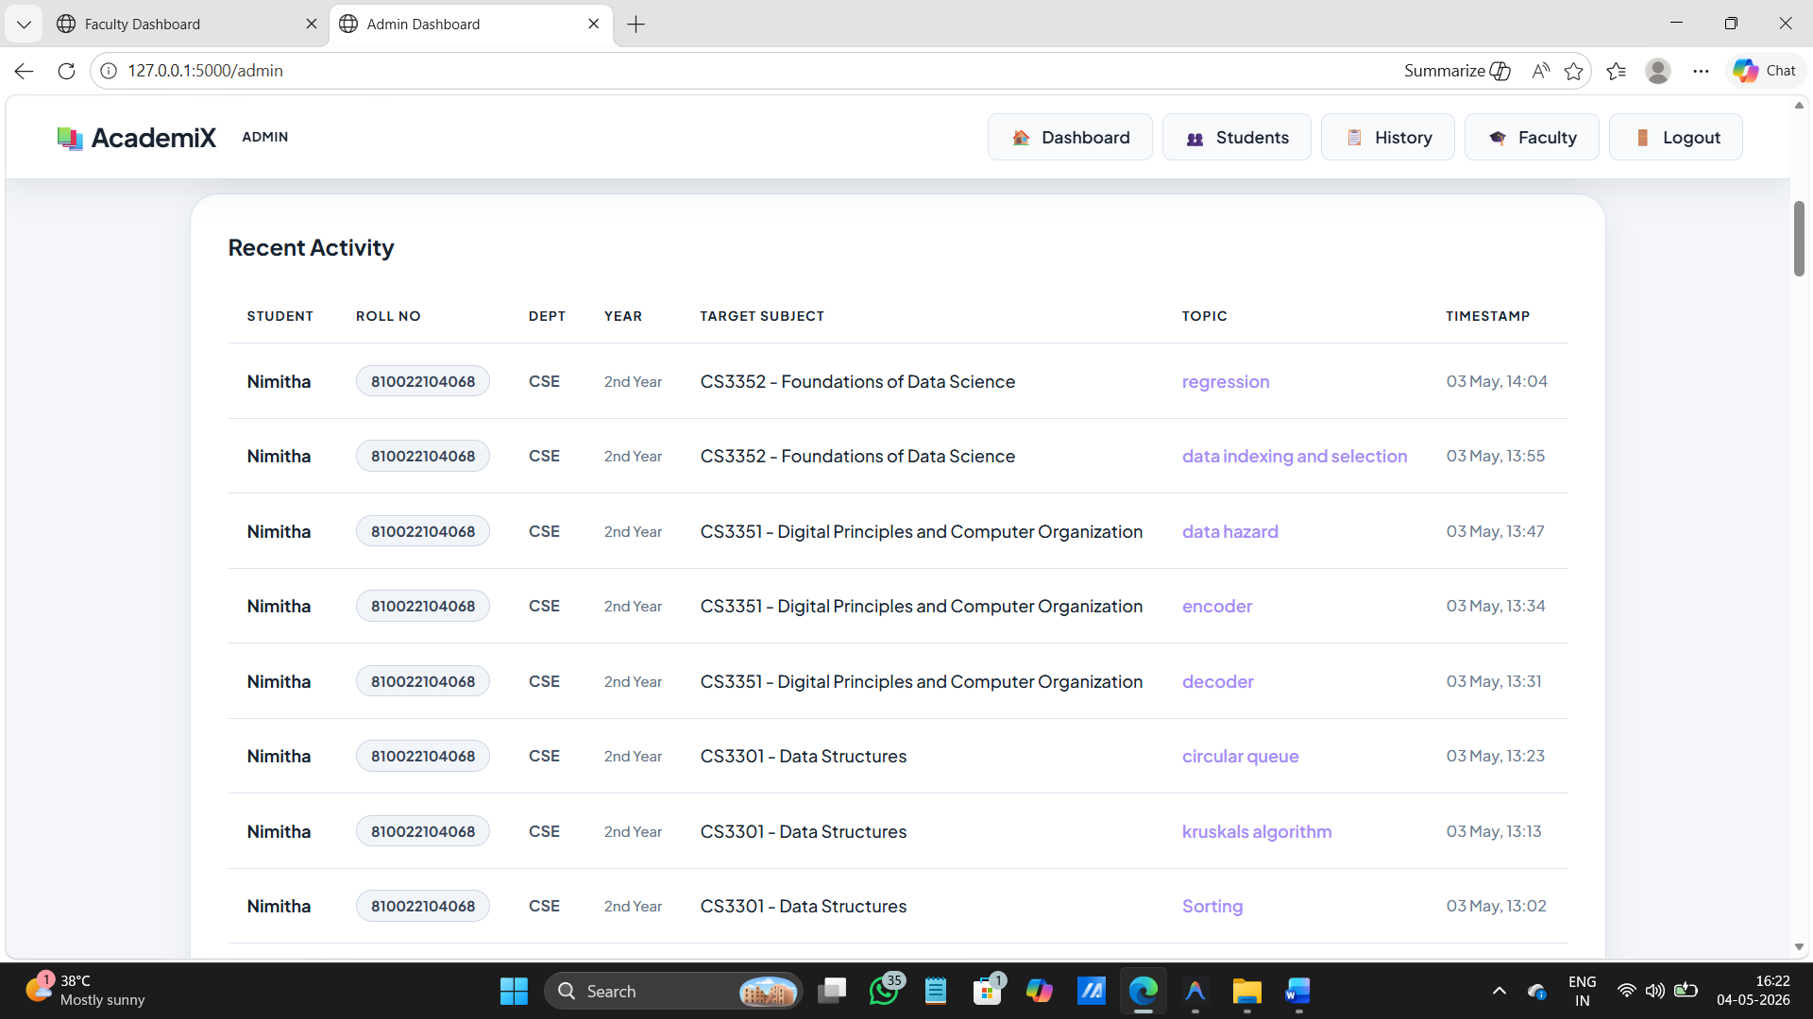
SCREENSHOTS
Student Management:

Slide 21
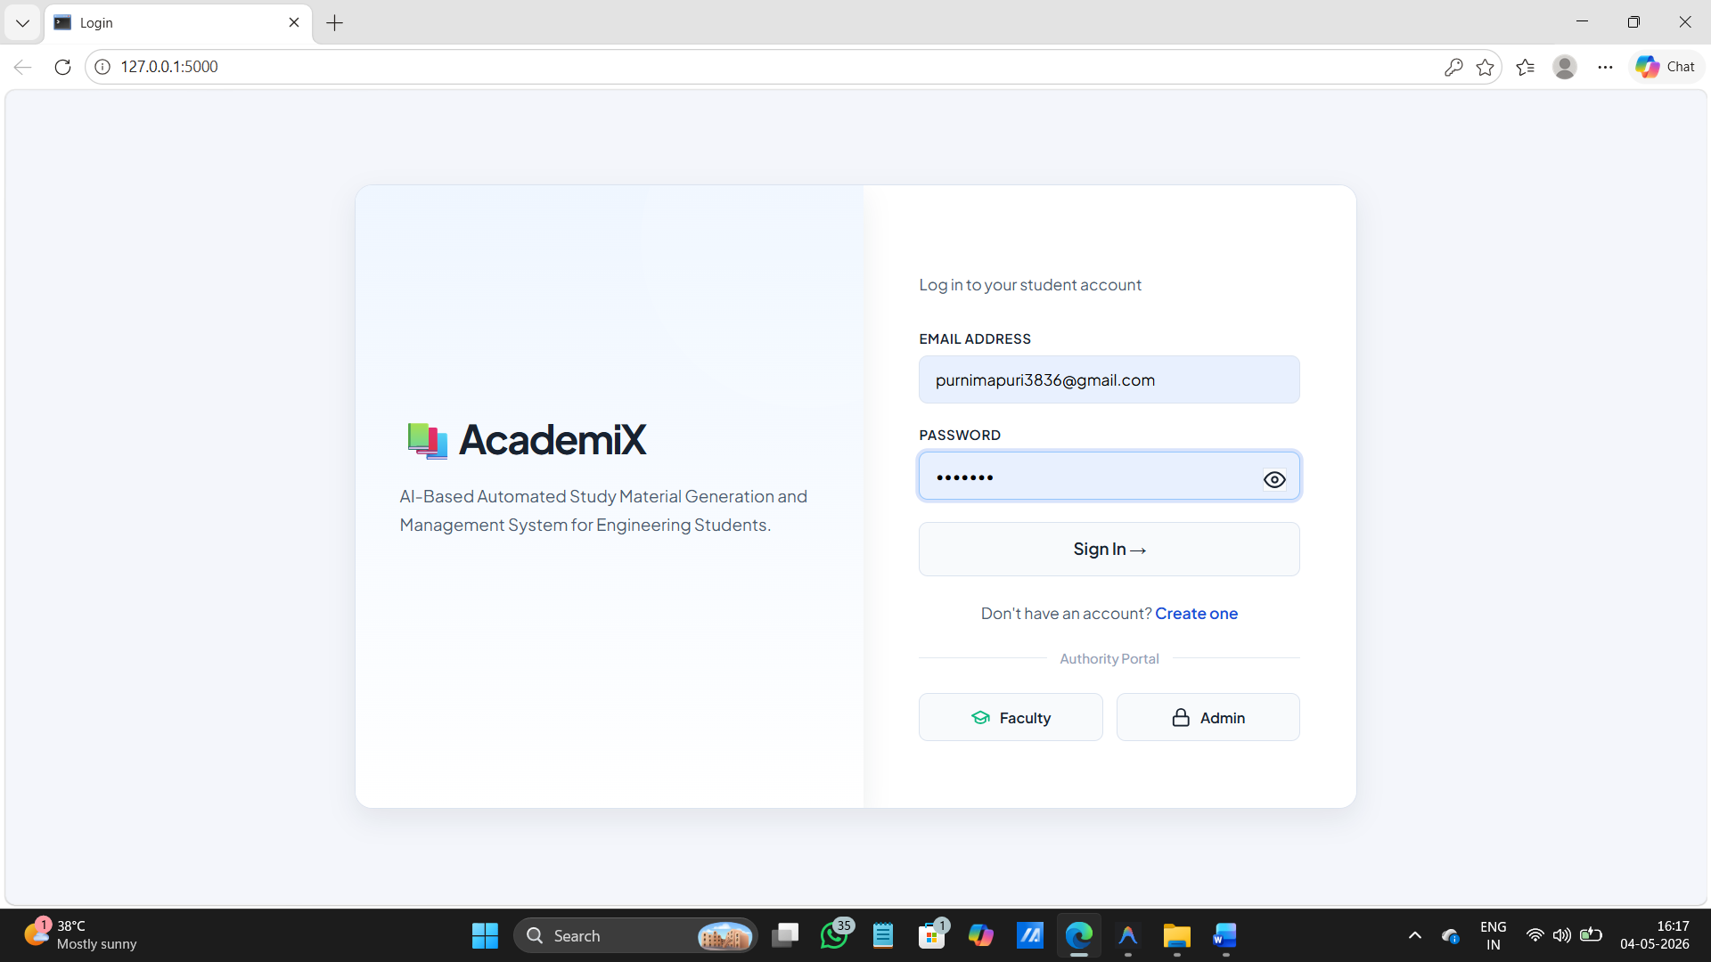
SCREENSHOTS
Student Dashboard:

Slide 22
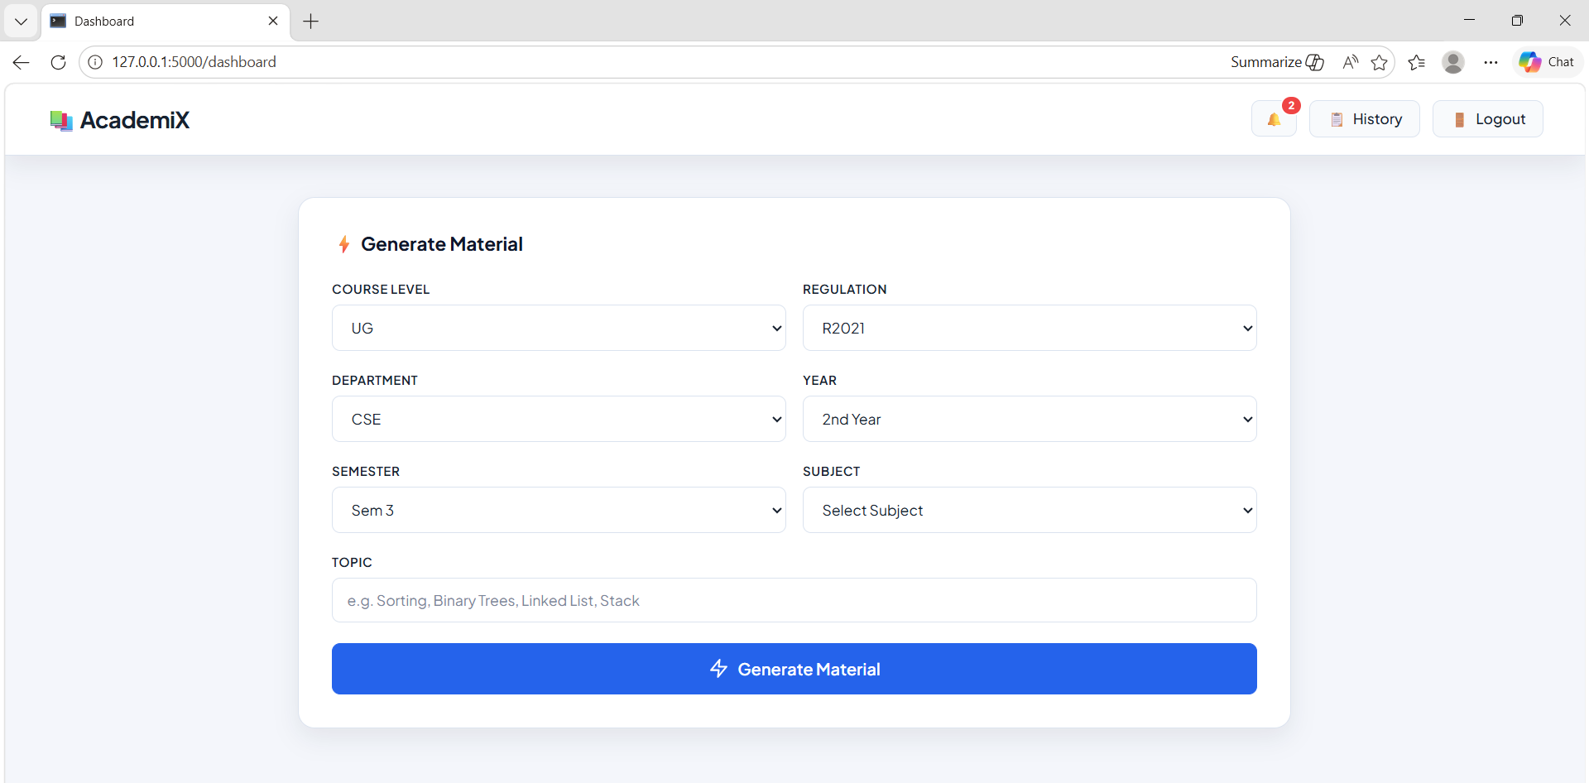
SCREENSHOTS
Subject Selection:

Slide 23
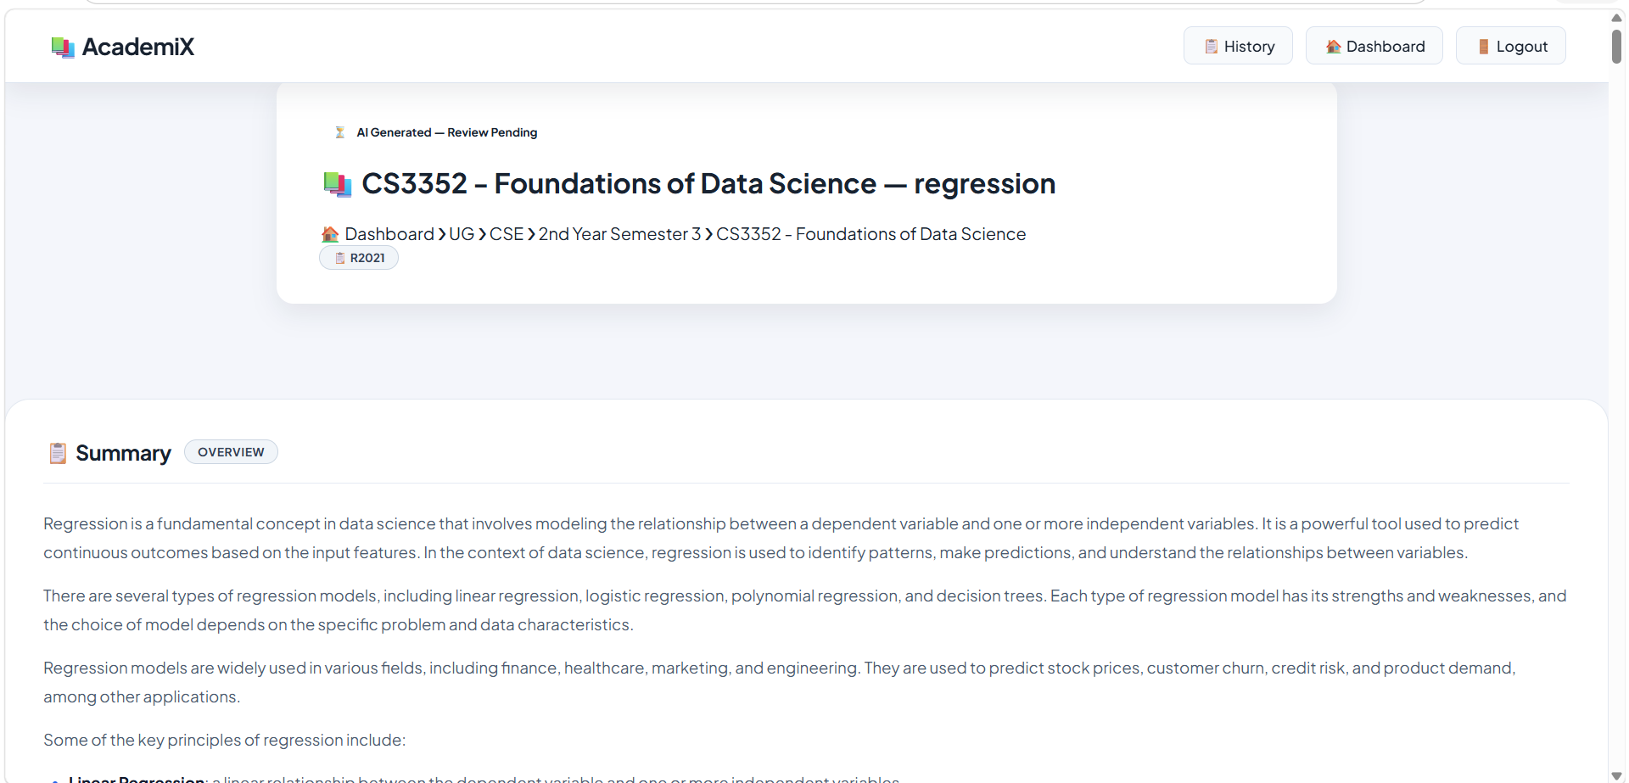
SCREENSHOTS
AI Content Generation:

Slide 24
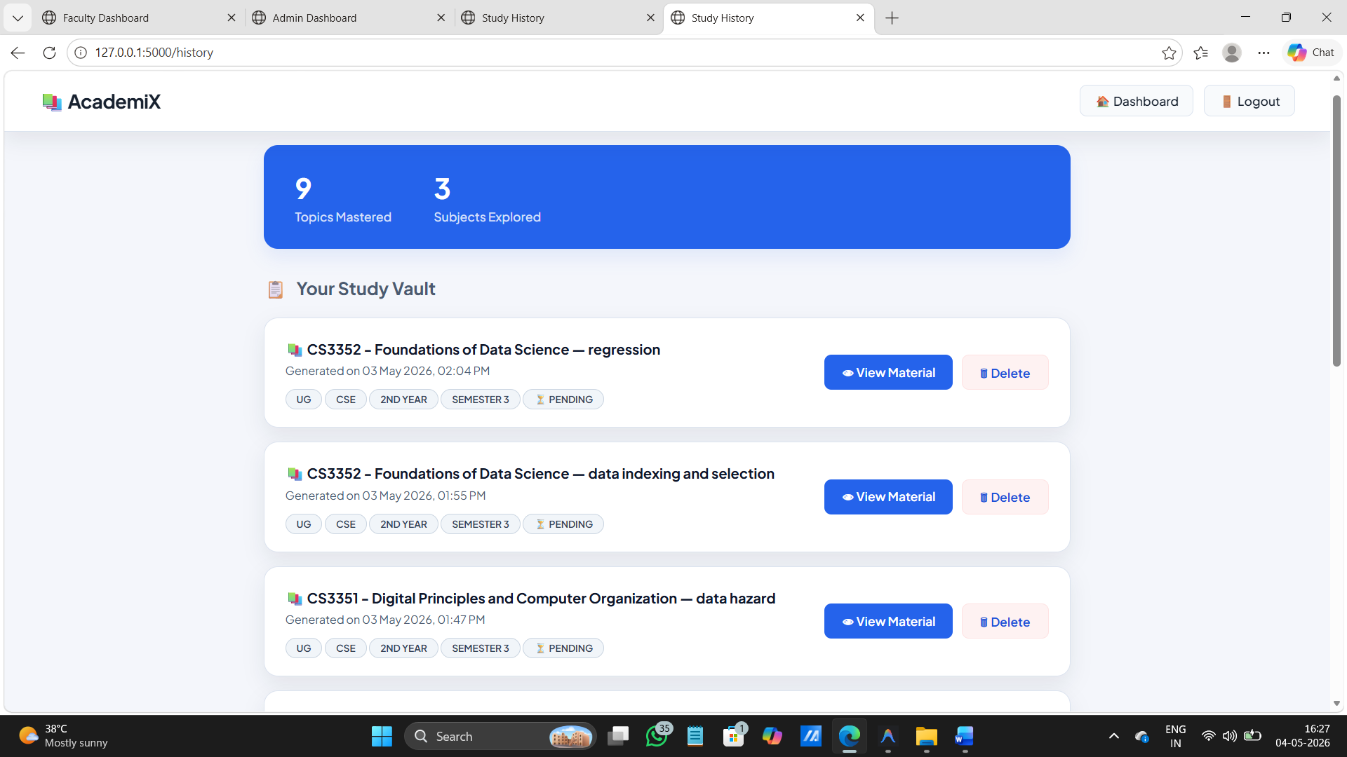
SCREENSHOTS
History Page:

Slide 25
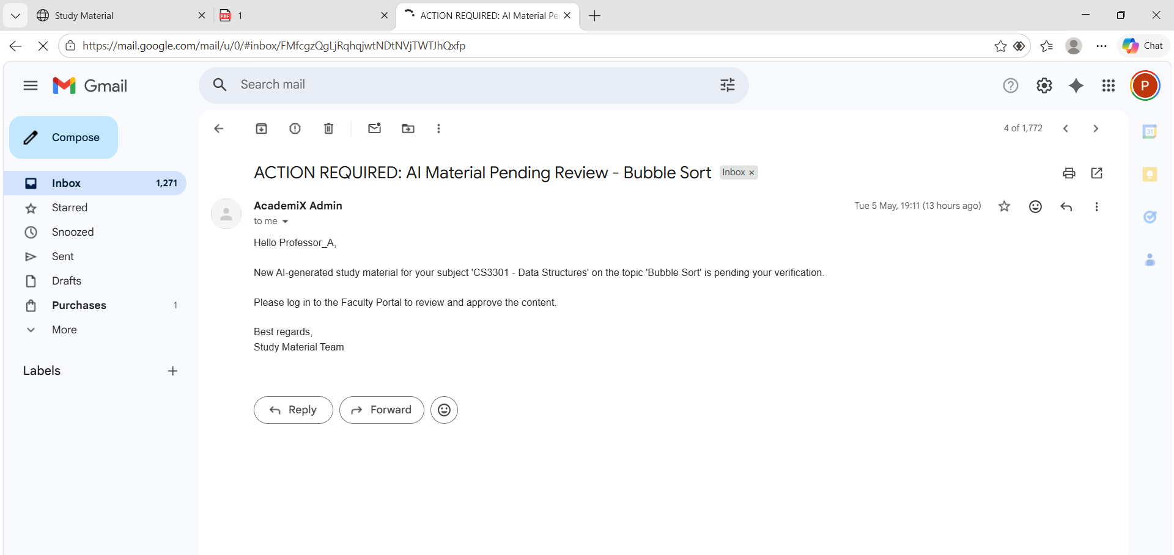
SCREENSHOTS
Email alert to faculty:

Slide 26
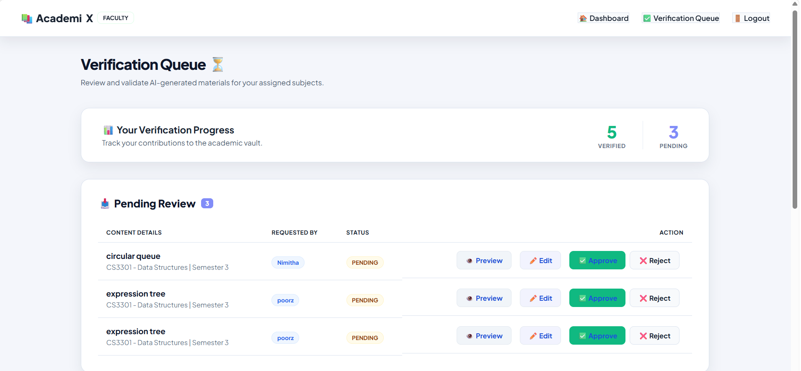
SCREENSHOTS
The Faculty Verification Hub:

Slide 27
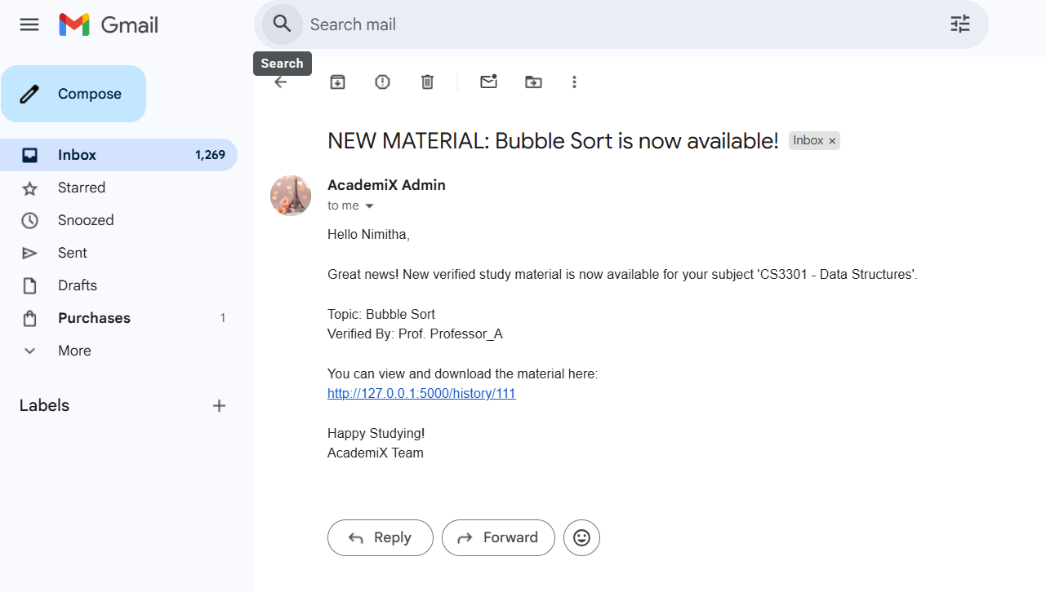
SCREENSHOTS
Automated SMTP Notification:

Slide 28
CONCLUSION
In conclusion, this project successfully demonstrates how Generative AI, when combined with a structured verification workflow, can revolutionize academic content management. By utilizing the Llama-3 model and Groq LPU technology, the system delivers high-quality, syllabus-aligned resources almost instantly. The inclusion of a mandatory faculty review process ensures that the speed of AI is balanced with the accuracy and integrity required in higher education. Ultimately, this system serves as a powerful tool for reducing faculty administrative burdens while providing students with verified, accessible, and personalized study materials to enhance their academic performance.

Slide 29
REFERENCES
Rutecka, M. (2025) ‘Generative AI in Curriculum Design: An Empirical Study on Faculty Perceptions and Interdisciplinary Mapping’, IEEE Transactions on Learning Technologies.
Baidoo-Anu, D. and Ansah, L. (2023) ‘The Rise of Generative Artificial Intelligence and Its Impact on Education: The Promises and Perils’, International Journal of Educational Research.
Bidry, M. (2024) ‘Transforming Education with Generative AI: A Comprehensive Review of Advancements, Challenges, and Future Opportunities’, International Journal of Science and Research (IJSR).
Chen, E., Lin, H., Huang, C., Hsieh, W., Chang, T. and Yang, C. (2024) ‘A Systematic Review on Prompt Engineering in Large Language Models for K-12 STEM Education’, arXiv preprint arXiv:2410.11123.
Cooper, G. (2023) ‘Examining Science Education in ChatGPT: An Exploratory Study of Generative Artificial Intelligence’, Journal of Science Education and Technology, Vol. 32, pp. 444–452.

Slide 30
6. Farrokhnia, M., Banihashem, S. K., Noroozi, O. and Wals, A. (2024) ‘A SWOT Analysis of ChatGPT: Implications for Educational Practice and Research’, Innovative Education and Teaching International, Vol. 61, No. 3, pp. 460–474.
7. Farrukh, M., Tlili, A. and Huang, R. (2023) ‘Are Generative AI Technologies Transforming Education for the 21st Century? A Comprehensive Literature Review’, Journal of Educational Computing Research.
8. Kasneci, E., Sessler, K., Küchemann, S., Bannert, M., Dementieva, D., Fischer, F., Gasser, U., Groh, G., Günnemann, S. and Hüllermeier, E. (2023) ‘ChatGPT for Good? On Opportunities and Challenges of Large Language Models for Education’, Learning and Individual Differences, Vol. 103, pp. 102274.
9. Li, H., Xu, T., Zhang, C., Chen, E., Liang, J., Fan, X., Tang, J. and Wen, Q. (2024) ‘Bringing Generative AI to Adaptive Learning in Education’, arXiv preprint arXiv:2402.14601.
10. Elkins, S., Kochmar, E., Serrano, G. D., Becker, J. and Serrano, J. (2024) ‘How Teachers Can Use Large Language Models and Bloom's Taxonomy to Create Educational Quizzes’, arXiv preprint arXiv:2401.05914.

Slide 31
THANK YOU

